Slide 1

Net Zero Accelerator
Workshop Two
Tuesday 21 January 2025

Slide 2
Housekeeping
Please have your cameras on
Stay on mute if you’re not talking
Pop your hand up if you have a question or comment
Use the chat box to interact
Join in!
All the links and resources, along with a pdf of the slides will be available after the session

Slide 3
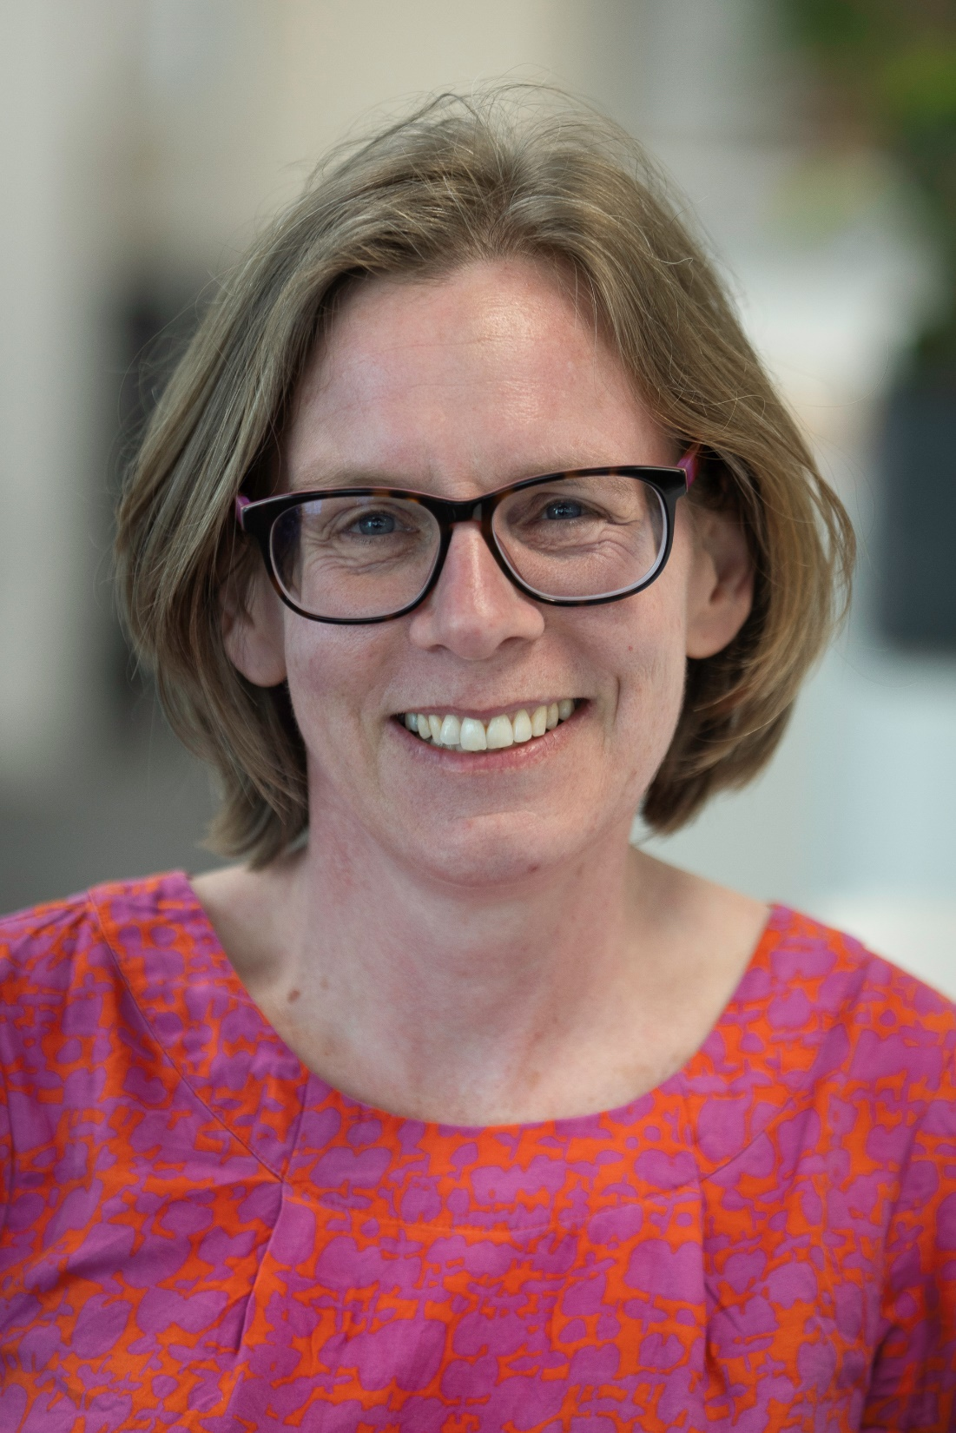
Facilitator Intro – Jen Gale
  Let’s Go Zero Climate Action Advisor in the South-West
  Carbon Literacy Trainer
  Background in climate education, comms and engagement
Notes:
Facilitator intro slide – **you will need to add your own pic and bullet points!**

Slide 4
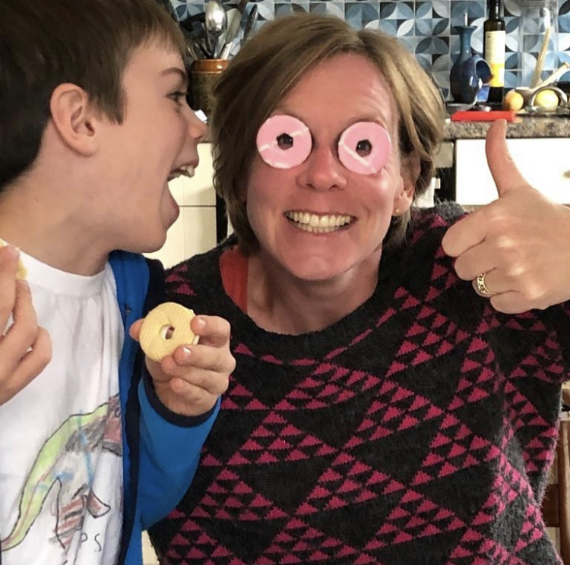
Notes:
This photo is here to remind me to say that I’m not a climate expert, and certainly not a qualified climate scientist. And that’s ok!
One of the key parts to Carbon Literacy training is ‘peer to peer’ delivery. This is also my disclaimer to say that you might ask questions that I don’t know the answer to! That’s great – someone else on the session might now, and we can all learn from each other. And if we don’t collectively know the answer, I will go away and find out for you.
We’re more likely to listen to ‘people like us’, so this isn’t about getting an external expert to come in and tell you what you need to do. This is about those of us within Bloomsbury, who understand the business and our own roles within it, working together to come with ideas and solutions that work for us.
It's also a great time to mention that we’re looking for people who might want to help us roll out this training within Bloomsbury – it will take forever if it’s just down to me! The only qualification that you need to deliver Carbon Literacy training is to be Carbon Literate, which you will all be after the course. If anyone is interested in finding out more about this, and the support that we will have available to support you, please do get in touch!

Slide 5
Intros
  Who are you?
  Where are you?
  What’s your role?
Notes:
If a group don’t know each other
NB. If it’s a big-ish group (above about 10) encourage them all to be as succinct as possible otherwise you will spend half an hour on intros!

Slide 6
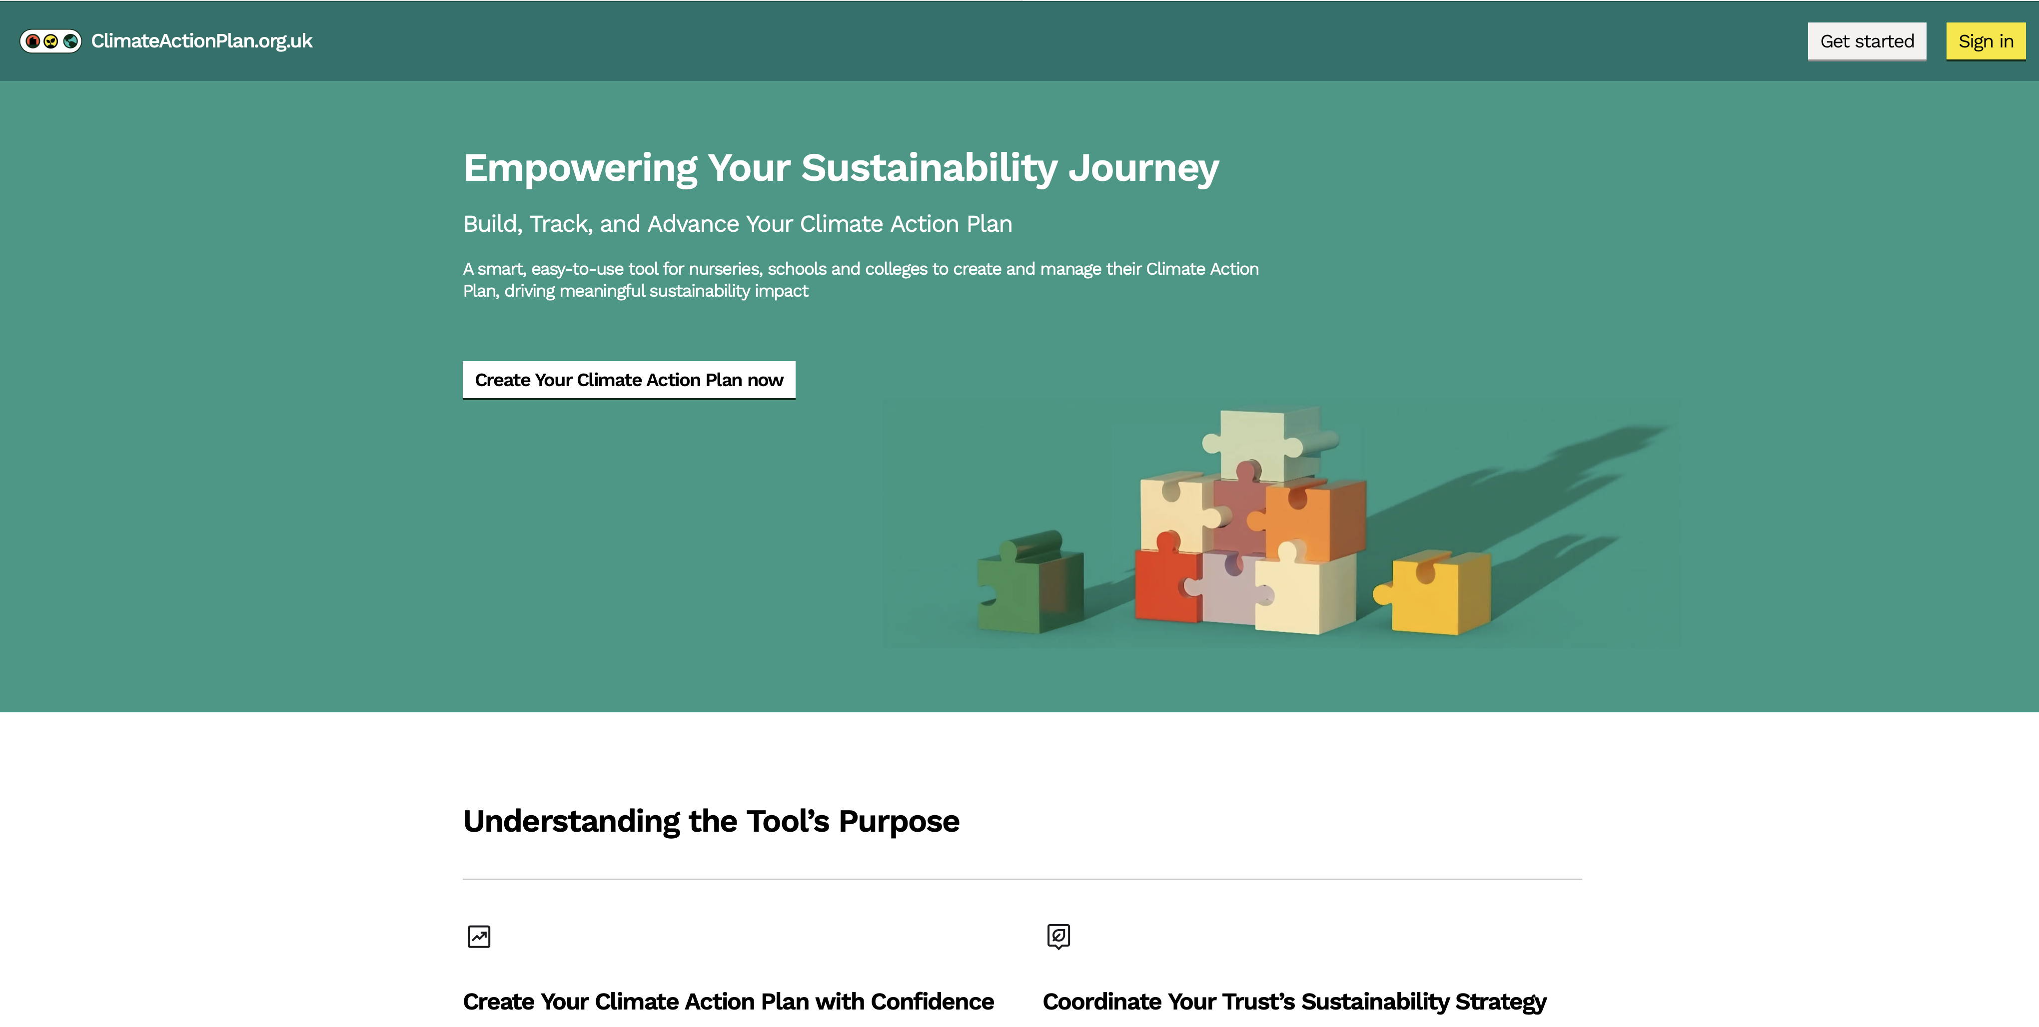
The Online CAP Tool
Your climate actions plans are currently being uploaded to the CAP tool
@ ClimateActionPlan.org.uk
In this session I will quickly show you:
How to use the CAP site
What your plans will look like
How to add new actions
& explain the new functionality coming soon

Slide 7
Agenda
Workshop One - Getting Started
Carbon footprinting
Saving energy:
Workshop Two – The Science
- Climate science 101
- Talking climate
Workshop Three - The Impact
- Climate impact
- Adaptation and risk
- Carbon footprints
Workshop Four – The Future
- What action has been taken
- Looking ahead
- Carbon Literacy Pledges

Slide 8
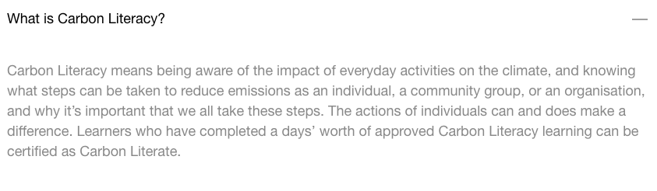

Introduction to Carbon Literacy
Notes:
OK, so let’s start with a question you may all have been asking… “What is Carbon Literacy?”
The Carbon Literacy Project is a charity that has been running since 2012. They don't deliver any Carbon Literacy training themselves but what they do is accredit all of the courses and accredit all of the learners.
On screen is the definition of carbon literacy that is given on the website *read out definition*
Another definition that I like is one that I heard Phil Korbel, one of the cofounders of the Carbon Literacy Project use. Phil used financial literacy as an analogy for Carbon Literacy. We all very quickly come to recognise a £5 note as a lower value note and a £50 note as a higher value note and we all have a basic understanding of whether something is cheap or expensive. In the same way Carbon Literacy means having a basic understanding of whether our actions have a high or a low impact when it comes to greenhouse gas emissions and climate change.

Slide 9
Learning Objectives
By the end of the course you will have…
Gained an understanding of the basic science of climate change and how climate change is affecting us both globally and locally
Gained an understanding of climate justice
Explored the different scenarios that lie ahead
Created an action plan to help reduce your carbon footprint and take collective action in your school
Explored strategies for influencing others to take action on climate change
And…
Be enthused and empowered to want to reduce your carbon footprint and the carbon footprint of those around you!
Notes:
Run through the learning objectives
With the last point, if you are training people who have trying to push their school on climate action for a while, it’s worth reflecting that it can feel really difficult sometimes, and if you’ve been going it alone for a while, enthusiasm may have waned. One of the great things about the training is that they will connect with other people on the same journey and hopefully feel more supported and less alone.

Slide 10


Acknowledgements
Carbon Literacy Project
Manchester Metropolitan University
Centre for Alternative Technology
Notes:
Before we dive in, just a few quick acknowledgements – some of the material in the slides is from the CLP themselves, some of the activities are based on resources created by Manchester Metropolitan Uni, and there’s an activity in Module 3 based on something similar from the Centre for Alternative Technology, so I wanted to acknowledge them and thank them for allowing us to adapt their resources.

Slide 11
How do you feel about climate change?
Notes:
Before we get started, I’ve got three menti polls for you – if you can scan the QR code if you have your phone to hand, or open a new window and head to Menti.com and pop in the code on the screen.
For this first one, can you share three words to describe how you feel about climate change. There are a couple of reasons for asking you to do this. Firstly, how often do we stop and allow ourselves to think about how we think about climate change?! It’s such a big and overwhelming issue and it might not feel hugely comfortable to think about, hence many of us don’t. So allowing ourselves a minute or two to think about it is important. Secondly, there’s a big issue with climate change called pleuralistic ignorance – so all of the studies show that 70-80% of people are concerned about climate change. But no-one talks about it. So we all think we’re the only ones who are worried about, so we don’t talk about it. Hopefully by asking you all to share a few of your feelings here today, you can see that you aren’t alone in those feelings, and that’s really important in helping us all to feel a bit braver to talk to people around us about our worries and concerns.

Slide 12
How confident do you feel in your climate change knowledge?
Notes:
OK, second poll. For this one can you let us know how confident you feel in your climate change knowledge. This isn’t a test! We will all be starting from different points, so it’s more than ok to be a 1 or a 2, or even a 0. I can’t see who answers what, so it’s all anonymous. The reason for asking you this is firstly to get a feel for what the levels of climate knowledge are in the group, and secondly, we’ll repeat the exercise at the end of the course, and hopefully the course will leave you feeling a little bit more confident in your knowledge!

Slide 13
How confident do you feel talking to other people about climate change?
Notes:
Right, this is the last one!
One of the threads running through this course is the importance of talking to other people about climate change, and we’ll discuss this in much more detail later on today. But lots of us (myself included!) find that quite difficult. So please do let us know how easy or otherwise you find it talking to other people about climate change. And again, we’ll repeat this question at the end to see if we’ve managed to make you feel a little more confident!

Slide 14
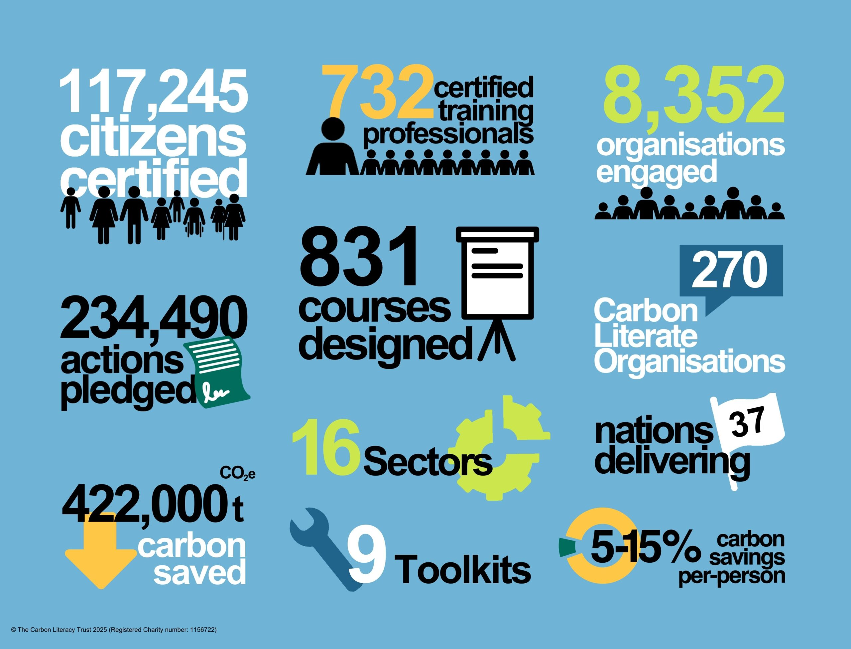
Notes:
I use this infographic to highlight the fact that people participating in the course are a part of something much bigger, that there are lots of organisations and sectors that are rolling out carbon literacy, and that it is making a huge impact
**NB – this infographic will need updating each month as new figures come out – you can find the latest version here: About Us - The Carbon Literacy Project
The CL project started in around 2013 in Manchester, and has now spread globally with over 100,000 now certified as Carbon Literate. There are over 700 different CL courses – this being one of them – and the reason for that is that the CL project want every course to be as specific as possible to the sector, the organization, or the geographic location, because we know that the more relevant we can make it to people, the more likely it is to have an impact and the more likely learners are to take action.

Slide 15
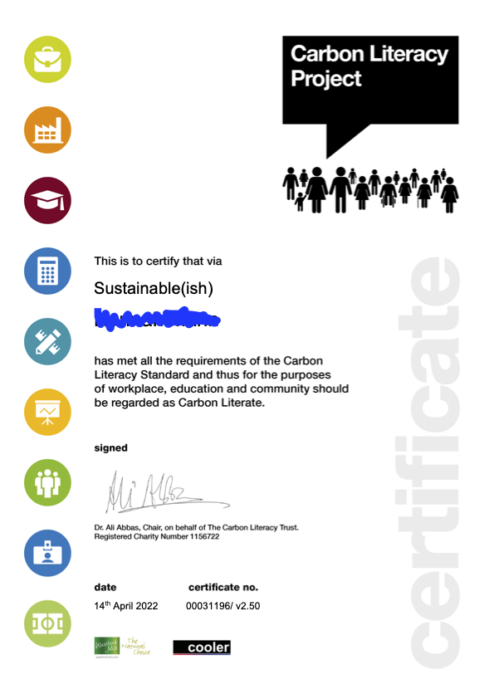
Carbon Literacy certification
Attend a day’s worth of accredited Carbon Literacy training
Design two pledges to reduce carbon
Complete and submit evidence form
Notes:
All attendees are eligible to apply for a Carbon Literacy certificate after the end of the course. In order to be certified as Carbon Literate you need to have attended a day’s worth of accredited Carbon Literacy training, designed two carbon reduction actions, and completed and submitted an evidence form. Don't worry too much about this at the moment, we will go into this in much more detail in Module 4.

Slide 16
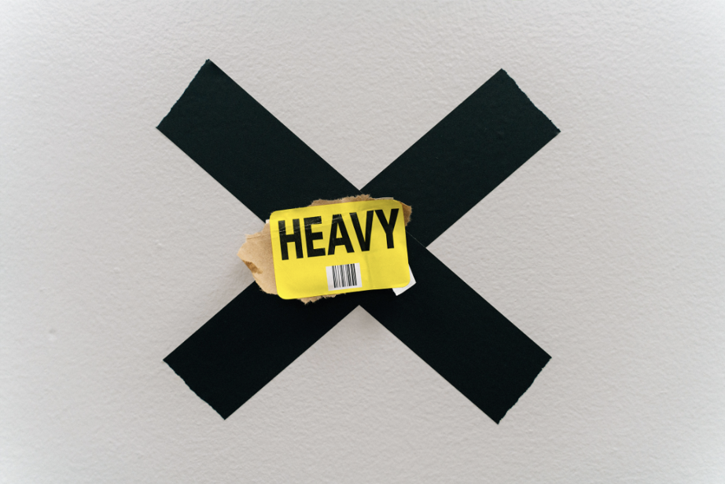
Before we dive in…
Notes:
Before we start with the science, it is worth taking a minute to acknowledge that some of the course material can be quite uncomfortable and has the potential to trigger or exacerbate eco anxiety. This is very much not the intention of the course and we have tried very hard to balance the difficult uncomfortable parts with more uplifting and action orientated sections.
If anyone does struggle with eco anxiety or finds themselves struggling during or after the course please do reach out, you absolutely don't need to suffer alone.
The book “Turn the tide on climate anxiety” by Megan Kennedy-Woodard and Patrick Kennedy-Williams is highly recommended as a tool to help negotiate any and all of the climate emotions that we might experience, and importantly channel any anxiety into action.

Slide 17
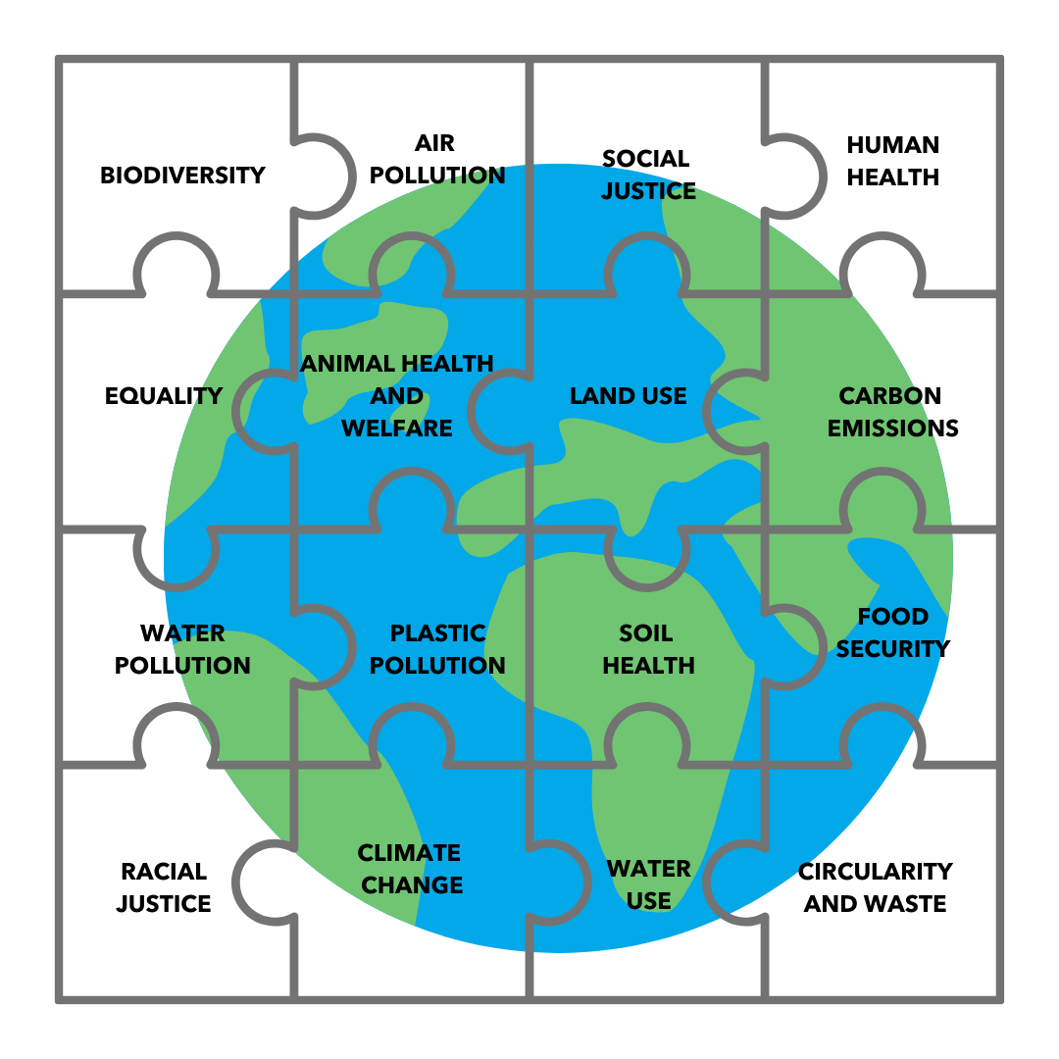
Remember – it’s not just about Carbon…
Notes:
It’s important to remember it's not just about Carbon!
Although the course is called Carbon Literacy, and we will talk about ‘carbon footprints’, it's important to remember that the challenges facing the planet are about far more than just carbon. There are other greenhouse gases contributing to climate change, but we also need to be aware of concurrent and overlapping issues.
It's important when we're thinking about actions to reduce greenhouse gas emissions that we don't inadvertently create additional issues elsewhere, for example planting trees is a good potential solution to sequester carbon, however if we appropriate indigenous land to do so, destroy biodiverse ecosystems, and replace them with monocrops we are creating more problems than we are solving.

Slide 18
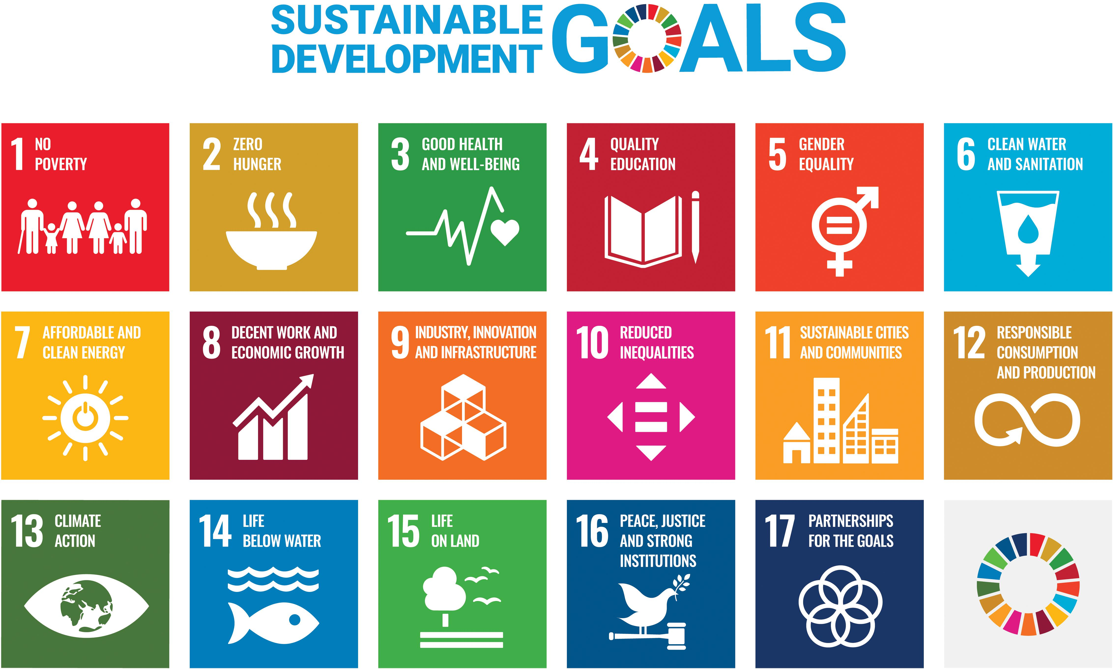
Notes:
If you’re looking for a very broad/holistic approach to sustainability, the United Nations Sustainable Development Goals are a very robust framework.
The 2030 Agenda for Sustainable Development, adopted by all United Nations Member States in 2015, provides a shared blueprint for peace and prosperity for people and the planet, now and into the future. At its heart are the 17 Sustainable Development Goals (SDGs), which are an urgent call for action by all countries - developed and developing - in a global partnership. They recognize that ending poverty and other deprivations must go hand-in-hand with strategies that improve health and education, reduce inequality, and spur economic growth – all while tackling climate change and working to preserve our oceans and forests.
Does anyone use the SDGs in their teaching? There are some great schemes to incorporate the SDGs into teaching, by help you to map your curriculum across the SDGs. There are some links in the notes, or do add any schemes that you’re aware of into the chat, and please let us know if you’re using them!

Slide 19
Why is Carbon Literacy important..?
We're in a climate emergency
Knowledge is power
Knowledge is confidence
We need everyone on board
Nothing changes if nothing changes
Individual actions can and do make a difference
This is crunch time
Notes:
Before we dive into the climate science, I always think it's useful to spend a few minutes thinking about why Carbon Literacy is needed, by us as a wider society. And also why climate action is something that we are concerned about as individuals.
Thinking back to that definition of Carbon Literacy from earlier – why do we think it’s important that everyone understands where emissions, and impacts, are coming from, and what they can do about it? Why do we need a Carbon Literate society?
These are some bullet points summarising just some of the wise for why carbon literacy is important for us as a global society:
- The science is very clear that we're in a climate emergency. We’re also in an ecological emergency as we saw just a couple of minutes ago when we looked at the biodiversity stripes.
- Knowledge is power - more people than ever are aware over the climate crisis, however it can be difficult to feel like we can make a difference and to know what we should be doing. Understanding the impact of our actions and where our power lies, allows us to make better decisions more of the time.
- Knowledge is confidence - the importance of talking about climate change has already been mentioned several times, however one of the things that holds many of us back from talking more about climate change and the actions that we're taking is a lack of confidence. The knowledge that we gain from carbon literacy training can give us more confidence to speak up and to take action.
- We need everyone on board - if we are to take action at the scale that is needed, we need everybody on board understanding the impact of their actions and the role that they can play in creating a safe and sustainable planet for everyone both now and in the future.
- Nothing changes if nothing changes - climate change is an overwhelming issue and at times it can feel like our efforts are futile. There is undoubtedly sometimes a temptation to throw in the towel, however the only thing we can guarantee is that nothing will change if nothing changes. The only way that we can guarantee nothing will change is if we sit back and do nothing.
- Individual actions can and do make a difference - it can be very easy to feel like our actions as individuals are futile and a drop in the ocean. However as we will see throughout the course individual actions are important in terms of emissions reductions, but also and perhaps more importantly in terms of shifting societal norms, getting those around us on board, and creating the cultural shifts that are so necessary.
- This is crunch time - as we will see as we dive into the science, we have until the end of this decade to make significant reductions in our global emissions if we are to stand a chance of maintaining a stable climate.

Slide 20
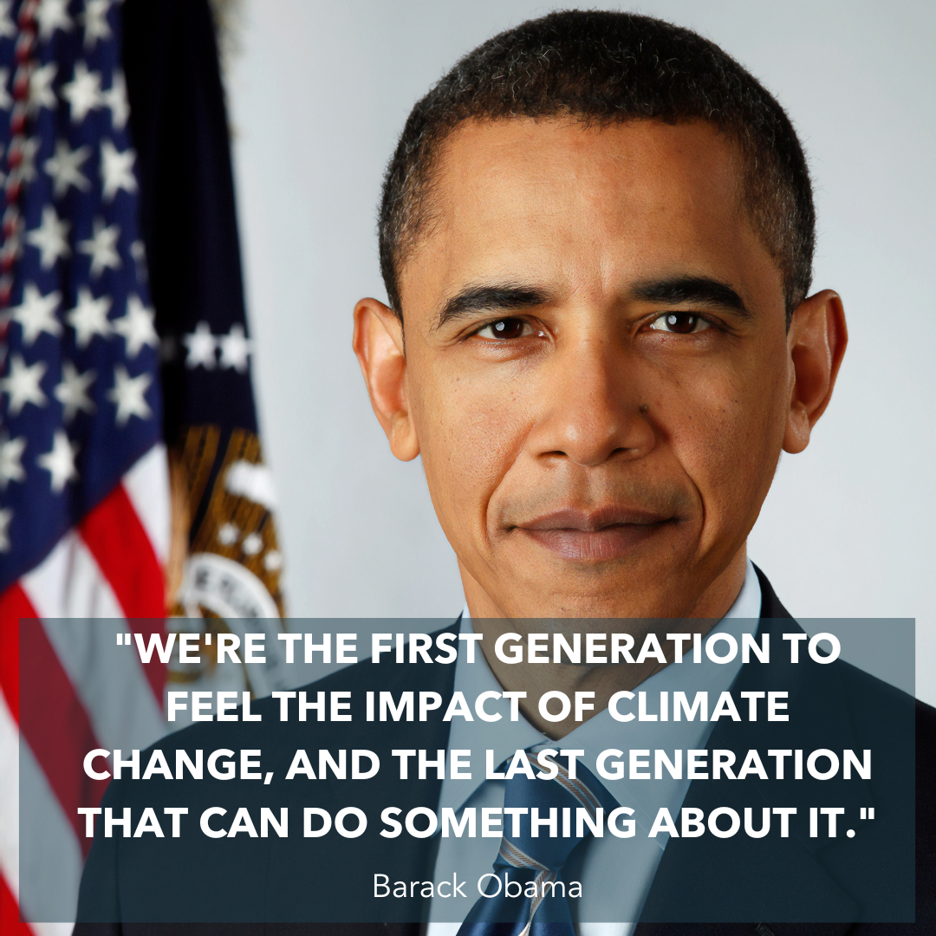
Notes:
*Read quote*

Slide 21
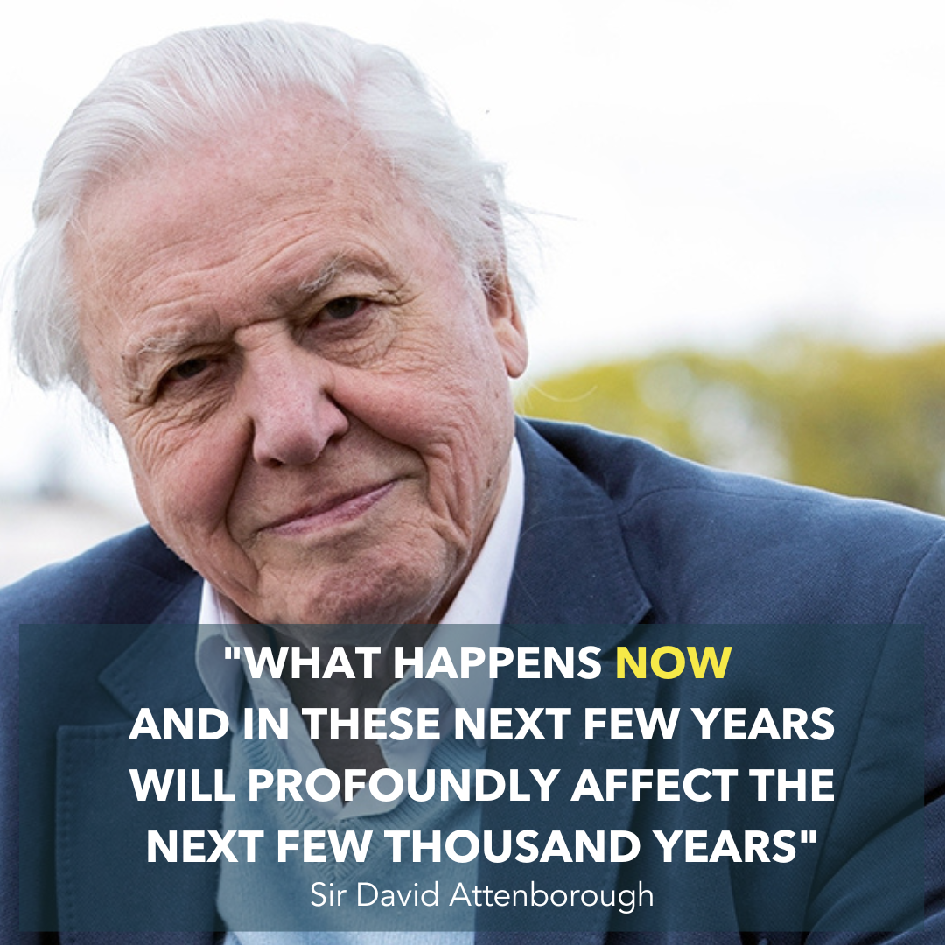

Notes:
I think it’s a legal requirement to have a quote from Sir David Attenborough on all environmental trainings, so here is ours!
*Read quote*
I can sometimes find this quote quite overwhelming, and I have to remind myself to flip it. “What happens now and in these next few years *if we get this right* will have a *positive* impact on the next few thousand years

Slide 22
Why is Carbon Literacy important
for education?
Notes:
Ask participants the question – why is CL important for education? What is unique about educational settings and their impacts on climate change, both positive and negative?
The DfE’s Sustainability and Climate Change Strategy sets an ambitious target to reduce greenhouse gas emissions by 75% by 2037 across all education settings. That will be tricky to achieve without getting everyone on board, and the more people working in education who understand the urgency of the issue, and really importantly what needs doing, and the role that they can play in making that happen, the more likely we are to be able to make that happen, and the more quickly we can do that.
The school estate is the largest emitter of CO2 in the whole public sector. The UK gov has a target for the public sector estate of a 78% reduction in emissions by 2035 and schools play a big part in that.

Slide 23
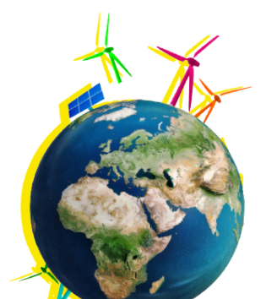






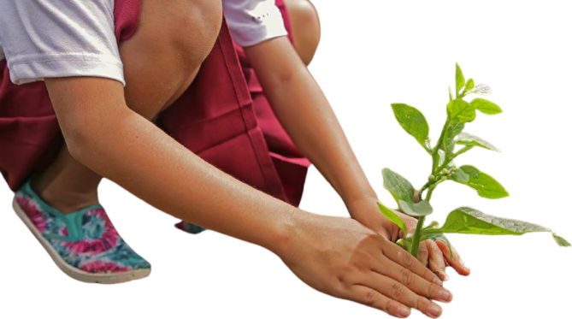
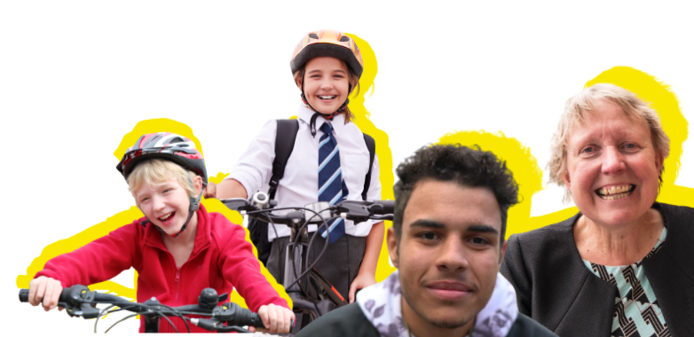
CARBON, WATER & ENERGY FOOTPRINT
PLANET
SOCIETY
LOCAL
COMMUNITY
SCHOOL
GROUNDS
KNOWLEDGE
VALUES
BEHAVIOURS
ACTIONS
EMPLOYEES & SUPPLIERS
LOCAL DECISION MAKERS
BIODIVERSITY
CONTRIBUTION
Notes:
Schools are perhaps unique in the position they sit when it comes to climate action.
All organisations can take steps to reduce their emissions, and they can take action to influence their employees and their wider community. Schools have a big role to play when it comes to the UK’s net zero goals – making up 37% of public sector But schools have the additional sphere of influence when it comes to educating the next generation – whether that’s through the formal curriculum, or through instilling different behaviours and social norms in the next generation.
Lots of the changes that need to happen need behaviour change as at least part of the solution, and when it comes to behaviour change we are most influenced by people we know and by people and organisations who we trust – schools are trusted sources of information for many families, so seeing schools take action can send out positive ripples to the wider community.
42% of households have school age or younger children in them and 10 million people go into schools every day. So the ability to role-model different behaviours, teach our young people about the changes that are happening and the roles we can all play, and empower our young people to be change makers means schools really play a vital role in the fight against climate change.
There are 32k schools in the UK – 24k of these in England

Slide 24
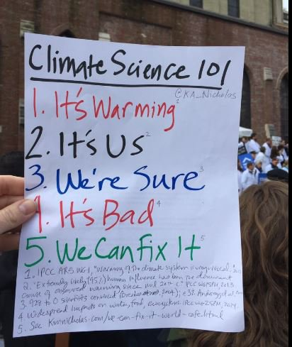
Climate Science in twelve words…
Image credit: Prof Kimberley Nicholas
www.kimnicholas.com
Notes:
If you hated science at school don't worry! We have tried to keep the science as accessible as possible but if you are someone who zones out when it comes to science, all you need to remember is these twelve words.
This is climate science in twelve words by climate scientist Professor Kimberly Nicholas. This is a piece of paper that she took with her to a climate demo, and I love the fact that you can tell she's a scientist because she has referenced each of her points below.
So climate science in twelve words:
It's warming, it's us, we're sure, it's bad, and really importantly, we can fix it. We're going to use these 12 words as our framework as we work our way through the climate science.

Slide 25
What is Climate Change?
Notes:
OK, so the first question that we need to answer is “What is climate change?”

Slide 26
“Climate change refers to a large-scale, long-term shift in the planet's weather patterns and average temperatures.”
UK Met Office
Notes:
There are many definitions of climate change this one here is from the UK Met Office.
*Read out definition*

Slide 27
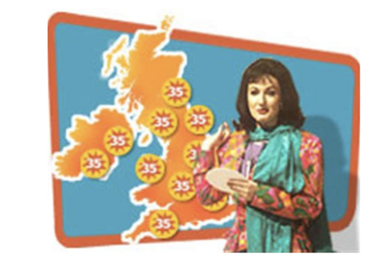
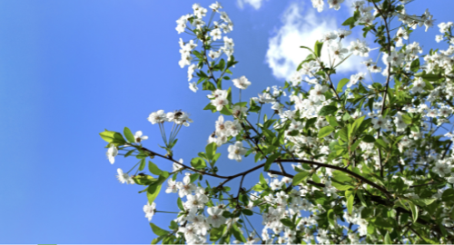
Weather Vs Climate
- What you see when you look out of the window
eg wind, rain, snow etc
- Hours/days
- The weather conditions that are expected in a region at a particular time of year
- Years/decades
”Climate is what we expect, weather is what we get.”
Robert A. Heinlein
Notes:
It's really important before we go on, to understand the difference between weather and climate.
Weather is very short-term – it’s what we see on the forecast, or on our weather apps, and it’s very localised.
Climate is much longer-term over decades or even hundreds of years.
So the weather in a certain place can be cooler than expected at that time of year, while the global average temperature is still going up.
An example is when a snow storm hit Texas in the USA in February 2021, wiping out infrastructure and tragically causing loss of life. This is not typical weather for this region at this time of year and triggered the worst energy infrastructure failure in Texas state history, with more than four and a half million homes and businesses left without power for several days.
Some Republican politicians used the crisis to deny climate change saying that global warming can't be happening if it's snowing in Texas.
Katharine Hayhoe is a climate scientist living in Texas, who we will meet shortly, and she likes to talk about ‘global weirding’, or ‘weird weather’, ie weather in regions and at times of years that we wouldn't expect, AKA climate change!

Slide 28
GLOBAL WARMING
CLIMATE CHANGE
=
CLIMATE CRISIS
CLIMATE EMERGENCY
CLIMATE BREAKDOWN
GLOBAL HEATING
Notes:
There are lots of different terms used to describe climate change.
Historically we have use the term global warming and that has now been largely replaced by climate change. Some organisations and media outlets now prefer to use the terms climate crisis or climate emergency, some organisations even use climate breakdown and global heating, all of these are an attempt to convey the urgency of the situation that we are facing.

Slide 29
Notes:
OK, so back to our climate science in 12 words, and we start at the top with ‘It’s warming’

Slide 30
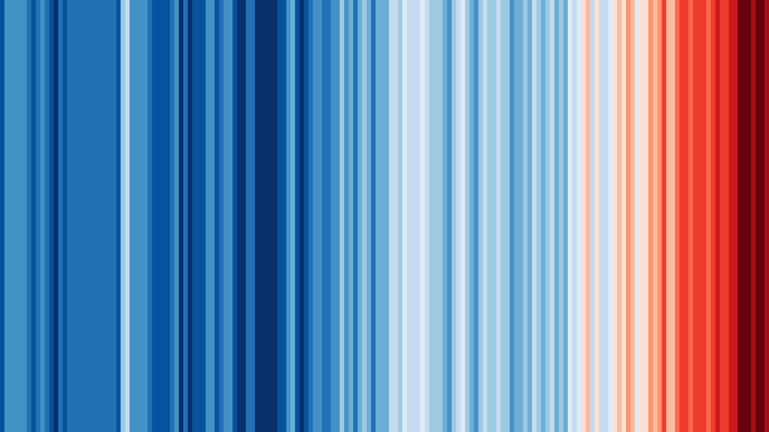
www.showyourstripes.info
Notes:
Ask participants if anybody has seen this image before.
If anyone has, ask them if they're happy to explain their understanding of what the image represents.
These are called the climate stripes, or the warming stripes , and were created by Ed Hawkins who is a professor at Reading University. Each year since about 1850 has been given a stripe and a colour depending on whether that year was warmer or cooler than the average for the 50 years leading up to 1850.
- Ask the group why 1850 was chosen as the starting point.
The answer we’re looking for is the Industrial Revolution-this is when we really started to see large volumes or fossil fuels being burned to create the energy to power the industrial revolution.
You may also get people suggesting that this is when accurate records began which is also true, however the main reason for beginning the stripes at 1850 is with respect to the industrial revolution.
Flag the warming stripes as an incredibly useful comes tool and conversation starter. They are a very effective way of demonstrating the warming that is so clearly visible over the last 20 years or so.

Slide 31
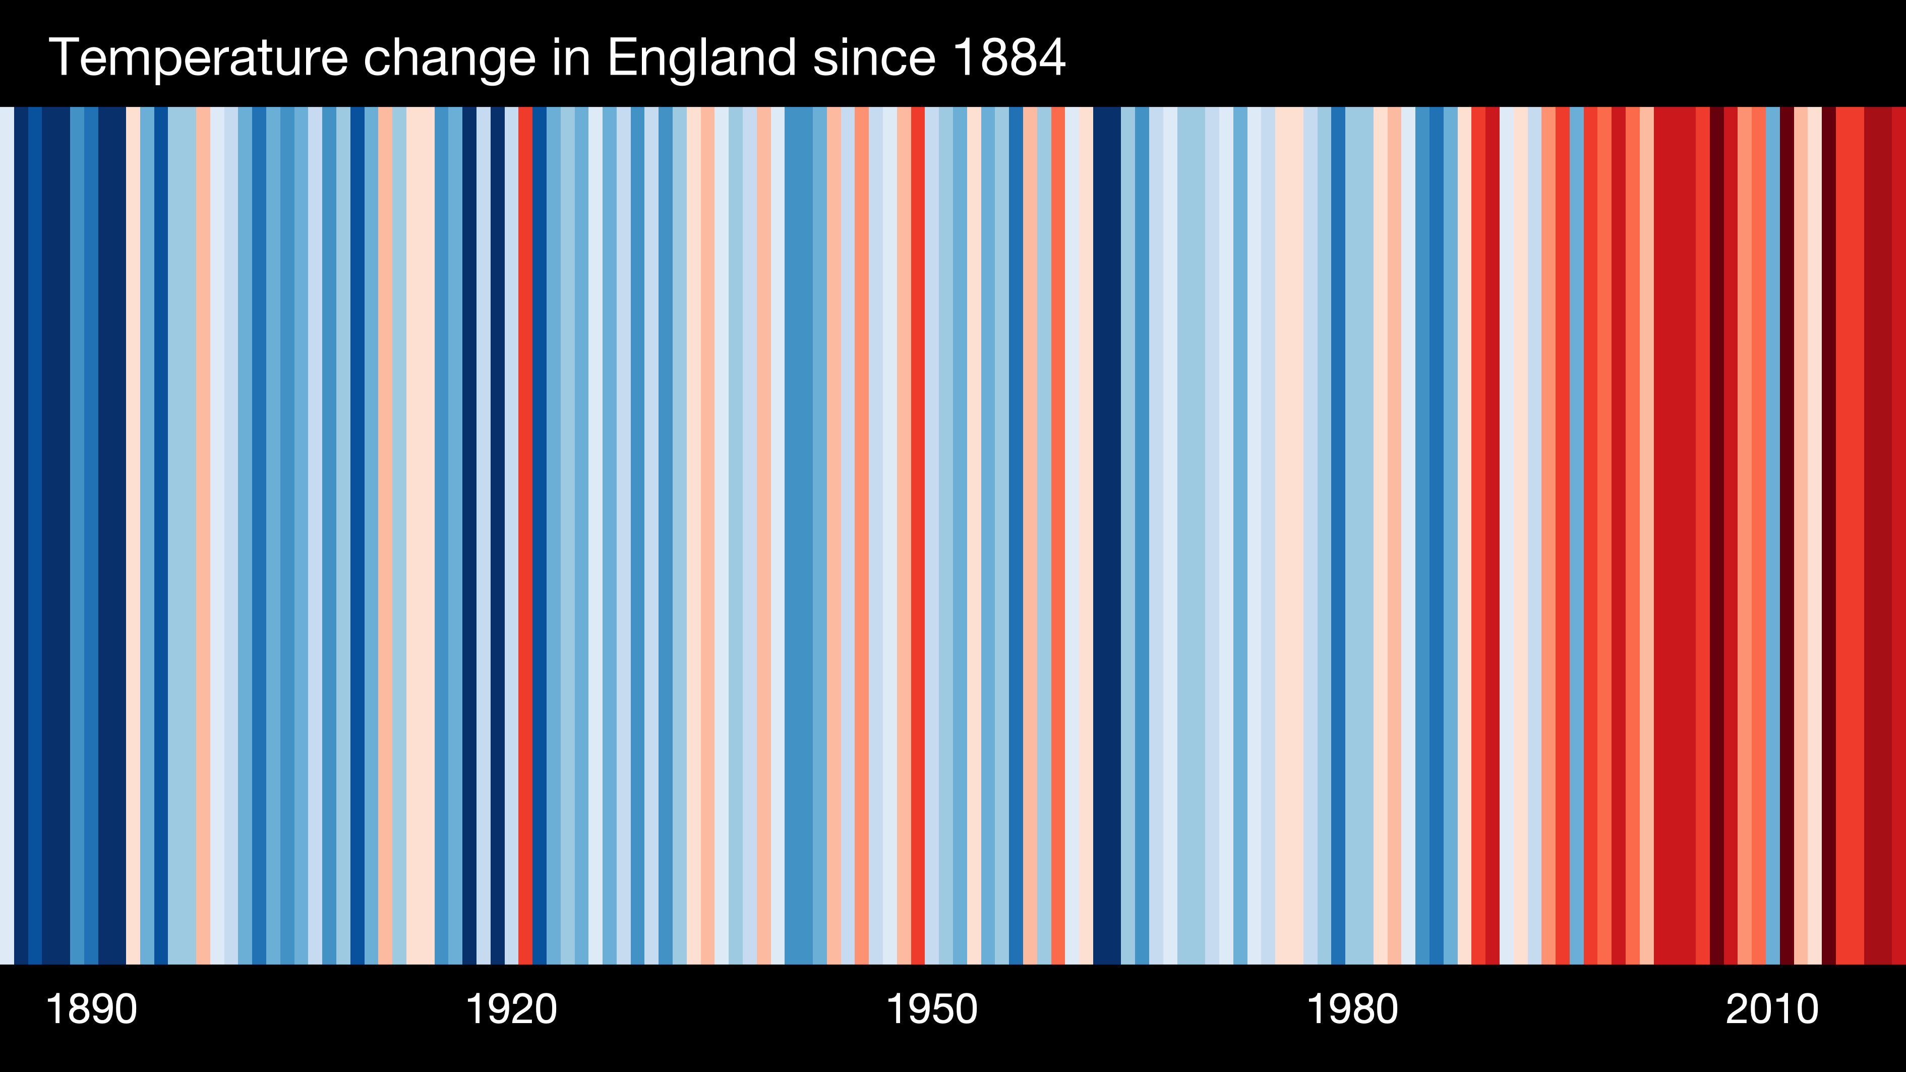
Notes:
The previous slide showed the global stripes.
These are the stripes for England.
On the warming stripes website you can find stripes for different parts of the world. Those of you in England can almost get down to county level on the website. And you can also see how quickly the climate is changing in other parts of the world. This could be a great activity to do with students – to look at how your region Is warming, and then to look at how another region in a different country is warming, discuss impacts etc.

Slide 32

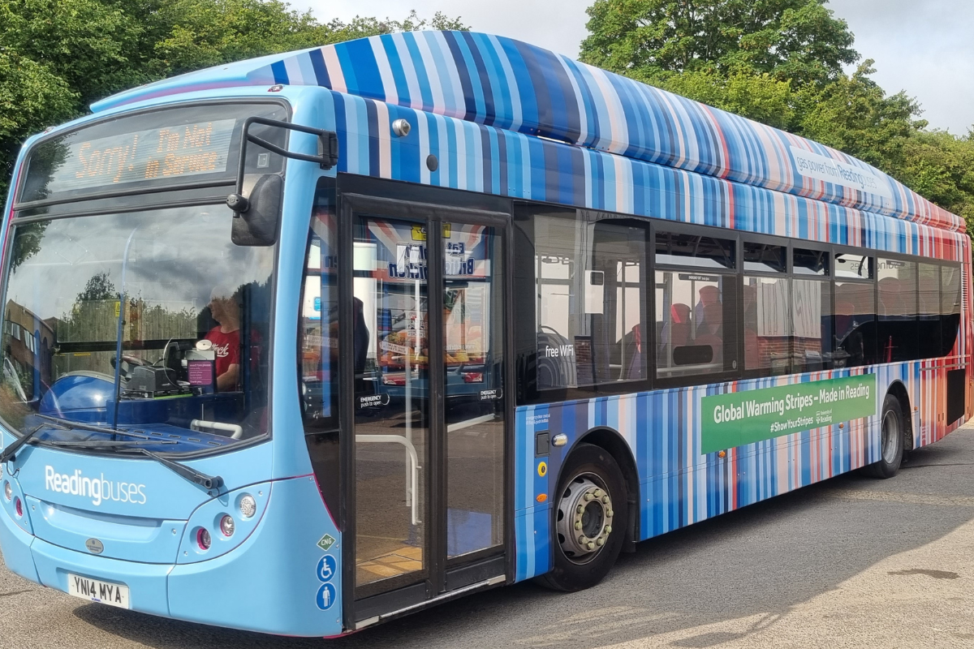
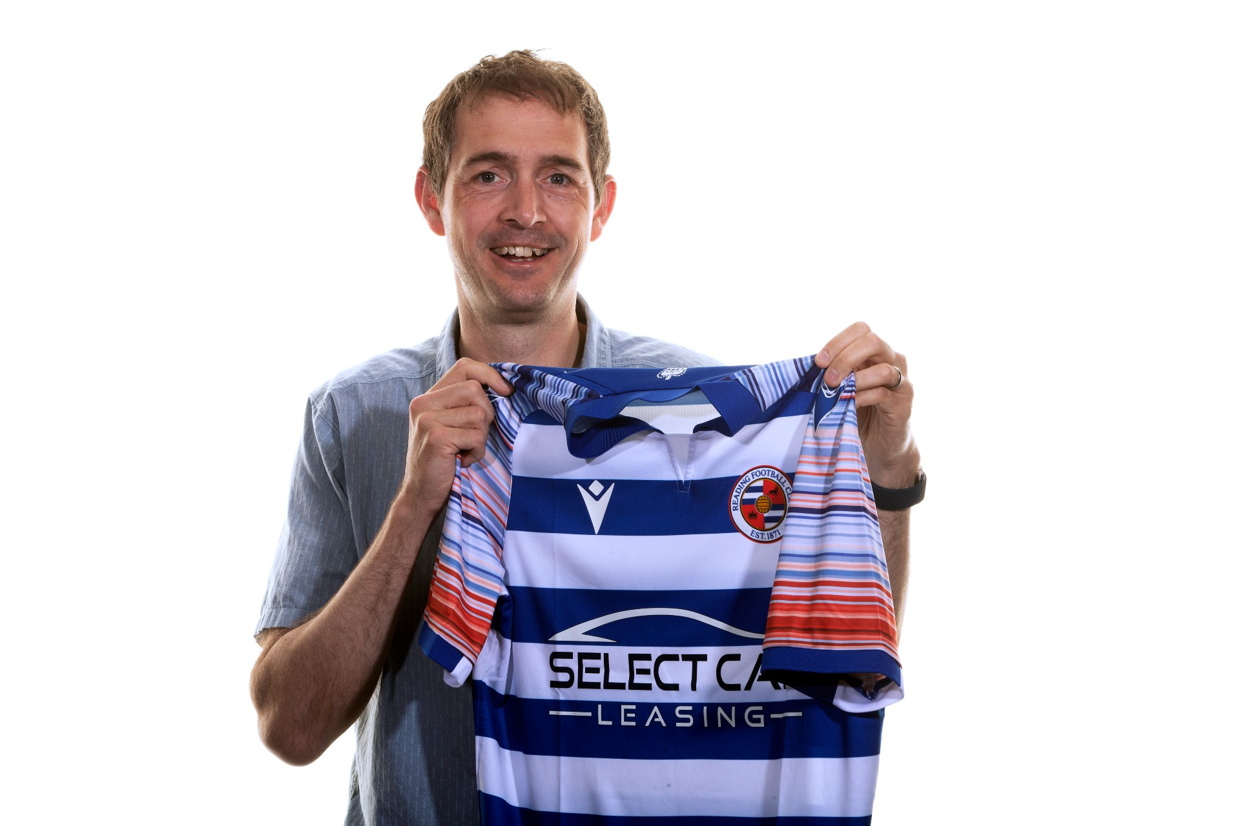
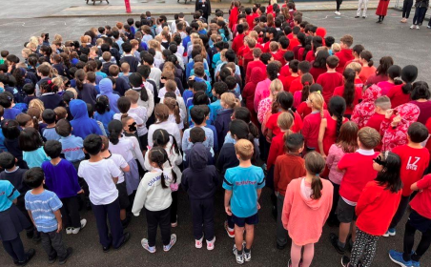
The climate stripes adorn a gas-powered Reading Buses bus, launched in July 2022
Image: www.showyourstripes.info
Glass artist Cathryn Shilling.
Image: www.showyourstripes.info
Pupils at Radstock primary school in Somerset recreating the stripes in person!
Image: www.showyourstripes.info
Ed Hawkins with the new Reading FC kit
Notes:
These are some examples of how the warming stripes have been used to help facilitate conversations around climate change.
One of the best and most impactful uses of the warming stripes is on the Reading Town Football Club strip. When the strip was introduced some fans liked it, some fans didn't. It doesn't really matter because what the strip has done is initiate a climate conversation amongst a group of people who we might not typically associate with climate action. It also meant that when Reading played Man United in the FA Cup in March 2023, on ITV, on a Saturday afternoon, in front of millions of people, the commentators started discussing the kit and what the stripes represented. A brilliant way of raising the issue of climate change in a very gentle way to millions of people who we might not typically associate with climate action.
Ask the group to think of ways that they might be able to use the climate stripes either in their home lives or at work. For example, some people use the stripes as their Zoom or Teams background, share the stripes on their social media profiles. How could the stripes be used in school as a comms tool internally, and how could they be incorporated into lessons?

Slide 33
Notes:
Back to our climate science in 12 words – we’ve done ‘it’s warming’, now we’re on to ‘it’s us’ We know it’s warming, but the climate has always changed, so how do we know that this time it’s human activity that is driving the warming?

Slide 34
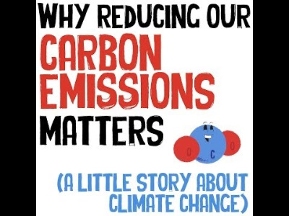
Notes:
This is a short video running through the timeline of carbon emissions and how scientists have been able to establish that carbon dioxide and other greenhouse gas emissions are driving a rising temperature.
It’s a few years old, so a couple of the stats are a little bit out of date, for example it mentions a global population of 7.5 billion, but it’s a good summary of emissions over time and how we have measured them

Slide 35
Greenhouse gases are gases in Earth’s atmosphere that trap heat.
They let sunlight pass through the atmosphere, but they prevent the heat that the sunlight brings from leaving the atmosphere.
www.climatekids.nasa.gov
Notes:
In the video, he mentions greenhouse gases, so what are they?

Slide 36
What are the main
greenhouse gases?
Notes:
There are seven different greenhouse gases mentioned in the Greenhouse Gas Protocol, but we are just going to concentrate on the main ones.
Can we collectively name the five most abundant greenhouse gases? Pop them into the chat.
Best guesses very welcome! There’s no expectation that you should already know this stuff – we’re here to learn together.

Slide 37
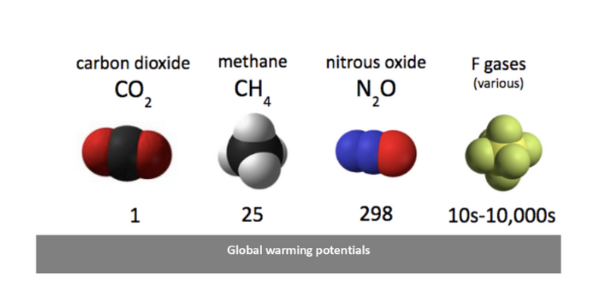
The main greenhouse gases
Water vapour
Carbon dioxide (CO2)
Methane (CH4)
Nitrous Oxide (N2O)
F-gases
Notes:
The five main greenhouse gases are listed here in order of abundance.
Water vapour is the most abundant greenhouse gas in the atmosphere. If you had no idea don't worry, it's not often discussed, because it is not one of the greenhouse gases that is accumulating as a result of human activity. However the warmer the planet becomes the more water evaporation there will be, and the more water vapour there will be in the atmosphere. This is one of the reasons why we are seeing more extreme and more frequent heavy rainfall events as the planet warms.
Each of the greenhouse gases has a different potential to trap heat within the atmosphere. In order to be able to compare the impact of the different gases, scientists have assigned each gas a “global warming potential”.
Over a 100 year period carbon dioxide has a global warming potential of 1. Methane is 25 times more potent then carbon dioxide over a 100 year time scale. Nitrous oxide is nearly 300 times more potent, and the F gases are a group of synthetic man made gases that are anywhere between 10s and 10s of thousands of times more potent ban carbon dioxide.
Each of these greenhouse gases also persists for different amounts of time in the environment say for example methane only persists for around 10-12 years in the atmosphere compared to carbon dioxide which persists for hundreds of years. Any reduction in methane emissions will have an impact over a much shorter time.
When we see carbon footprints discussed, what is usually being referred to is a greenhouse gas footprint. Everything releases different amounts of different greenhouse gases and in different proportions. Scientists look at the different greenhouse gases that are released by a particular item or activity and “do the maths” with the global warming potentials to arrive at one number that is expressed as CO2e, or carbon dioxide equivalent, and this means that we have one number for an item or an activity that allows it to be easily compared with another item or activity.
If you're starting to zone out that this bit don't worry all you need to know is that different greenhouse gases have different potentials to trap heat and they persist in the environment for different amounts of time.

Slide 38
Where do they
come from?
Notes:
Where do each of these greenhouse gases come from?
We’re going to do an activity where we try and match the human activity with the predominant greenhouse gas. In reality, everything will produce a mix of different greenhouse gases, but we’re looking for the predominant one in each case.

Slide 39
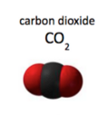

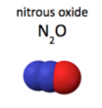
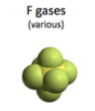
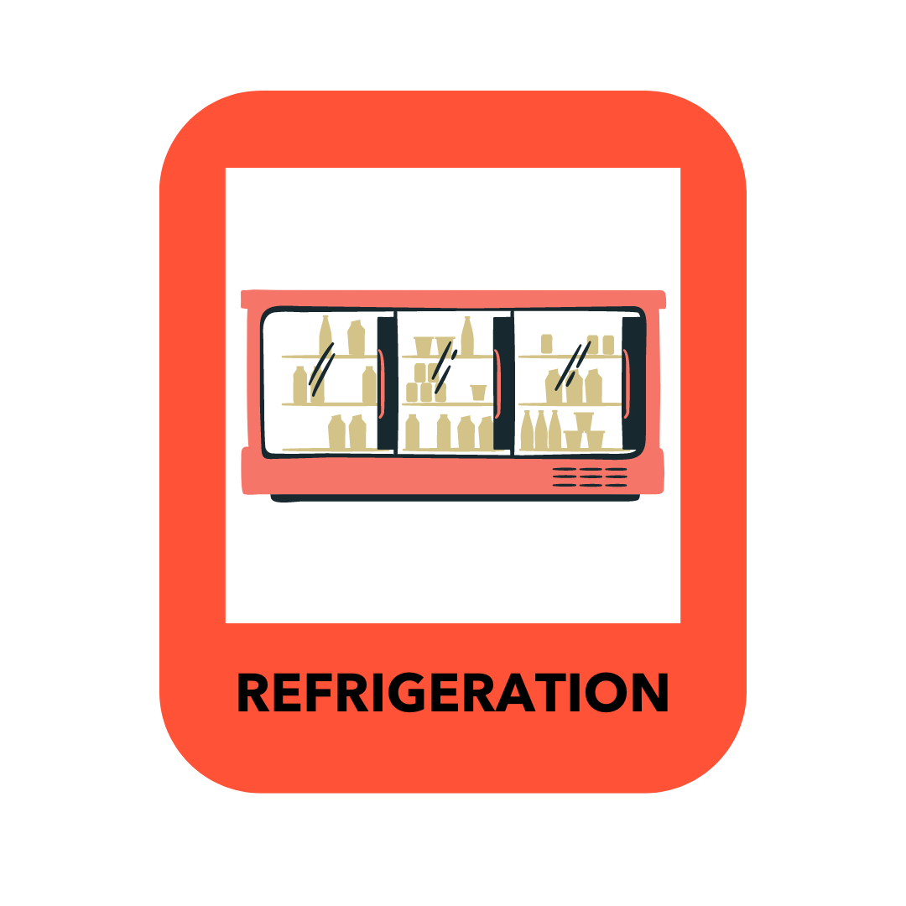
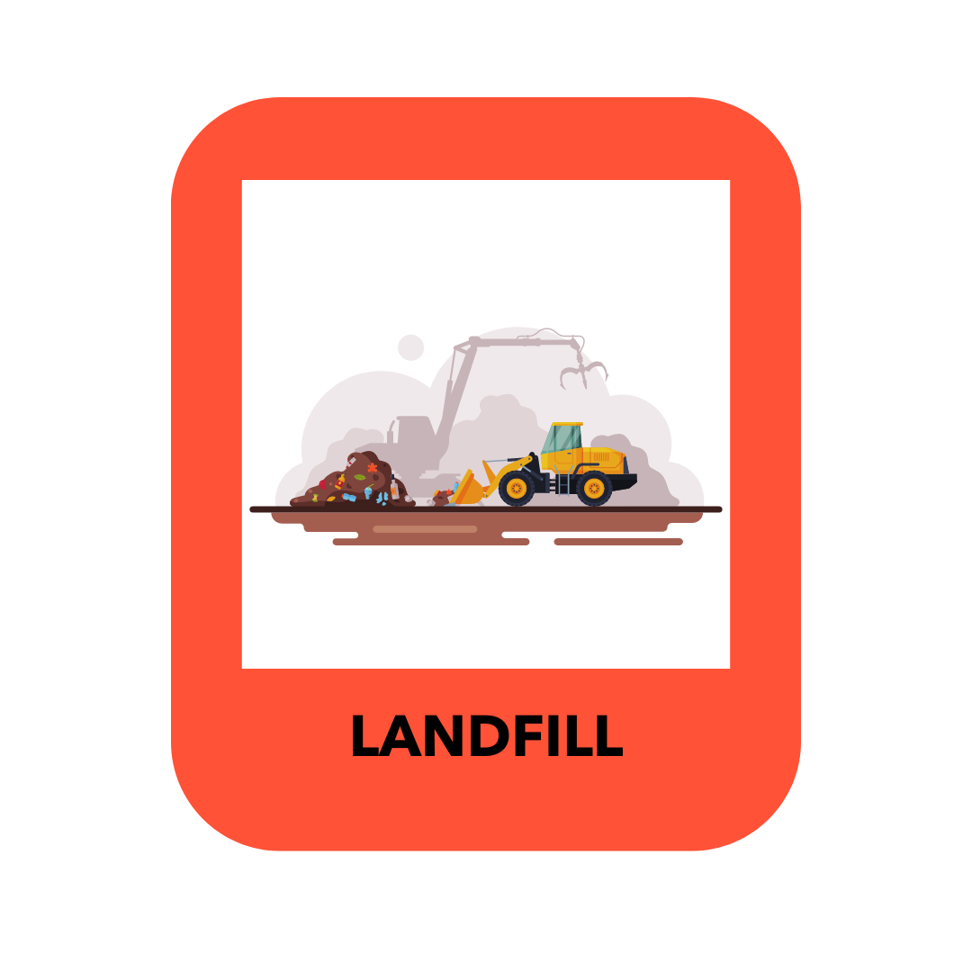

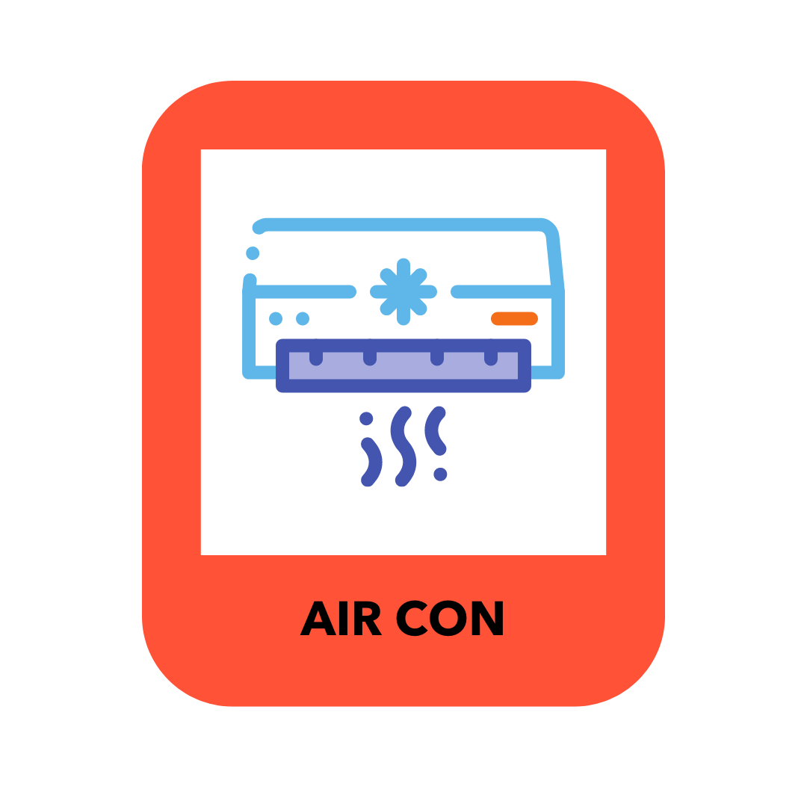
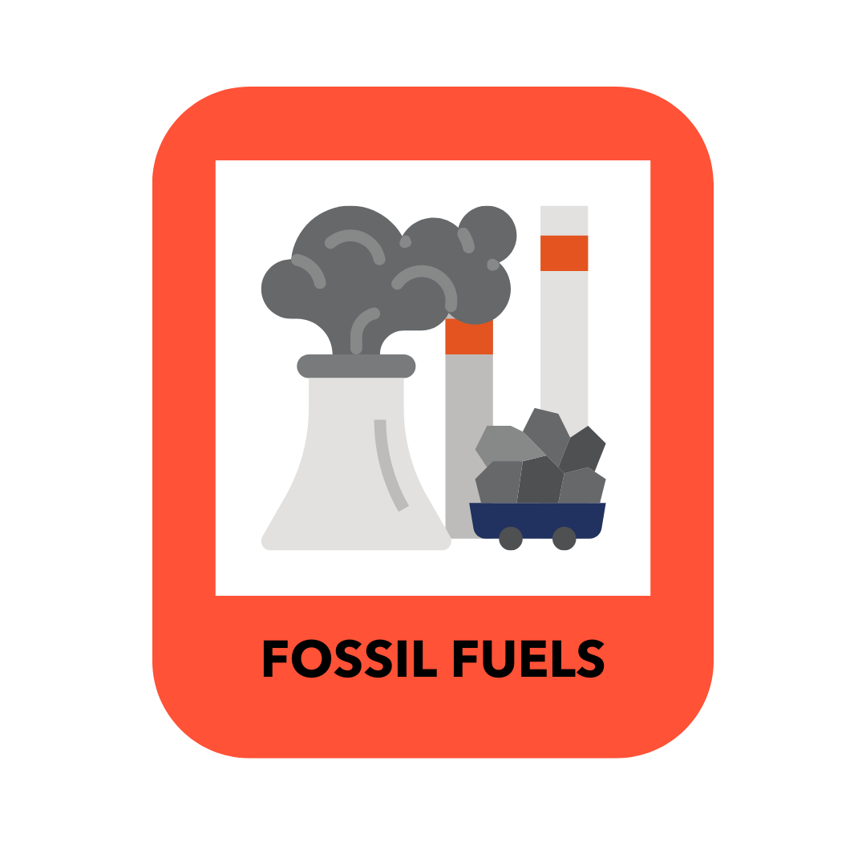
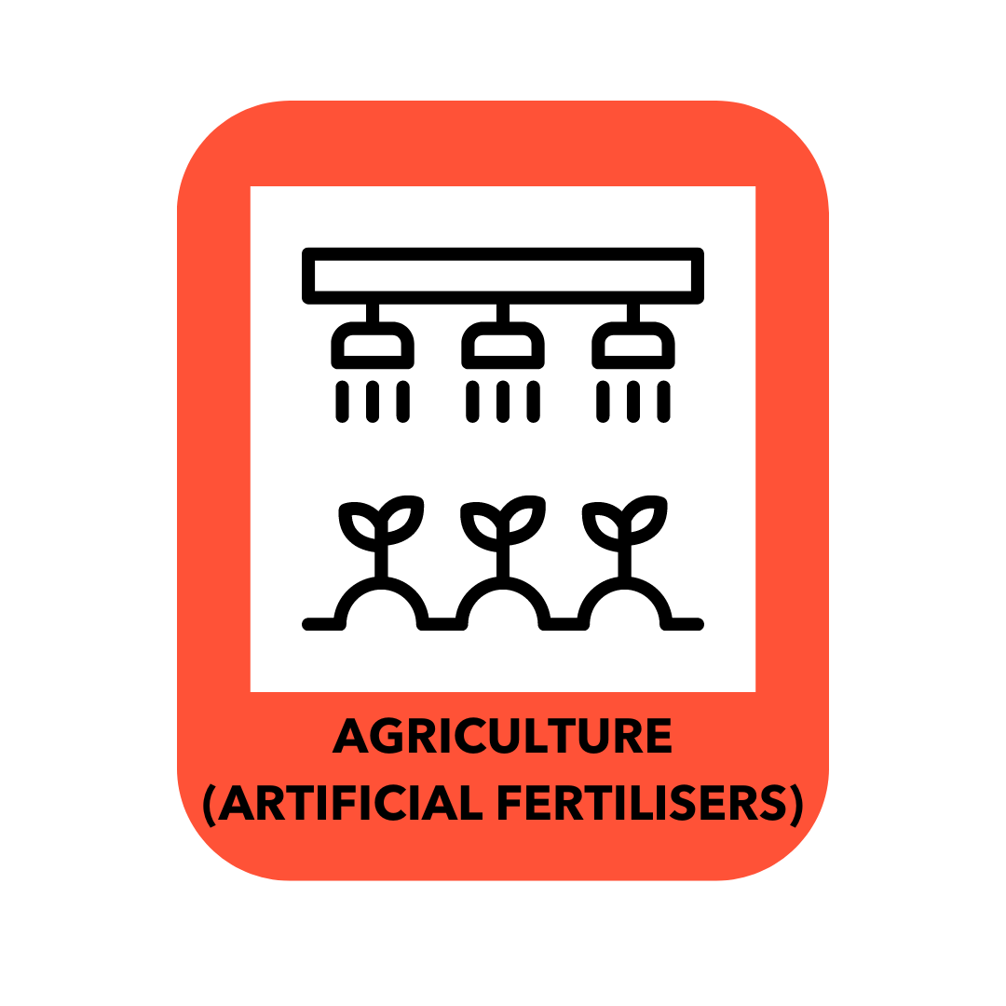



Notes:
Greenhouse gas quiz!
What we are going to try and do is move these cards so that the human activity is sitting under the predominant greenhouse gas that it emits.
I’m going to stop sharing now and go over to a whiteboard.
**Stop sharing slides. Go to share ->Microsoft whiteboards -> CL – Module 1 GHGs
The whiteboard should show on the screen. Pick a card and ask a member of the group to tell you which greenhouse gas it sits under. Go around participants in turn asking them which human activity sits under which greenhouse gas. .
Emphasise that there is no expectation to know the answers-we're all here to learn! Encourage people to give their best guess.

Slide 40
Notes:
OK, so here’s the answers.
Burning fossil fuels
Burning fossil fuels such as coal and oil is the main contributor to carbon dioxide emissions and a key driver of climate change.
Natural gas can sometimes be a tricky one. Natural gas is methane and is a fossil fuel. However once it is burned, it is carbon dioxide that is released. It is important to note however that during the extraction of natural gas there are often considerable leakages of methane into the atmosphere both at the extraction site and along pipelines.
Cement production
This is an area that not a lot of people are aware of so reassure your participants that they are not alone if they didn't know the answer to this one.
Cement production is responsible for around 8% of greenhouse gas emissions globally. Around half of those emissions come from the chemical reactions, and the other half come from the intense amounts of heat and energy that are required. The construction industry is a high emitting sector and one where we don't yet have all the answers for zero carbon construction.
This is one of the reasons why buildings come with a lot of “embodied emissions”- the emissions associated with the construction of the building, which we often forget, more usually focusing on the emissions associated with running the building. This has relevance if we are building new schools, or indeed houses, and in the vast majority of cases retrofitting existing properties is a lower carbon option two new build.
Ruminant agriculture
This is animals like cows and sheep, and is associated with methane emissions. This is because of the way ruminants digest their food, fermenting it resulting in the release of methane, about 90% of which is burped. This is one of the reasons why we are becoming increasingly familiar with the narrative around reducing meat and dairy and in our diets as a climate action we can take as individuals to reduce emissions.
Landfill and food waste
These are both big contributors to methane emissions.
When organic and biodegradable material ends up in landfill it ferments and releases me thing. Many modern landfill sites in places like the UK are capped to try and capture some of this methane and feed it back into the grid, however there are thousands of unregulated landfill sites around the world all significantly contributing to methane emissions.
Food waste is a particular problem and if food waste was a country it would be the third biggest emitter of greenhouse gas emissions after the USA and China. We will look at food waste again in Module 4 when we start to look at actions but reducing food waste at home and in our businesses is an incredibly impactful climate action.
Artificial agricultural fertilisers
These are a big contributor to atmospheric nitrous oxide levels. The role of artificial fertilisers is to replace nitrogen in the soil that plants have used. Artificial fertilisers are fossil fuel based and incredibly energy intensive to create in addition to the fact that when spread on the ground nitrous oxide emissions are released.
F gases
These are most commonly used for refrigeration and air conditioning. During both of these processes there will be leakage of F gases into the environment. F gases are incredibly potent greenhouse gases, the use of which in places like the UK is highly regulated, although this is not the case worldwide. As the planet warms demand for air conditioning will increase, leading not only to an increase in demand for energy and electricity, but also to an increase in demand for F gases and potentially in their leakage into the environment.

Slide 41
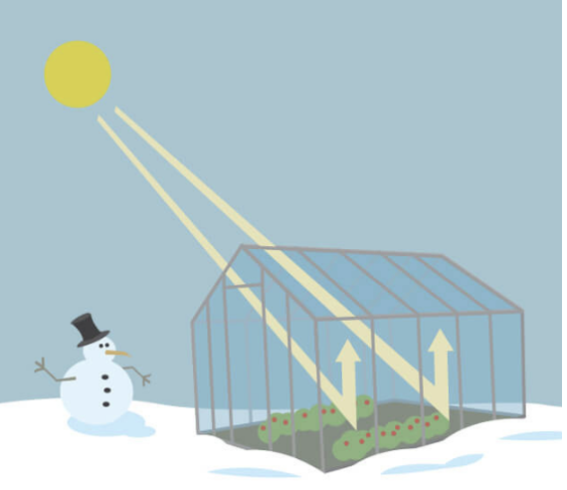
The greenhouse effect is a process that occurs when gases in Earth’s atmosphere trap the sun’s heat. This process makes Earth much warmer than it would be without an atmosphere. The greenhouse effect is one of the things that makes Earth a comfortable place to live.
www.climatekids.nasa.gov
Notes:
All of these greenhouse gas emissions contribute to the greenhouse effect – read out definition

Slide 42
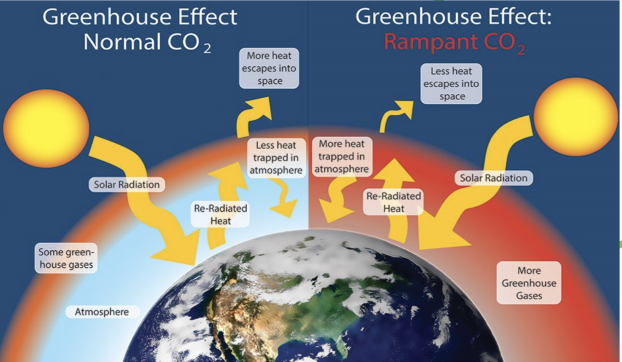
www.nps.gov
Notes:
This image showing the normal healthy layer of greenhouse effect versus the rampant greenhouse effect exacerbated by human activities and the increase in atmospheric greenhouse gases.
The greenhouse layer is often referred to as a blanket trapping in some heat. We are adding to that blanket, making it thicker and trapping more heat, in the same way as we put another jumper on when we’re cold.

Slide 43

What would the average temperature on earth be without the
natural greenhouse effect?
15°C
5°C
O°C
-18°C
Notes:
Ask participants “what would the temperature on earth be without the greenhouse effect?”
This is mentioned briefly in the carbon dioxide emissions video so some participants may remember it from there.
The answer is -18C. Earth would not be a habitable planet without the greenhouse effect however human activity is exacerbating this warming the planet and changing the climate.

Slide 44
Notes:
Back to our climate science in 12 words – we’ve done ‘it’s warming’, and ‘it’s us’, so now we’re onto ‘we’re sure’.
There is quite a lot of climate mis- and dis-information around, trying to cast doubt on the now very established climate science.
So I thought it would be useful to have a look at how the scientific consensus has changed over the last 30 or so years.

Slide 45
Scientific consensus
IPPC
= Intergovernmental Panel
on Climate Change
The United Nations body for assessing the science related to climate change.
Created in 1988.
The objective of the IPCC is to provide governments at all levels with scientific information that they can use to develop climate policies..
1995 IPCC report: a 'discernible' human influence on global climate
2007 IPCC report: human activity 'very likely' to be influencing global climate
2013 IPCC report: human activity 'extremely likely' to be influencing global climate
2021 IPCC report: "It is unequivocal that human influence has warmed the atmosphere, ocean and land”
Notes:
The most accurate reflection of the scientific consensus is gained via the IPCC reports.
The IPCC is the Intergovernmental Panel on Climate Change and is a United Nations body that brings together all of the latest scientific research to create a consensus that governments around the world can use to inform their climate policies. It is the result of the work of thousands of climate scientists all around the world.
In 1995 the IPCC report stated “a discernible human influence on global climate” all the way through to the latest 2021 report which stated “it is unequivocal that human influence has warmed the atmosphere ocean and land”.
For a long time scientists have been at pains to not be seen as alarmist however the language they are now using is intended to convey in no uncertain terms that the science is settled, climate change is human induced, and action is imperative.

Slide 46
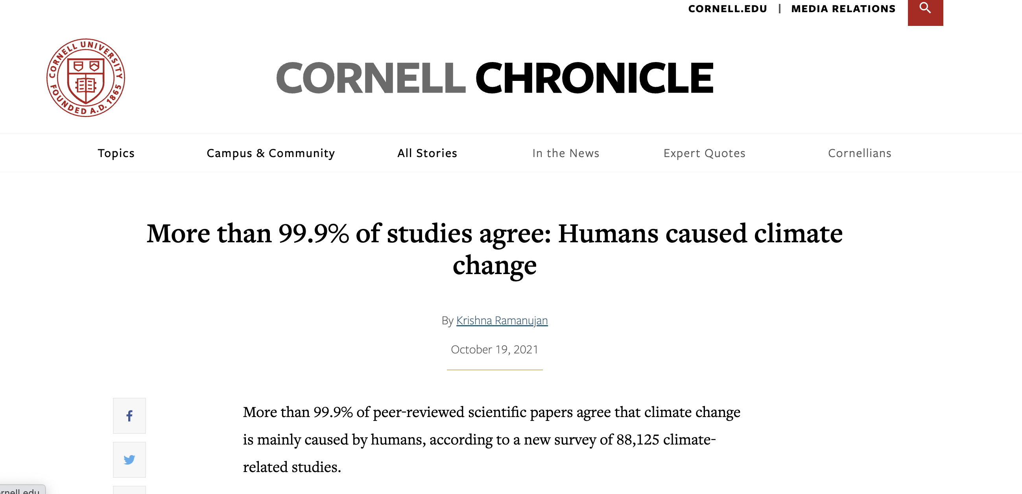
www.news.cornell.edu/stories/2021/10/more-999-studies-agree-humans-caused-climate-change
Notes:
For a long time we talked about “97% of scientists” agreeing that climate change is human induced, however a study from Cornell University in 2021 found that 99.9% of studies agreed that climate change is human induced.
Even if you can't remember the facts and the stats around climate change, if you are having a conversation with someone who is doubting the science, all you need to remember is that 99% of qualified climate scientists whose job it is to investigate this issue agree that climate change is human induced.
OK, that was the science bit!
How is everyone doing?
Any questions?

Slide 47
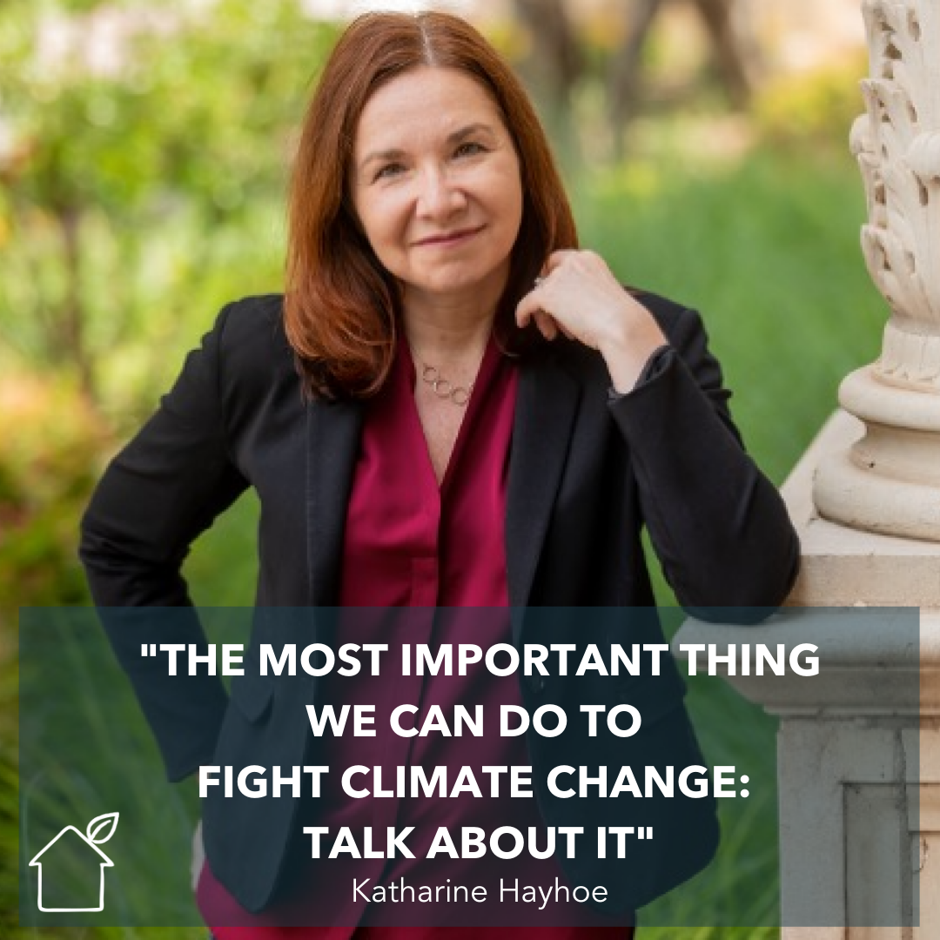
Talking climate
Notes:
This is Katharine Hayhoe, the climate scientist from Texas who we briefly mentioned earlier.
Katharine is a Canadian climate scientist living in Texas who is not only a brilliant climate scientist but also a wonderful communicator. She has a TED talk called “The most important thing we can do to fight climate change: talk about it” . Do go and watch it!
Katharine says that whilst the vast majority of those are now aware of climate change and report being concerned (around 75% of people say they are concerned about climate change) none of us are talking about it. This results in a phenomenon known as “pluralistic ignorance” - whereby we think we're the only one worried about climate change because nobody is talking about it. So we don't talk about it because we think no one else is worried about it creating a vicious circle of silence.
It sounds super simple to say all we need to do is to talk more about climate change however this is easier said than done for the majority of us.

Slide 48
What stops you
talking about climate change?
Notes:
Ask participants to share in the chat or to unmute and share some of the things that stop them from having more climate conversations with their friends family and colleagues.
If you’re doing ok for time, you can ask a couple of people to unmute and share.
If you have a large group, you could split them into breakout rooms.

Slide 49
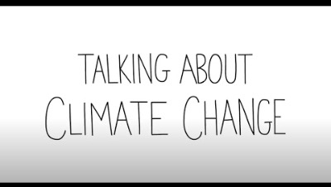

Slide 50
Spheres of influence
FAMILY AND FRIENDS
WORKPLACE/
COMMUNITY
CONSUMERS
CITIZENS
Notes:
So who can YOU talk to?
Obviously we can talk to friends and family, but we have lots of different ‘spheres of influence’ as individuals (and as schools!), and leaning into these can really help to amplify the impact of our climate actions.
We often underestimate the impact that we can have as individuals, in our own lives, and in our workplaces. AND as individual schools – think back to that diagram from the start of the session about the influence of schools – the things you do at your school influence your students, other members of staff, parents and the wider school community. AND potentially other schools in your Trust, Diocese or local area.
Thinking about the different spheres of influence we exert can be helpful – when we’re going through this, think about you can apply it to yourself as an individual, AND how you could use this as school or Trust as well.
The biggest impact we can have on climate change is the influence that we have on others, whether that’s friends or family, or colleagues and senior leadership at work – that could be role modelling some changes (and that could be as simple as bringing your reusable water bottle or coffee cup into school, or walking to school once a week); and you could share the co-benefits that come along with that, whether that’s saving money, or the fact that on the mornings you walk to school you feel a bit less frazzled and a teeny bit smug that you’ve already done your exercise for the day!
Citizens
It’s often easy to forget our influence as ‘citizens’but a 2017 study asked MPs why they weren't taking more action on climate, the vast majority replied that they weren't hearing from their constituents that it was an issue for them. We have to let our elected representatives know that this is an issue that we want to see the government take action on. And we have to educate our young people about democracy, and how it works, and how they can make their voices heard.
Who is your MP? How do you get in touch?
Hope for the Future is a brilliant organisation that helps and supports people to engage constructively with their MPs and there’s definitely scope for discussing this with our young people and empowering them to be engaged citizens.
Also think not just about your central government but local government too. Who is your local authority? What are they doing to support climate action and reduce emissions in schools in the area?
Consumers
The last one is the influence we can have, as individuals, or as schools/Trusts as ‘consumers’. There's a lovely quote by Anna Lappé that says “Every time we spend money we are casting a vote for the kind of world that we want.” Making more thoughtful decisions about the companies and organisations that we choose to give our money to can make a difference. We have already seen the power of our consumer pound in action when we think about the rise in availability of plant based products both in the supermarket and in restaurants and pubs in the UK. This hasn't happened because the government have legislated around this issue or because supermarkets have decided unilaterally to take action. This has happened as a direct result of consumer demand.
It's also important to note that whilst there may be occasions when we cannot make the purchasing decisions we might want to for a variety of different reasons, we can always make our consumer voices heard. Think about the businesses that you spend money with on a regular basis, and how you might be able to make your voice heard.
As schools – as we’ll see when we look at carbon footprints in the next module, the majority of your emissions will come from purchased goods and services – what conversations can you be having with suppliers? Who are the 3 or 5 companies you spend the most money with? How can you find out more about their sustainability credentials, and let them know that this is a priority for you.

Slide 51
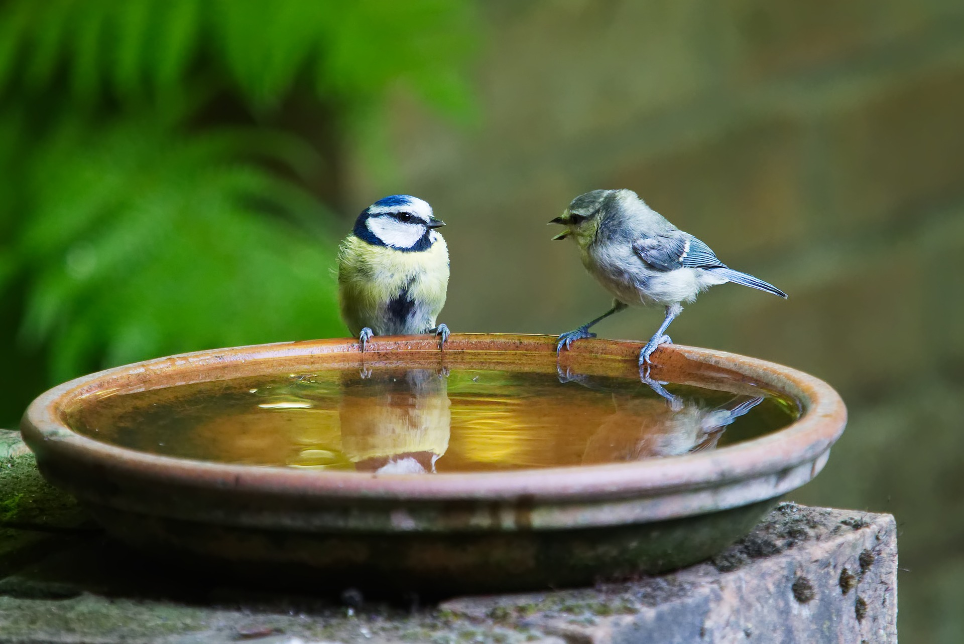
(Entirely optional) Homework!
Map out your spheres of influence
- Personal
- In your role
- For your school/setting
Have a climate conversation!
- Who with?
- When is a good time?
- What’s your opening line?
Notes:
Ask people to share in the chat who they're going to have their climate conversation with, when they might be able to do it, and what their opening line might be. The reason for asking people to do this is that it makes it much more likely that they will do it!
Wrap up – remind people of date and time of next session etc.
And

Slide 52
Agenda
Workshop One - Getting Started
Carbon footprinting
Saving energy:
Workshop Two – The Science
- Climate science 101
- Talking climate
Workshop Three - The Impact
- Climate impact
- Adaptation and risk
- Carbon footprints
Workshop Four – The Future
- What action has been taken
- Looking ahead
- Carbon Literacy Pledges
Notes:
Here’s our agenda for the course:
In module 1 we do a quick run down of climate science, and then spend a bit of time at the end of the session talking about the importance of talking about climate change(!).
In Module 2 we look at current climate impacts, globally, in the UK and on the education system. And then we start to explore carbon footprints.
In Module 3 we start off by looking at what action has already been taken, again starting globally, then looking at UK action, as well as exploring changes that have already been implemented in the education sector.
And then we move on to look at different future scenarios for what could lie ahead depending on how quickly or otherwise we get our act together.
In Module 4, it’s all about action! And this always my favourite module, because ‘nothing changes if nothing changes’ and this is where we can really get inspired and informed about the actions we can take. We’ll also make sure that everyone is happy with what they need to do in order to get their Carbon Literacy certificate.
**Each session is around 2 hours – if you’re doing 4x2hr sessions, then each module is stand alone. If you’re doing 2x4hour sessions, you’ll do modules 1 and 2 (with a break) in one session, and then 3 and 4 in another. If you’re doing an in person day, you’ll do all four in the day.

Slide 53
Questions?
Notes:
Any questions about anything we’ve covered today?
I’m aware that we cover a lot in each session, and that we go quite quickly, so please do shout if there’s anything you’re unsure of.
Optional – you can ask people to share three words in the chat for how they’re feeling after the first session.
OR ask them to share one ‘takeaway’ from the session

