Slide 1

NZAP Workshop Three:
Climate impacts, adaptation and risk, carbon footprints
Wednesday 5 February 2025

Slide 2
Welcome Back! Housekeeping reminder
Please have your cameras on
Stay on mute if you’re not talking
Pop your hand up if you have a question or comment
Use the chat box to interact
Join in!
All the links and resources, along with a pdf of the slides will be available after the session
Notes:
Quick reminder of the housekeeping

Slide 3
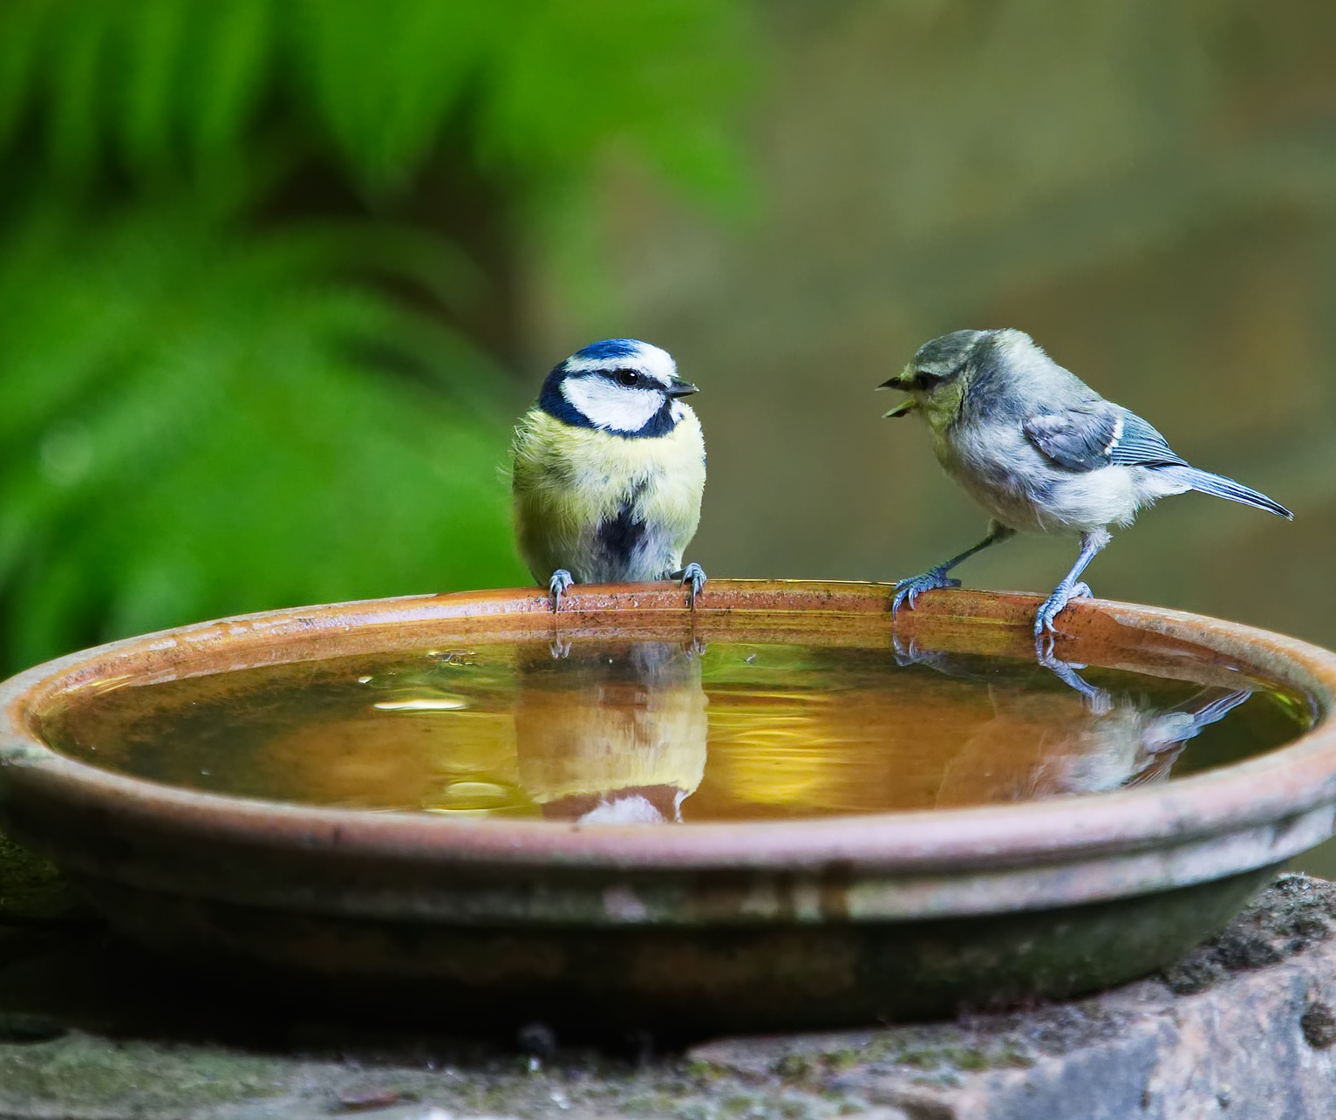
Homework check-in!
Map out your spheres of influence
Have a climate conversation!
- Who with? - When is a good time? - What’s your opening line?
Notes:
How did everybody get on with the homework. Did anybody manage a climate conversation? Ask if anyone wants to share

Slide 4
Agenda
Workshop One - Getting Started
Carbon footprinting
Saving energy:
Workshop Two – The Science - Climate science 101 - Talking climate
Workshop Three - The Impact - Climate impact
- Adaptation and risk
- Carbon footprints
Workshop Four – The Future - What action has been taken
- Looking ahead
- Carbon Literacy Pledges

Slide 5
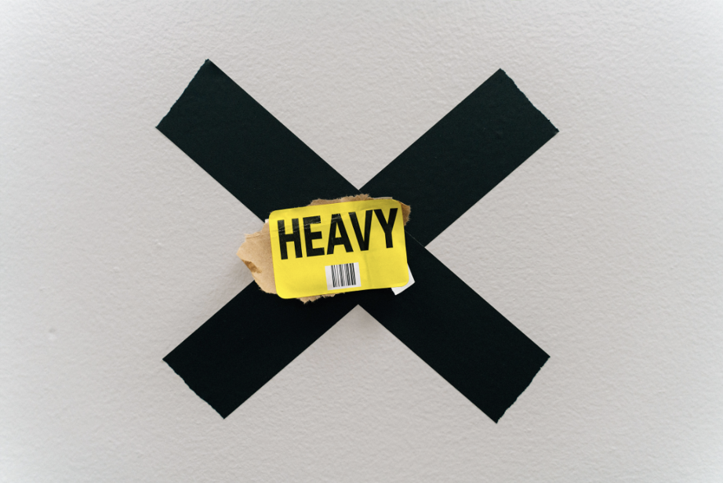
Notes:
Just to flag this again – I don’t think the last session was too bad anxiety wise, but there definitely some of the material today that can be a little bit heavy and the last thing we want is for anybody to go away feeling worse than when they started or feeling like they're on their own attempting to manage eco anxiety.
Some of the material today especially that talking about climate vulnerability and climate justice is really uncomfortable. If you're finding it really uncomfortable please know that you won't be the only one, and if you feel brave enough please do comment or share in the chat. Also remember the book recommendation from last week turned the tide on climate anxiety

Slide 6
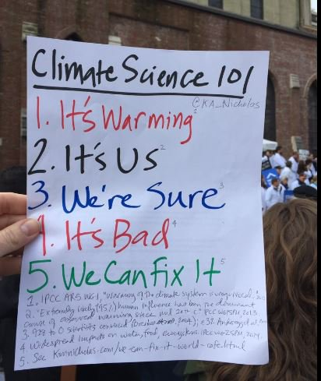
Climate Science in twelve words…
Image credit: Prof Kimberley Nicholas www.kimnicholas.com
Notes:
If you remember our climate science in 12 word that we were using as our framework last time to work our way through climate science. Unfortunately we're up to it's bad and we need to sit with that for a little while until we can move on to we can fix it.

Slide 7

How much has the world already warmed compared to pre-industrial levels?
0.5°C
1.2°C
1.5°C
2°C
Notes:
How much has the average global temperature warmed compared to pre industrial levels?
Half a degree, 1 degree, 1.2 degrees, 1.5 degrees
The correct answer is 1.2 degrees Celsius. Although….(move on to next slide)

Slide 8
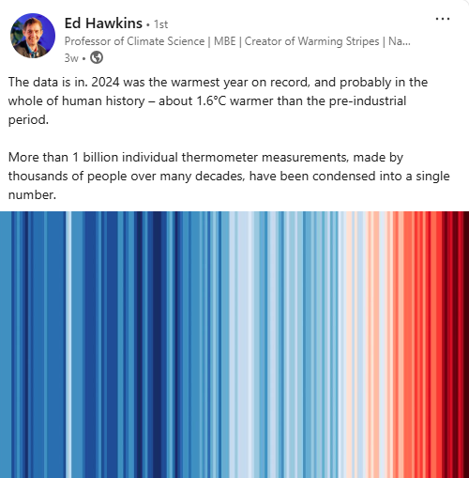
Notes:
We have experienced the first year at 1.5C above pre-industrial levels and 2024 looks set to be the hottest year on record. However the official figures on based on rolling averages of 10 or 20 years, so we still haven’t ‘officially’ breached 1.5C yet.

Slide 9
Is 1.2C a big deal?
Notes:
I think that one of the potential issues that we have had with climate science and climate communications is that 1.2 degrees Celsius doesn't sound like a particularly big deal. I couldn't tell you if my cup of tea or my bath was 1.2 degrees Celsius warmer or colder our normal, so i can understand why people might think that 1.2 degrees of global warming is not a big deal.

Slide 10
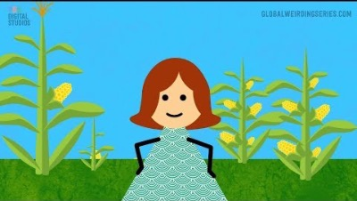
Notes:
** Just show up to 2mins 20s ** This is a video from Katherine Hayhoe who we met at the end of module 1 when we were talking about the importance of talking about climate change. This is a video from Catherine 's YouTube channel called Global Weirding. It's a few years out of date I think it was created in 2018, but I really wanted to show you the brilliant analogy that Professor Hayhoe uses to explain why 1.2 degrees of warming is in fact a big deal.

Slide 11
Global Impacts
Notes:
I think that one of the potential issues that we have had with climate science and climate communications is that 1.2 degrees Celsius doesn't sound like a particularly big deal. I couldn't tell you if my cup of tea or my bath was 1.2 degrees Celsius warmer or colder our normal, so i can understand why people might think that 1.2 degrees of global warming is not a big deal.

Slide 12
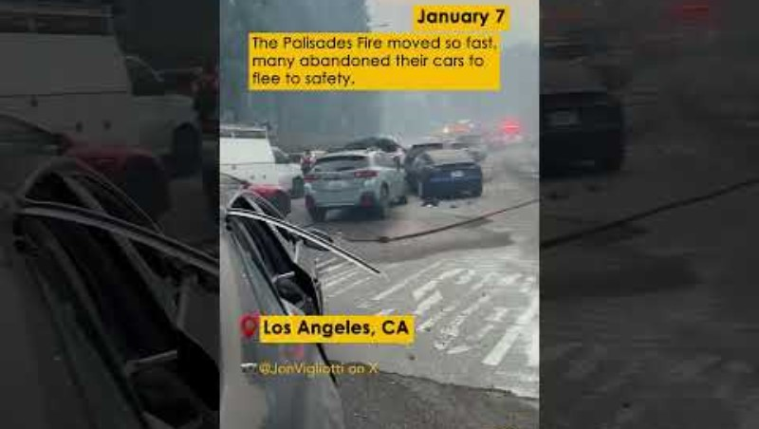
January 9 | The Extreme Weather Report | Yellow Dot Studios
Notes:
**NB. This slide will need updating periodically This is a short video from the Climate Council in Australia highlighting just some of the extreme weather events we’ve seen already in 2024.

Slide 13

www.biodiversitystripes.info/global
Notes:
It’s important to recognise that climate change is one of the key drivers of biodiversity loss. This image is the Biodiversity Stripes and they were created by Professor Miles Richardson at Derby university after seeing the impact of the warming stripes and how they were being used so successfully as a tool to highlight climate change and drive conversations. Apparently climate change gets 8x more media coverage than biodiversity loss and if nature goes down, we’re going with it as we are 100% reliant on it for food, water, clean air etc. Does anybody know what percentage decline we’ve experienced in global biodiversity since 1970? (The answer is 69%).

Slide 14
UK impacts
Notes:
OK, so we’ve looked at some of the global impacts we’re already experiencing. What are we seeing here in the UK?

Slide 15
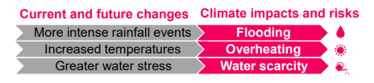

Independent Assessment of UK Climate Risk - Climate Change Committee
GLA_Schools_CAPs - Tiverton Primary School (1).pdf
Notes:
The Climate Change Committee carried out an independent assessment of UK Climate risk and identified the 3 biggest risks in the UK are flooding, over-heating, and water scarcity. Let’s have a quick think about how those three things are already impacting schools and education in the UK, and potential future impacts.

Slide 16
Climate Risk, Adaptation and Resilience
5 steps to becoming more resilient
Notes:
Any questions about anything we’ve covered today? I’m aware that we cover a lot in each session, and that we go quite quickly, so please do shout if there’s anything you’re unsure of. Optional – you can ask people to share three words in the chat for how they’re feeling after the first session. OR ask them to share one ‘takeaway’ from the session

Slide 17






So, what can we do?
Learn and explore
Reflect and recall
Acknowledge any fear, confusion, anxiety and overwhelm.
Take a solution focused approach!
Do what you can within the sector's current constraints.
While help and support is developing, there are things you can do right now to understand which climate hazards are currently most significant to your school and start to take steps to address them.
Quick Win Actions
Assess the future
Plan for tomorrow
Notes:
What can we do?
Firstly, its important to recognise this can feel scary and overwhelming. There will be staff and learners within your school that experience climate-related anxiety and stress when discussing climate change. So its really important to take a solutions-focused approach. What we mean by that is rather than focusing too much on the negatives, and the impacts, you can frame the conversation to look towards what actions you can take and things that are within your control in your school to improve your resilience.
I think the other thing we need to highlight here is that actually the quality and quantity of guidance for schools on climate adaptation at the moment probably feels lacking, and it is an underserved area currently compared to things like decarbonisation action.
However, with those things being said, there are things you can do right now to understand which climate hazards and risks will currently have the greatest impacts on you school, and identify ways to address them.
So as part of this programme of workshops, we've created a 5 step plan to help you do this.
And I'm going to take you through those steps today.

Slide 18

Learn and explore
Understand climate change and its local impacts to build awareness around current guidance, best practice and funding.
How to complete this step:
This workshop!
Department for Education Strategy – adaptation
Sustainability and climate change: a strategy for the education and children’s services systems - GOV.UK
Helpful resources to increase awareness of climate adaptation and resilience
Mayor of Londons' Climate Adaptation Plans for Schools (p.27 onwards)
Example Climate Adaptation Plan
Keep an eye out for national and local funding and grants!
See appendix for a list of opportunities
Keep an eye on Sustainability Support for Education,
and speak to your Let's Go Zero Advisor!
Notes:
So looking at the first step in more detail, learn and explore, is about understanding what climate change means as a concept, start to build a sense of local impacts. And actually attending today's session means you've already done this, which is fantastic.
But there also some other bits of guidance and resources that are worth being aware of at this stage, and I've captured these here for you below.
So for example, we have the DfE's latest position on climate change and sustainability in education. Their strategy is littered with reference to making the education sector more resilient, and how they aim to do it. So if you haven't already, have a read and just be aware of their position.
Additionally, some work has been done in the London area in particular around assessing schools climate vulnerabilities and helping them to identify measures they can take to improve their resilience. So the two links I've provided here, are really fantastic resources for any school setting to understand different measures they can take, and what should be considered and included in any climate adaptation plan.
And then finally for this step, just keeping an eye out for any local or national funding or grants related to improving climate resilience. We are aware of some currently, and we've included these in the appendix of todays presentation, and a copy of these slides will be sent after we wrap up today.
And before I move on to the next step just a reminder that the landscape is evolving, keep an eye out for updates from the DfE as guidance is developed over time to support you. And this will be shared through the sustainability support hub so its worth signing up if you haven't already.

Slide 19
Reflect and recall
Looking at past climate events and their impacts helps uncover patterns and weaknesses in resilience.
The aim of the reflect and recall stage is to complete a Climate Risk Baseline.
Climate Risk Baseline
A reference point in time, used to understand current climate vulnerabilities.
It will also be used to compare and measure the potential future impacts of climate change as part of a Climate Risk Assessment, acting as the starting point for assessing how climate risks might evolve under different warming scenarios.
Vs
Climate Risk Assessment
The process of identifying and analysing any potential future, long term negative impacts of climate change, including the likelihood of future climate hazards and their potential consequences, to inform decision-making on adaptation strategies and mitigation measures.
Notes:
So the next step then, reflect and recall, this is about looking at past climate events and how they impacted your school to identify your weak spots.
Once you've familiarized yourself with key concepts, and any relevant guidance, you can start to complete your climate risk baseline.
So what is a climate risk baseline? Well simply put it’s a reference point in time, which is used to understand your school's present climate vulnerabilities. And crucially, it will also be used as the reference point against which you can then compare and measure any future potential impacts of climate change as part of a later Climate Risk Assessment. So the baseline is focused on right now, what's your exposure.
And then a Climate Risk Assessment, for comparison, which comes later in the 5 steps, that's where you look to the future and identify what your school's vulnerabilities under different warming scenarios. So for example, if we manage to keep warming to under 2 degrees Celsius then the impacts will be less severe than if we breach 2 degrees, and perhaps reaches 3 degrees or even 4. And the risk assessment allows you to identify any risks and the severity of impacts that will come from these warming scenarios if realised, so that you can plan and prepare your school accordingly.

Slide 20
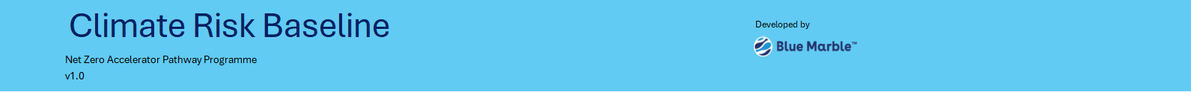
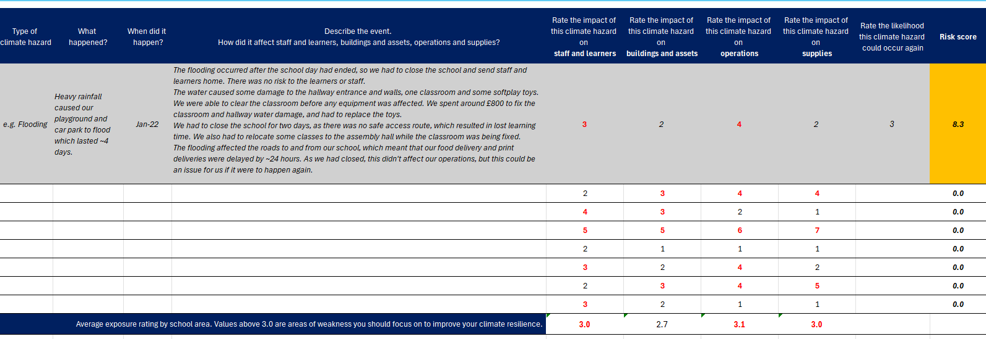
Reflect and recall
Climate Risk Baseline Template
A copy of this template will be provided along with a copy of these slides at the end of the workshop.
A story-based approach
Notes:
So to help you complete your climate risk baseline, we have put together a template that sets out the process and helps you identify areas of weakness that you can start to focus on.
The template takes a 'story based' approach, and what we mean by that is rather than having to identify and analyse climate data and numerical values, instead its about speaking to your staff, learners and parents, particularly those who have been at the school for a long time, to record any climate events that your school has experienced in the recent past.
And this template is going to be provided to you after today's session ends. It includes a step by step guide on how to follow the process for completing a climate risk baseline and by the end of it, you'll have identified which areas of your school are particularly vulnerable to climate events, so that could be people, it could be buildings and assets, it could be operations, or it could be your supply chain. It will also highlight to you which climate hazards are most signficant to your school, so for example flooding, or heat stress, or extreme cold.

Slide 21
Quick win actions
Taking smaller, achievable steps helps strengthen resilience and build momentum for longer-term change.
Type of intervention:
Examples:
Solar shades, SuDS
planters, permeable
surface: woodchip etc
Emergency response protocols, policy reviews, cooling and heating schedules etc
Prioritise local suppliers, diversify network, review essentials delivery schedules
Heat and weather adaptation awareness, first aid training, emergency response training
Helpful resources
https://www.arup.com/globalassets/downloads/projects/climate-change-guidance-and-plans-for-london-schools-and-early-years-settings/gla-schools-adaptation-guidance.pdf
https://www.arup.com/globalassets/downloads/projects/climate-change-guidance-and-plans-for-london-schools-and-early-years-settings/compendium-adaptation-and-resilience-measures.pdf
Identify some quick wins to improve your setting's climate resilience
Sustainability Hub Resources
How to choose training resources
Building and asset-focused (physical) interventions
Operations-focused interventions
Supply chain-focused interventions
People-focused interventions
Notes:
Ok so moving on then to step 3 this is where you will use what you've learned through completing your climate risk baseline to start to take some simple, achievable actions that will help improve your climate resilience. So for example if you identified that some areas of your buildings or estate are particularly exposed, or perhaps you need to make improvements to your operations to help you better respond to climate events, this is where you can identify some actions to take.
The template will help you to capture these, but in addition to that, I've included just some examples of what those actions could be here, and some resources that might help your understanding and planning. So first thing to note then is there are different types of measures or interventions you can take, so you might focus on buildings and that could be installing solar shades to help reduce heat stress during extreme heat, or it could be using woodchip to help reduce flooding potential in flood prone areas.
Then you've got operational interventions and this will be things like looking at your emergency response protocols, cooling and heating schedules etc.
We've also got supply chain interventions, and I appreciate that as part of a trust this can be more complex, but its worth creating that dialogue with your central team to identify mitigating actions. So this could look like prioritizing local suppliers, and improving essentials delivery schedules.
And then finally, you have people focused interventions. And this is about reducing the exposure of your staff, your learners and your parents. So it could be ensuring more staff have received first aid training, emergency response training, access to water/appropriate clothing, and generally being equipped to respond to extreme weather.
And there are a couple of resources here to help guide you in selecting and taking action.
Before I move on something to bear in mind, which is one of the fantastic things about the NZAP programme that you're going through, is there are a lot of synergies between decarbonisation measures and improving your climate resiilience. So for example improving building insulation or optimizing your energy management, that's also going to help reduce your exposure to and the impacts of things like extreme cold or heat.

Slide 22
Assess the future
Exploring different warming scenarios helps you prepare for a changing climate with the right tools and strategies.
What is a warming scenario? Warming scenarios refer to different possible future levels of global temperature rise based on how much greenhouse gas emissions increase or decrease over time. They can be used as part of a Climate Risk Assessment to assess, plan and prepare for climate change impacts. The most common warming scenarios to be aware of are: Low Warming (1.5°C - 2°C above pre-industrial levels) Moderate Warming (2°C - 3°C) High Warming (3°C - 4°C) Very High Warming (above 4°C)
Helpful resources for this stage:
digital-school-grounds-climate-survey.xlsx
UK Climate Resilience Programme outputs - Met Office
LCAT: Local Climate Adaptation Tool
Local_Partnerships_Climate_Adaptation_Toolkit_v1.pdf
https://www.london.gov.uk/media/101815/download
Remember Sustainability Support for Education!
Notes:
So the 4th step is about completing a Climate Risk Assessment by exploring different warming scenarios. And this is going to help you prepare for the long term changing climate with the right tools and strategies.
At this point its helpful to understand what we mean by warming scenarios. Warming scenarios refer to different possible future levels of global temperature rise based on how much greenhouse gas emissions increase or decrease over time. Warming scenarios can be used as part of a Climate Risk Assessment to assess, plan and prepare for climate change impacts. The most common warming scenarios to be aware of are: Low Warming (1.5°C - 2°C above pre-industrial levels) – Requires rapid global action to cut emissions and transition to clean energy. This scenario limits severe climate impacts but it will still cause more extreme weather. Then you've got Moderate Warming (2°C - 3°C) – Emissions reductions happen more slowly, leading to stronger heatwaves, sea-level rise, and extreme weather. Then you have High Warming (3°C - 4°C) – If emissions continue to rise significantly, we will experience extreme heat, droughts, storms, and coastal flooding is going to become more frequent and much worse. And finally, Very High Warming (above 4°C) – A scenario with little or no action to reduce emissions, leading to severe global consequences, including food and water shortages, we will see ecosystem collapse, and unhabitable conditions in some regions of the world.
One big caveat to this step is that we don't recommend completing a Climate Risk Assessment just yet. And this is for a couple of reasons. Firstly, as part of the DfE's strategy we do expect more guidance and support to develop in the not too distant future, so for the time being a climate risk baseline, and taking action on some quick wins is sufficient. The second reason is that there's plenty of tools and climate data available at the moment, but its not necessarily easy to understand or in accessible formats for you. That’s not to say you can't complete one, but the process might be longer and more difficult at the moment.
So in the meantime, what we recommend is taking a look at some of these resources we've shared here. For example the Met Office have some city packs that give you a nice overview of how your local city is likely to be affected by climate change. There's also a climate adaptation toolkit for local authorities but it has a good framework and principles you can follow, should you want to complete a climate risk assessment.

Slide 23
Plan for tomorrow
Long-term interventions ensure your school remains safe, sustainable, and adaptable in an evolving climate.
Examples include:
Green Roofs and Walls Climate-Resilient Building Materials Solar Panel Installation
Water Harvesting and Recycling Systems Stormwater Management Systems
Microgrid and Battery Storage Systems High-Efficiency HVAC systems Extreme Weather Adaptation Plans
Resilient Power & Communication Systems Structural Seismic and Windproofing Reinforcements
Green Car Parks and Playgrounds Climate Resilience Education Staff Resilience Training
Emergency Stock & Inventory Buffering Supplier Risk Assessments On-Site and Local Food Production
Resilient Food Suppliers Emergency Food Storage and Alternative Supply Chains
Notes:
And then finally we have step 5 which is implementing long term interventions to ensure that your school remains safe, sustainable and adaptable in an evolving climate.
And so this is where you will use the results of your climate risk assessment and the potential impacts from each warming scenario, and start to take actions that are going to make you resilient to those scenarios.
And obviously these long term interventions will change slightly depending on the outcome of your school's climate risk assessment, when you come to do one. But I've included some on the slide here to give you a flavour of the types of actions you might take in the future.
And just to pick a couple out, we have solar panel installation, for example, which will help to reduce your school's dependency on the grid, and any energy market instability that comes from climate change. We have stormwater management systems, and that's going to reduce your flooding impacts. We have emergency stock and inventory buffering, and that's going to help with supply chain instabilities. So there's a really diverse range of actions you can take to increase long term resilience.
But as I mentioned earlier, for now, if you can just get to the point of completing a climate risk baseline that's going to put you in a really strong position to start to take those small, quick win actions, and lays the foundation to complete your climate risk assessment and look at these long term interventions, when the time comes to do so.
So I'm going to hand over to my colleague John now to touch on water efficiency and conservation and how this will help to improve your school's cliamte resilience.

Slide 24
Water efficiency and conservation
Notes:
Any questions about anything we’ve covered today? I’m aware that we cover a lot in each session, and that we go quite quickly, so please do shout if there’s anything you’re unsure of. Optional – you can ask people to share three words in the chat for how they’re feeling after the first session. OR ask them to share one ‘takeaway’ from the session

Slide 25
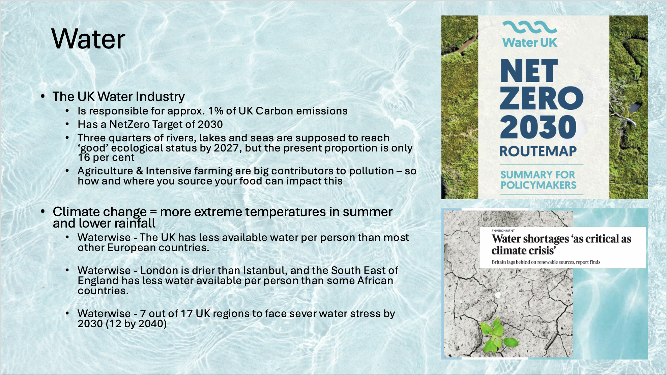

Slide 26
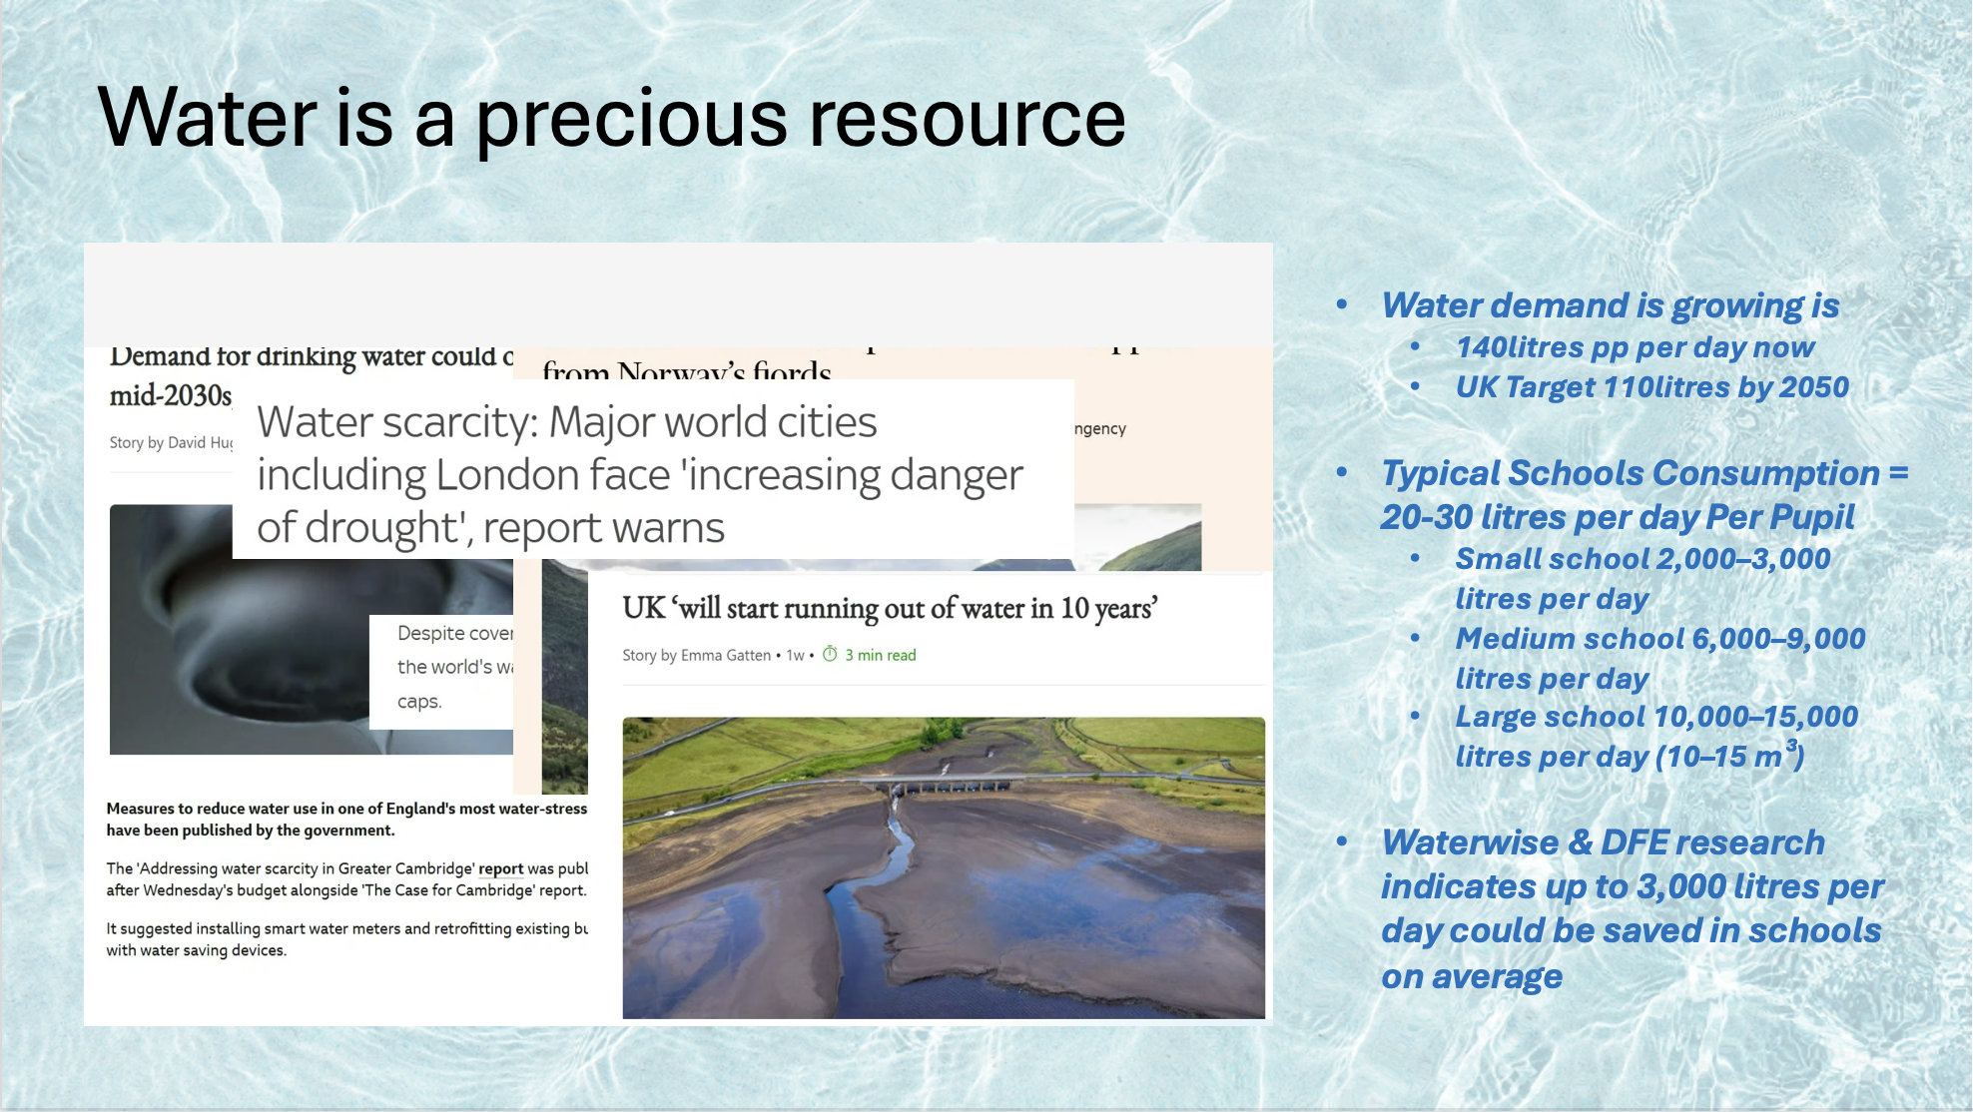

Slide 27
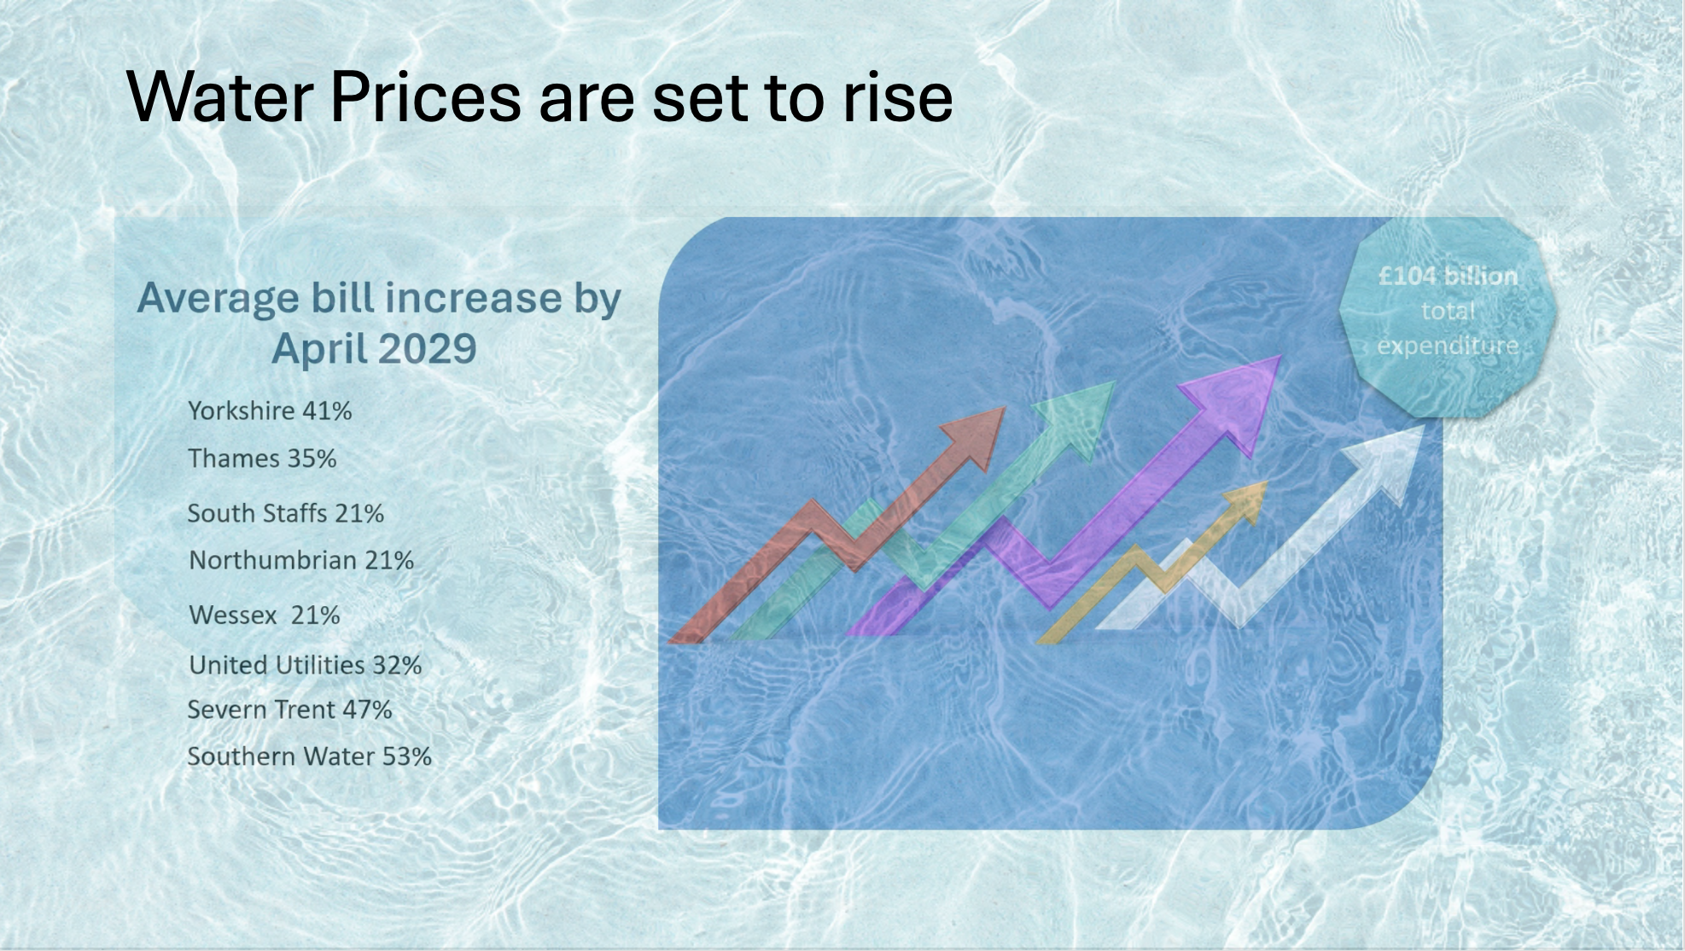

Slide 28
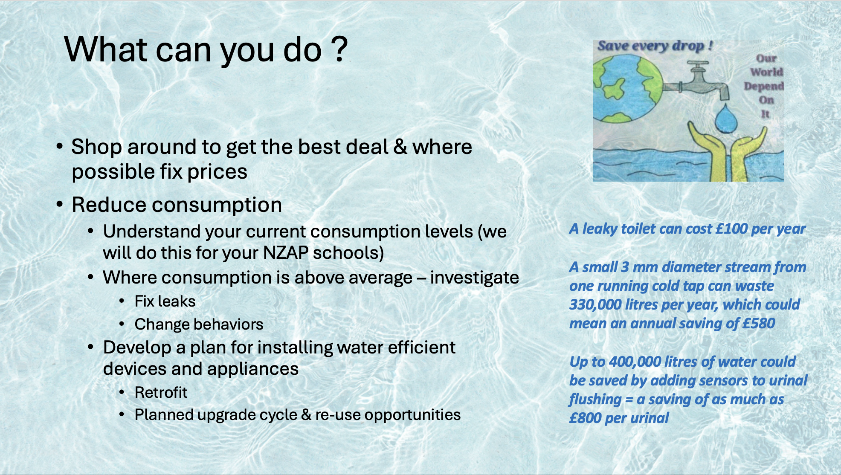

Slide 29
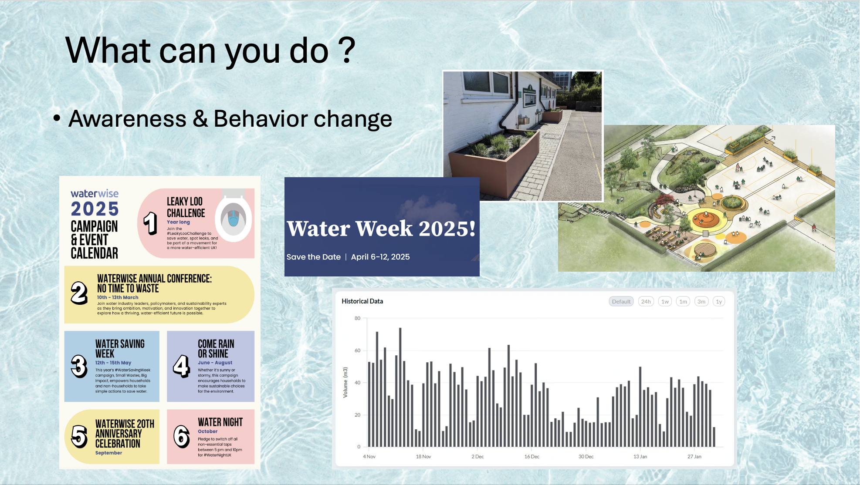

Slide 30
Check in - How are you doing?
Notes:
Take a minute to pause and check in with the group. Acknowledge that this is heavy stuff and uncomfortable to look at. There’s a saying in the climate space that if you’re not scared, you’re probably not paying attention. Sharing how we’re feeling can be very powerful and can give other people ‘permission’ to share their feelings too. How can we at LGZ support each other with climate anxiety? How can schools support students and staff?

Slide 31
Climate Vulnerability
Defined by the 3rd IPCC Report as: "the degree to which a system is susceptible to, and unable to cope with, adverse effects of climate change, including climate variability and extremes”.
ECONOMIC VULNERABILITY
GEOGRAPHIC VULNERABILITY
Notes:
Climate vulnerability as defined by the third IPCC report is "the degree to which a system is susceptible to, and unable to cope with, adverse effects of climate change, including climate variability and extremes”.
The system can be a person a business, a school, a town, or even a country.
And each of those systems will have an economic vulnerability, basically how rich or otherwise that person business town or country is. And it will have a geographic vulnerability depending on where in the world it is.
We are going to have a look at how climate vulnerability varies between countries around the world.

Slide 32




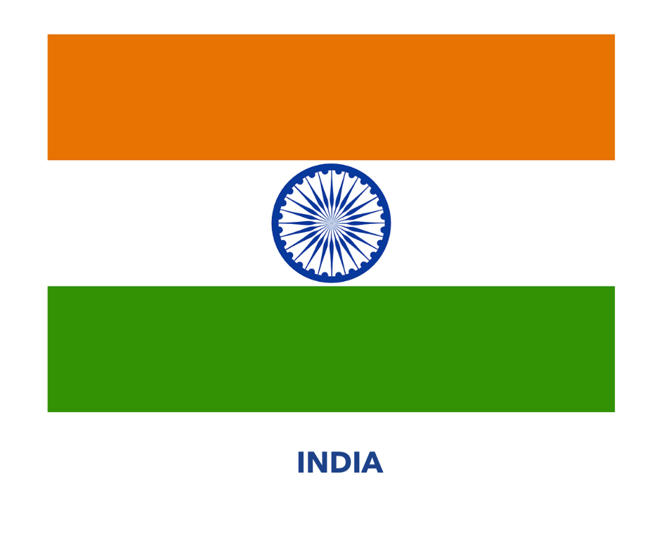
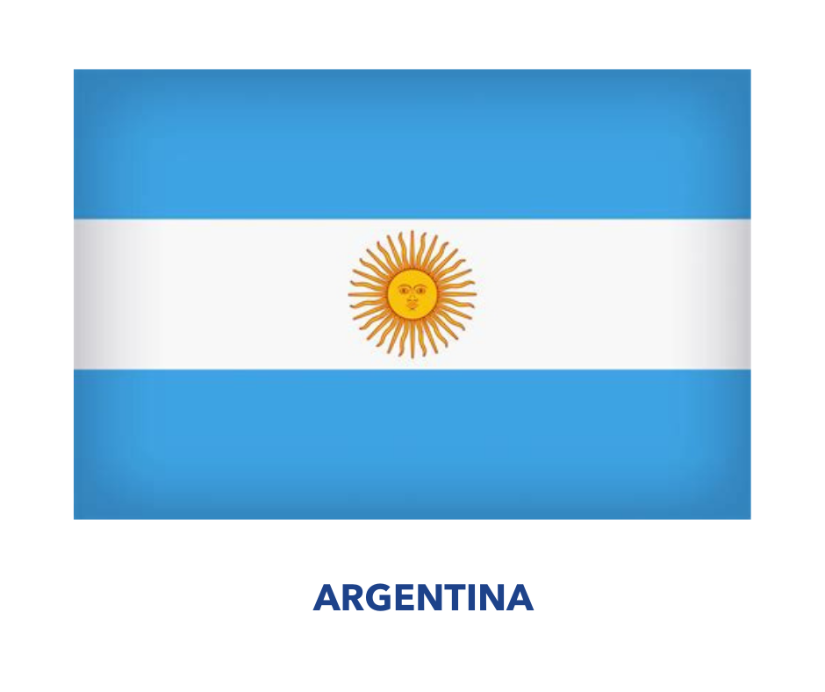


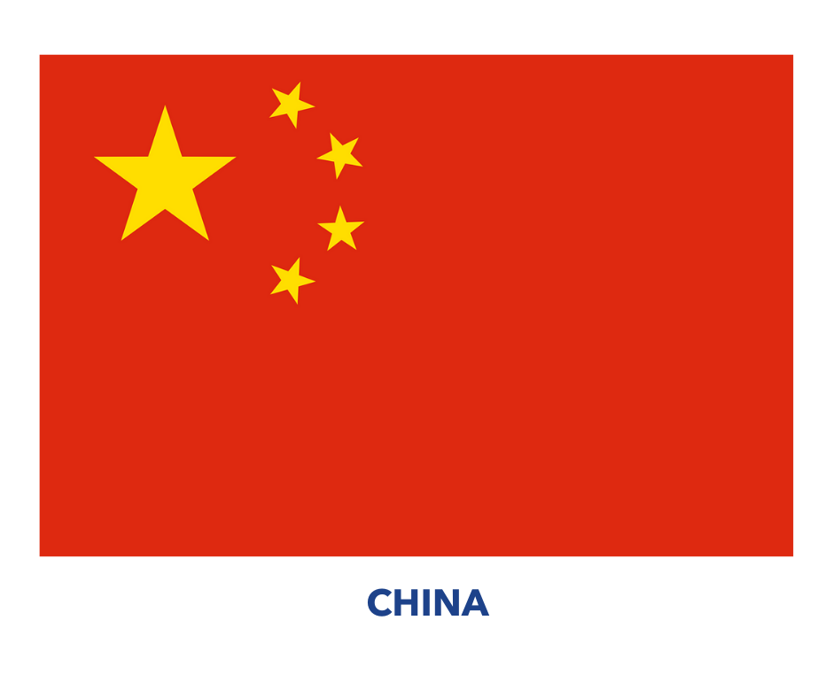
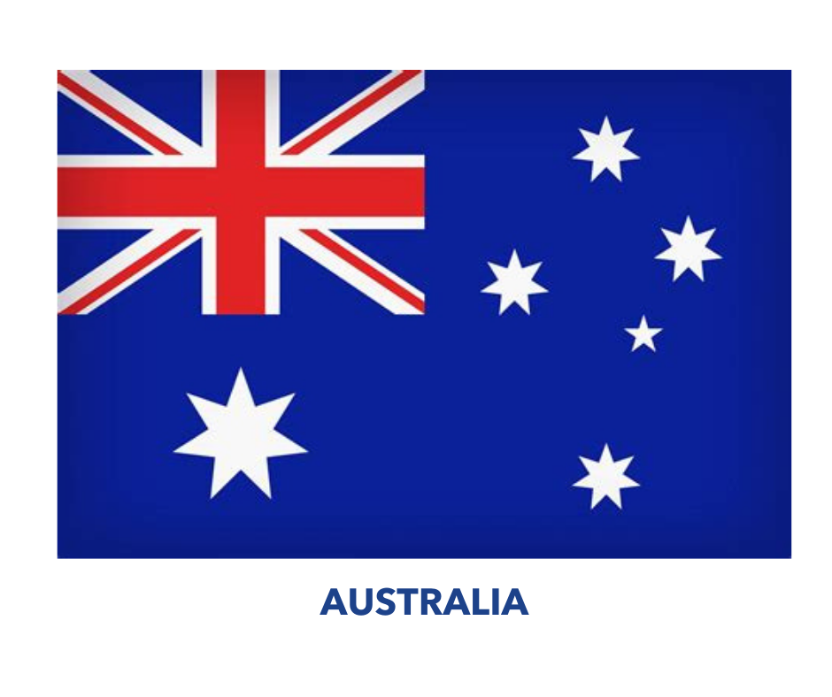

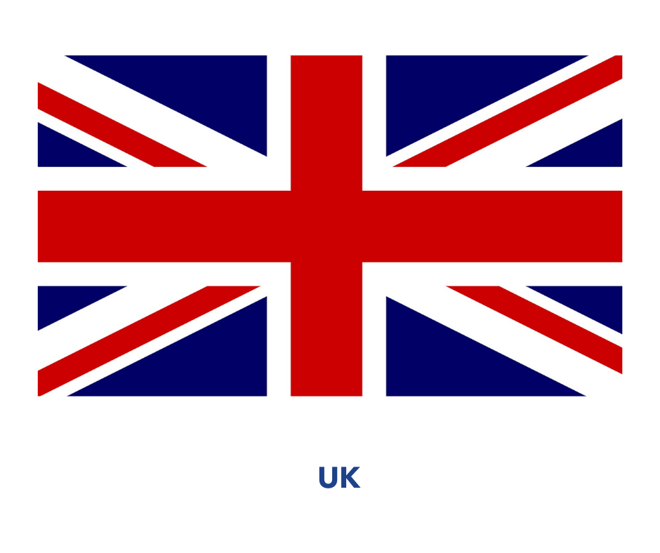
Notes:
We are going to try and rank these countries according to their climate vulnerability, from the country that we think is least vulnerable to the impacts of climate change through to the countries that we think is most vulnerable to the impacts of climate change. Remember that best guesses are very much encouraged. There is no expectation that you will get this activity right! The important thing is taking parts and being made to think a little bit about what contributes to a country's climate vulnerability.
**If delivering in person, we will hopefully have decks of cards you can use – split the group into smaller groups and ask them to re-arrange the cards. If online, there is a whiteboard set up – stop sharing the slides, then share -> Microsoft whiteboards -> CL Module 2 – vulnerability. The whiteboard should come up on the screen. Go round the group – ask the first person to say which country they think is LEAST vulnerable, then the next person to do the next one etc. Move the flags on the board to the positions are each person has their turn. NB Before you stop sharing the slides, the next slide has a map with the countries highlighted!

Slide 33
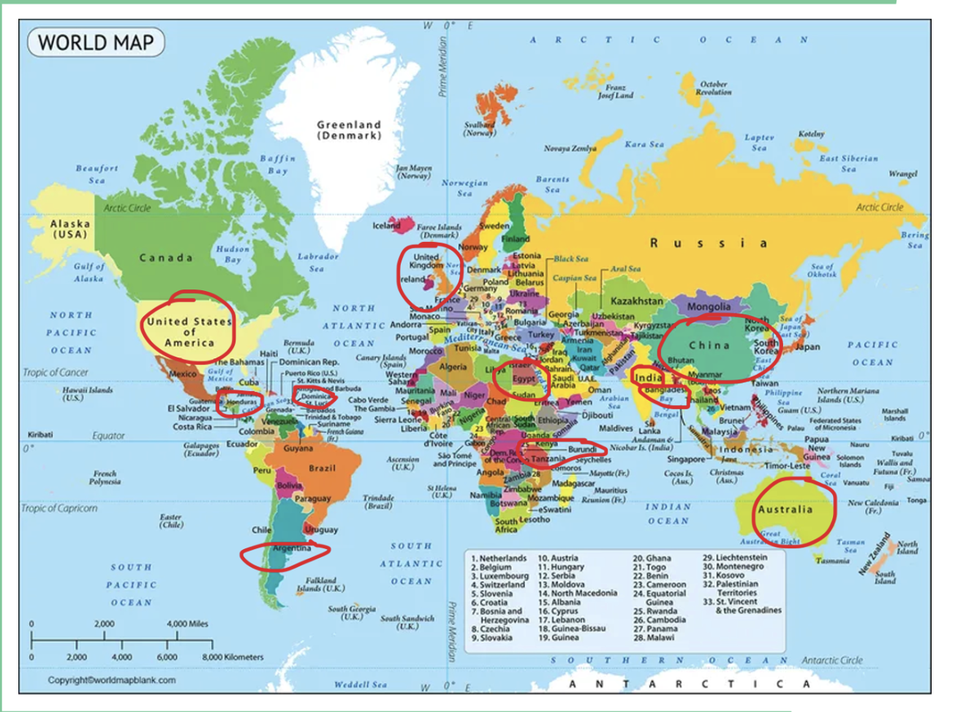
Notes:
For anyone whose geography is as bad as mine, here’s a map showing where the countries are!

Slide 34
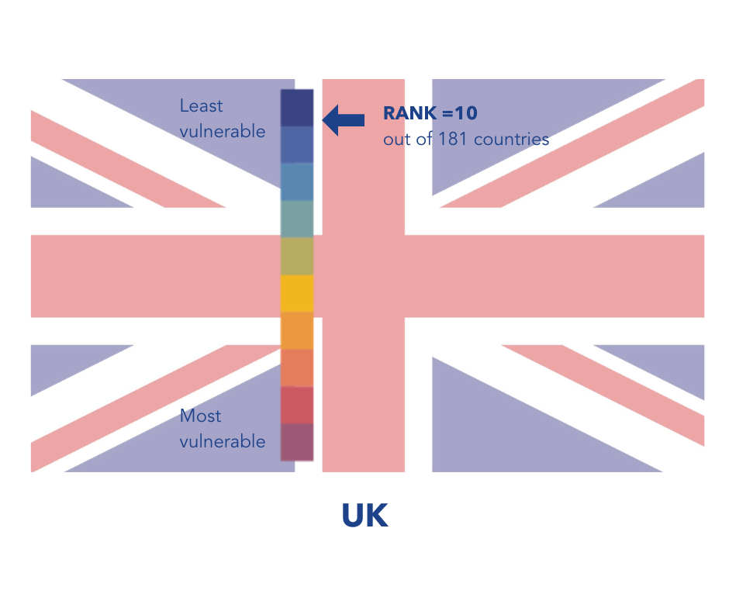
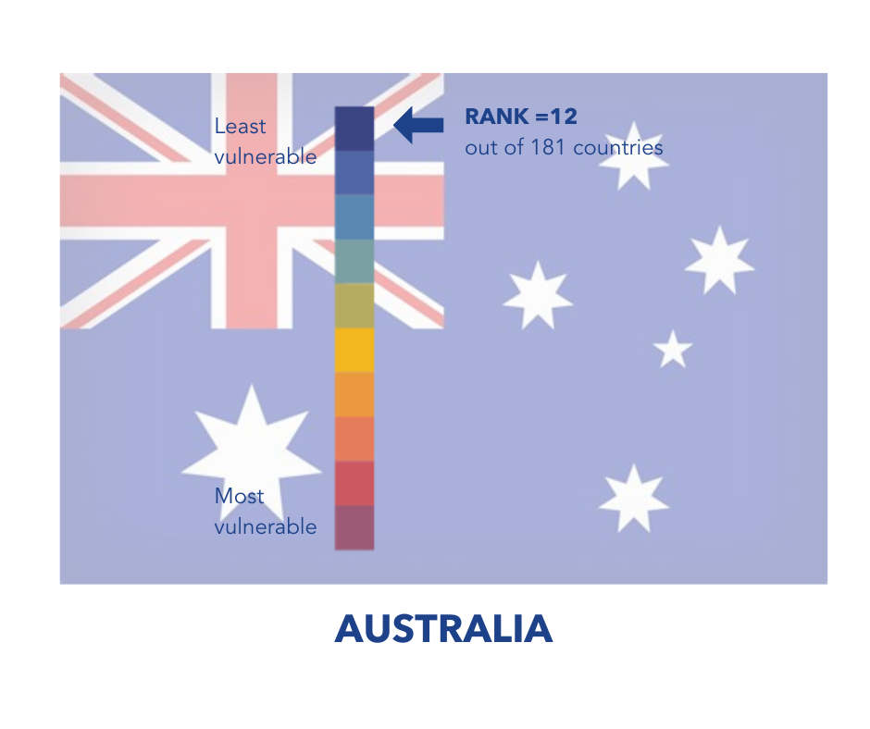
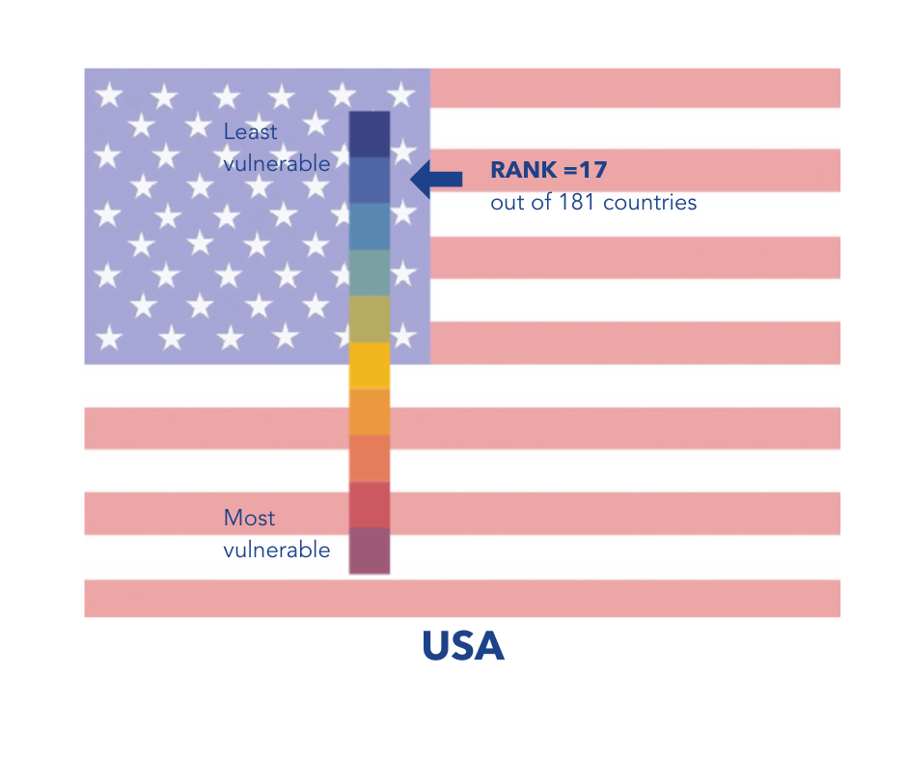
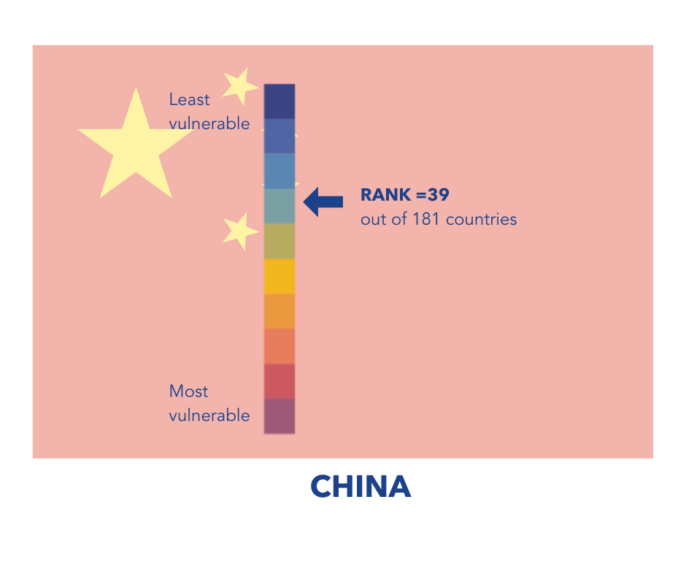
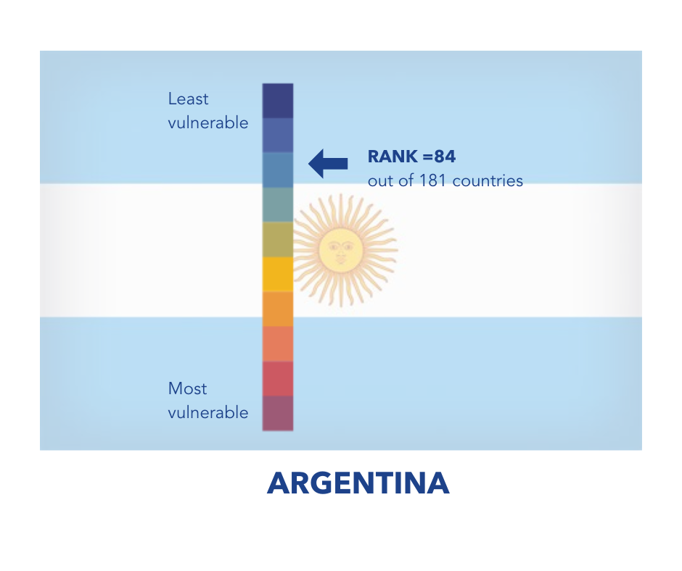
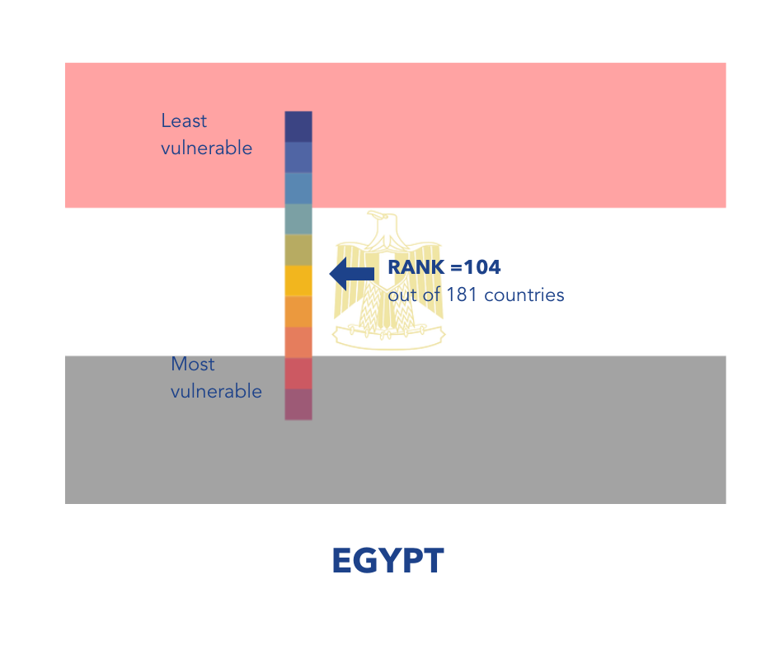
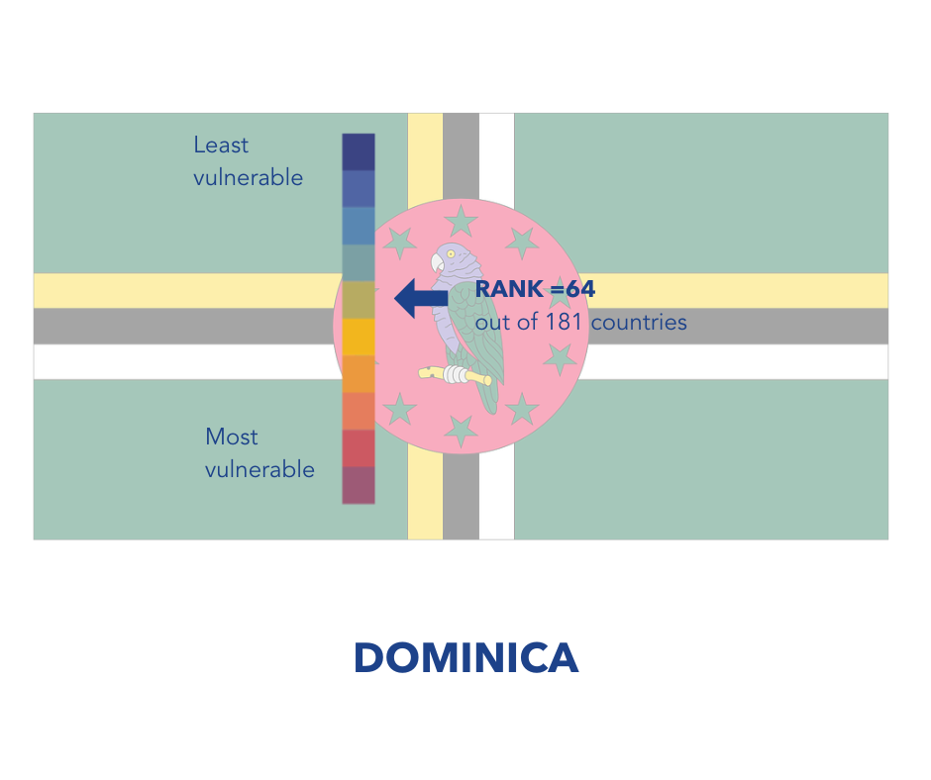
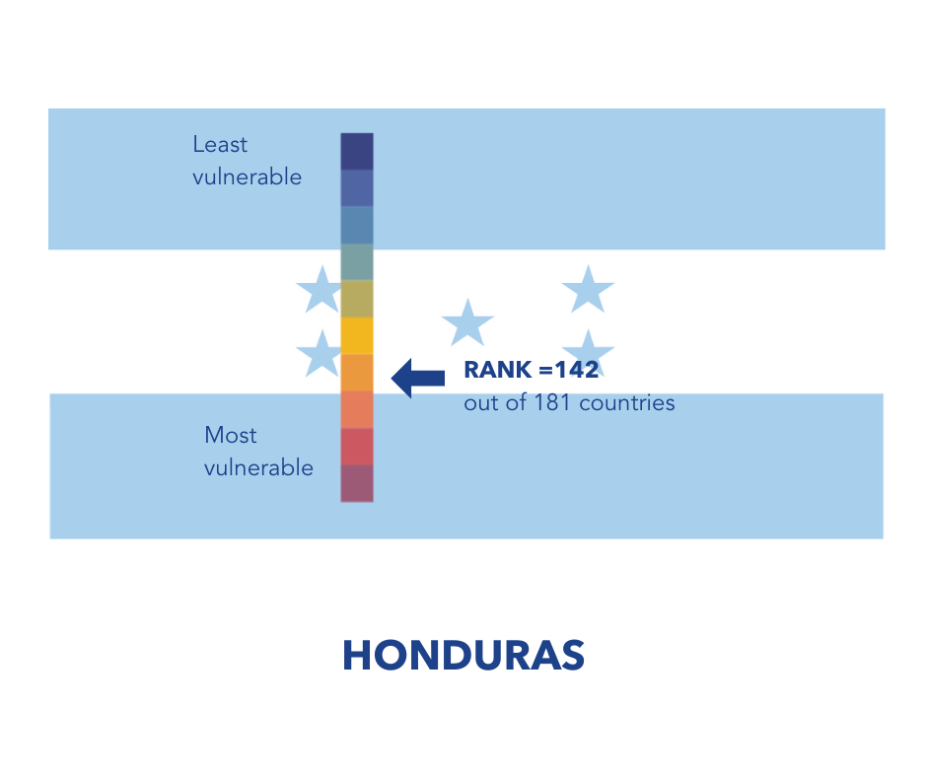
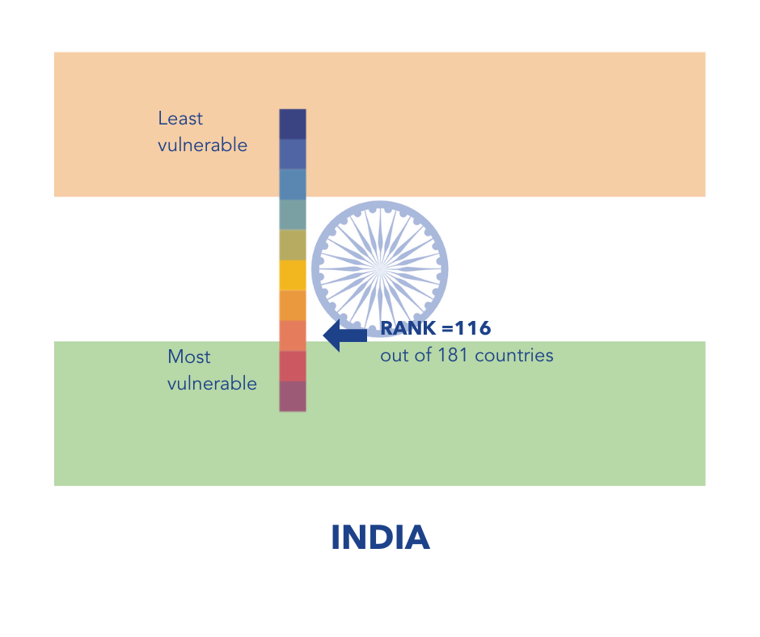
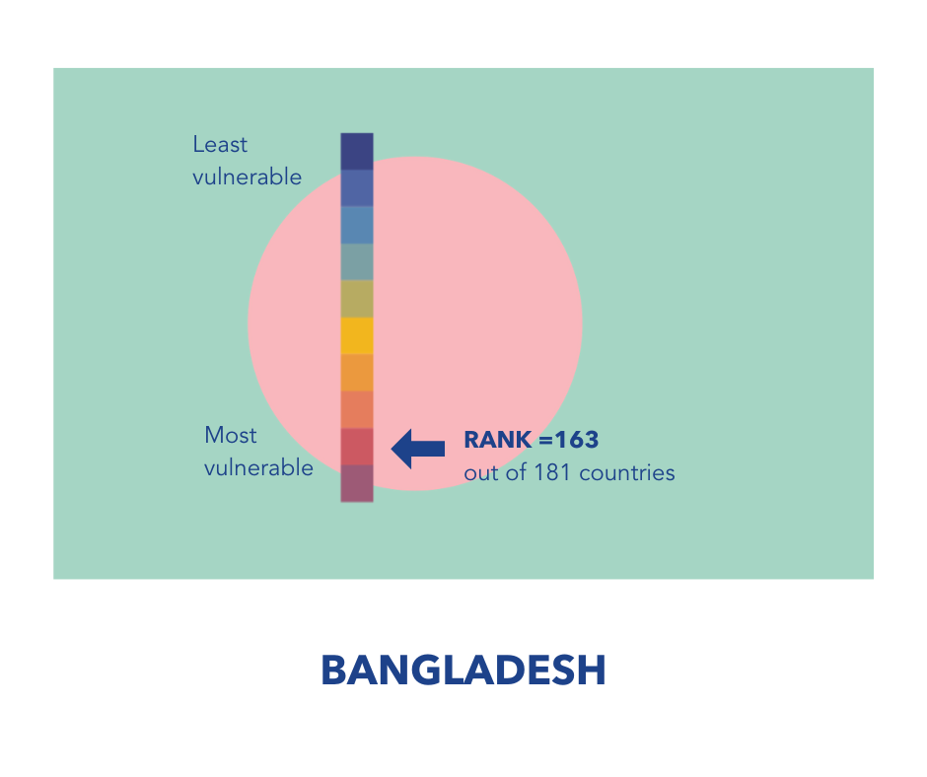
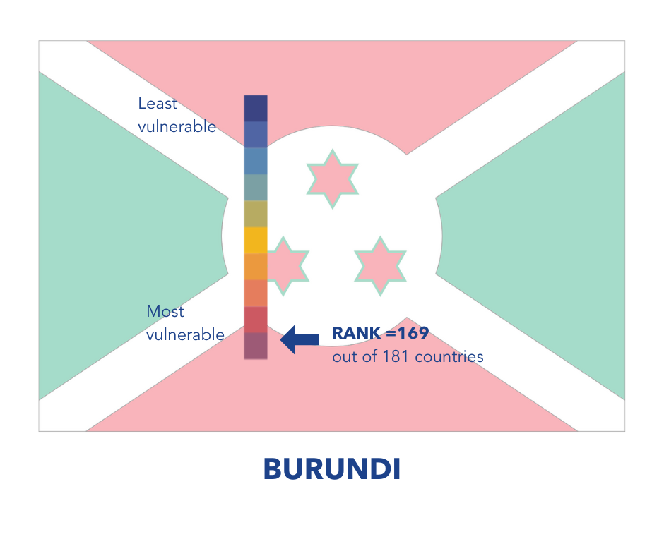
Notre Dame Global Adaptation Initiative // University of Notre Dame (nd.edu)

Slide 35
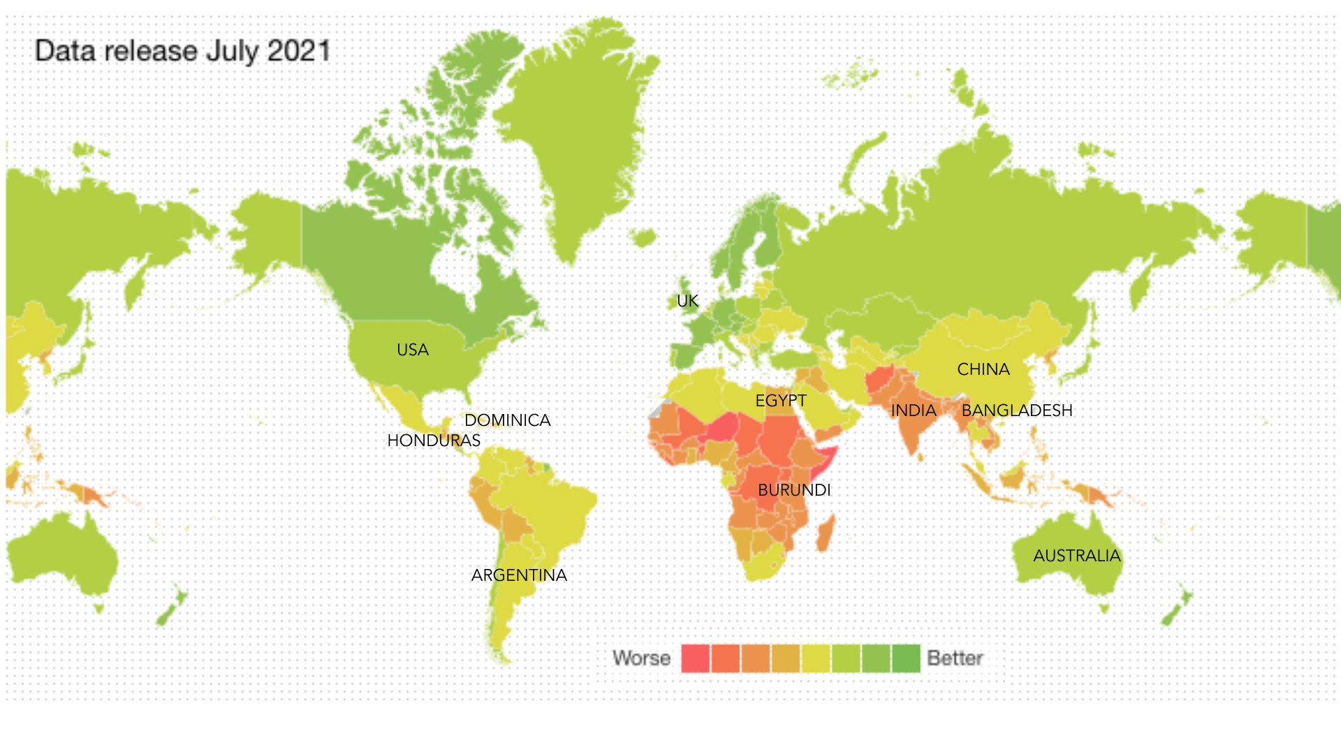
Notes:
If we plot climate vulnerability on a global map, with Reds being most vulnerable to the impacts of climate change, and the dark greens being the least vulnerable to climate change, what is this map showing us about the geographic distribution of climate vulnerability? Answer-countries along the equator are much more vulnerable and there is a clear Global North-South divide. You might sometimes hear people talking about the fact that climate is a race and a social issue – this map is an indicator of that.

Slide 36
Where are emissions coming from?
Notes:
So we now have a better idea of which countries are more vulnerable to the impacts of climate change. We now need to look at where emissions are coming from.

Slide 37
Carbon footprints of countries
Notes:
And to do that we need to look at the carbon footprints of countries.

Slide 38

What actually is a carbon footprint?
“The term carbon footprint is a shorthand to describe the best estimate that we can get of the full climate change impact of something. That something could be anything – an activity, an item, a lifestyle, a company, a country or even the whole world.” Mike Berners-Lee
Notes:
But before we do that we need to understand what we mean by the term carbon footprint. There are lots of different definitions for the term carbon footprint. I think this is one of the best ones, and it is from Mike Berners-Lee, who is essentially the carbon footprinting King and the author of the great book “How bad are bananas?” “The term carbon footprint is a shorthand to describe the best estimate that we can get of the full climate change impact of something. That something could be anything – an activity, an item, a lifestyle, a company, a country or even the whole world.”
If you remember back in module one when we were looking at greenhouse gases and where they come from, we looked at global warming potentials, and I said that most of the time when we use the term carbon footprint, we are using that as a shorthand for greenhouse gas footprint. Scientists have crunched the numbers and looked at all of the different greenhouse gas emissions from a particular object organisation or country, to give a carbon footprint that is expressed as carbon dioxide equivalent, CO2e.

Slide 39
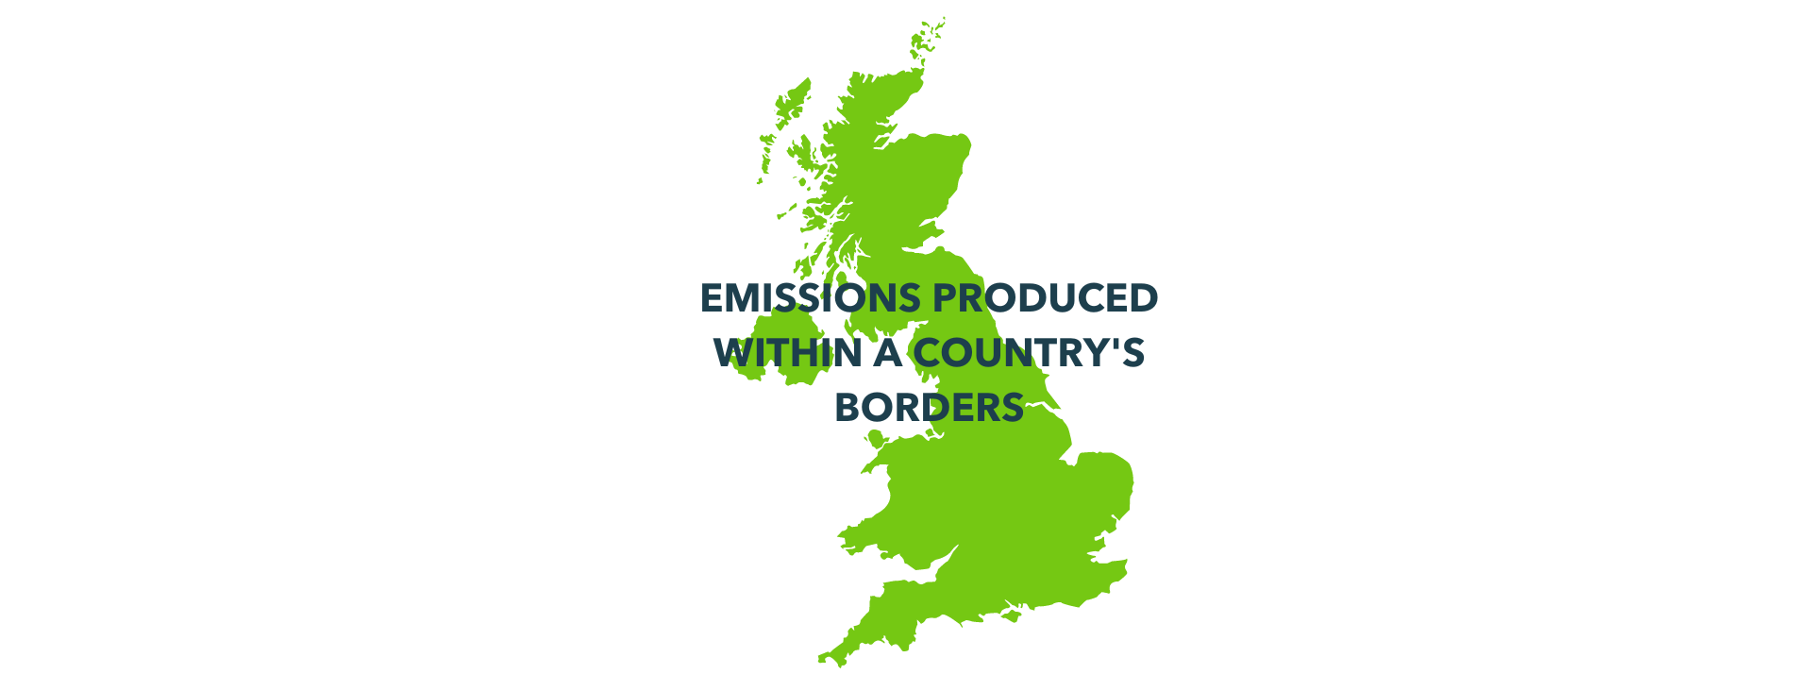
Production based footprints
Notes:
There are lots of different ways of measuring the carbon footprints of different countries. We’re going to look at two, the first one being production based footprints. This is all of the emissions that are created within a country's borders. So for the UK that would be all of our agriculture, transport within our borders, any manufacturing. It doesn't take into account imports and exports. And in this example we are just looking at a total carbon footprint per country, regardless of how many people live there. So we will look at the carbon footprint of the UK as a whole and compare that to the carbon footprint of the USA, or Bangladesh for example.

Slide 40
Notes:
Looking at the countries we looked at a minute ago, which do you think are the three countries with the highest production based footprint? Ask people to write their answers in the chat BUT DON’T PRESS RETURN UNTIL YOU SAY! This is so that people give their own thoughts without being influenced by others! Then do a countdown and ask everyone to press return

Slide 41
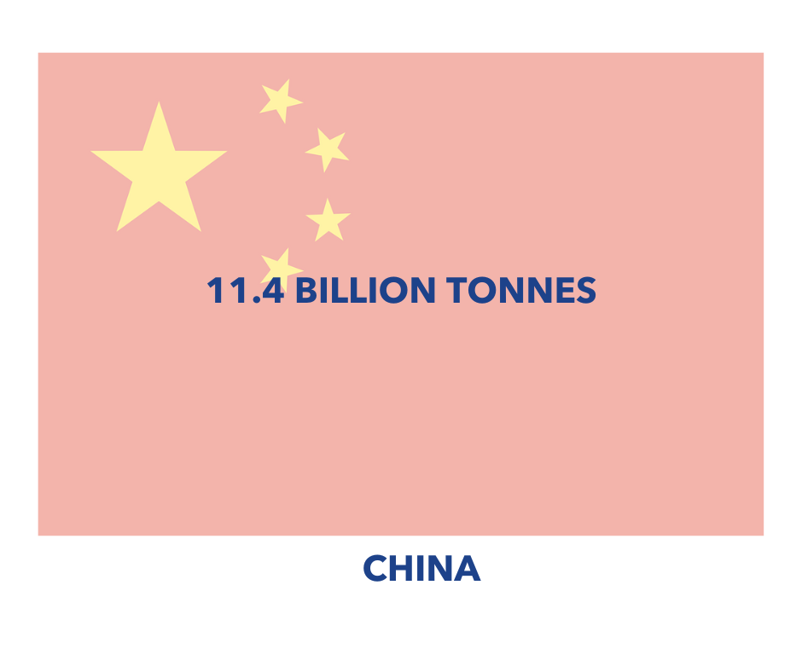
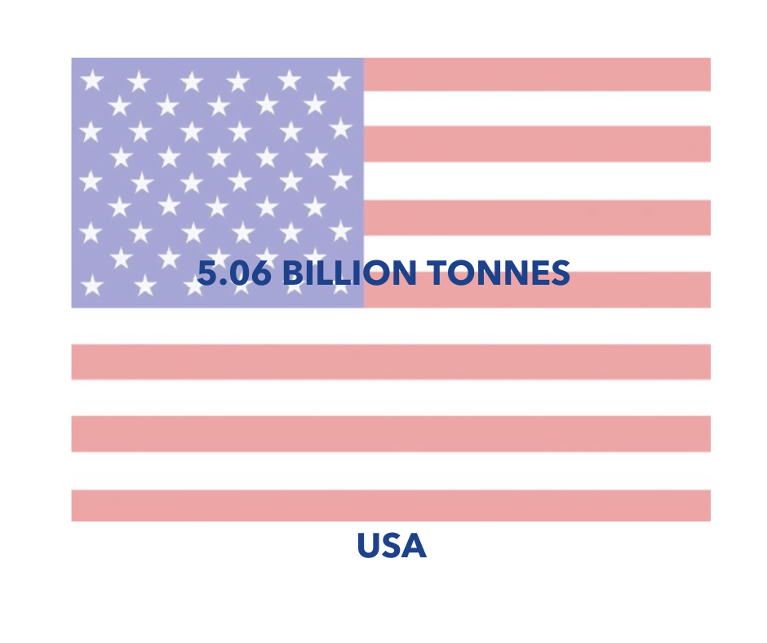
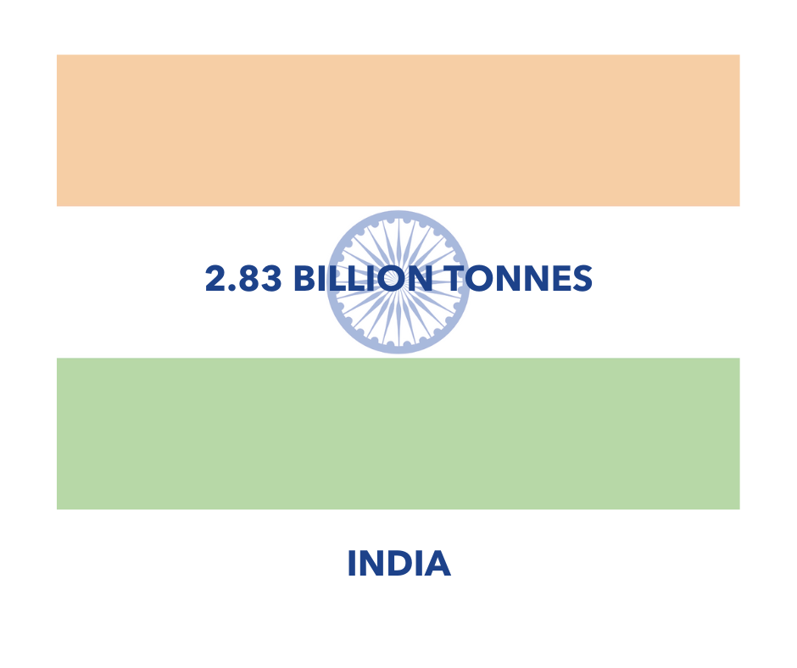
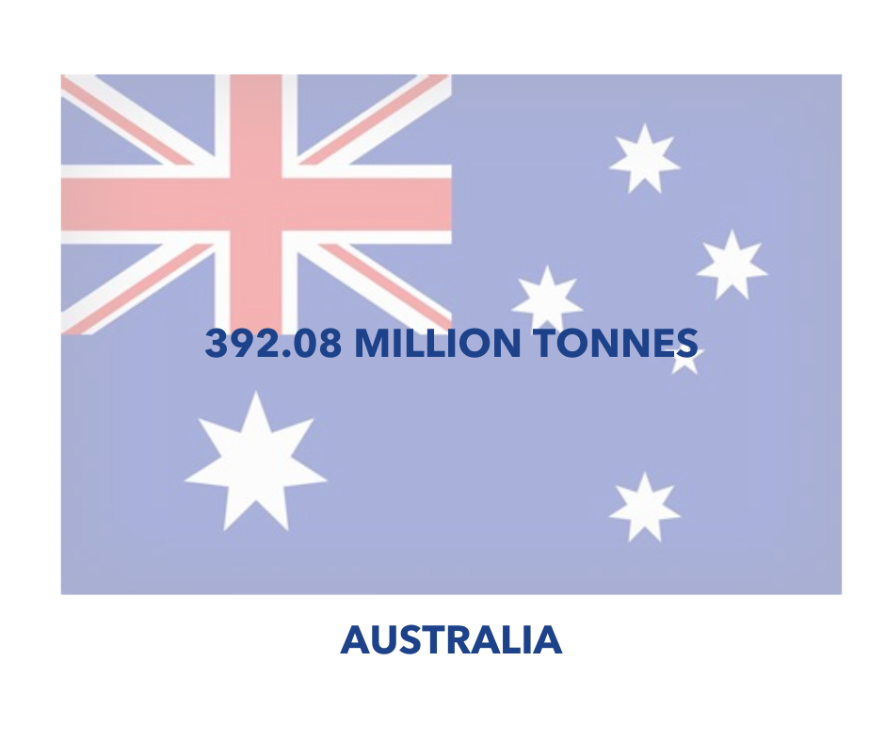
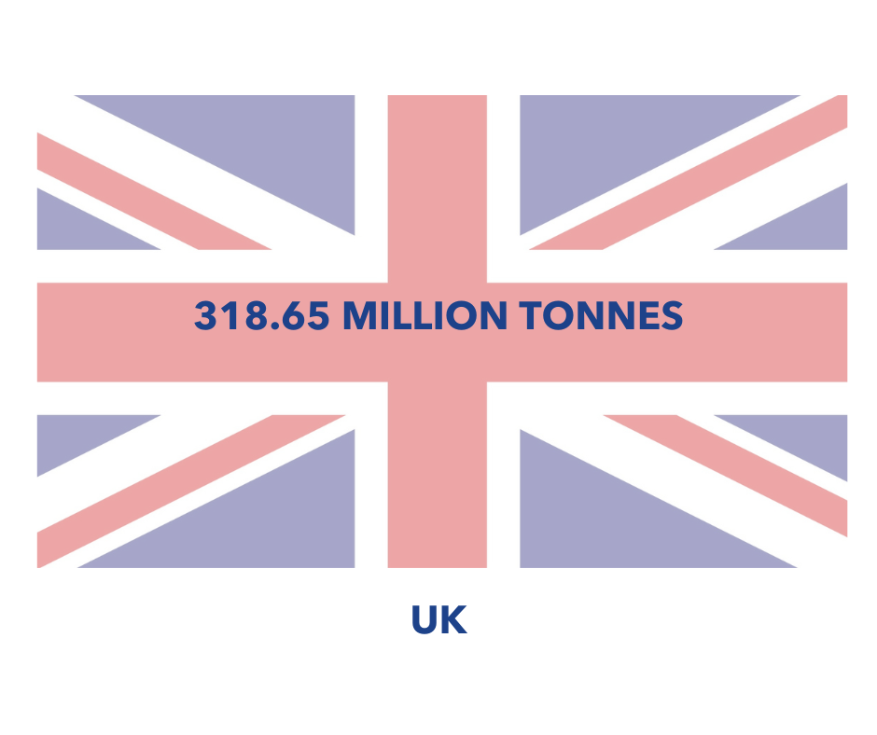
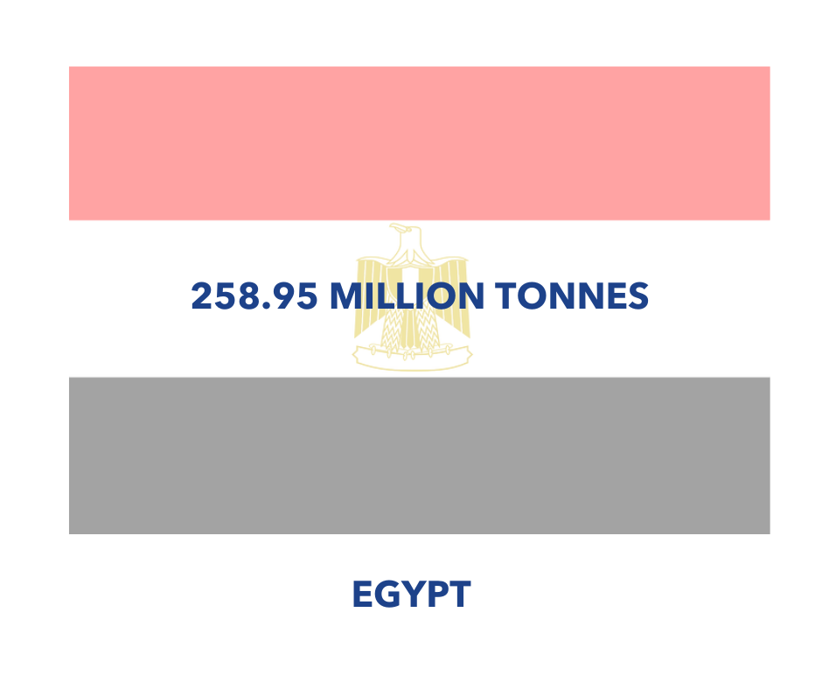
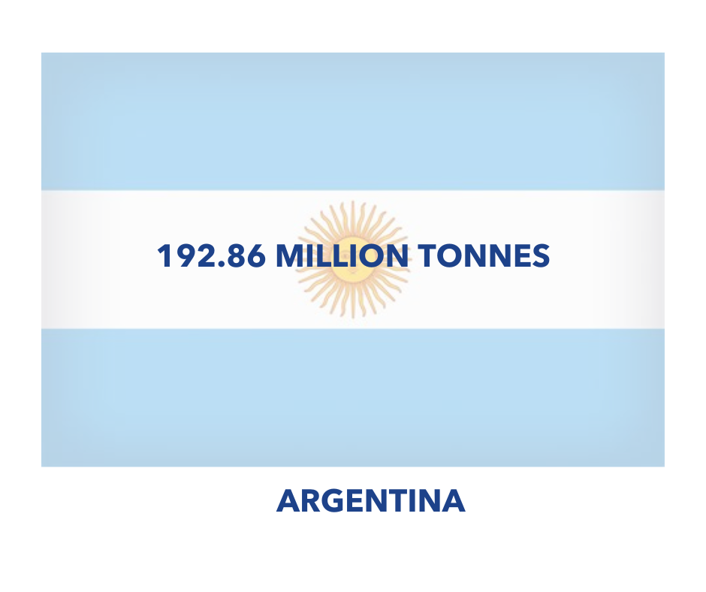
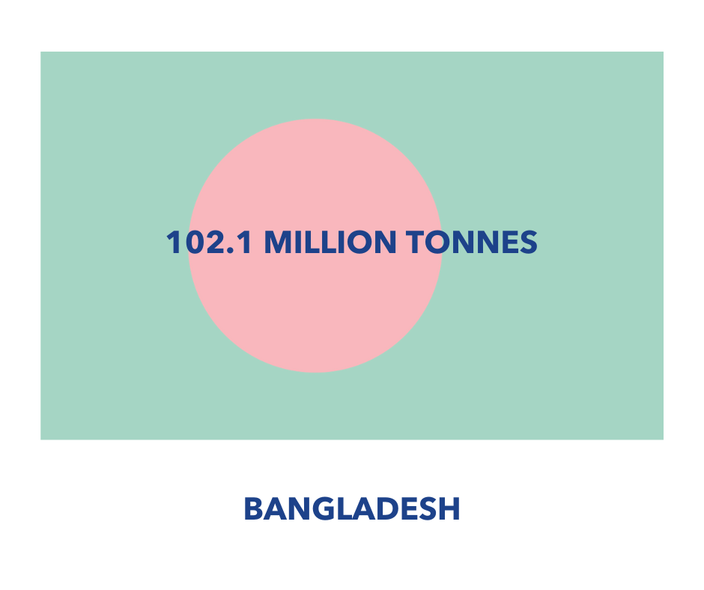
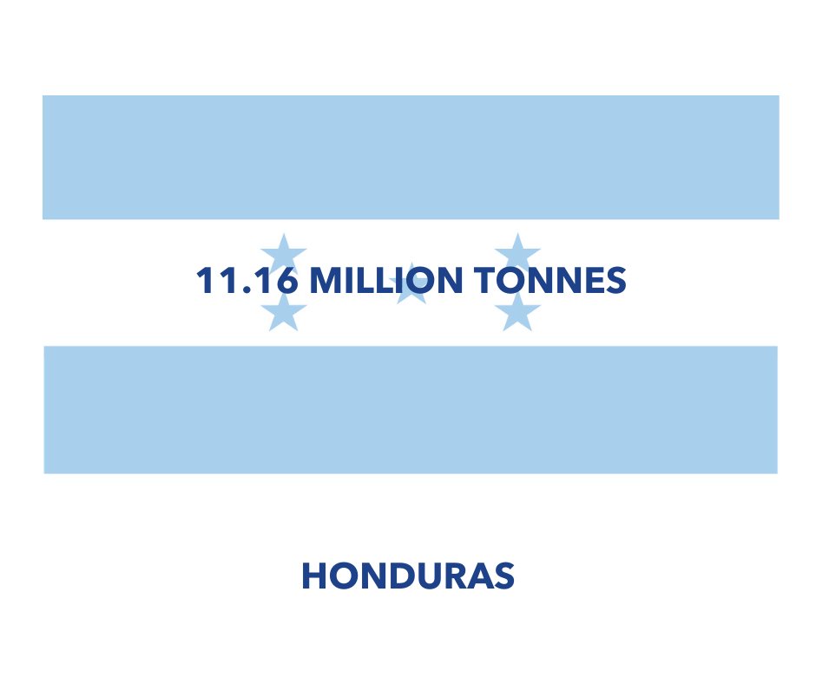
CO₂ emissions - Our World in Data

Slide 42
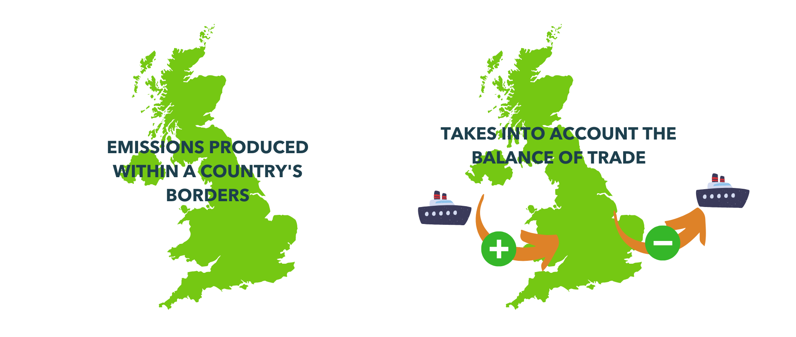
Per capita consumption based footprints
Notes:
Perhaps a fairway to compare countries is to look at their consumption based footprints, so taking into account the balance of trade. And also to do it on a per capita basis. So to take a country's consumption based footprint and divide it by the number of people that are living in that country. This gives us an average carbon footprint for an individual citizen living in that country.

Slide 43
Notes:
Looking at the countries we looked at a minute ago, which do you think are the three countries with the highest average carbon footprint for their citizens? Ask people to write their answers in the chat BUT DON’T PRESS RETURN UNTIL YOU SAY! This is so that people give their own thoughts without being influenced by others! Then do a countdown and ask everyone to press return

Slide 44

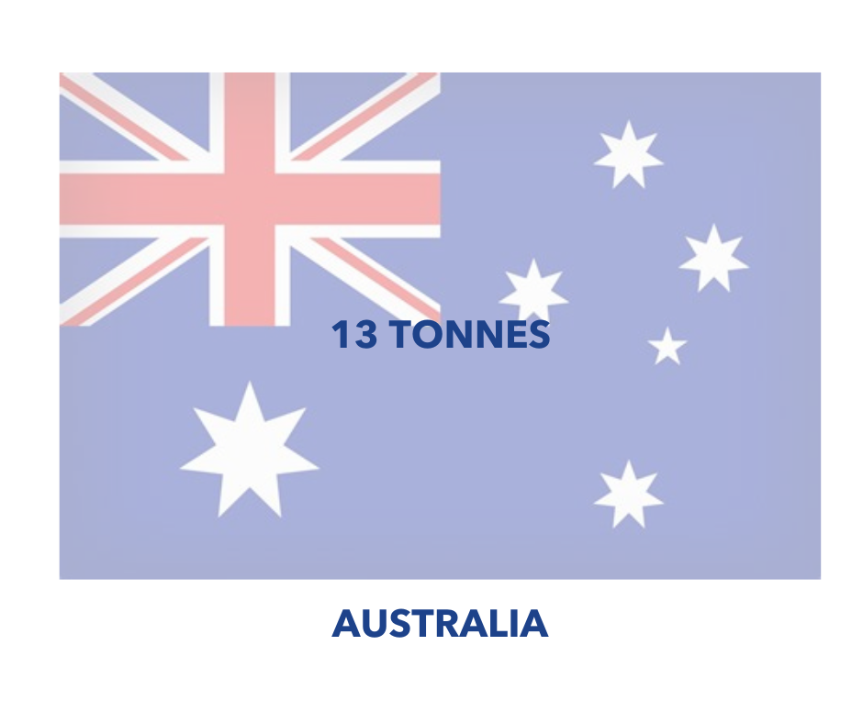

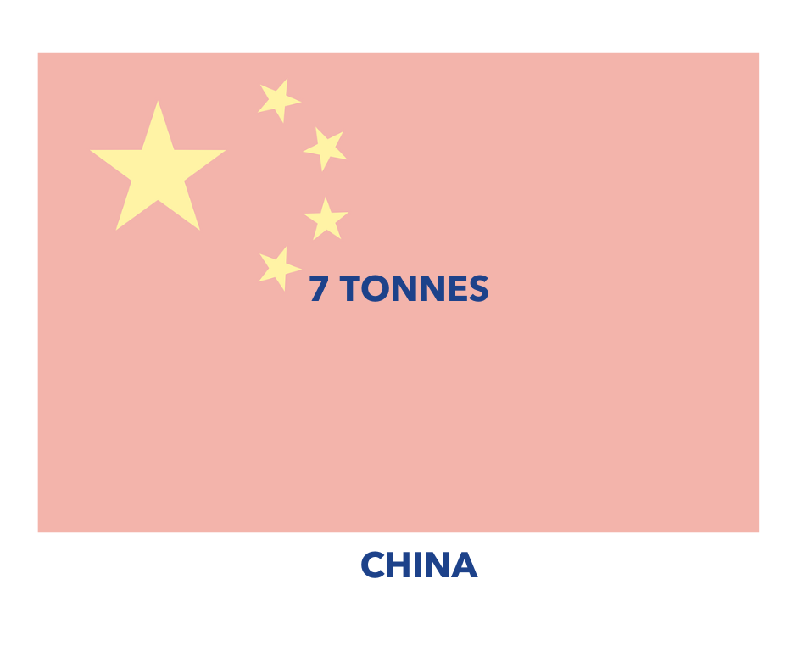
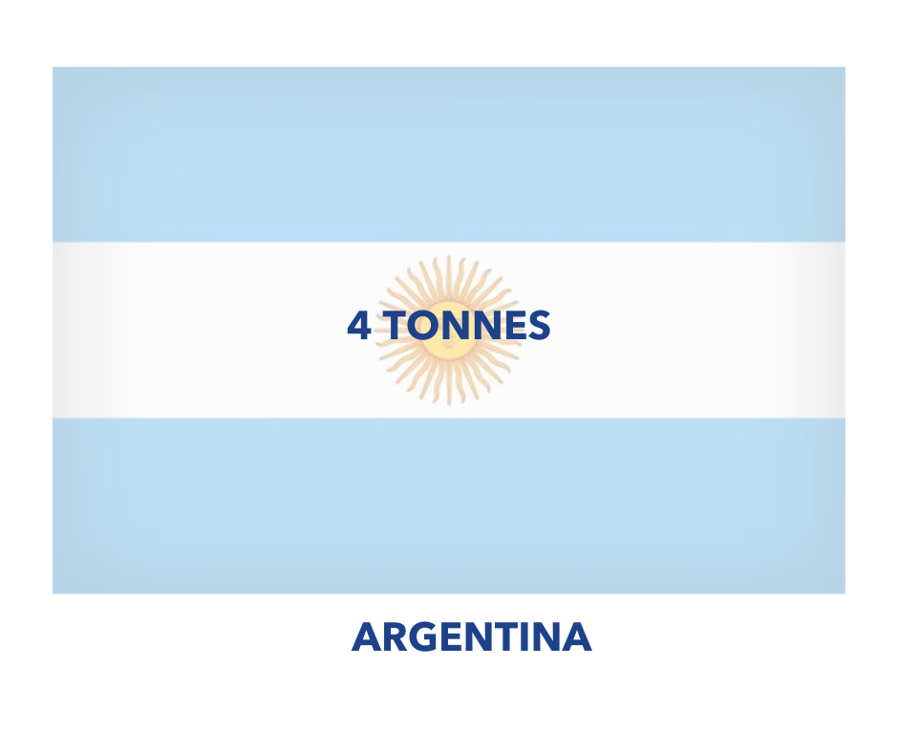
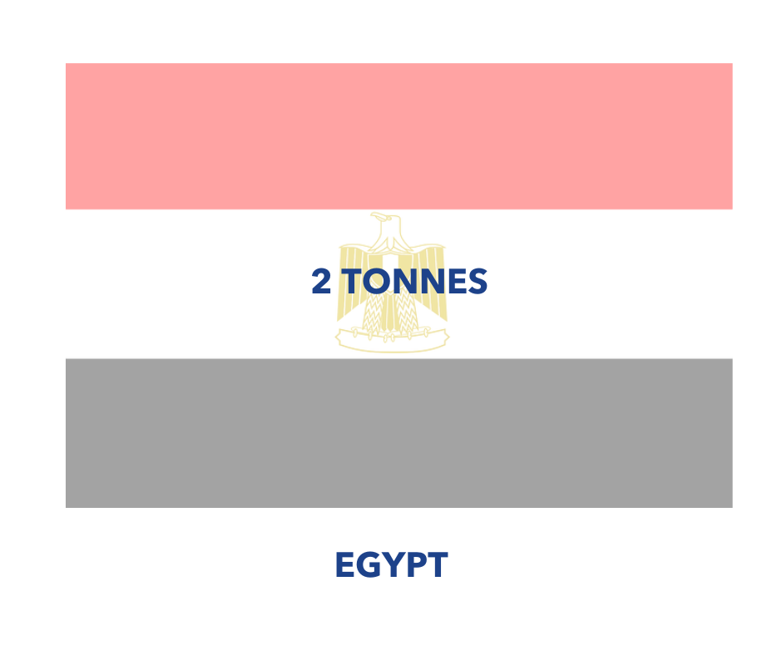
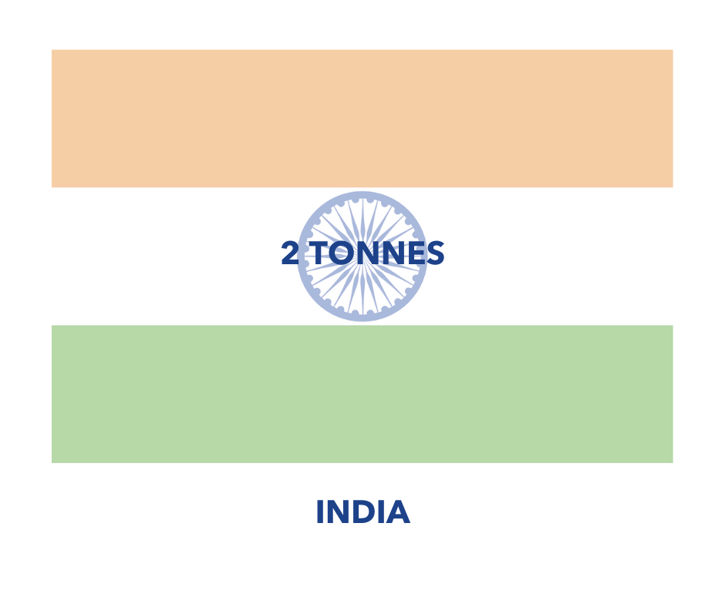
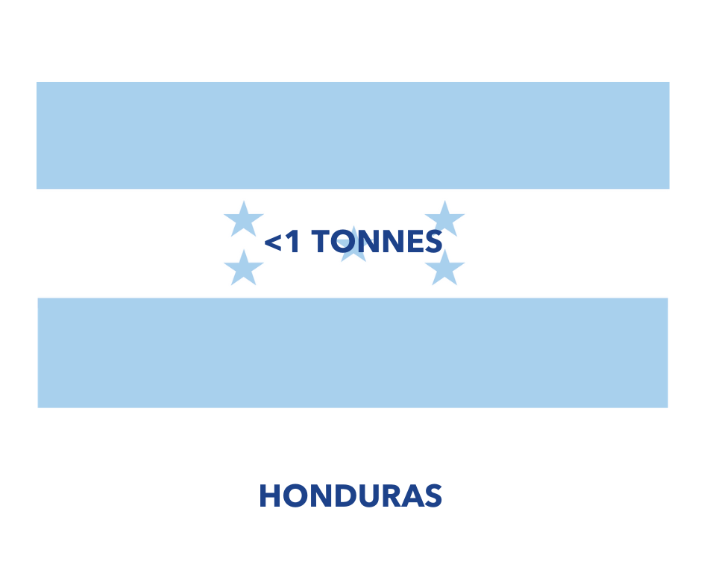
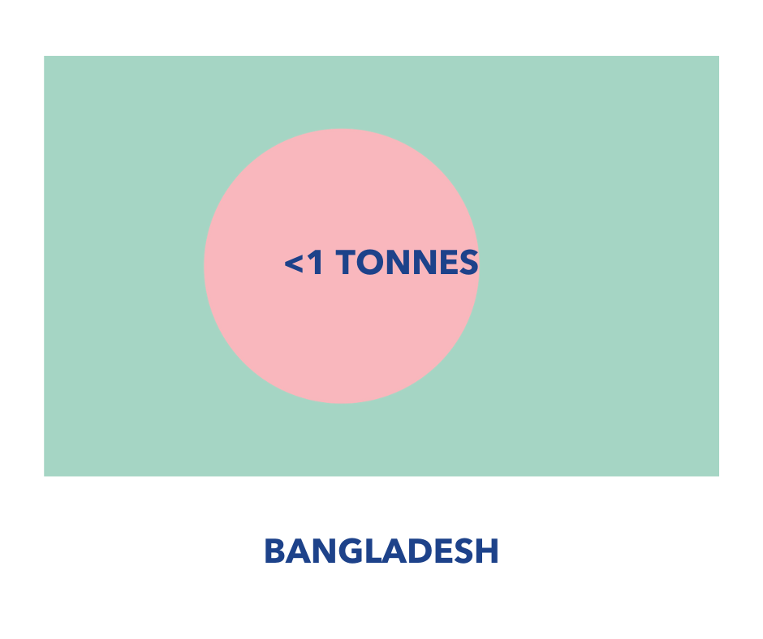
CO₂ emissions - Our World in Data

Slide 45

Cumulative (historic) emissions
Notes:
But that’s not the whole picture, we also need to look at historic, or cumulative, emissions in terms of thinking about ‘who is responsible’? This is a graph from Our World in Data looking at historic emissions and we can see that although China is climbing rapidly, the USA is the largest historic emitter, and obviously as the home of the Industrial Revolution we in the UK were almost solely responsible for emissions in the early 1800s.

Slide 46


Climate justice in three graphs
Notes:
These three graphs quite neatly sum up the idea of ‘climate justice’. We can see that the areas that are most vulnerable (graph on the R) are not the ones that are currently, or have historically emitted the most. It is an interesting thought experiment to think about what would have happened if those emitting the most were worst affected – I think we would have taken far more action far more quickly…

Slide 47

https://www.oxfam.org/en/research/confronting-carbon-inequality
Notes:
And the last piece on this is just to bring it back to a more individual perspective. This is some research from Oxfam, which shows that the world's richest 10% are responsible for almost half of total lifestyle emissions.
The richest 10% of the global population, comprising about 630 million people, were responsible for about 52% of global emissions over the 25-year period, the study showed.
Globally, the richest 10% are those with incomes above about $35,000 (£27,000) a year, and the richest 1% are people earning more than about $100,000. In 2015, around half the emissions of the richest 10 percent - people with net income over $38,000 - are linked to citizens in the US and the EU The richest 10 percent of households use almost half (45 percent) of all the energy linked to land transport and three quarters of all energy linked to aviation. The world’s richest 1% (approx. 63 million people) cause double CO2 emissions of poorest 50% (3.1 billion people) , says Oxfam. You’re in the world’s richest 1% if you earn over around £100-120k ayear, so we might all know someone in that 1%. Yes the super rich have a huge and disproportionate impact, and this slide isn’t shown to make us all feel guilty, but just to reflect that effectively the richer you are, the bigger your carbon footprint is (whether that’s as an individual, a business or a country) and there is a strong argument that therefore you have a bigger responsibility to take action.

Slide 48
Check in - How are you doing?
Notes:
Take a minute to pause and check in with the group. That's quite a lot to take on board and is often something that we haven't really given much thought to before. It is an uncomfortable realisation that our lifestyles in developed countries like the UK are having such negative consequences on countries, communities, and people in the global South who have contributed very little to the problem. Remembering the phrase “Think global, act local” can be useful when it comes to dealing with the overwhelm that can result from thinking about the negative consequences of our own actions. Being aware of the global impact of our choices, and looking to see what different choices we can make locally, whether that's in our own homes and households, in our communities, or in our schools

Slide 49
Individual carbon footprints
Notes:
We've looked at countries carbon footprints, so now what about ours? Before we dive into this it is worth pointing out that some people in the climate space really dislike the idea of individual carbon footprints. They were apparently popularised by BP in the early 90s as a very deliberate campaign to divert attention away from their own operations and enormous emissions, and to put the focus onto individuals.
Having said all of that, I do think the’re incredibly useful because our emissions are invisible, and it can be very difficult to join the dots between the choices that we're making and the impact that they're having. A carbon footprint calculator is one way of helping us to do that. Simply by asking the questions it helps us to join the dots, and simply by measuring our footprint we very often start to take action as a very natural next step. They're also a great way of seeing that we're moving in the right direction. Before we dive into this, it’s worth pointing out that some people in the climate space really dislike the idea of individual carbon footprints. They were apparently popularised by BP in the early 90s as a very deliberate campaign to divert attention away from their own operations and enormous emissions, and to put the focus onto individuals.
Having said all of that, I do think the’re incredibly useful because our emissions are invisible, and it can be very difficult to join the dots between the choices that we're making and the impact that they're having. A carbon footprint calculator is one way of helping us to do that. Simply by asking the questions it helps us to join the dots, and simply by measuring our footprint we very often start to take action as a very natural next step. They're also a great way of seeing that we're moving in the right direction.

Slide 50
What is the average carbon footprint for someone living in the UK?
4.85 tonnes CO2e
8 tonnes CO2e
9-10 tonnes CO2e
13 tonnes CO2e
Notes:
What is the average carbon footprint for someone living in the UK?
4.85 tonnes? 7.71 tonnes? 9 to 10 tonnes? 13 tonnes? What is the average carbon footprint for someone living in the UK?
4.85 tonnes? 7.71 tonnes? 9 to 10 tonnes? 13 tonnes?
The answer is they are all right depending on how you measure it! 4.85 tonnes is the average footprint you get when you divide the UK's production based footprint by the number of people living here.
7.71 tonnes, some of you might remember seeing this on the flag in the previous exercise, is the number you get when you divide the UK's consumption based footprint by the number of people that live here.
9 tonnes is the figure used by Giki, which is a carbon footprinting platform that we will look at in just a little minute. Some people talk about a 10 tonne average footprint, as it's a nice round number and easy to work out percentages with. And Mike Berners-Lee, the author of “How bad are bananas?”, talks about the average UK footprint being 13 tonnes.
Mike Berners-Lee gives everybody in the UK a proportion of the MOD's carbon footprint, the NHS’s carbon footprint, the education system’s carbon footprint etc. Whereas Giki decided not to do that, I think on the basis that there is little that we can do as individuals to reduce those particular components of our carbon footprint.

Slide 51


10 tonnes CO2e is the same as….
5 return flights from London to New York
Driving nearly 1.5 times around the world in a Ford Focus
OR
Notes:
One of the problems that we have when we talk about carbon footprints and we expressed them in tonnes of carbon dioxide equivalent is that that means nothing to most of us.
There are lots of different ways of trying to visualise what a tonne of carbon dioxide looks like. But what is often easier is to equate our carbon footprints to things that we are more familiar with. So for example a banana has a carbon footprint of 110g of CO2e a cheeseburger has a carbon footprint of 3.2kg of CO2e. Driving a ‘fairly thirsty petrol car’ for 1000 miles has a footprint of 1.3 tonnes of CO2e. And a return flight from London to somewhere like Hong Kong or Singapore has a carbon footprint of four and a half tonnes of CO2e. If we were to use the Giki 9 tonne average carbon footprint per year we can see that one return flight for a holiday or a business trip could easily be half of the average annual individual carbon footprint.

Slide 52
Your carbon footprint
Notes:
Hands up or let us know in the chat if you have ever had a go at measuring your own carbon footprint. .

Slide 53


www.footprint.wwf.org.uk
www.zero.giki.earth
Notes:
There are lots of different carbon footprint calculators available. And they will all give you a different number! Depending on the methodology they use and what they include. These are two of the more commonly used ones.
The carbon footprint calculator from the World Wildlife Fund is perhaps the most commonly used carbon footprint calculator. It is quick and relatively easy but has its limitations in the level of detail that it goes into.
Giki is another carbon footprint calculator. When you first go in you put in some basic details, and then you can go back in and add in much more granular information, for example you can add in your details on your electricity usage, your gas usage, your water usage, how much rubbish you throw away, how much meat you eat, whether you have pets etc etc
It is worth pointing out that some people in the climate space really dislike the idea of individual carbon footprints. They were apparently popularised by BP in the early 90s as a very deliberate campaign to divert attention away from their own operations and enormous emissions, and to put the focus onto individuals.
Having said all of that, I do think the’re incredibly useful because our emissions are invisible, and it can be very difficult to join the dots between the choices that we're making and the impact that they're having. A carbon footprint calculator is one way of helping us to do that. Simply by asking the questions it helps us to join the dots, and simply by measuring our footprint we very often start to take action as a very natural next step. They're also a great way of seeing that we're moving in the right direction. How might you be able to use these tools to engage students and colleagues?

Slide 54


Notes:
Both the WWF calculator and Giki will give you a score, they will compare you to the UK average, and I think compare you to the global average. They will both also give you a breakdown of the areas of your life that are contributing the most to your carbon footprint. This information can be useful when we start to think about the big impact actions that we can take to reduce our own carbon footprint.
In Mike Berners-Lees' book “How bad are bananas?” he breaks down the average UK carbon footprint and it works out that roughly 1/4 of our emissions come from food, roughly 1/4 from home and accommodation, just over 1/4 from travel and transport, and just under 1/4 for “everything else”.

Slide 55
But your impact is about more than just your carbon footprint…
Notes:
But just as important as our carbon footprint, but not talked about anywhere near as often, is the idea of our climate shadow.

Slide 56

Enter: the “climate shadow”, a concept that I created to help each of us visualize how the sum of our life’s choices influence the climate emergency. Think of your climate shadow as a dark shape stretching out behind you. Everywhere you go, it goes too, tallying not just your air conditioning use and the gas mileage of your car, but also how you vote…where you work, how invest your money, how much you talk about climate change, and whether your words amplify urgency, apathy, or denial.”
The power or your climate shadow is that, unlike a carbon footprint, it includes actions that defy easy calculation (which as Greta’s #FridaysforFuture strike showed us, almost all high impact actions do). The climate shadow also includes contagious behaviors, like installing solar panels, giving up flying, or talking about climate change in everyday conversation.”
Notes:
Emma Pattee wrote about this concept of the climate shadow in an article on Medium and describes it as this: *Read out*
I think it's incredibly powerful and is a great way of helping us to think about the impact of the things that cannot be quantified and measured - I have yet to find the box on Giki to tick if I was Greta that says “started a global climate movement that mobilised millions of people”. This action will have done absolutely nothing to reduce Greta's carbon footprint but her climate shadow and her impact is enormous. Think back to those spheres of influence we looked at it Module 1 – how can you grow you shadow within your sphere’s of influence?

Slide 57
School carbon footprints
Notes:
We've looked at countries footprints, we've looked at individual carbon footprints, now we're going to have a quick look at school carbon footprints. For context, the school estate is the largest emitter of CO2 in the whole public sector at around 37% of public sector emissions.

Slide 58


XXX Primary School’s Count Your Carbon score
Total score: 383.72 tonnes CO2e. (updated with HDP data) This equates to approximately 0.99 tonnes CO2e per pupil. The average for a primary school from our data set is 1.1 tonnes CO2e per pupil.

Slide 59
Agenda
Workshop One - Getting Started
Carbon footprinting
Saving energy:
Workshop Two – The Science - Climate science 101 - Talking climate
Workshop Three - The Impact - Climate impact
- Adaptation and risk
- Carbon footprints
Workshop Four – The Future - What action has been taken
- Looking ahead
- Carbon Literacy Pledges

Slide 60
Questions?
Notes:
Any questions about anything we’ve covered today? I’m aware that we cover a lot in each session, and that we go quite quickly, so please do shout if there’s anything you’re unsure of. Optional – you can ask people to share three words in the chat for how they’re feeling after the first session. OR ask them to share one ‘takeaway’ from the session

Slide 61
Funding opportunities
https://www.stormsaver.com/about-stormsaver-and-water-reuse/rainwater-harvesting-news/suds-for-schools-
https://buyingforschools.blog.gov.uk/2023/12/04/sustainable-drainage-systems-for-schools-environmentally-friendly-flood-prevention/
https://www.susdrain.org
Free Trees for Schools and Communities - Woodland Trust
Applications are expected to close in August 2025
carbonfootprint.com - School Tree Application
You can make your application at any time so that you can be considered for our next order of trees. There is no closing date.
Trees for Schools, Apply for Free Trees
The planting season usually runs from November through to March but you can make your application at any time. There is no closing date.
Info for Schools — Earth Restoration Service
Schools may apply at any time, but it is not until September to October that the service will inform schools if they have been selected to receive trees and/or wildflowers.
School Garden Grants | School Food Matters
The 2025 applications have not opened yet. Schools can sign up to this link to be notified of when the applications open.
MPGA - Grants​
There are four application rounds each year with the deadlines for: End of February, End of May, End of August, End of November​
Free Trees for Schools and Communities​
Applications are expected to close in August ahead of the November delivery.​
carbonfootprint.com - School Tree Application​
You can make your application at any time so that your school can be kept in mind for the next order of trees.​
Science Grant Scheme | Edina Trust​
Funding depends on the region the trust supports ​
Network Rail Community Tree Planting Fund - The Tree Council​
This fund is now open. Please email grants@treecouncil.org.uk for further information and to register your interest.​
Trees for Schools, Apply for Free Trees​
There is no closing date, the fund seems to be open for the foreseeable future. ​
Tree Planting in Schools | Trees for Cities​
Get in touch with us at schools@treesforcities.org for more information.​

