Slide 1








Net Zero Accelerator
Workshop One
Wednesday 11 December 2024

Slide 2
Housekeeping
Please have your cameras on
Stay on mute if you’re not talking
Pop your hand up if you have a question or comment
Use the chat box to interact
Join in!
All the links and resources, along with a pdf of the slides will be available after the session

Slide 3
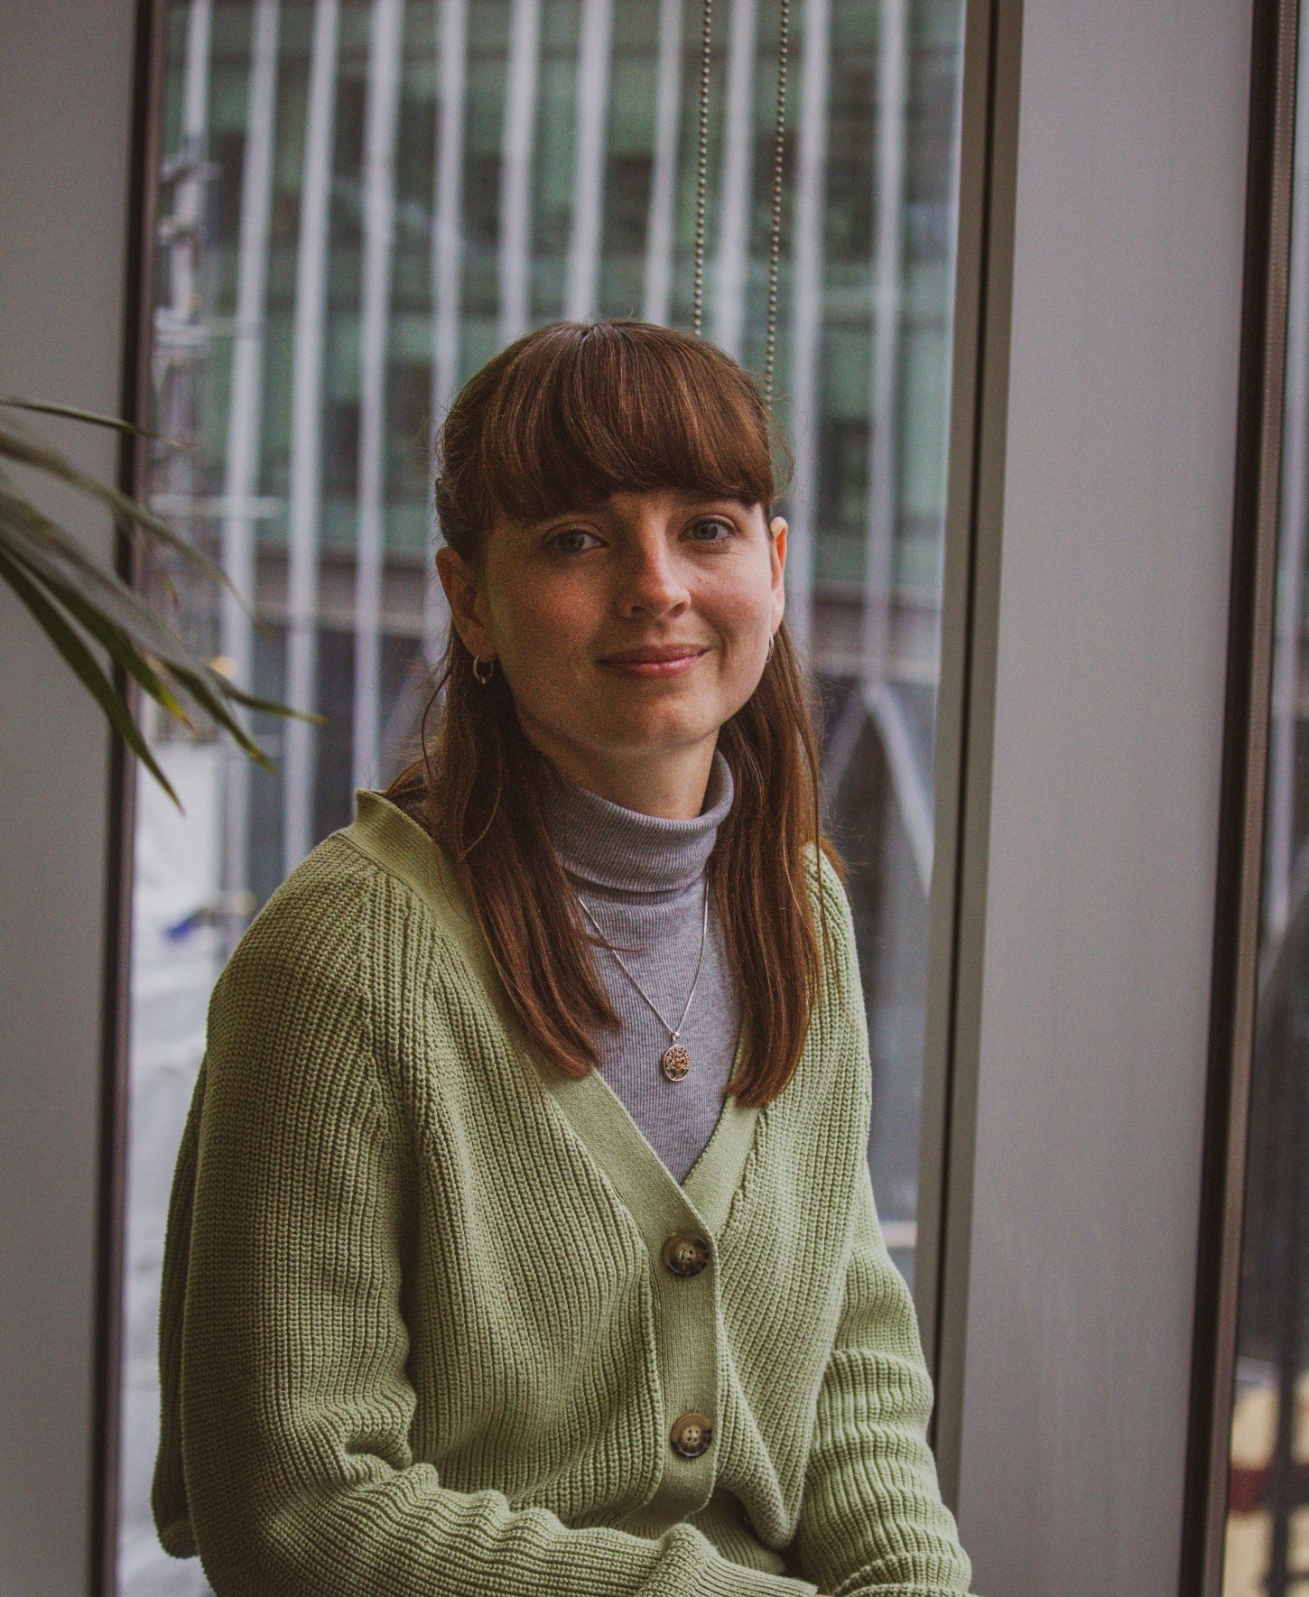
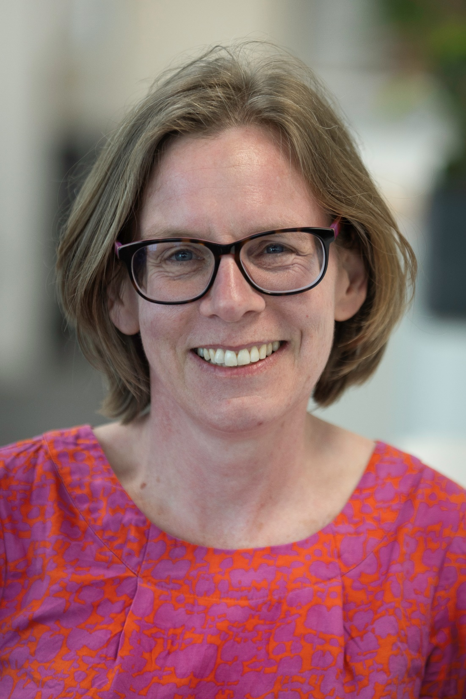

Meet the Team
Bobby Brady
Sustainability Consultant
Blue Marble
Jen Gale
Carbon Literacy Trainer and
Climate Action Advisor (Southwest Team)
Suzanne Gibbon
Programme Coordinator

Slide 4
Net Zero Accelerator Programme
We are on a mission to support schools to meet the net zero challenge and help the next generation to lead the way in climate change action.
The Department for Education is investing in the first stage of this journey and has selected the Barker Consortium of net zero experts to work with 25 partner schools to deliver a pathfinder project which will create an exemplar model for all schools.
Your school has been selected to participate in this pathfinder project.

Slide 5
Net Zero Accelerator Programme –
What to expect?
Our experts will be on site to:
survey the school buildings,
capture a range of data,
test energy efficiency,
develop solutions that will accelerate the reduction of carbon emissions and lowering energy costs.
Alongside this, our Climate Action Advisors from Let’s Go Zero will:
demonstrate how your school building wastes energy using thermal cameras,
show you how to Count Your Carbon to reduce your carbon footprint, and
help you create your school’s Climate Action Plan.

Slide 6

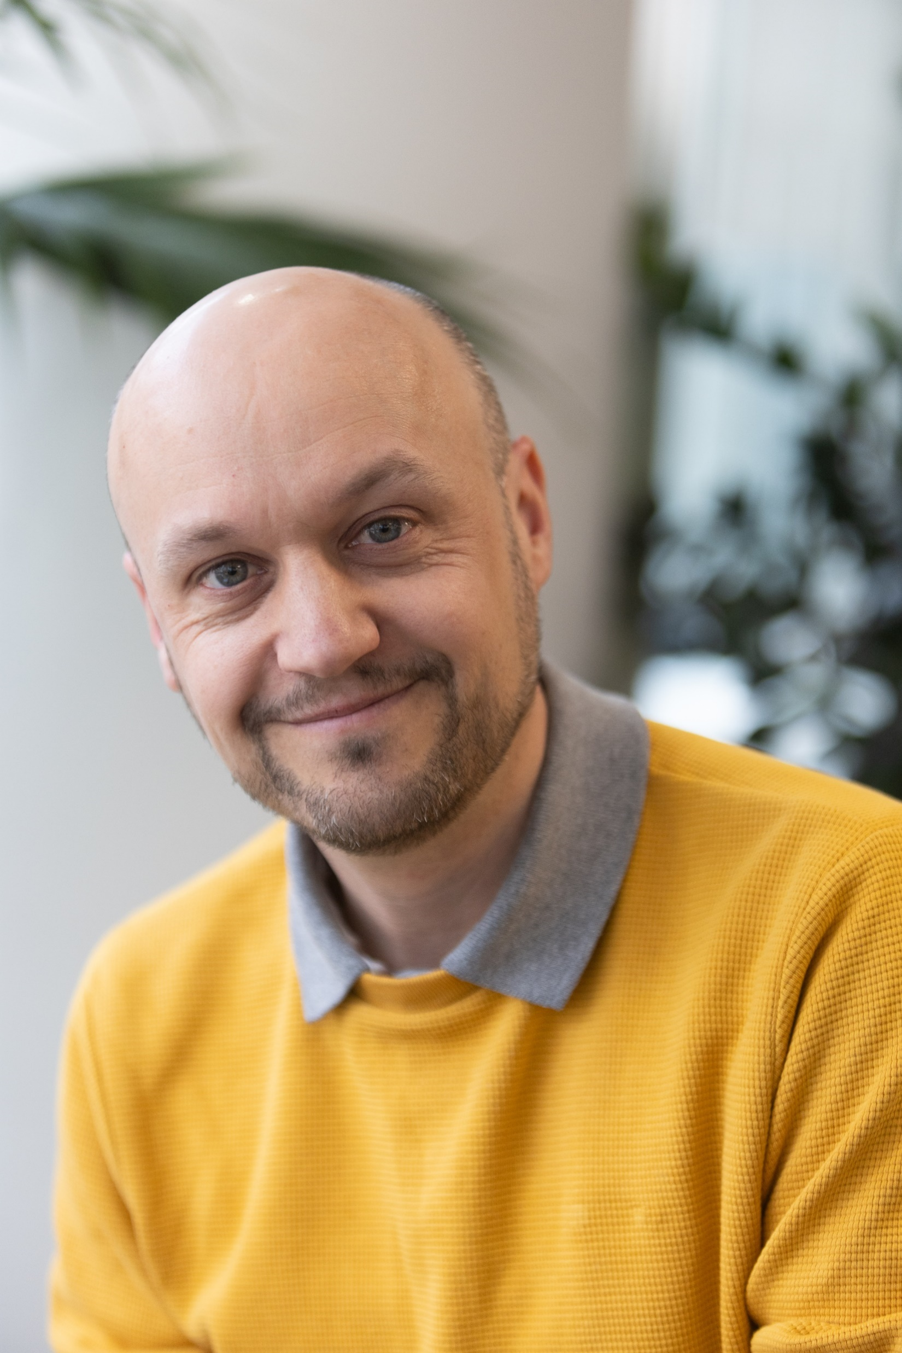
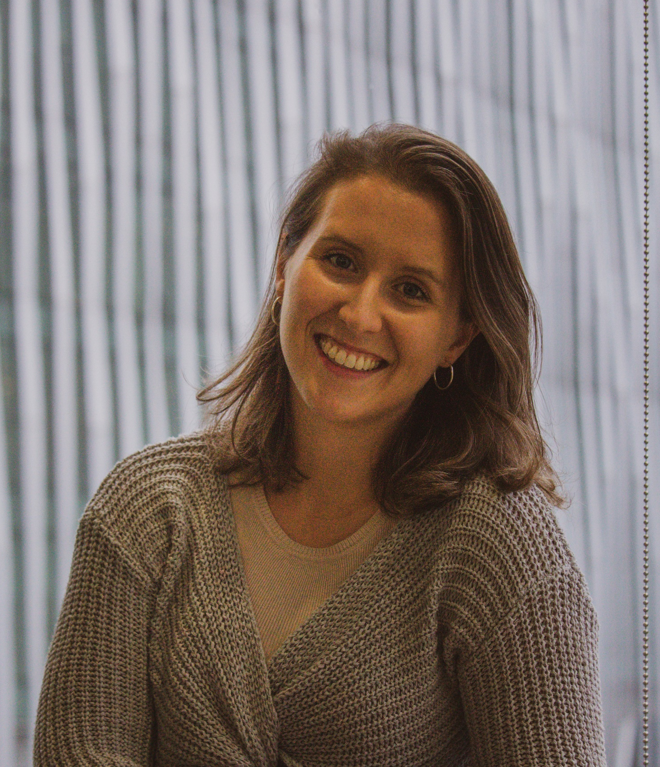

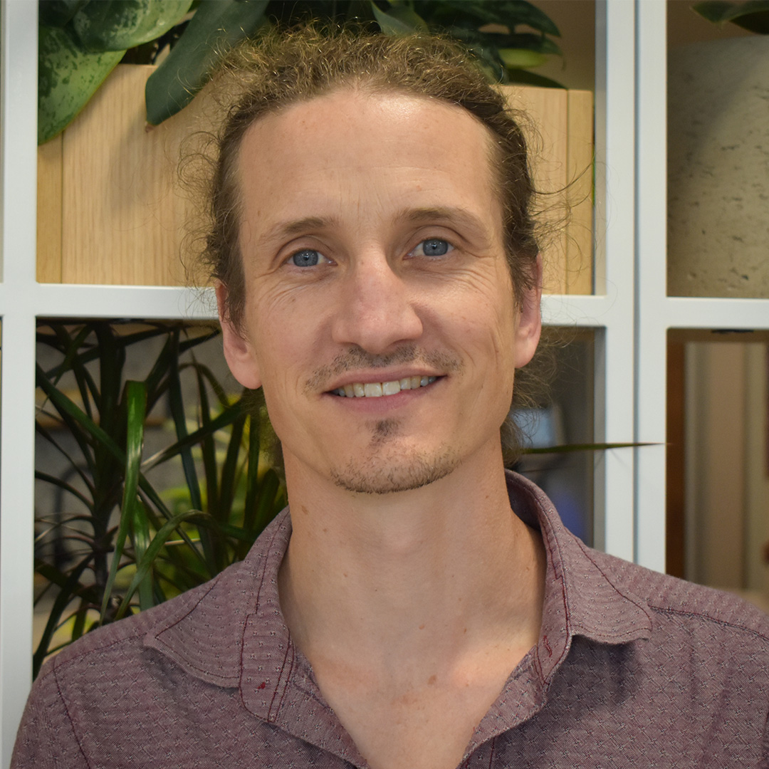
Meet the Team – Advisors
Jasmine Newhouse
Climate Action Advisor (Southeast Team)
Holly Campbell
Climate Action Advisor (London Team)
Jeremy Williams
Climate Action Advisor (East Team)
Matt Keyse
Climate Action Advisor (Northeast Team)
Rosie Pincott
Climate Action Advisor (Midlands Team)

Slide 7
What is the requirement of schools in terms of sustainability and climate change?

Slide 8
DfE Policy Paper - 2022
Sustainability and climate change: a strategy for the education and children’s services systems
“With the campaign Let’s Go Zero, we will set targets for schools between 2025 and 2035.”
“By 2025: All education settings will have a designated sustainability lead and a climate action plan.”
“A climate action plan should typically cover the following four areas:
Decarbonisation - calculating and taking actions to reduce carbon emissions
Adaptation and Resilience - taking actions to reduce the risk of flooding and overheating
Biodiversity and Green Infrastructure - e.g. engaging with the National Education Nature Park
Climate Education and Green Careers - ensuring education provided gives comprehensive teaching about climate change, and teaching staff feel supported to offer this”

Slide 9
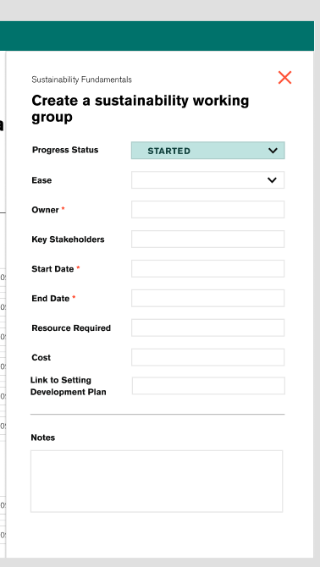
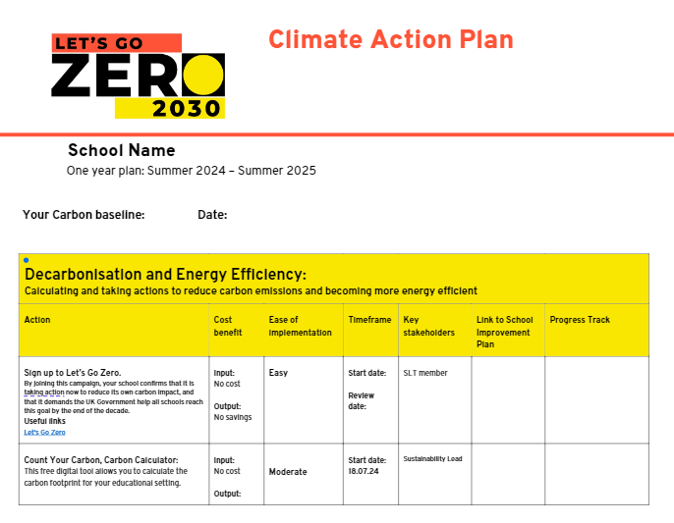
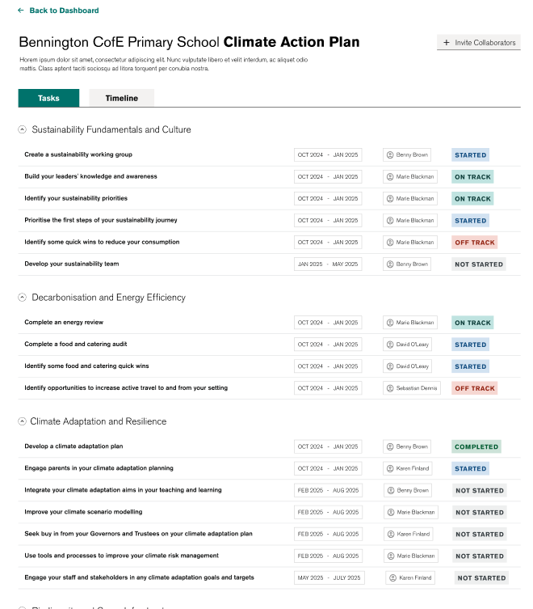
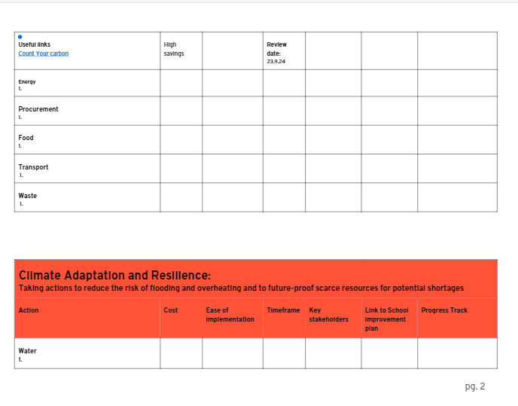
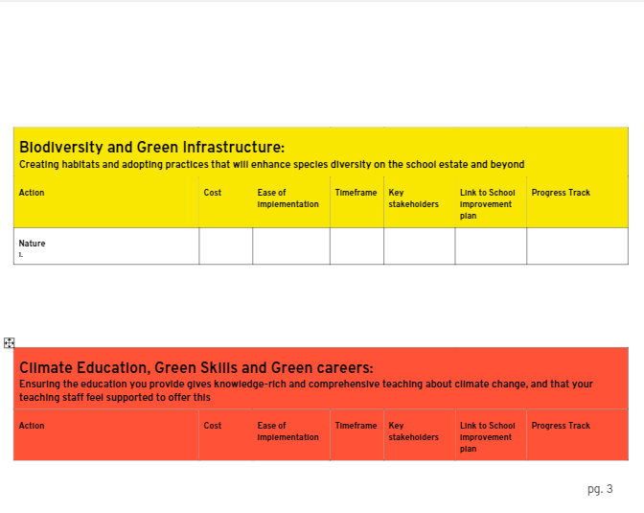
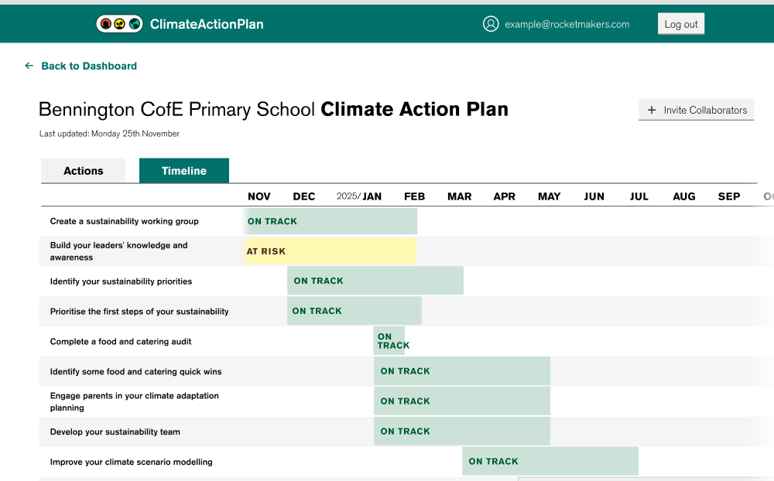

NZAP Climate Action Plan
Notes:
Note from Bobby: As part of the NZAP programme a new Climate Action Plan dashboard has been created to help schools and their Let's Go Zero Climate Action Advisors, quickly and easily create their Climate Action Plan. The dashboard will allow schools to easily track and manage their progress, and also acts to provide each Trust's central team with visibility of each school's plan.

Slide 10
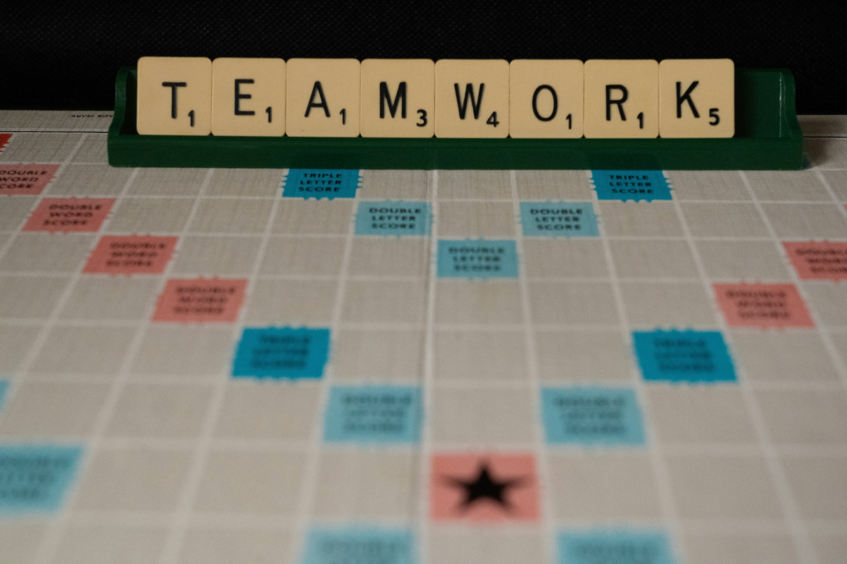
Remember -this is a group effort!
Photo by Nick Fewings on Unsplash
Notes:
Although the DfE strategy is asking all schools to nominate a Sustainability Lead, in our experience, to achieve the changes needed, this works so much better if it’s a group effort! Our recommendation would be that alongside that named Sustainability Lead you have a sustainability working group – key stakeholders should include someone from SLT, someone on the curriculum side, someone from estates/buildings/ops, someone from catering, and could also include student reps as well.
Obviously who is in your team will depend on your school and the size of it – if you’re in a small primary, you may well be wearing lots of hats!

Slide 11
School Carbon Footprint
Notes:
Now we're going to have a quick look at school carbon footprints.
For context, the school estate is the largest emitter of CO2 in the whole public sector at around 37% of public sector emissions.
Carbon Footprint

Slide 12
DfE Policy Paper - 2022
Sustainability and climate change: a strategy for the education and children’s services systems
“With the campaign Let’s Go Zero, we will set targets for schools between 2025 and 2035.”
“By 2025: All education settings will have a designated sustainability lead and a climate action plan.”
“A climate action plan should typically cover the following four areas:
Decarbonisation - calculating and taking actions to reduce carbon emissions
Adaptation and Resilience - taking actions to reduce the risk of flooding and overheating
Biodiversity - e.g. engaging with the National Education Nature Park
Climate Education and Green Careers - ensuring education provided gives comprehensive teaching about climate change, and teaching staff feel supported to offer this”

Slide 13
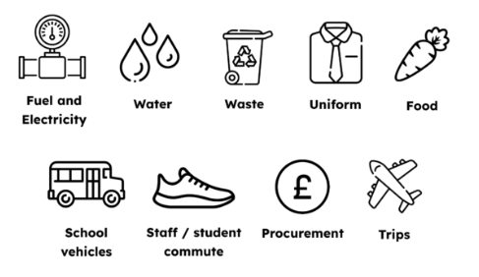

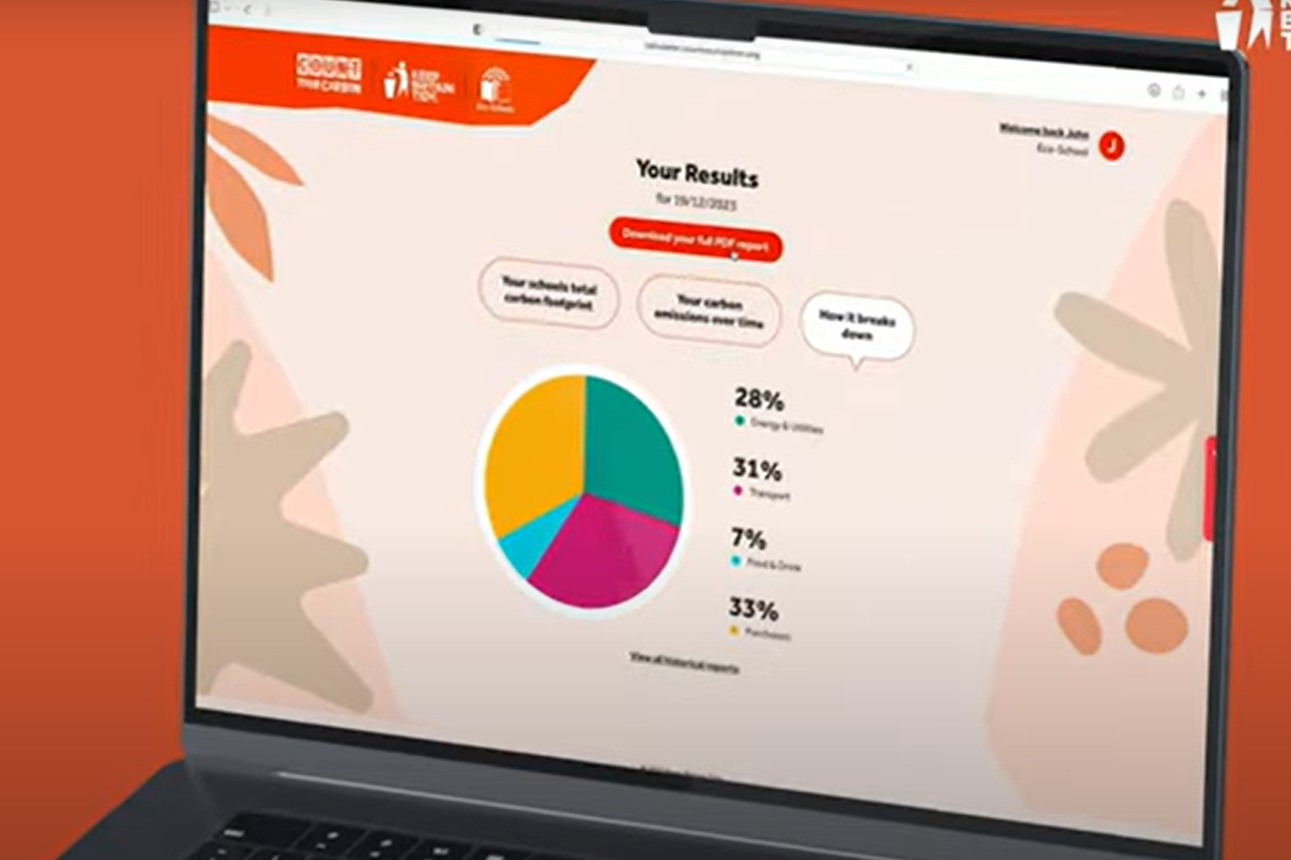
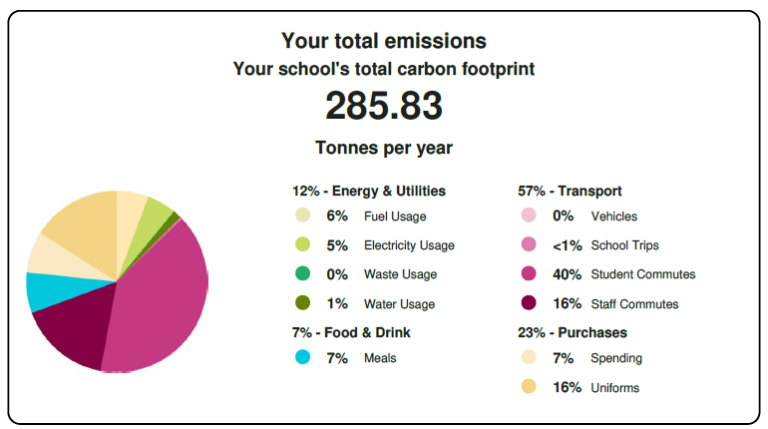
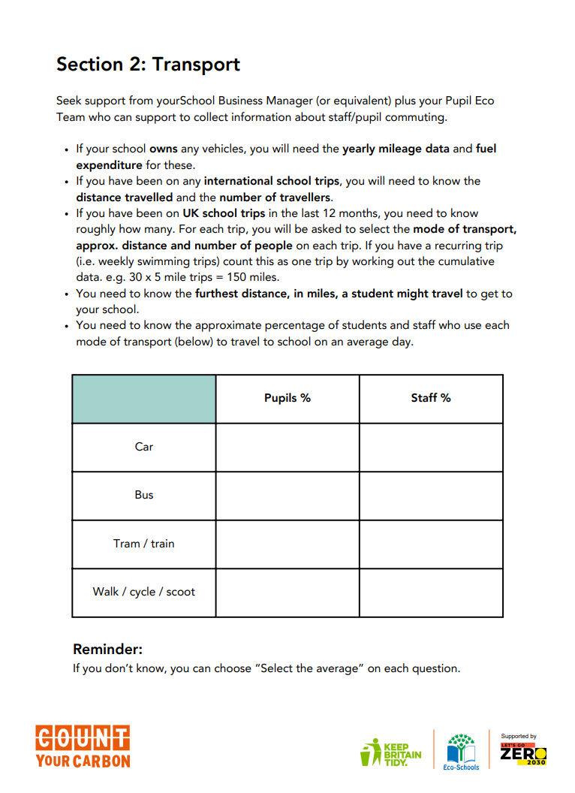
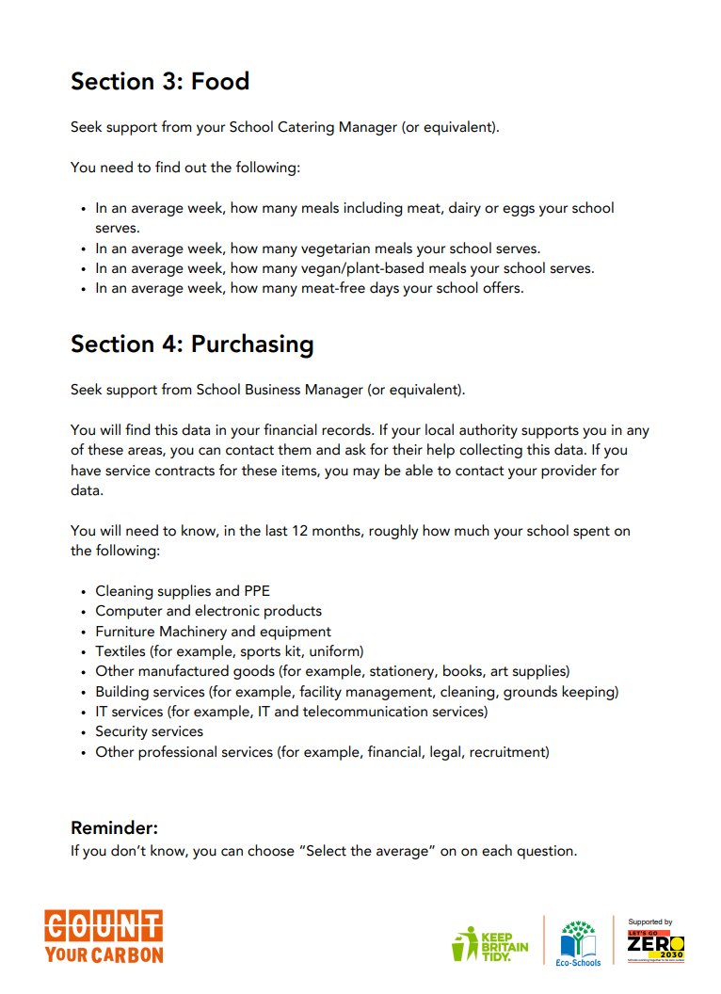
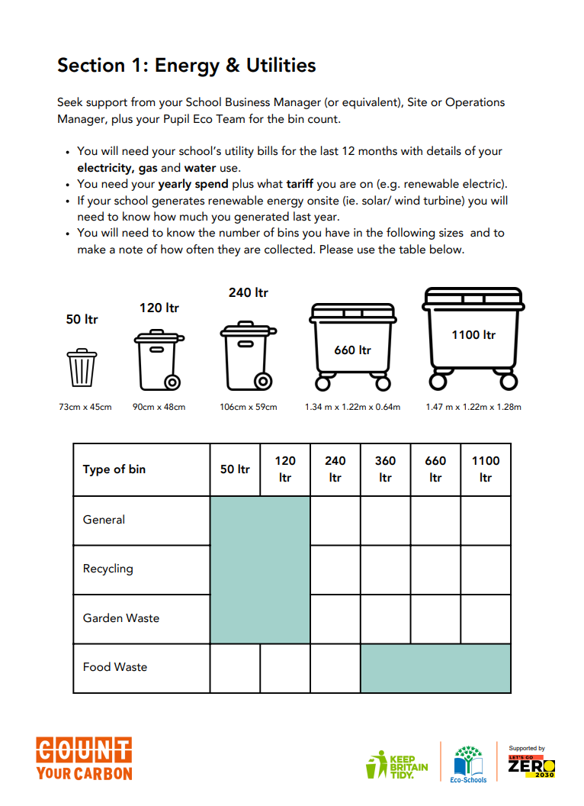


Understand your school’s carbon footprint
Notes:
Calculate school emissions: Count Your Carbon
Count Your Carbon is a free tool for educational settings to calculate, understand, reduce and track their carbon emissions.
The tool is easy to use and provides a total carbon emission figure, which can be used as a baseline to work from when taking action to reduce emissions.
The tool provides a holistic overview of all the school’s direct and indirect emissions – including utilities, transport, waste, water, catering, and procurement.
To use the tool, key information will need to be gathered from a variety of school staff – such as site managers, office staff and canteen managers.
Measuring emissions allows greater ability to track and monitor progress on climate action. The tool should be used each year to understand emissions reduction.
Having visuals of energy consumption also provides great learning opportunities for students to engage with.

Slide 14

An ‘average’ carbon footprint for a school
Notes:
This slide shows the average proportions of the contributions to a school’s carbon footprint according to the figures on the Count Your Carbon website – so we can see that the biggest emissions source for a typical school will be it’s purchasing, followed by transport, then energy and utilities – so this one includes waste and water as well, and lastly food and drink.

Slide 15
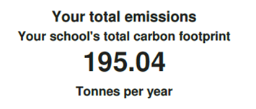
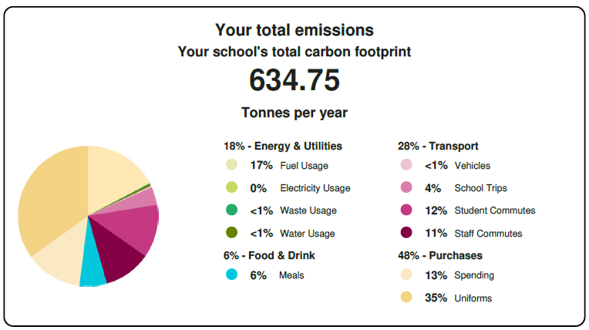

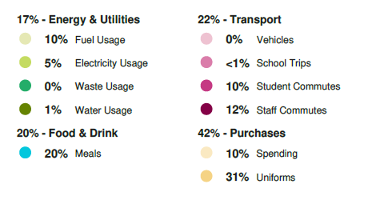
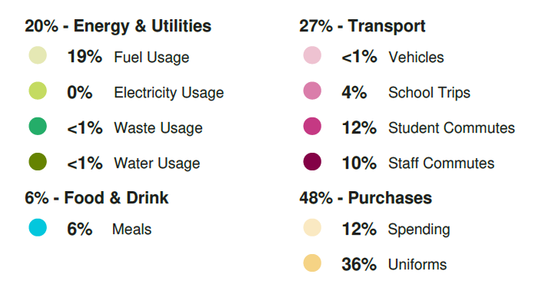
Carbon Footprints: Spot the difference
Primary Example #1
Primary Example #2
Secondary Example #3

Slide 16
Let’s focus on Energy

Slide 17
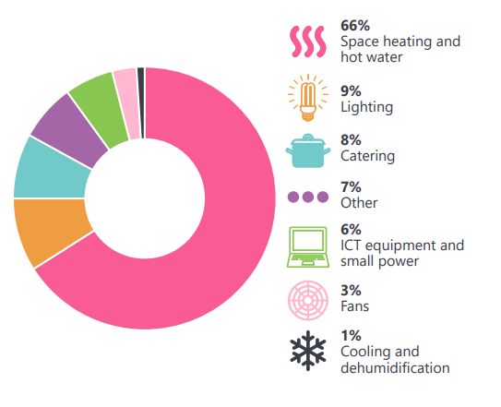
Percentage energy use in a typical school
Catapult Climate-Action-Plan-Decarbonisation-1.pdf
Notes:
This is a graph from Energy Systems Catapult who have produce a great resource specifically to help schools to decarbonise – it’s linked to in the supporting PDF and well worth a read.
We can see that most energy in schools is used in heating both spaces and water, with lighting and catering coming next.From Energy Systems Catapult Climate Action Plan Decarbonisation PDF: Catapult Climate-Action-Plan-Decarbonisation-1.pdf

Slide 18
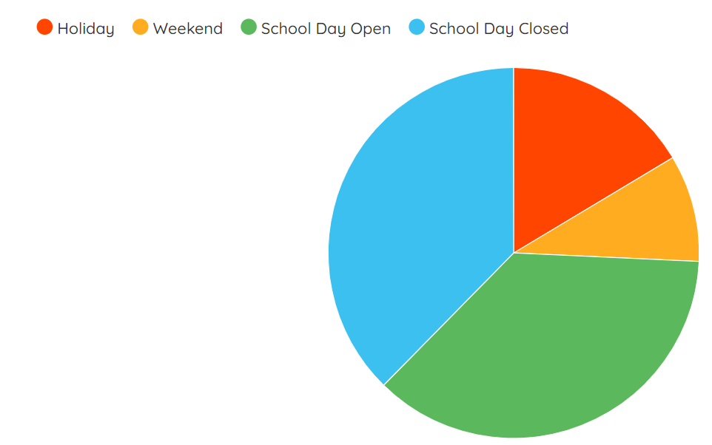
Energy consumption in schools
Electricity data from Energy Sparks / Winford Primary School
Notes:
And shockingly most of this energy is used in schools when they’re closed to pupils! So Energy Sparks found 58% /63 % primary/secondary of electricity is used when the school is closed to pupils and the figures for gas are 62%/68% primary/secondary.
Using a system like Energy Sparks means that you can see what the patterns are for your school and identify if there are any tweaks needed to your heating system or to your switch off routine.

Slide 19
The Energy Hierarchy
Saving energy
Energy efficiency
Renewable energy
Low carbon energy
Conventional
Notes:
Before we move on from energy, I just wanted to introduce the idea of the ‘Energy Hierarchy’ to you. The idea is that we start at the top, with a focus on energy saving, because the best energy to use is always none at all, so saving energy should always be the first priority. Then use it efficiently – so this would be looking at not only energy efficient appliances, but things like insulation and double glazing etc. These are often the more daunting and expensive tasks. There is a great resource from Catapult that I mentioned earlier, and your Climate Action Advisor can also signpost to resources and funding for these kinds of projects.
Then sustainable – solar, wind. So for most schools this would be solar PV, and there are lots of schemes helping schools to get solar on their roofs. There are some suggested resources in the supporting document, and again, this is something we can help schools with.
Then we'd be looking at low carbon – so electricity rather than gas, HP rather than boilers. And you guessed it, we can signpost you to experts to help you with this.

Slide 20
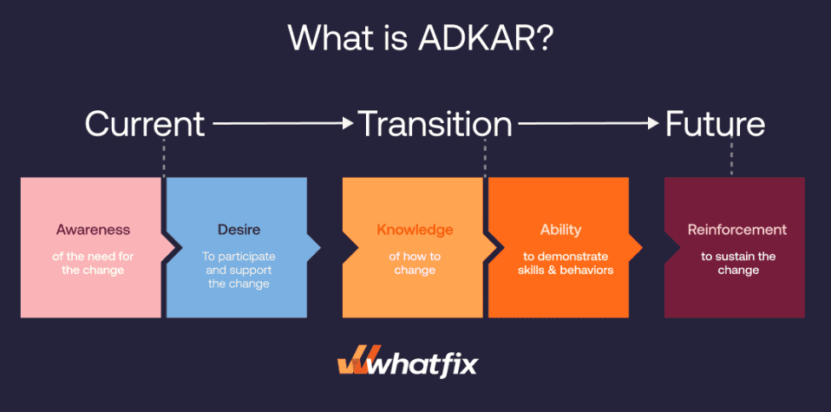
Energy and Behaviour Change management
What is a change management framework?
When it comes to energy efficiency and consumption, using a CM framework helps the adoption of energy-saving behaviours.
What is the ADKAR model?
Provides a holistic and structured approach to successfully embedding energy-saving behaviours
Engages your community and addresses the human side of change
Manages resistance
Supports communication
Facilitates continuous improvement
Notes:
What is a change management framework?
A structured approach to managing change effectively
When it comes to energy efficiency and consumption, using a CM framework helps the adoption of energy-saving behaviours
There are several available, but will focus on the ADKAR model
Using a Behaviour Change model might sound over-kill right now, but it does help to plan for new ways of working, and gives you a simple framework that will help you move from current state (high or inefficient energy consumption) to the future state (lower, efficient energy consumption and cost savings!) and take people along with you.
What is the ADKAR model?
Provides a holistic and structured approach to successfully embedding energy-saving behaviours
Engages your community and addresses the human side of change
Manages resistance
Supports communication
Facilitates continuous improvement
It consists of 5 stages:
Awareness, Desire, Knowledge, Ability, Reinforcement

Slide 21
Behaviour Change: Awareness
Reflect on:
Do your staff and learners know that you have a target to reduce energy use?
Do your staff and learners know what they are expected to do, to save energy?
Do you staff and leaners receive prompts to save energy?
How do you increase awareness?
Visible leadership
Champions of initiatives
Visibility of energy use and any reduction targets
Dialogue: ask staff and leaners for their views, gauge their support, collect ideas
Use local or national campaigns
Positive communication
STOP LEAVING YOUR MONITORS ON!! ☹
A BIG thank you for switching your monitor off at the end of the day. 90% of our staff and learners switch off monitors when not at their desk. Last year you helped us to save ~69 tonnes of CO₂ through our 2022 Easter switch-off campaign! * 😊
*Source: University College London, 2022 https://www.ucl.ac.uk/sustainable/news/2022/may/easter-switch-2022-how-much-carbon-we-saved
Notes:
First stage: Awareness
Some questions to think about at this point are:
Do your staff and learners know that you have a target to reduce energy use? (If you have one)
Why its important: Staff and learners who are aware of their settings energy practices and aims are more likely to act.
Do your staff and learners know what they are expected to do, to save energy?
Why its important: Staff and learners who are aware of energy saving expectations are more likely to act.
Do you staff and leaners receive prompts to save energy?
Why its important: Studies have shown organisations and institutions with posters and reminders to turn off computers and lights are more likely to change behaviours.
How do you make staff and learners aware?
Visible leadership and champions of initiatives
Visibility of energy use and reduction target. Nothing is too small – posters, intranet, newsletters, meetings, assemblies etc
Dialogue – ask staff and leaners for their views, gauge their support, collect ideas. This can be through meetings, surveys, polls, or any other forum.
Use local or national campaigns e.g. COP, Earth Day
A note on positive communication:
Research highlights humans have a strong "negativity bias". This bias causes people to focus more on negative experiences than positive ones, even when the positive experiences are more frequent or significant. This effect means that, for instance, people may dwell on the 10% of negative comments or feedback rather than the 90% of positive comments. To enable behaviour change, avoid bringing in any unnecessary negatives, use praise and nudges, and illustrate with outcomes and results.

Slide 22
Behaviour Change: Desire
Case Study*
Results from 2023 Challenge:
Total Carbon Savings across 10 schools: 9.83 tonnes (17.5% saving)
Carbon Saving per school occupant: 2.09kg
How do we create desire?
Incorporate reward and incentives into the initiative
Align the changes to your staff and learners' needs and values
Encourage competition between groups (both internal and cross-setting)
Finally, have fun with it! **
How do we enable desire?
Ensure staff and learners understand their contribution
Acknowledge feedback
Incorporate feedback, where possible
Follow up: explain why feedback hasn’t been incorporated
Continuous improvement: create a regular feedback loop
*Source: Case Study https://www.powercor.co.uk/schools-rise-to-the-challenge-as-energy-efficiency-competition-proves-huge-success/, https://www.satro.org.uk/energy-saving-challenge
**Source: Ludic Pedagogy https://www.facultyfocus.com/articles/philosophy-of-teaching/ludic-pedagogy-schooling-our-students-in-fun/
Notes:
Second step: DESIRE
How do we create it?
Incorporate reward and incentives into the initiative
Align the change to your staff and learners needs and values
Encourage competition between groups (both internal and cross-setting) e.g. Energy Saving Challenge 2023. This initiative involved several schools competing to reduce their carbon emissions and energy consumption through behaviour change and educational activities. Over the course of the challenge, the participating schools collectively saved 9.83 tonnes of carbon emissions.
Finally, have fun with it! By focusing on making these initiatives enjoyable and engaging, rather than an absolute target that must be achieved we can create a positive atmosphere that uplifts everyone involved, transforming everyday responsibilities into rewarding experiences that build a stronger community.
How to enable desire?
Ensure staff and learners understand their contribution
Acknowledge feedback
Incorporate feedback, where possible
Follow up: explain why feedback hasn’t been incorporated
Continuous improvement – create a regular feedback loop

Slide 23
Behaviour Change: Knowledge
Why its important to build knowledge?
Knowledge helps staff and learners understand the importance of energy conservation
Helps staff and learners to identify energy-saving opportunities
Enables informed decision making
Awareness
Campaigns
Assemblies
Training
Notes:
Third step: KNOWLEDGE
Why its important to build knowledge?
Knowledge helps staff and learners understand the importance of energy conservation.
Helps staff and learners to identify energy-saving opportunities
Enables informed decision making
Examples:
Awareness campaigns: Create simple awareness campaigns using posters, newsletters, and digital platforms to explain why saving energy is important, and provide examples on good energy-saving behaviours.
Assemblies and training: Organize assemblies for staff and learners that focus on energy conservation. For staff sessions can cover topics like energy audits, effective use of appliances, and understanding energy bills. For learners an assembly can cover what energy conservation is, why its important, daily habits, games and quizzes, and a call to action. You may be able to find local experts who can provide a free energy conservation session.

Slide 24
Behaviour Change: Ability
What does ability mean in the context of energy conservation?
Training and Professional Development
Agreeing new roles and responsibilities
Providing resources, tools and equipment
Hosting practice sessions or demonstrations
Encouraging and build confidence
Creating communication channels
Identifying and addressing barriers
Prompts
What are prompts?
Labelling switches
Checklists
Using these two tools can help to ‘automate’ desired behaviour changes and will help to embed them to become unconscious standard practice over time.
Notes:
Fourth step: ABILITY
To enable ability we need to support our staff and learners to understand what they can do to contribute to energy conservation
A key question that is often asked at this point in a behaviour change journey is ‘Our staff and learners know what they need to do, why aren’t they doing it’
Ability in the context of energy conservation means:
Training and Professional Development e.g. doesn’t have to be formal or paid, could also be free online learning
Agreeing new roles and responsibilities (and addressing any skills gaps)
Providing resources, tools and equipment (where needed)
Hosting practice sessions or demonstrations
Encouraging and build confidence e.g. through training, guidance, and demonstrations
Creating communication channels e.g opportunities to ask questions and raise concerns (anonymising this can be helpful as people tend to be more open about their concerns)
Identifying and addressing barriers e.g. Cultural Norms prioritising convenience
Creating support networks and a Sustainability Working Group or Eco team and Eco Champions role model or touch point
Prompts e.g Signposting or creating easy to follow guidelines and checklists
A note on prompts:
Most people will not take the risk of making the wrong decision and will keep lights or equipment on rather than switching off. Labelling switches is a quick, low-cost solution.
Checklists – these are prompts to ensure that staff or learners follow the same desired sequence each day. These take away the mental load and avoid equipment being left on by accident.
Using these two tools can help to ‘automate’ desired behaviour changes and will help to embed them to become unconscious standard practice over time.

Slide 25
Behaviour Change: Reinforcement
Why is reinforcement important?
Sustain behaviour change in the long term
Overcome any residual resistance
Build a culture and ethos
Ensure continued motivation and engagement
Allows you to track and evaluate progress
How do we reinforce behaviour changes?
Share energy data
Reward energy saving
Encourage a positive culture and shared accountability
Sharing Energy Data!
Sharing your energy reduction successes reinforces good energy saving behaviours.
Sharing persistent energy hotspots can help you to work with your community to address barriers to change.
Notes:
Final step: Reinforcement
Why is it important?
Will sustain energy saving behaviours in the long term
Helps to overcome any residual resistance
Build a culture and ethos of energy efficiency and conservation
Ensure continued motivation and engagement
Allows you to track and evaluate progress
To reinforce energy saving behaviours we need to:
Share energy data – use data to reinforce behaviour e.g. sharing reductions reinforces good energy saving behaviours, or any persistent energy hotspots can help you to work with your community to address barriers
Reward energy saving – reinforcing good behaviour by rewarding efforts.
Encourage a positive culture and shared accountability. E.g. Consistently share key messages and progress and celebrate success – no matter how small!

Slide 26
Energy Saving top tips/ activities to do in school

Slide 27
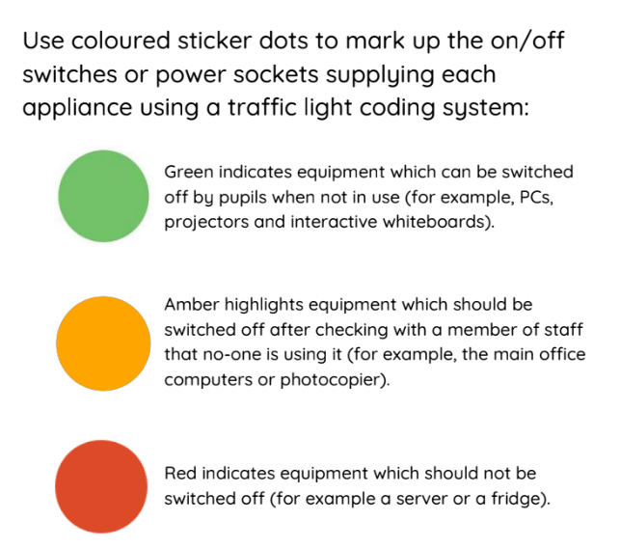
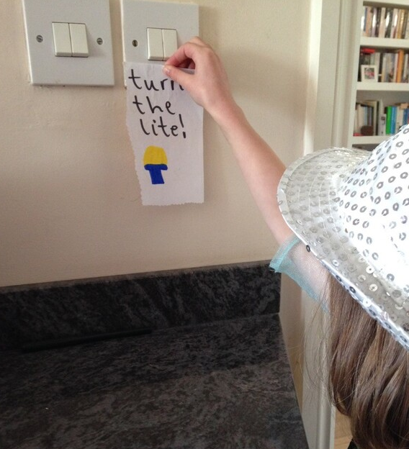
Make it everyone's responsibility
Notes:
Everyone, no matter how small can take responsibility for saving energy at school.
In school get your eco team to put traffic lights coloured stickers on all electrical appliances. Green if anyone can turn them off, such as lights in an empty room or it the sun is shining, red if no one should turn them off (such as fridges and IT servers), and orange if you can turn them off once you've checked with an adult – like if the interactive whiteboard is on but not being used. Make sure, through assemblies and posters, that every one, even the smallest pupils, knows that they can turn green and orange appliances off if they're being wasted.
Pictures c. Energy Sparks.

Slide 28
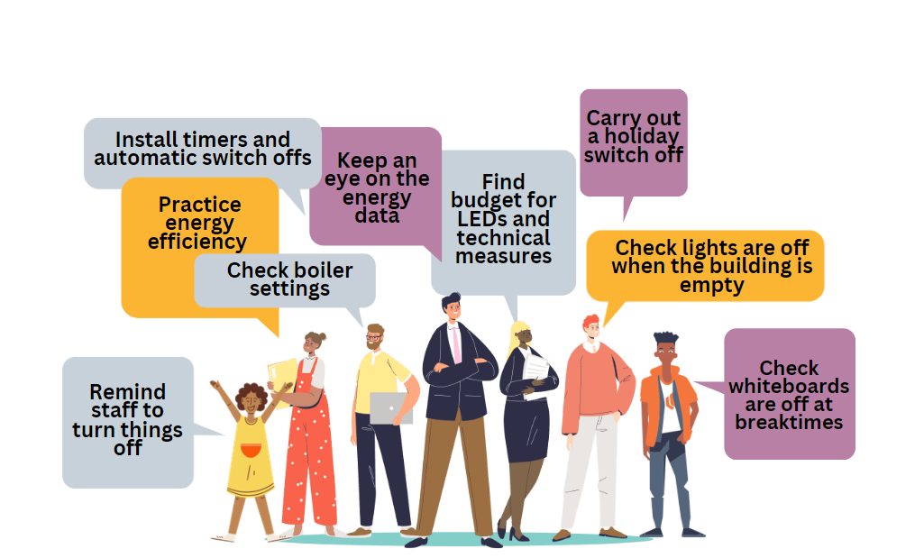
Find your energy allies
Notes:
Everyone, no matter their role, in your school community can play a part in saving energy.
Your pupils might not know how to set a boiler but they can certainly remind the teachers to switch off whiteboards at break; your kitchen staff can be practising energy efficient meal preparation and making sure fridges are freezers are emptied over the holidays; governors can be approving sustainable policies and approving budgets for energy saving measures.

Slide 29
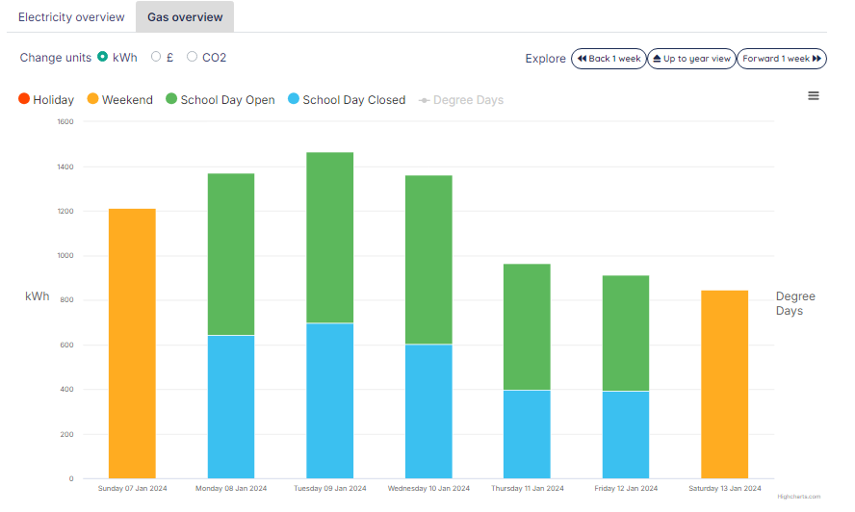
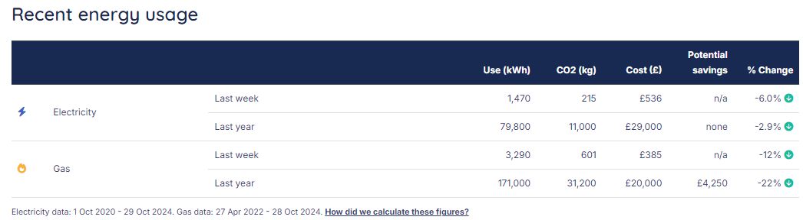
Monitor your data
Notes:
However you choose to monitor your energy, build time into your schedule for weekly or monthly monitoring to check that you're only using what you expect to be using, when you need to be using it. Keeping a n eye on this means you can respond to issue rapidly, saving energy and avoiding big bills. There are a range of options available to schools wanting to monitoring their half hourly energy data and some of these, such as Energy Sparks, can occasionally be free for schools.
Pictures c. Energy Sparks.

Slide 30
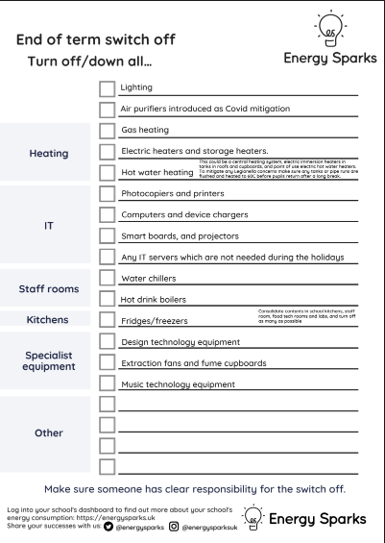
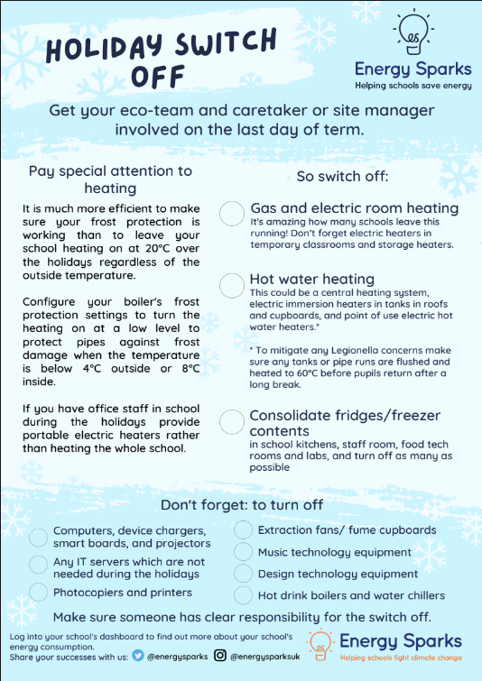
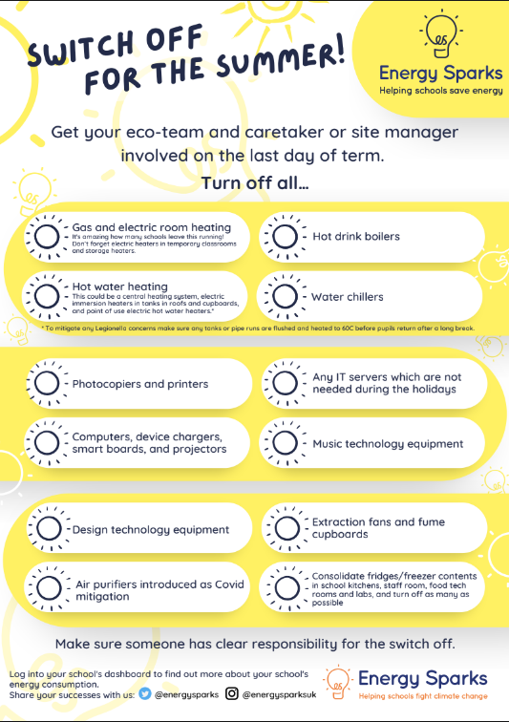
Switch off everything
Notes:
Most appliances can be turned off over the holidays so why waste energy and money by keeping them on? Make a switch off checklist – get the pupils involved if you can, and check everything off on the last day of term.
(nb. Energy Sparks has guidance about frost and legionalla settings)
Pictures c. Energy Sparks.

Slide 31



Make it an event
Notes:
Make a big deal about reducing your energy even if it's just for one day (or afternoon even).
You could encourage pupils to come to school dressed in their cosiest clothes and turn the heating down for a Layer Up, Power Down day. Or challenge your teachers to a computer-free day or tie this in with Outdoor Classroom Day, or even join thousands of other UK schools in a national event like Switch Off Fortnight!

Slide 32

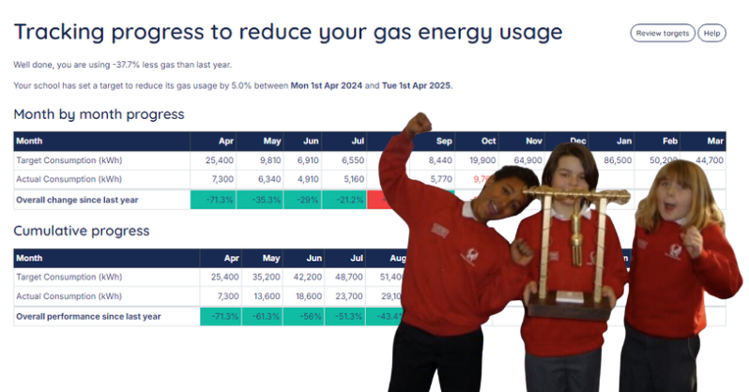
Celebrate the savings
Notes:
Make sure you share the good news about your energy efficiency works. Set yourself a target for reducing your energy: this could be a reduction in your use as seen on your energy management platform or the result of lights off/boards off/heating down surveys that your pupils are conducting but whatever it is, make sure you share your progress in assemblies, newsletters or noticeboards.
Pictures c. Energy Sparks.

Slide 33
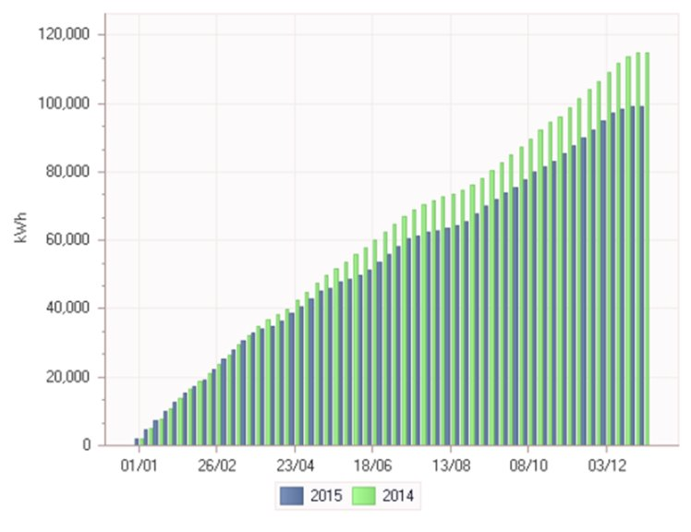
Abbey Road Primary, Midlands
£1,600 (£2,160)

Slide 34
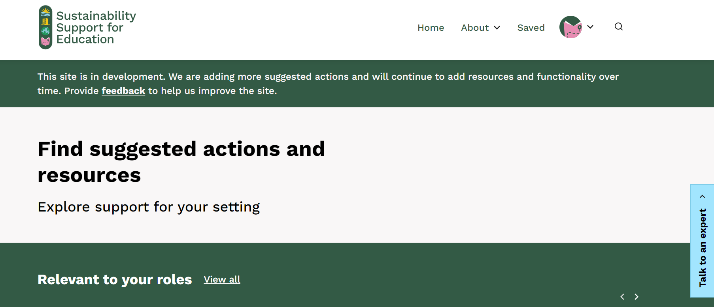
Finding actions to build your Climate Action Plan

Slide 35
Questions?
Notes:
Any questions about anything we’ve covered today?
I’m aware that we cover a lot in each session, and that we go quite quickly, so please do shout if there’s anything you’re unsure of.

Slide 36
Workshops
Workshop One; Getting started, carbon footprinting and saving energy:
  LIFT and Plymouth Cast – Tuesday 26 November 3:30 – 5pm
  BPET – Wednesday 11th December 4 – 5:30pm
Workshop Two; The Science : Tuesday 21 January 2025; 3:30 – 5:30pm
  Climate science 101, talking climate
Workshop Three; The Impact : Wednesday 5 February 2025; 3:30 – 5:30pm
  Climate impact​, adaptation and risk, carbon footprints
Workshop Four; The Future : Thursday 13 March; 3:30 – 5:30pm
  What action has been taken, looking ahead, climate action
  Carbon Literacy pledges
Notes:
Alongside this we are organising four workshops for the sustainability lead of each school to attend. By attending all four workshops they will receive a certificate that will mean they are Carbon Literacy certified by The Carbon Literacy Project.
To offer a more flexibility, if the school/ sustainability lead does not want this certification then the school can choose to attend 3 out of 4 workshops and send any representative from the school to any of the workshops.
Alternatively, a handful of schools from each trust can attend if they agree to share learning and handouts to other school representatives that are not present. Trust leads are also welcome to join.
We would highly recommend representatives attend workshop one as this gives an introduction of the project and overview of support offered.

Slide 37

Don’t forget! Homework
1. Start reducing energy use in your school!
Choose at least one activity we’ve discussed today.
Think about who in your school you need to involve? Students, staff, SLT?
2. Collect the data required to complete Count Your Carbon.
Use the Count Your Carbon Let’s Go Guide.
Have it ready for your school visit from our advisor.
Notes:
Homework
Start reducing energy use in your school
Count Your Carbon data collection

Slide 38
Questions?
Notes:
Any questions about anything we’ve covered today?
I’m aware that we cover a lot in each session, and that we go quite quickly, so please do shout if there’s anything you’re unsure of.
Ask them to share one ‘takeaway’ from the session

