Slide 1


NZAP Workshop Four:
The Future

Slide 2

Any updates..?!
Any climate conversations?
Any progress on climate actions?
Anything else?!
Photo by Kelly Sikkema on Unsplash
Notes:
How did everybody get on with the homework. Did anybody make any progress on the data collection piece for their school, or have a poke around on the CYC website? Or did anyone have a go at measuring their own carbon footprint?

Slide 3
Agenda
Workshop One - Getting Started
Carbon footprinting
Saving energy:
Workshop Two – The Science
- Climate science 101
- Talking climate
Workshop Three - The Impact
- Climate impact
- Adaptation and risk
- Carbon footprints
Workshop Four – The Future
- Update on waste regs
- What action has been taken
- Looking ahead
- NZAP Climate Action Plans
- Carbon Literacy Pledges

Slide 4
Intro to the New 'Simpler Recycling' regulations
DATE FOR THE DIARY: 31st of March 2025.
The regulations require settings to separate the following list of recyclable materials from residual waste:
food waste
glass
metal
plastic
paper and cardboard
(if a setting produces) garden waste
the collection of plastic film will not be mandatory until 31 March 2027.
An NZAP report summarising these regulations, and how Trusts and their schools can prepare, will be released shortly.
Notes:
The new regulations come into effect from the 31st of March 2025. The regulations require settings to separate the following list of recyclable materials from their general, (black bin) residual waste:
food waste including leftovers and waste generated by preparing food (of any volume, including if your setting does not serve food or have a canteen)
glass (such as drinks bottles and rinsed empty food jars)
metal (such as drinks cans and rinsed empty food tins, empty aerosols, aluminium foil, aluminium food trays and tubes)
plastic (such as rinsed empty food and drink containers, bottles, tubs, tubes, trays)
paper and cardboard (such as waste print, envelopes, delivery boxes and packaging)
garden waste – if your setting produces any,
And then just to note that the collection of plastic film won't be mandatory until 31 March 2027.

Slide 5
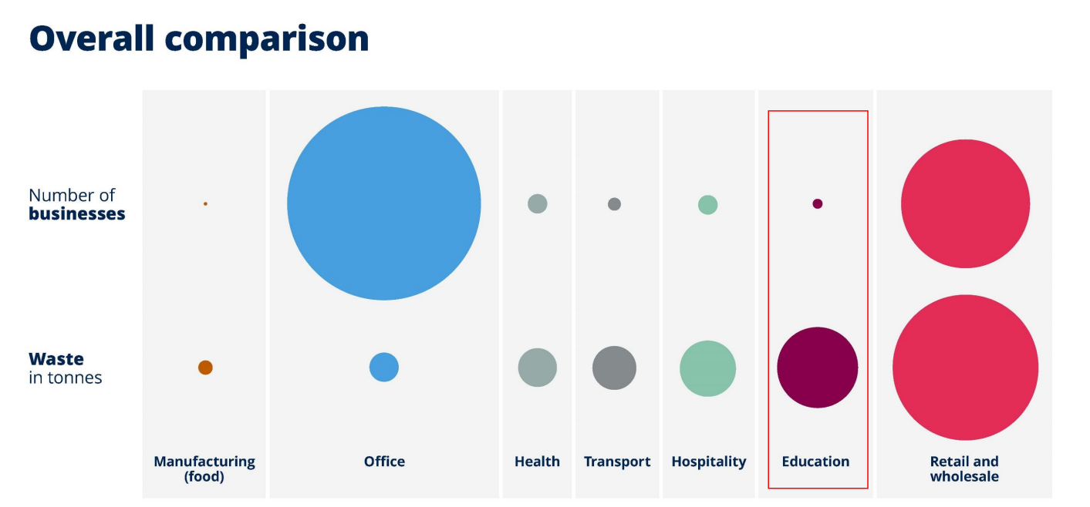
Why it is important
While the education sector represents a relatively small percentage of the total number of businesses in England, it produces a comparatively much greater volume of waste!
WRAP comparison of business sectors and waste produced.
Notes:
Just to visualise the need for improved waste management across sectors, you can see here in this helpful visual from WRAP that when we look at the education sector, while it represents a relatively small percentage of the total number of businesses in England, it produces a comparatively much greater volume of waste.

Slide 6
How to comply
A minimum of four types of waste bin:
one for general waste (non-recyclables and highly contaminated waste that can't be washed)
one for food waste
one for paper and cardboard
and one for dry mixed recycling (plastic, metal and glass).
Hints and tips!
Speak to your central Trust team, if you haven't already.
Speak to your waste collector about:
  how any dry recyclable waste will be collected.
  how food waste will be collected, and the type of sacks or bins required for collection.
  the acceptable level of food residue on any dry mixed recyclables they will collect.
  their threshold for contamination.
  service optimisation; how can collection frequency be improved?
  whether any free bins can be provided!
When buying new bins, think about the volume of waste they will need to hold (a waste audit is a good way to identify this!)
Contamination
The presence of an unwanted item, material, or substance i.e. food residue on food packaging such as plastic tubs, which ‘contaminates’ recyclable materials making them unsuitable or unable to be recycled. Contamination generally occurs when an individual places items into a recycling container, despite these items not being collected or accepted for recycling.
Notes:
Each school should ensure they have the correct waste disposal infrastructure in place before the regulations kick in.
So, that means that settings are required to have a minimum of four types of waste bin:
one for general waste (non-recyclables and highly contaminated waste that cannot be washed)
one for food waste
one for paper and cardboard
and one for dry mixed recycling (plastic, metal and glass).
Some hints and tips on preparing:
Firstly, Speak to your central Trust team, if you haven't already.
Secondly, Speak to your waste collector about:
how any dry recyclable waste will be collected. For example, does your waste collector collect all dry mixed recycling together (glass, metal, plastic) or will the settings need to separate some materials from others?
how food waste will be collected, and the type of sacks or bins required for collection.
the acceptable level of food residue on any dry mixed recyclables they will collect.
their threshold for contamination.
service optimisation; how can collection frequency be improved?
whether any free bins can be provided.
When purchasing the necessary bins, it is helpful to consider the volume of waste they will need to hold, and how often they will be collected. To determine this, you may want to complete a waste audit, or, in some instances, your waste contractor may be able to undertake this for you. So ask!

Slide 7
What happens if we get it wrong?
Compliance is overseen by the Environment Agency (EA). The most important thing to note for Trusts and their settings is if you can demonstrate you are making best endeavours to comply then the EA will be pragmatic in their approach.
Where contamination occurs:
First 'stage' - discussion, support and guidance (potential for additional charge for disposal of contaminated recyclables)
Second 'stage' - where advice and guidance are ignored a written warning or compliance notice will be served to the waste collector or waste producer; the EA will determine where the responsibility lies.
Third 'stage' - Formal caution; the offending party will be required to admit the offence and accept the caution, otherwise,
Fourth 'stage' - Prosecution. The decision to prosecute will not be taken lightly, as it must be in public interest, and will be in the form of fine. In the event of prosecution, the level of fine is not specified in the regulations and will be at discretion of the court.
Notes:
Now there's a lot of nervousness in the sector at the moment around non-compliance, and what happens if schools get it wrong, and that's completely understandable. I attended a webinar with the Trust Network recently and they had a representative from the Environment Agency who confirmed that they're going to take a very pragmatic approach to enforcement. So as long as you are making best endeavours to comply, then the EA are there to support and guide and help in any way they can.
So hopefully that puts everyone at ease a little bit. But I'm just going to touch on what the enforcement process looks like.
So when contamination occurs, as a first response, your waste collector and the EA will come back to you discuss the issues and provide support and guidance to help you resolve them. Now there may be additional charge from the waste collector so that they can correctly dispose of any contaminated recyclables. But worth speaking to your waste collector now to understand how that will work.
And then the next step up would be where advice and guidance are ignored, the EA will issue a written warning or compliance notice.
Any further escalation would lead to a formal caution; and the offending party will be required to admit the offence and accept the caution, otherwise, finally, the EA would proceed to prosecution. But again, remember that the decision to prosecute isn't going to be taken lightly, as it must be in public interest, and it will be in the form of fine. So, in the event of prosecution, the level of fine is not specified in the regulations and will be at discretion of the court.

Slide 8
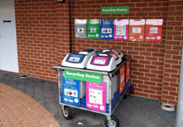
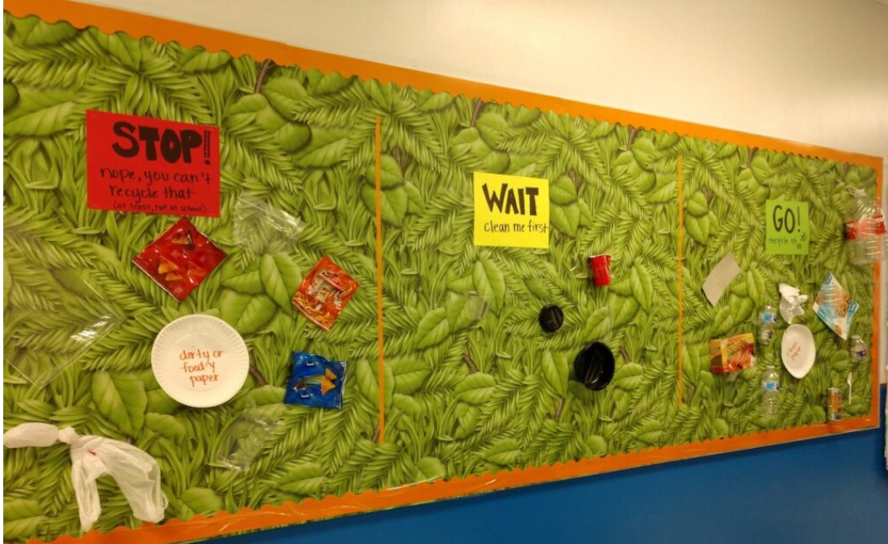
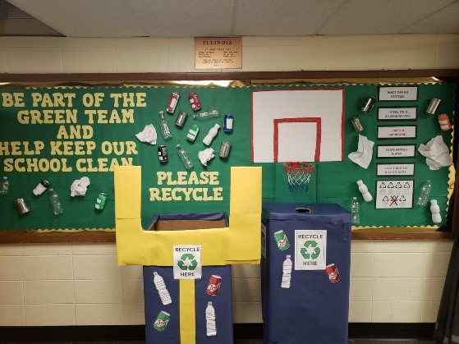
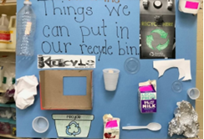
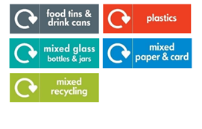
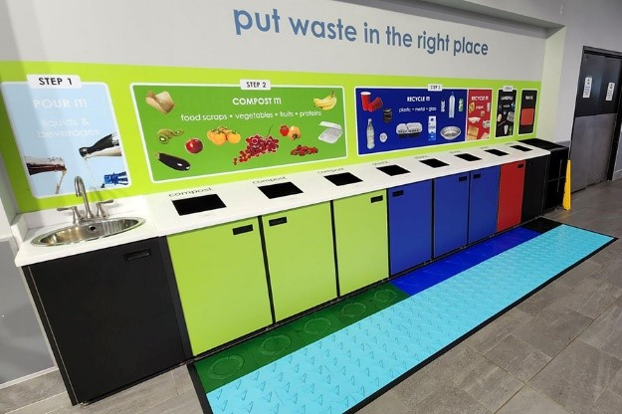
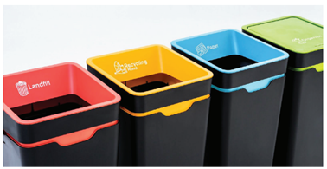
Inspiration!
Notes:
So, moving on then to some hopefully helpful inspiration for how you can motivate your school community to take the correct action when it comes to disposing of waste, and avoid contamination.
There are some helpful behaviour change tools and strategies you can use to achieve this!
Bin placement: Convenience is key. Ideally, bins should be placed within a 10 second walk of your staff and learners at all times to ensure accessibility. One way of increasing convenience is to create ‘recycling stations’; designated area where staff and learners can properly sort and dispose of all materials. So there's a couple of examples here on the screen.
Signs, prompts, colours and iconography: The use of consistent labels, colour-coded systems, posters and signage is going to facilitate easy identification of the new waste categories. It can be helpful to identify high-footfall areas and waste hotspots to make clear what staff and learners are expected to do with their litter, and/or to help them find the appropriate bins. Items often speak louder than words, so use the results of your waste audit to identify some examples of rubbish you can use on signs and prompts. And actually, WRAP’s Business of Recycling website provides posters of various sizes for use as bin labels and so on to save you time creating your own.
Awareness Campaigns: Creating an awareness campaign can help to prepare your staff and learners for the impending changes and prime them to take the desired actions. When learners actively participate in creating awareness materials, such as posters and assemblies, they develop a deeper connection to the topic and are more likely to adopt the desired behaviour. Campaigns can also leverage social norms by highlighting positive recycling behaviours, showcasing role models, and celebrating success stories, which can influence peer behaviour through positive reinforcement.
Competition and Rewards: Introducing fun into recycling can help you to reinforce correct recycling behaviours. The nature of any gamification, competition or rewards will change depending on the age groups of your learners. One example is to design to look like goals. The idea being that you make waste disposal more fun, and you can see an example of that on screen.
And then finally, social norms and social infrastructure: Use your community to reinforce these new ‘social norms’. It shouldn't all be on one person, or the staff to get this right. Schedule and assign waste monitors through your current eco-team or green team or set up a new group of ‘waste warriors’. For example, nominated learners can monitor waste on things like the playground and in the lunchroom to reduce the risk of waste contamination.

Slide 9
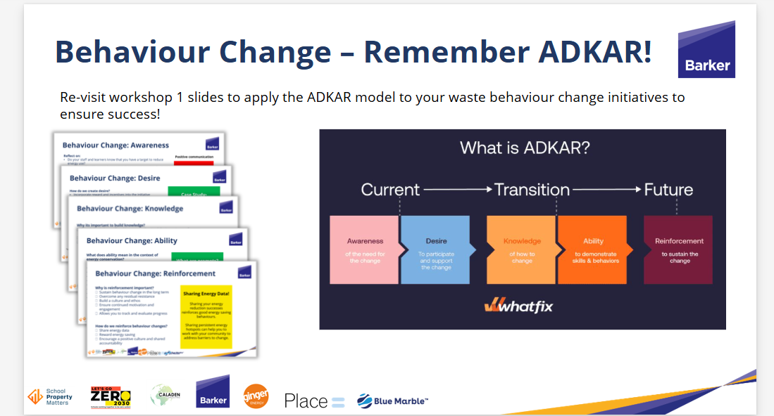
Next Steps
1. Update your CAPs with any actions you need to take to prepare!
2. Refer back to workshop 1 on behaviour change to help you use the ADKAR model to implement correct behaviours.
3. Remember 'best endeavours'; you might not get it 100% right on your first try, and the EA and your waste collectors will do their best to support you to make improvements.
Notes:
1. Update your CAPs with any actions you need to take to prepare!
2. Refer back to workshop 1 on behaviour change to help you use the ADKAR model to implement correct behaviours.
3. Most importantly, remember 'best endeavours'; you might not get it 100% right on your first try, and the EA and your waste collectors will do their best to support you to make improvements.

Slide 10
Helpful resources
1 - Simpler Recycling Government Guidance: https://www.gov.uk/guidance/simpler-recycling-workplace-recycling-in-england#workplaces-that-must-follow-these-rules
2 – WRAP: https://businessofrecycling.wrap.ngo/
3 - Public Register of Waste Carriers, Brokers and Dealers: https://environment.data.gov.uk/public-register/view/search-waste-carriers-brokers
4 – Find a Framework Tool: https://www.gov.uk/guidance/find-a-dfe-approved-framework-for-your-school
5 – How to conduct a Waste Audit: https://www.sustainabilitysupportforeducation.org.uk/indicator/waste-audit?term=waste+audit&returnTo=search
6 – Let’s Go Zero’s webinar on the new waste regulations: https://www.youtube.com/watch?v=Q01gYVRDNcM
7 - Circular Economy online training course: Education and learning towards a circular economy
Notes:
And finally just to note I've included some helpful links here so that you can explore additional guidance on the topic.

Slide 11
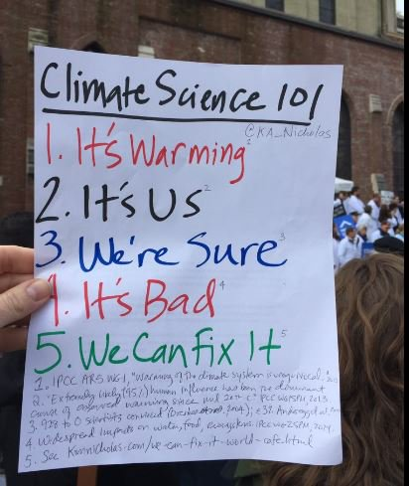
Climate Science in twelve words…
Image credit: Prof Kimberley Nicholas
www.kimnicholas.com
Notes:
And from our climate science in 12 words framework, we’re still stuck it’s bad for little bit longer.

Slide 12
What action have we taken so far?
Notes:
So what action have we taken so far?
We will start off by looking internationally an having a think about COPs. You may well have heard of the COPs they are annual international conferences for all the countries around the world to come together to discuss climate action

Slide 13

What does COP stand for?
Conference of
the people
Conference of
the parties
Collection of
the parties
Cracking on with the parties
Notes:
So, first up what does COP stand for?
Do you think it stands for conference of the people, conference of the parties, collection of the parties, or cracking on with the parties?
The answer is conference of the parties. In this context the countries a party to the agreements and therefore referred to as parties rather than countries.
Another explanation is perhaps that Conference of the Countries is a slightly different acronym and perhaps one that doesn't commandeer the same level of respect…
Has anyone done a School or MAT COP? This can be a great way to engage students in the political process around climate change, and gain an understanding of different perspectives of countries around the world, diplomacy and negotiation skills, and the art of compromise!
There are some resources in the supporting PDF signposting organisations who can help schools to organise ‘mini-COPS’

Slide 14
When was the first COP?
1975
1984
1995
2000
Notes:
When was the first COP held?
Do you think it was 1975, 1984, 1995, or 2000?
The answer is 1995 and if your mental maths is good you will have been able to work that out. COP 29 is being held at the end of November 2024 and taking 29 years off 2024 gets us to 1995.

Slide 15
The Paris Agreement in 2015 stated that we should be aiming to keep average global warming to…?
0.5-1°C
1.-1.5°C
1.5-2°C
2-3°C
Notes:
One of the most important outcomes from any of the cops has been the Paris agreement, which came out of cop 21 in Paris in 2015. In the Paris agreement all countries around the world agreed to come together to take action on climate in an effort to keep the temperature rise two below…
0.5-1C, 1-1.5C, 1.5-2C, 2-3C.
The answer is 1.5-2C.

Slide 16
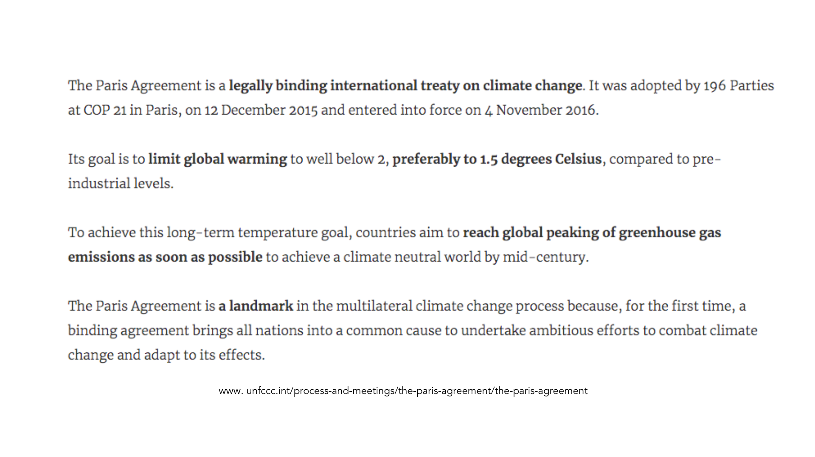
Notes:
The Paris Agreement was the first time that countries came together to agree to take climate action and its goal is to limit global warming to “well below 2, preferably to 1 1/2 degrees Celsius, compared to pre industrial levels”.
It was seen, and is still seen as a real landmark, and it was a real feat of diplomacy to get countries to sign up to this legally binding agreement. There is some debate over the legally binding nature of the agreement, for example I don't think there were any repercussions when Trump decided to pull the USA out of the Paris Agreement as one of the first acts of his Presidency. However, being legally binding does mean that governments can be taken to court and challenged if their policies are not in line with their legal obligations to the Paris Agreement.

Slide 17
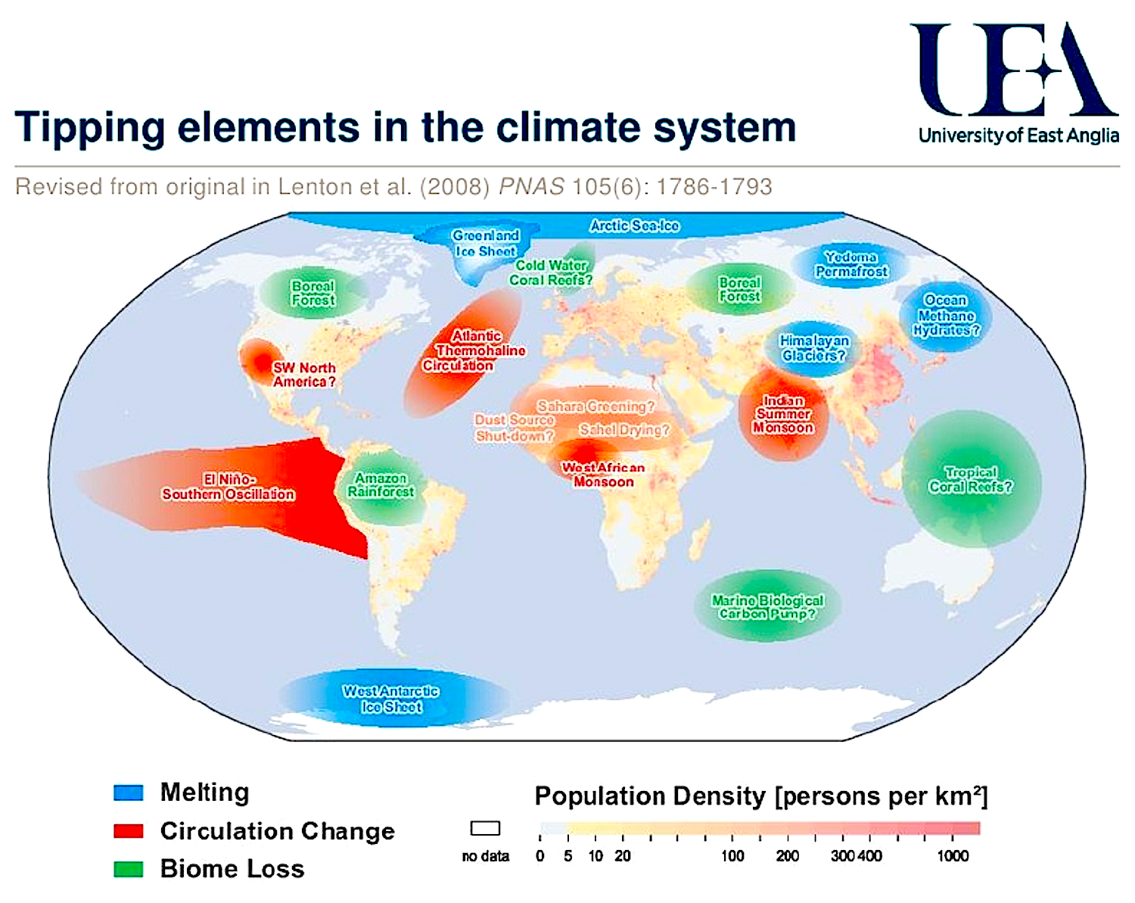
Notes:
Tipping points are essentially points of no return within the climate system. An analogy is pushing a big boulder up amount and. Until he reached the top of the mountain, it is possible to bring that boulder back down under sun semblance of control. Once you have reached the top and tipped over, that boulder is racing down the other side of the mountain out of control. Climate change is having a slow and steady impact on many of our climate systems. The closer we get to 1.5C of warming the more likely it is that we will hit some of these climate tipping points, at which point change will happen exponentially. And these changes will be irreversible for centuries to come.
This graphic shows some examples of some of the climate tipping points that scientists are concerned about. Possibly one of the most common ones that you may have heard of is the Amazon rainforest. At school we probably all learned that the Amazon is the lungs of the earth. It is responsible for sequestering, or sucking in, huge amounts of carbon dioxide. There is a concern that the Amazon is very close to its tipping point, and if this is breached, it will become a net emitter of carbon dioxide. There is evidence that already at least a couple of parts of the Amazon rainforest have passed this tipping point.
Another example is the permafrost at the poles. These are areas of permanently frozen land, under which is trapped a huge amount of methane and other greenhouse gases. As the temperatures increase, this permafrost is starting to thaw, releasing some of these previously trapped greenhouse gases. These additional greenhouse gases in the atmosphere exacerbate the warming and set off a vicious cycle.

Slide 18
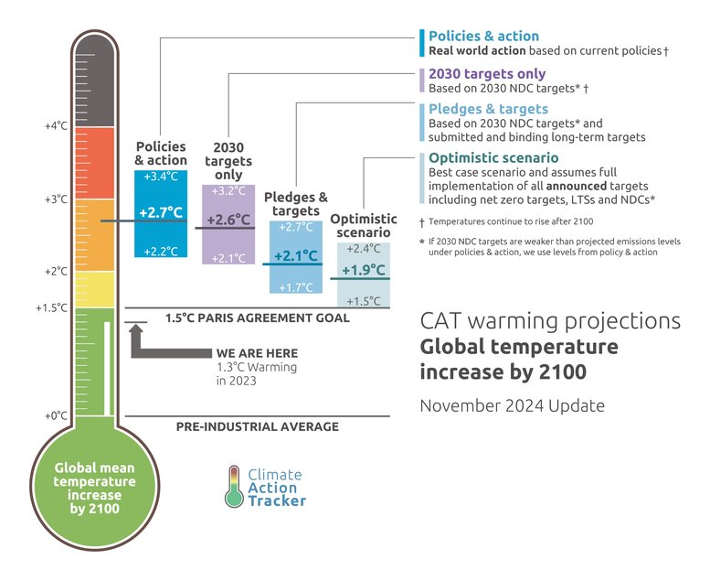
Home | Climate Action Tracker
Notes:
What we're left with after the COPs is an ambition gap.
This is an infographic from Climate Action Tracker where the green line is where we need to be in terms of emissions to be consistent with keeping temperature rise below that 1.5 degree threshold. The solid blue at the top is the policies and actions that are in place. And the lines in between are pledges, targets and promises. The problem as we can see is that pledges, promises and targets are easy to say, and easy to set, whereas policies and actions are much more difficult. We need to see much more in the way of concrete policies and action from our governments.

Slide 19
The UK government has set a Net Zero target of…?
2040
2045
2050
2060
Notes:
OK so that's what's happening on the international stage how about what is happening here in the UK?
The UK government has set a net zero target of 2040, 2045, 2050, 2060?
The answer is 2050.
The UK government were one of the first to come out and set a net zero target, however we are very much not on track to be hitting net zero. The climate change committee is an independent statutory body established under the climate change act in 2008, with the purpose of advising the UK and evolved governments on emissions targets and to report to parliament on the progress made in reducing greenhouse gas emissions and preparing for and adapting to the impacts of climate change. The most recent reports from the climate change committee have clearly shown that we are way off track in the majority of areas.

Slide 20
The Education Sector
Notes:
What about the education sector?
The school estate is the largest emitter of CO2 in the whole public sector at around 37% of public sector emissions. The government’s NZ target for the public sector estate is a 78% reduction in emissions across scopes 1 and 2 by 2035.

Slide 21
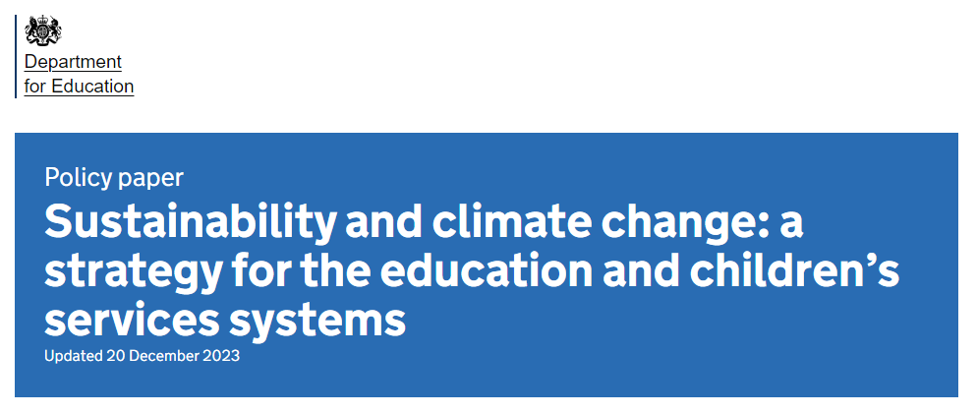
Sustainability and climate change strategy - GOV.UK (www.gov.uk)
Notes:
Can we just have a quick Y or N in the chat – who has heard of, or was aware of this strategy?
I don’t think it’s been widely pushed by the DfE and awareness of it and it’s contents are quite low – we hope that that will change with more push on it from the DfE and we are certainly flagging it to all the schools, MATs and LAs that we’re working with!

Slide 22
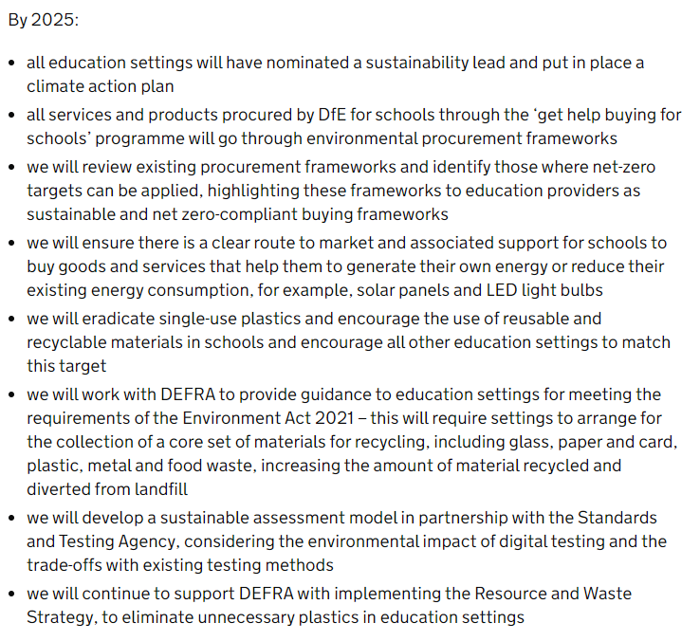
Sustainability and climate change strategy - GOV.UK (www.gov.uk)
Notes:
There’s a lot in there, as with all policies! But really the takeaway for those ‘on the ground’ is that there is “All education settings are required to appoint a sustainability lead and produce a Climate Action Plan by 2025.” (this is from the DfE’s FAQ document regarding the Sustainability Support for Education Hub). It’s not a statutory requirement yet, but we would anticipate that further direction on this as the government ramps up it’s actions, given that schools are such a big part of public sector emissions.

Slide 23
Your setting?
Notes:
What has happened so far at your school or MAT?
**If there is time, put people in breakout rooms to discuss what has happened so far at their setting
Do you have a sustainability lead? A CAP? A sustainability strategy? And Net Zero goal? These are all quite ‘new’ actions for schools to be thinking about, so don’t be disheartened if the answer is ‘no’ (and this is absolutely all stuff we can help you with!). But you WILL have done lots of things already – pretty much every setting we meet with starts off by telling us they haven’t really done anything, and as the conversation progresses, loads of actions come out!
One of the things I always encourage schools to do before they dive into actions is to create a ‘Ta-da! List’ of things they have already done. This can be a great baseline, and a way of celebrating the people who have made this stuff happen and then launching into the next phase. The invitation is here if you would like it, to make a note and get started on that Ta-Da! List after today’s session
NB If there is time, you can put people in breakout rooms to discuss.

Slide 24
What does the future hold?
Notes:
So what action have we taken so far?
We will start off by looking internationally an having a think about COPs. You may well have heard of the COPs they are annual international conferences for all the countries around the world to come together to discuss climate action

Slide 25
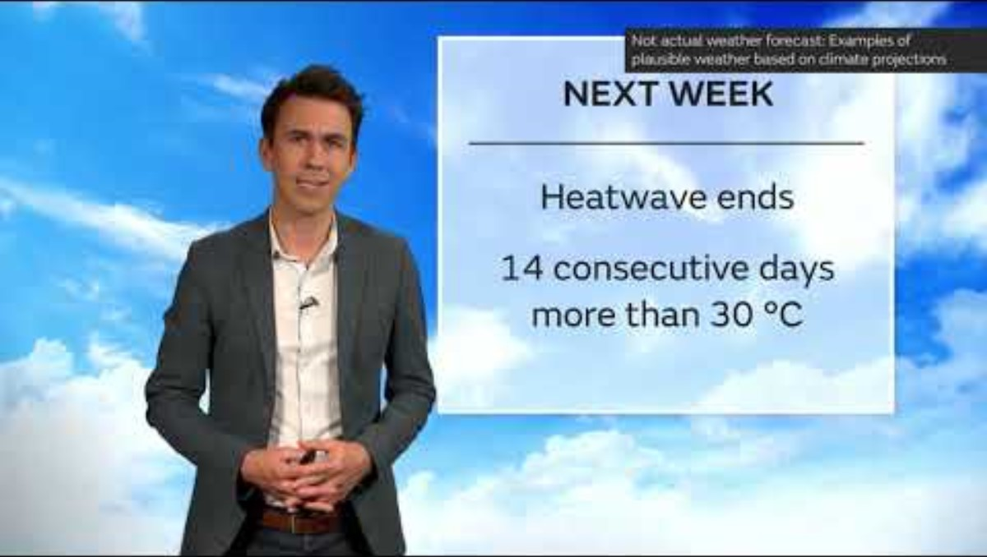
Notes:
So what does that actually mean? This video is from the Met Office in the UK, and is a weather forecast for a summer day in the UK in 2050. It’s about 6 minutes long, so a bit longer than some of the other videos we’ve watched, but I think it’s well worth it.
*PLAY VIDEO
This video was created in 2021 and some of the stats are already are already out of date. This was before the record breaking heatwave in the summer of 2022, and before the UK experienced it’s wettest winter on record in 2023/24 with devastating impacts on many of our crops.
If you hear the phrase ‘adaptation and resilience’ (and it’s one of the key pillars that the DfE want schools to include in their Climate Action Plans) this is what it’s talking about. Ensuring that we’ve thought about different future scenarios and the plans that we need to put in place to ensure that we can still do what we need to do – in the case of schools, that means how do we still deliver the quality education and care that we’re all so passionate about, in a heatwave, or if our local area repeatedly floods, or if food prices sky rocket?

Slide 26
What needs to happen?
Notes:
So what action have we taken so far?
We will start off by looking internationally an having a think about COPs. You may well have heard of the COPs they are annual international conferences for all the countries around the world to come together to discuss climate action

Slide 27

“Limiting warming to around 1.5°C (2.7°F) requires global greenhouse gas emissions to peak before 2025 at the latest, and be reduced by 43% by 2030”
IPCC_AR6_WGIII
“We are at a crossroads. The decisions we make now can secure a liveable future. We have the tools and know-how required to limit warming,”
IPCC Chair Hoesung Lee.
“It’s now or never, if we want to limit global warming to 1.5°C (2.7°F). Without immediate and deep emissions reductions across all sectors, it will be impossible.”
IPCC Working Group III Co-Chair Jim Skea
Notes:
These are a few quotes from the latest IPCC report. And possibly the most important slide of the whole course.
Net Zero goals are useful tools, but they still feel a long way off. What feels much more pertinent is a goal for 2030, and the science is telling us that we need to effectively halve our emissions by then, across all three scopes. Now this is hugely ambitious for most businesses and indeed for schools, but the longer we leave it, the harder it will get, and the more heat we will have ‘locked in’ to the system. This is one of the reasons why we’re really encouraging settings to start measuring their carbon footprints – once we know what it is, we can start setting some goals and targets to reduce it. Now please don’t worry, we’re not going to sit there and dictate to you that you need to halve your footprint – some of the big reductions need big pots of money, and that will need to come from government, but this is the North Star, and we would really should be setting ambitious goals (both for our schools and for ourselves) and putting pressure on the government to get the funding and policies in place to help us achieve them.
It’s important to note that we have the tools and know-how to achieve this 50% reduction – we don’t have everything we need to get to Net Zero yet, but we do have what we need to halve emissions.

Slide 28

Notes:
No one is coming to save us. We need to stop looking around for somebody to do something about this. We are all somebody. We all have huge potential to create and contribute to the climate action we so desperately need.
As we have seen our governments are acting far too slowly given the scale and speed of the changes that we are experiencing. We need communities, businesses, schools and individuals to come together to take and demand collective action. We are the superheroes we've been looking for.

Slide 29
Climate Science in twelve words…
Image credit: Prof Kimberley Nicholas
www.kimnicholas.com
Notes:
And from our climate science in 12 words framework, we’re still stuck it’s bad for little bit longer.

Slide 30
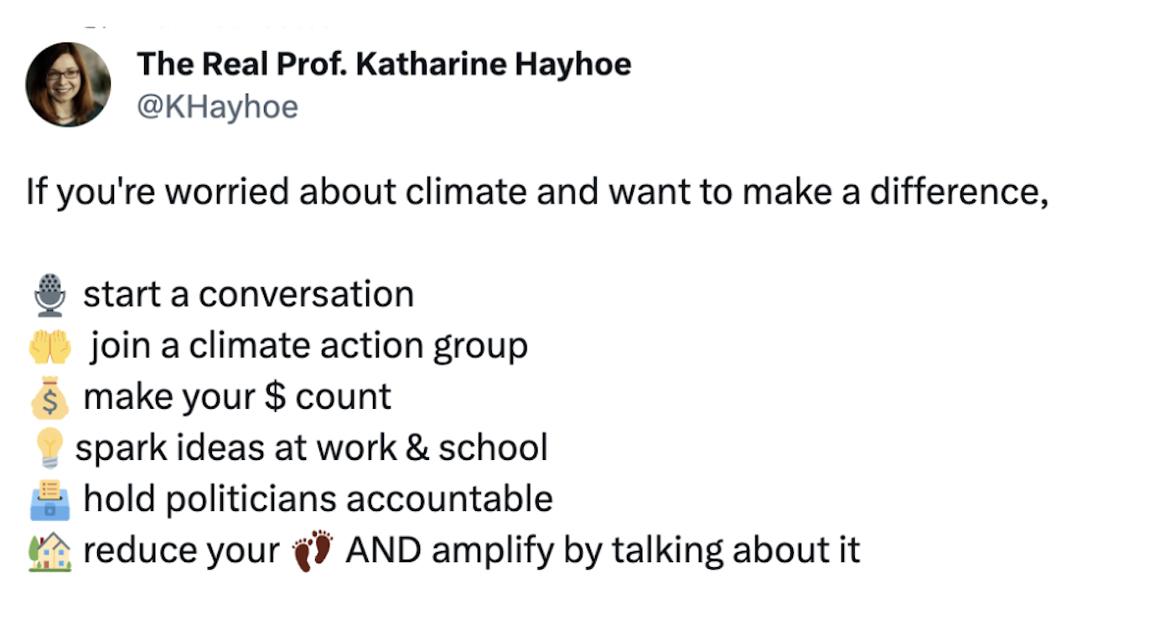
Notes:
I know we’ve covered a lot, but to finish up, I want to finish by saying that the most important thing we can all do as individuals to help tackle the climate crisis, is to stop thinking of ourselves as individuals, and think about the multiple roles that we can play to bring other people on board. This applies at a school or MAT level as well – what can you do to help inspire and empower other schools and MATs to join in.
This tweet from Katharine Hayhoe sums it up quite nicely!

Slide 31
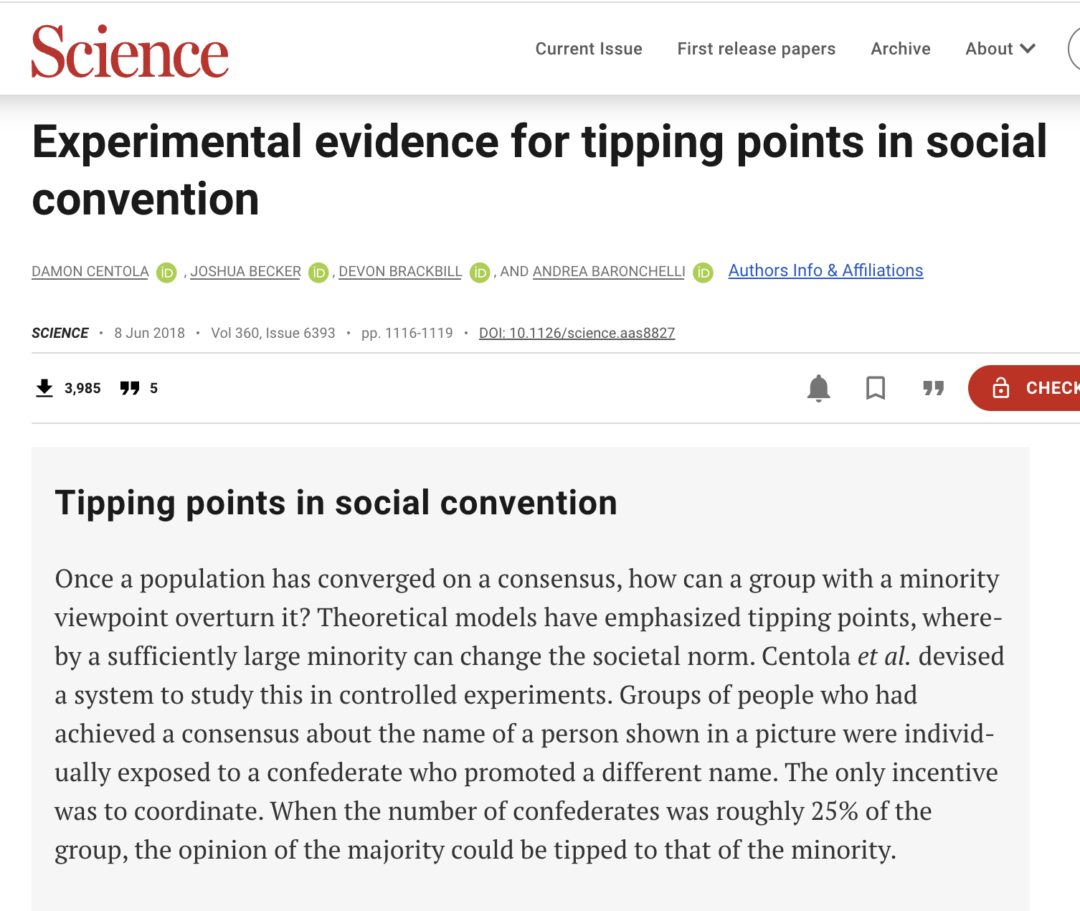
Notes:
And there is an increasing body of evidence supporting the idea of social tipping points. As human beings we are incredibly social creatures, and we are hardwired to fit in with those around us. Recent experiments have shown that it needs around 25% of a population or a community to be doing something differently in order for that to quickly become the new social norm.
So, what are some other things that we can do, some of the conversations that we can have in our schools, to help move us towards that 25% tipping point at your setting?
Share one idea each in the chat.

Slide 32


Postcards from the future...

Slide 33
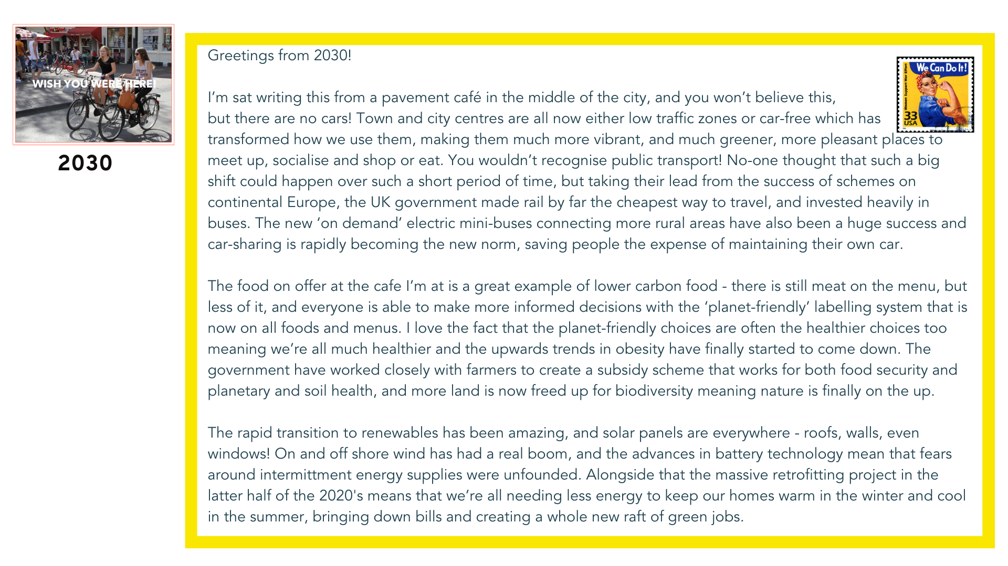


Slide 34

What does a day in the life of your school look like in 2030?
What changes can you see?
- To the buildings and infrastructure
- To how students and staff are travelling to school
- School trips
- School meals
- The curriculum
- To classrooms
- To the outdoor space
etc etc
How could you use this exercise to engage pupils and colleagues?
Notes:
So what's your vision for your setting in 2030? In a 2030 where it has managed to halve its emissions.
What changes can you see in the buildings, in how staff and students are travelling to school and on trips, to the school meals, to the outdoor space? What does your curriculum look like? What conversations are you hearing?
** If you have time, you could split people into breakout rooms to start to discuss this.
Point out to people that this could also be a great follow-on session that could be really engaging, getting people together to co-create a vision with colleagues and students.
There's a lovely example from the town of Frome in Somerset, where three organisations within the town came together to co-create a 2030 vision, and then made this into a four page newspaper spread that was distributed as the outer to the local paper, the Frome Times. Could the school create their own postcard, or their own mini newspaper?
Encourage schools to make sure they then use that vision to create actions and change and that it doesn’t simply sit on the shelf!

Slide 35
*access will be given via email after today’s session
Show and tell: your Climate Action Plans
(Demo)

Slide 36


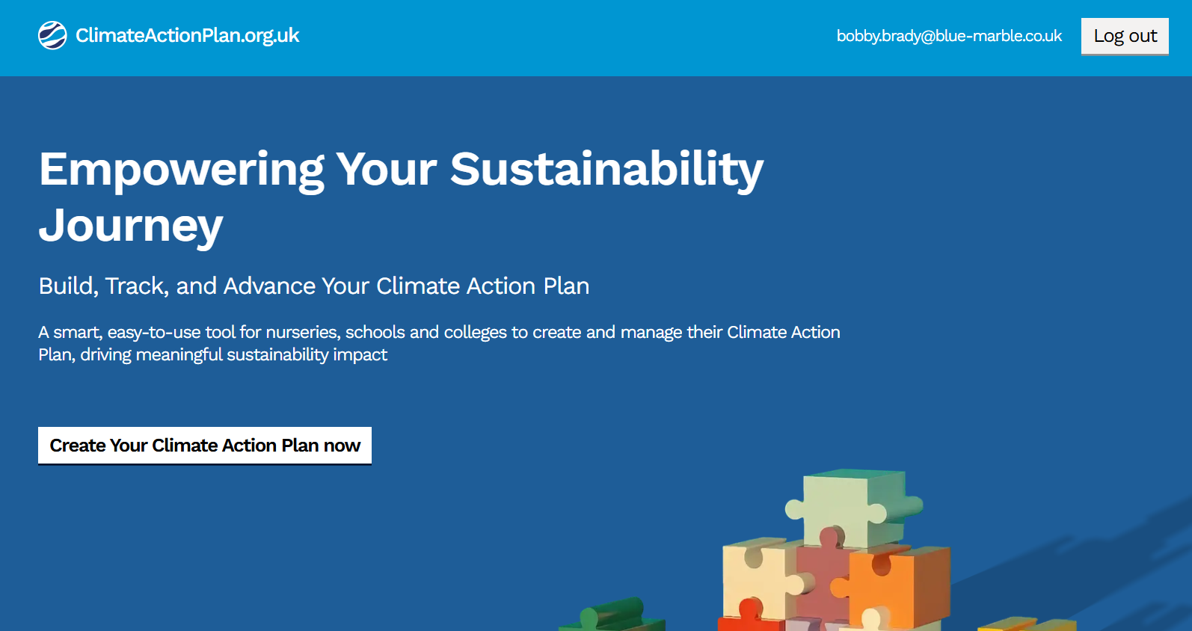
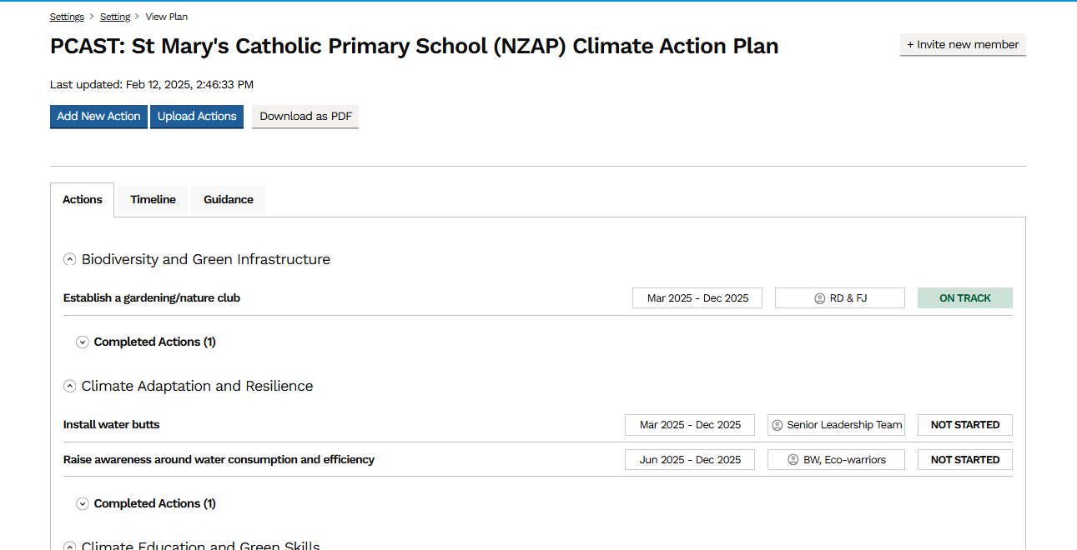


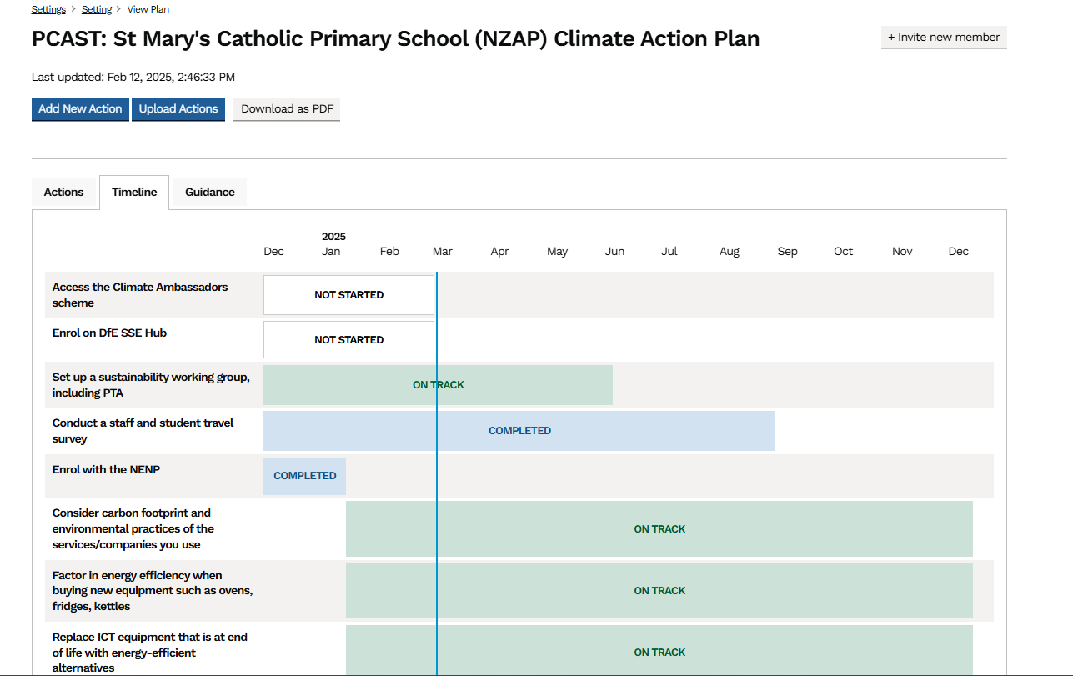
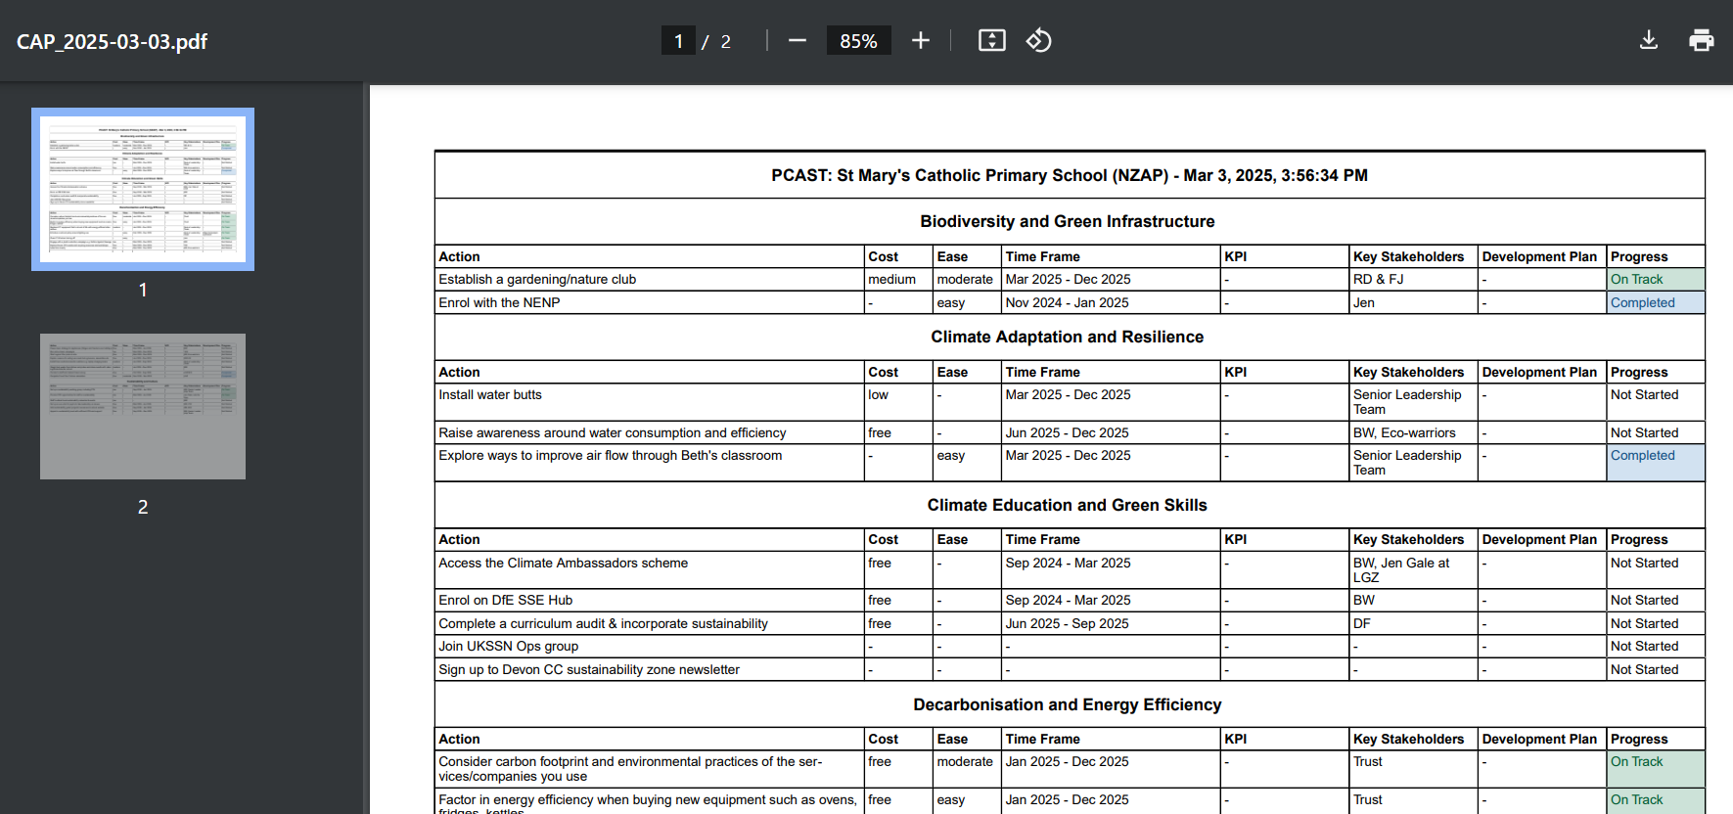
Your NZAP Climate Action Plans
*access will be given via email after today’s session
Visit: www.climateactionplan.org.uk
Review and update your plan
Waste actions,
Dates,
Action Owners!
See what’s coming next
Download and print snapshots as needed

Slide 37
The (Not So) Great Big
Carbon Literacy Quiz!

Slide 38
Methane emissions are associated with…
A) Ruminant agriculture and artificial fertilisers
B) Landfill and artificial fertilisers
C) Ruminant agriculture and landfill
D) Cement production and landfill
Notes:
OK so that's what's happening on the international stage how about what is happening here in the UK?
The UK government has set a net zero target of 2040, 2045, 2050, 2060?
The answer is 2050.
The UK government were one of the first to come out and set a net zero target, however we are very much not on track to be hitting net zero. The climate change committee is an independent statutory body established under the climate change act in 2008, with the purpose of advising the UK and evolved governments on emissions targets and to report to parliament on the progress made in reducing greenhouse gas emissions and preparing for and adapting to the impacts of climate change. The most recent reports from the climate change committee have clearly shown that we are way off track in the majority of areas.

Slide 39
Which of the following are usually less than1% of a school’s carbon footprint?
A) Uniform
B) Waste
C) Staff travel
D) Water
Notes:
OK so that's what's happening on the international stage how about what is happening here in the UK?
The UK government has set a net zero target of 2040, 2045, 2050, 2060?
The answer is 2050.
The UK government were one of the first to come out and set a net zero target, however we are very much not on track to be hitting net zero. The climate change committee is an independent statutory body established under the climate change act in 2008, with the purpose of advising the UK and evolved governments on emissions targets and to report to parliament on the progress made in reducing greenhouse gas emissions and preparing for and adapting to the impacts of climate change. The most recent reports from the climate change committee have clearly shown that we are way off track in the majority of areas.

Slide 40
For a typical primary school, what percentage of
its gas usage occurs when the school is closed to pupils?
A) 23%
B) 38%
C) 56%
D) 62%
Source: Energy Sparks
Notes:
OK so that's what's happening on the international stage how about what is happening here in the UK?
The UK government has set a net zero target of 2040, 2045, 2050, 2060?
The answer is 2050.
The UK government were one of the first to come out and set a net zero target, however we are very much not on track to be hitting net zero. The climate change committee is an independent statutory body established under the climate change act in 2008, with the purpose of advising the UK and evolved governments on emissions targets and to report to parliament on the progress made in reducing greenhouse gas emissions and preparing for and adapting to the impacts of climate change. The most recent reports from the climate change committee have clearly shown that we are way off track in the majority of areas.

Slide 41
What makes the biggest contribution to a
food’s carbon footprint?
A) Food miles
B) The type of food
it is
C) Packaging
D) Seasonality
Source: Energy Sparks
Notes:
OK so that's what's happening on the international stage how about what is happening here in the UK?
The UK government has set a net zero target of 2040, 2045, 2050, 2060?
The answer is 2050.
The UK government were one of the first to come out and set a net zero target, however we are very much not on track to be hitting net zero. The climate change committee is an independent statutory body established under the climate change act in 2008, with the purpose of advising the UK and evolved governments on emissions targets and to report to parliament on the progress made in reducing greenhouse gas emissions and preparing for and adapting to the impacts of climate change. The most recent reports from the climate change committee have clearly shown that we are way off track in the majority of areas.

Slide 42
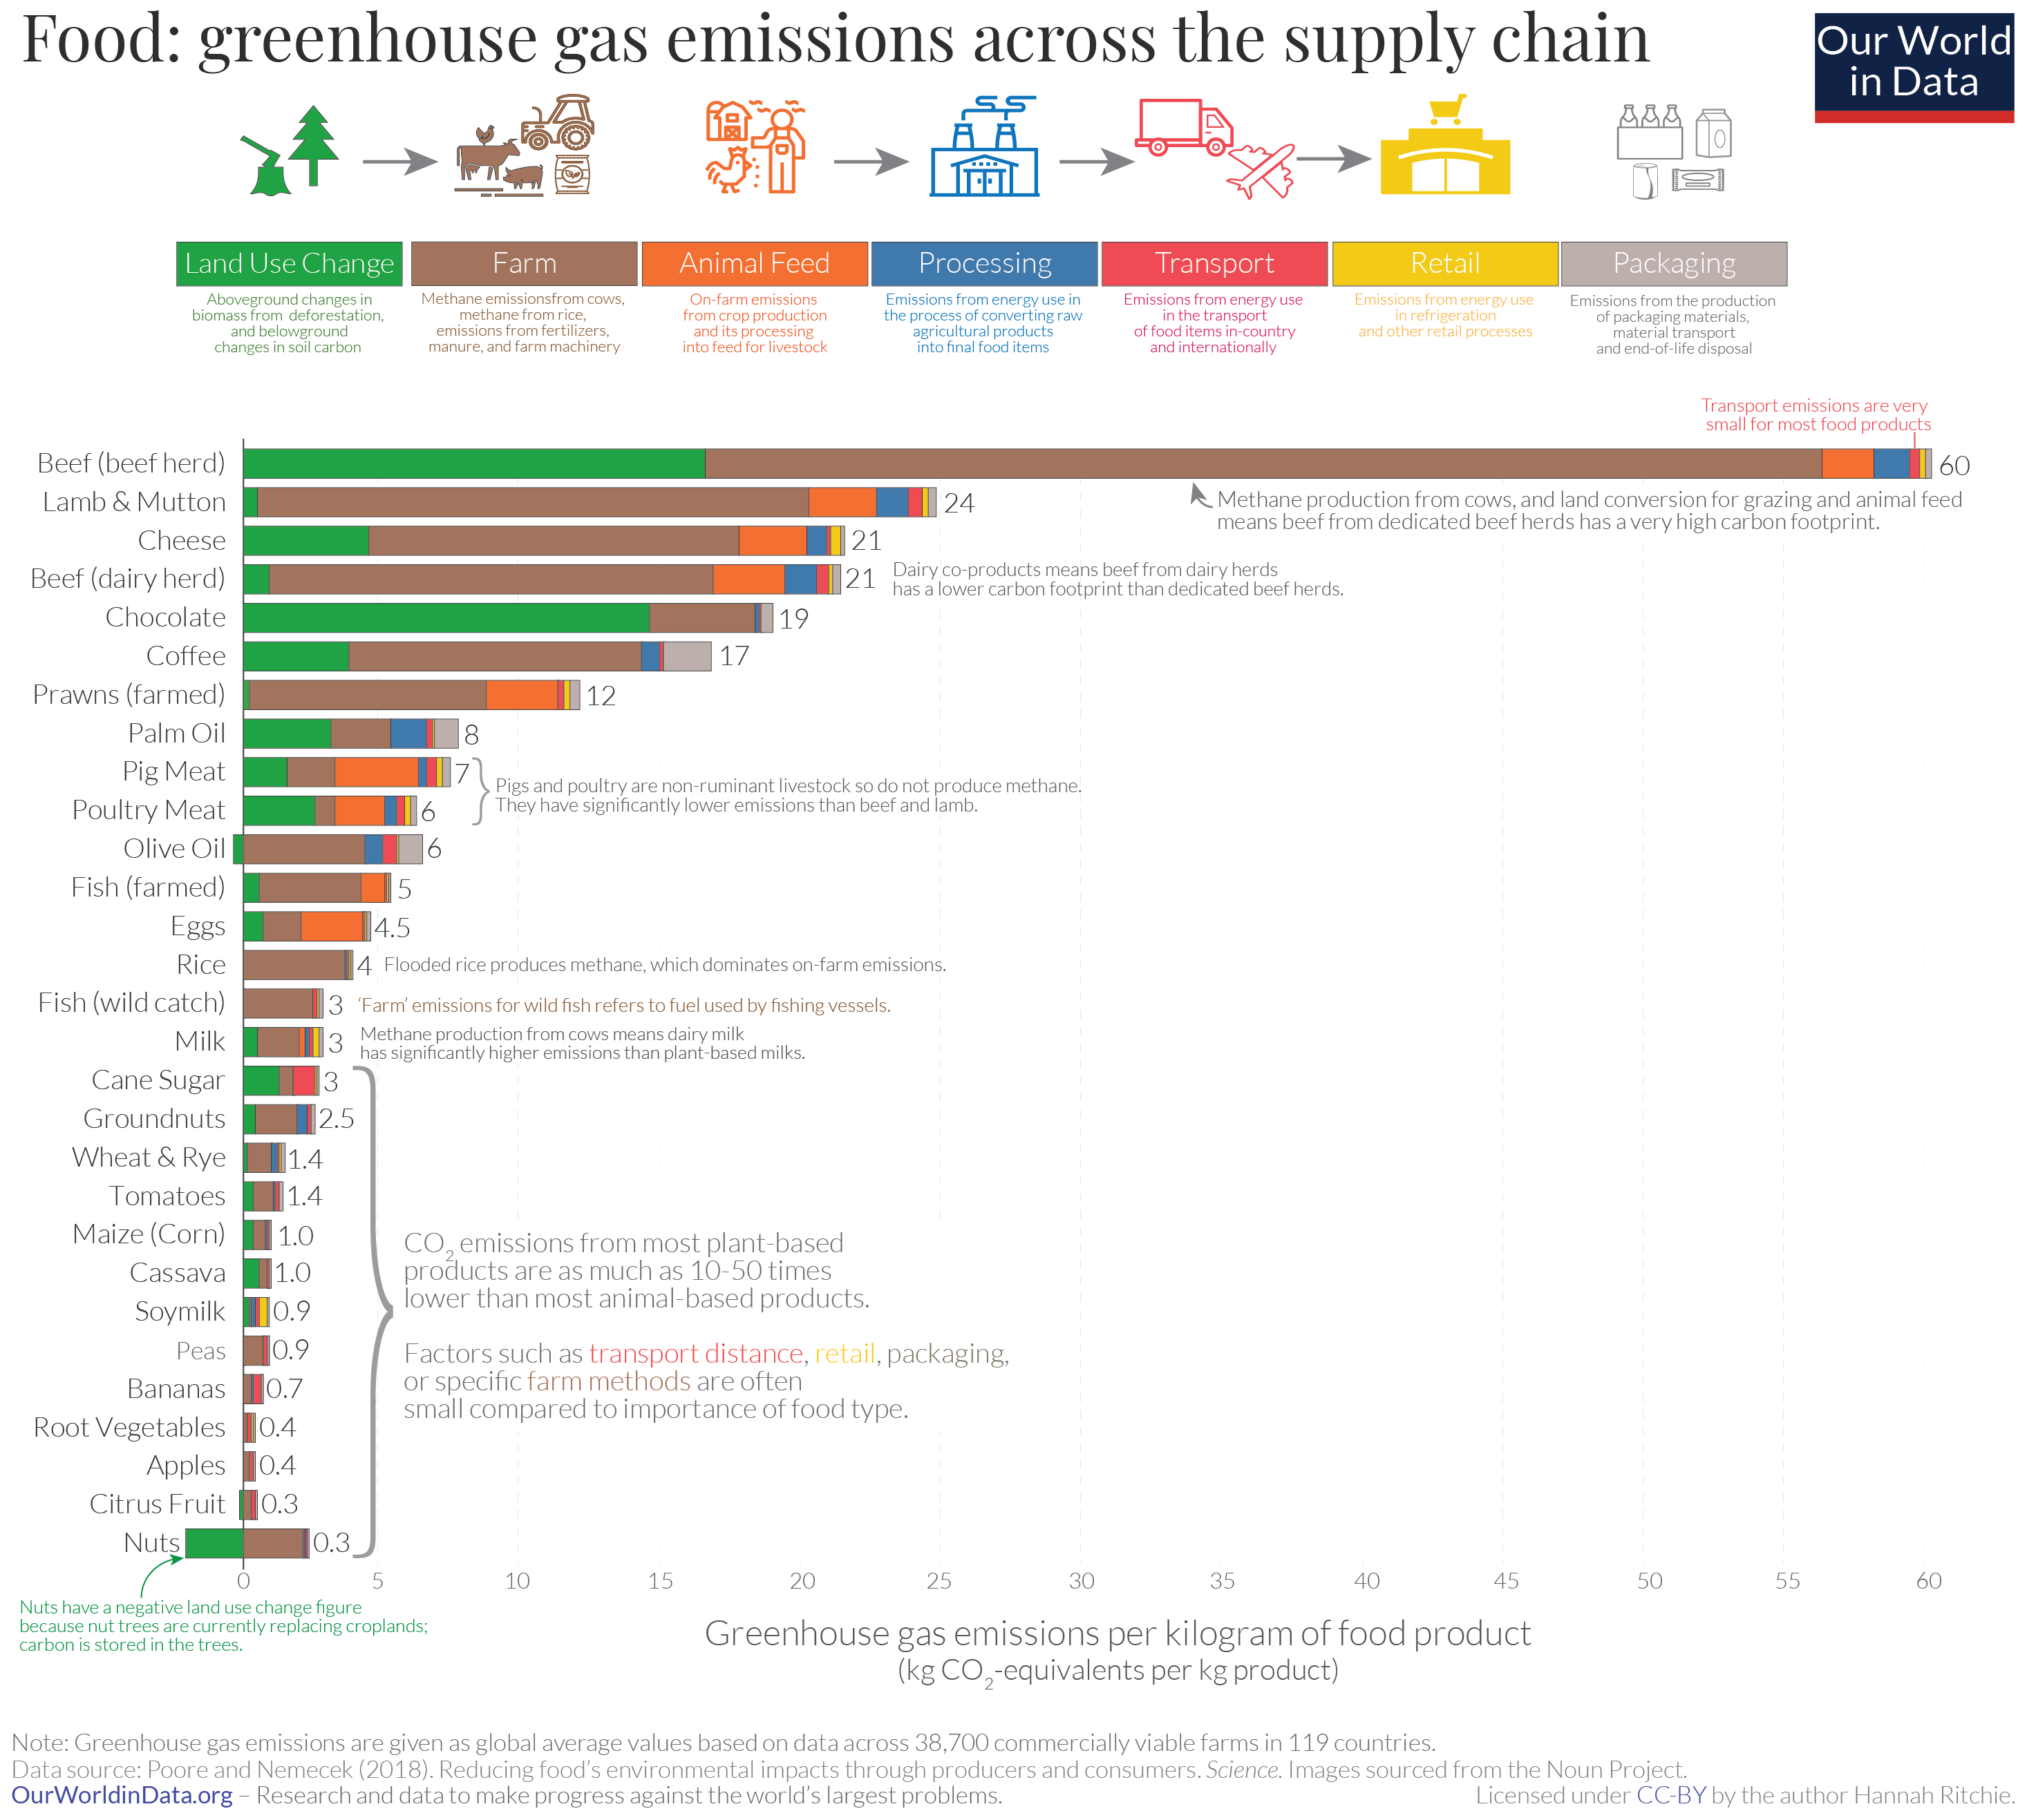
Notes:
This is a graph from a website called our world in data that looks at food and the greenhouse gas emissions along the supply chain. You can see from this chart that for most foods transport actually makes up a very small amount of their carbon footprint. So an avocado, even if it's been transported from halfway around the world and wrapped in plastic, will still invariably have a lower footprint than a beef steak even if that was from locally produced meat.
Where transport can have a bigger impact on a food’s footprint is if that food has been air freighted. In his book “How bad are bananas?”, Mike Berners-Lee gives the example of a 250g pack of asparagus. That 250g pack of asparagus, if it was locally grown and in season, would have a carbon footprint of 1.1kg CO2e. The same pack, air freighted from Peru, would have a carbon footprint of 4.7kg CO2e. And Mike Berners-Lee goes on to note that if your entire diet was as carbon intensive as long haul asparagus, your food would have a footprint of more than 80 tonnes. Examples of other foods that are very likely, when out of season, to have been air freighted include baby corn, baby carrots, mange tout, green beans, fine beans, okra, shelled peas, lettuces, blueberries, raspberries and strawberries.
So if we're looking at foods that haven't been airfreighted, and therefore transport isn't as big an issue as we may originally have thought, what is another think we need to take into consideration that contributes to our food's carbon footprint?
The seasonality of food can have a big bearing on its carbon footprint.
Another example from “How bad are bananas?” is a kilo of tomatoes. A kilo of large salad variety tomatoes grown locally in season, will have a carbon footprint of 1.3kg CO2e.
A kilo of organic vine cherry tomatoes, grown in a heated greenhouse in the UK in March, could have a carbon footprint of 28.2kg CO2e. This is a worst case scenario, on a farm where the green houses I heated using energy directly from the grid. Many farms have renewable energy generation on site, for example solar panels or anaerobic digestion. However eating more seasonally is still a very effective way to not only reduce your carbon footprint, but to ensure that you get the tastiest food.

Slide 43
What is the percentage of people joining in needed for ‘social tipping points’?
A) 10%
B) 25%
C) 38%
D) 51%
Source: Energy Sparks
Notes:
OK so that's what's happening on the international stage how about what is happening here in the UK?
The UK government has set a net zero target of 2040, 2045, 2050, 2060?
The answer is 2050.
The UK government were one of the first to come out and set a net zero target, however we are very much not on track to be hitting net zero. The climate change committee is an independent statutory body established under the climate change act in 2008, with the purpose of advising the UK and evolved governments on emissions targets and to report to parliament on the progress made in reducing greenhouse gas emissions and preparing for and adapting to the impacts of climate change. The most recent reports from the climate change committee have clearly shown that we are way off track in the majority of areas.

Slide 44
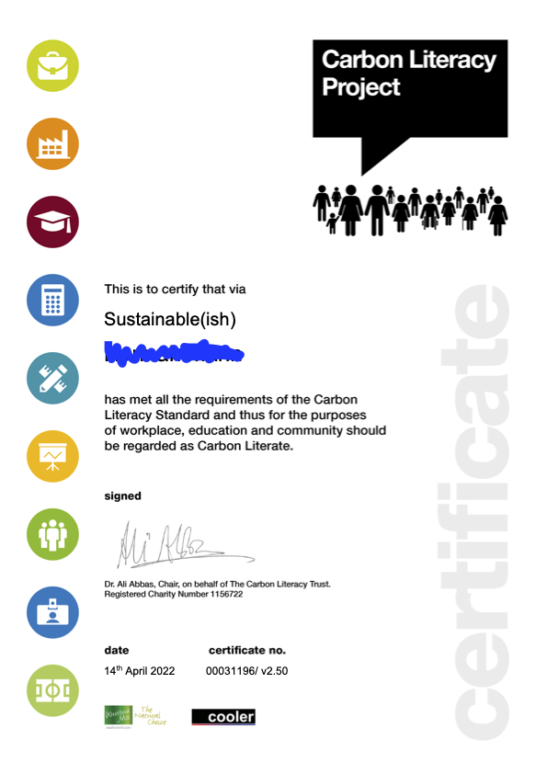
Carbon Literacy certification
Attend a day’s worth of accredited Carbon Literacy training
Designed (and completed!) actions to reduce carbon
Notes:
OK, so that was all of the learning! Apologies for bombarding you with so much stuff – there’s a lot out there and a lot to be done! I hope it hasn’t been too overwhelming, and please remember that you can enlist the support of a Climate Action Advisor to help you cut through any overwhelm and work out what will work for your school or setting.
To finish up, we’re going to look quickly at what you need to do to get your Carbon Literacy certificate!
REMEMBER – the Climate Action Plan that I gave you a template for is for you to take away and continue working on, and you can enlist the support of a CAA to do that.
To get your Carbon Literacy certificate, there’s another action plan you have to fill (I appreciate this might be confusing, apologies if so!)

Slide 45
Your action plan
INDIVIDUAL ACTION
A personal action geared towards changes you can make in your home, or place of work, or in your lifestyle choices to reduce your carbon footprint
AND
GROUP ACTION
A group action should consider the differences you can make in your workplace/community/place of study etc. to reduce the carbon footprint of a group of people.
“When individuals have attended CL training as part/on behalf of their work, we expect to see work-based actions.”
ACTIONS MUST BE NEW ACTIONS, SIGNIFICANT,
AND FOCUSSED ON CARBON REDUCTION

Slide 46
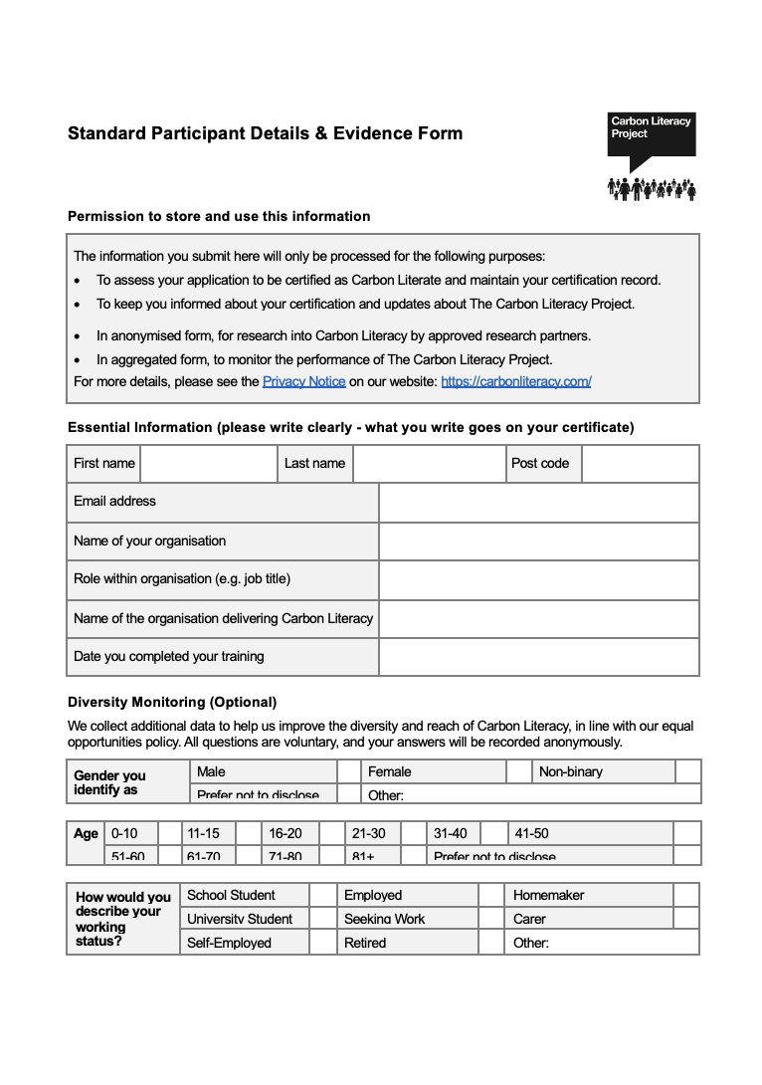
The form
Notes:
There is an evidence form that you need to complete in order to get to your Carbon Literacy certificate. The form needs to be completed and returned to me via e-mail within two weeks of today.
I will check over the forms before sending them off to the Carbon Literacy Project. If I think there are any amendments that need making I will get back to you. And then the forms are sent off in a batch to the Carbon Literacy Project for them to assess, and this process usually takes three to four weeks.
There are four parts to the form.
The first part is simply asking you for some demographics information. There is also space to let the Carbon Literacy Project if you are happy for them to share your pledge on their social media. They share their favourite ‘plegend’ of the month on social media- if you are happy for your pledge to be included for consideration, let them know by ticking the right box. And again if they think your pledge is amazing and would make a great case study on the website it may be that one of their team will want to follow up with you. Again if you are happy for that to happen let them know.
The second part is “What do we need to do as a society to reach net zero?” This is where you demonstrate your Carbon Literacy, that you’ve been on the course and you’ve taken on board the big, SOCIETAL changes that we need to make, for example, transitioning to renewable energy, investing in public transport and active travel infrastructure etc.
The third part is your individual pledge.
- What new action(s) will you be committing to?
- Where will the action take place – remember we really want this to be a workplace action.
If for any reason you can’t come up with a workplace action, or you think you can have a bigger action elsewhere, eg if your workplace potential actions are quite low impact, but you’re a frequent flyer and of reducing your flights/attempting a flight-free year, there’s space to explain this on the form.
- Estimated CO2e saving per year
You don’t need to work this out or google, but they want to see that you have an understanding of whether your action is low, medium, or high impact. Remember that definition of Carbon Literacy from module 1.
- What greenhouse gas(es) will this reduce? How?
This is another way that you can demonstrate your Carbon Literacy and that you understand how your action is reducing emissions.
- Why is this change significant?
This is where you let the CLP know why this is a significant action for you. Your action doesn’t have to be high impact, but ideally it should be something that is pushing you out of your comfort zone slightly, and therefore significant to you.
The fourth part is your group action, with very similar questions to part 3, and the addition of “Who are the group you will be doing this with?” and “What will your specific role be?”
Reminder, you have two weeks to get the form back to me!

Slide 47
Return to course lead via e-mail
Within 2 weeks of the end of the course
Course lead will check, and then send off the CLP for certification
3-4 week turnaround with CLP
Any questions, please shout (e-mail!)
Notes:
So when you’ve completed your form, return it to me via e-mail. I will then review and get back to you with any feedback (it costs another £10 to re-submit forms, so we try as hard as possible to make sure everybody is certified first time around!). Once I have all of the forms, I send them off to the Carbon Literacy Project and they have the final say over certification. There’s usually a 3-4 turnaround to hear back them, and as soon as I do, I will send out certificates and congratulations straightaway!

Slide 48
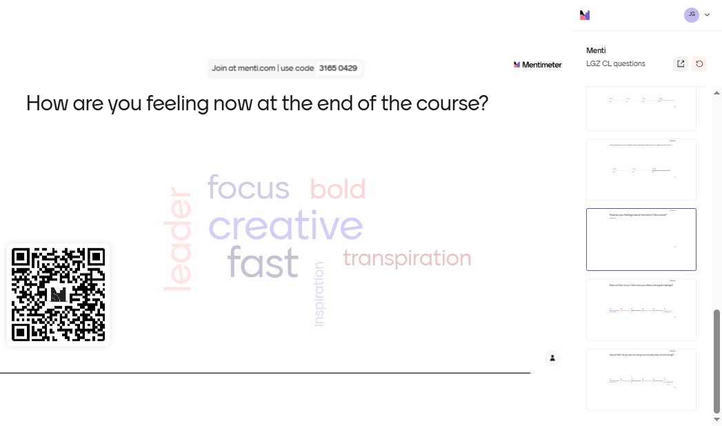
Notes:
To finish up, let’s repeat those Menti polls from the very start of the course! Can you give me three words for how you’re feeling now at the end of the course?

Slide 49
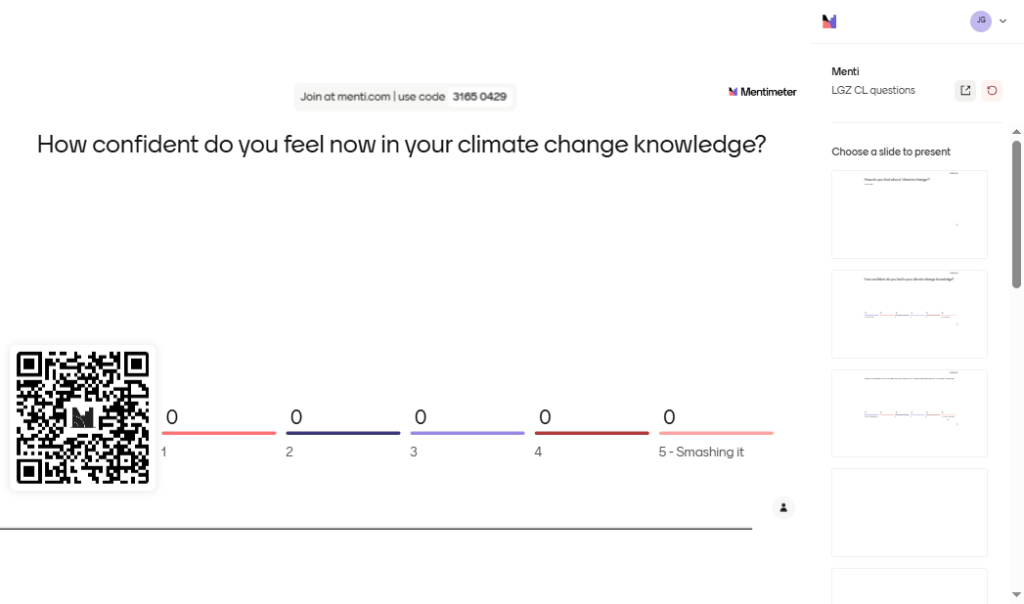
Notes:
How confident do you feel now in your climate change knowledge?.

Slide 50

Notes:
How confident do you now feel talking to other people about climate change?

Slide 51
Questions?
Notes:
Any questions about anything we’ve covered today?
I’m aware that we cover a lot in each session, and that we go quite quickly, so please do shout if there’s anything you’re unsure of.
Optional – you can ask people to share three words in the chat for how they’re feeling after the session.
OR ask them to share one ‘takeaway’ from the session

Slide 52
THANK YOU!

