Slide 1
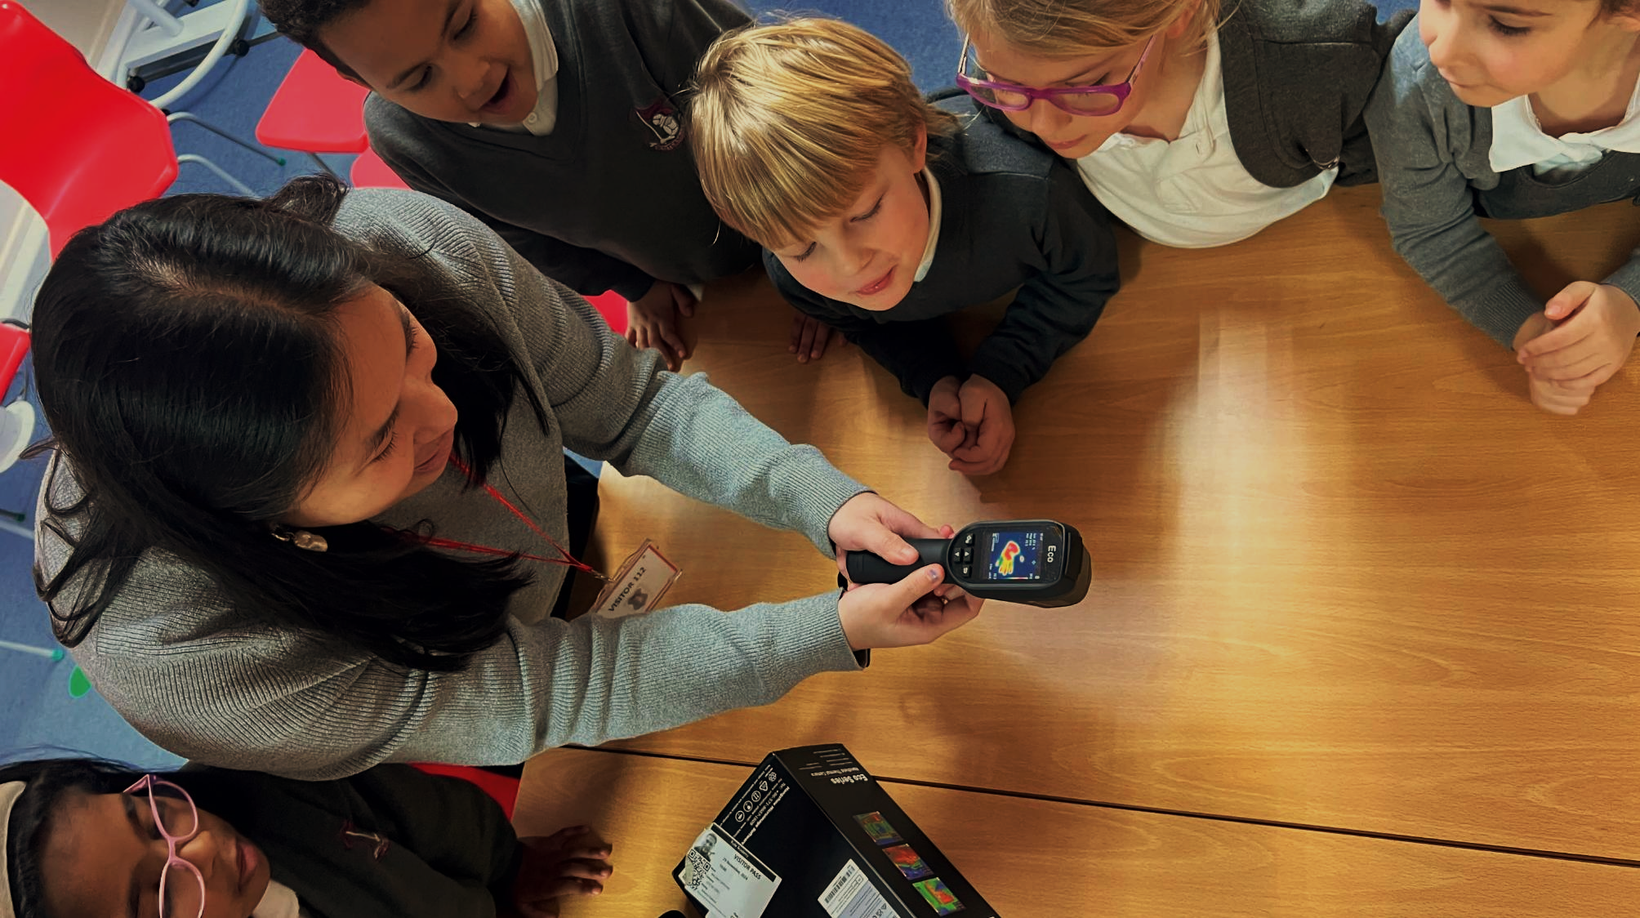









GBESP
Green Skills and Careers
[Controls Management and Optimisation]

Slide 2

Green Skills and Careers
A group of green industry expert organisations have been working with selected schools and colleges in the region to reduce their energy bills and help them reach net zero.
The green economy is booming, and we would like to share our experiences and outline the types of jobs that young people can get in the future.

Slide 3
CALADEN CONSULTING
We provide a broad range of independent advice and technical services that support our clients in delivering real carbon and cost reductions.
Notes:
We have more than 100 years of combined experience in the implementation of robust carbon reduction strategies, heat decarbonisation plans, and net zero roadmaps, which identify realistic opportunities, drive ambitious carbon reduction programmes, and deliver real cost savings. We work with organisations of all sizes, across both the private and public sector.
I’ve worked in energy and environmental consulting for more than 20 years and have long track record of helping organisations reduce their energy use and environmental impact.

Slide 4
Why does Saving Energy Matter?

Slide 5
WHY ENERGY MATTERS IN SCHOOLS & COLLEGES
Schools & Colleges spend money on energy
Energy use affects the planet
Comfort still matters
Energy is a major operational cost. Wasted energy means less budget for resources, facilities, and student support.
Most energy still produces carbon emissions. Using more than necessary directly increases a school’s environmental footprint.
The goal isn’t more heating, it’s efficient heating. Buildings should deliver the right temperature, at the right time, with minimal waste.
Notes:
Let’s start with why energy matters in schools.
First, schools spend a significant amount of money on energy every year — often tens of thousands of pounds. That’s money that could otherwise go towards things like books, facilities, or student support. So, when energy is wasted, it’s not just abstract — it has a direct impact on the school budget.
Secondly, energy use has a real impact on the environment. Most of the energy we use still results in carbon emissions. So if a school is using more energy than it needs to, it’s also increasing its carbon footprint unnecessarily.
And finally, comfort still matters — but it needs to be managed properly. The goal isn’t to make buildings as warm as possible. It’s to make sure they’re at the right temperature, at the right time, without wasting energy. So really, energy in schools is about balancing three things: cost, carbon, and comfort — and getting that balance right is what good energy management is all about.

Slide 6
WHERE ENERGY IS USED IN SCHOOLS & COLLEGES
HEATING
About 60%
LIGHTING
15–20%
HOT WATER
About 10%
KITCHENS
About 5%
IT AND
EQUIPMENT
5–10%
Notes:
On this slide, we can see how energy is typically used across a school building. The biggest takeaway is that heating dominates energy consumption, making up around 60% of total use. That means most of the energy a school pays for is simply keeping the building warm.
Next, we have lighting, which accounts for roughly 15 to 20%. This is still a significant portion, and it’s an area where simple changes—like switching to LEDs or using natural light—can make a noticeable difference.
Hot water comes in at about 10%, covering things like taps, showers, and cleaning.
Then we have kitchens, which use around 5%. This includes cooking equipment, refrigeration, and food preparation areas.
Finally, IT and equipment make up 5 to 10%. That includes computers, projectors, printers, and other classroom technology.
Overall, this breakdown helps us understand where the biggest opportunities for energy savings are. Heating is clearly the largest area to target, but improvements in lighting and equipment use can also add up.

Slide 7
Source: Energy Consumption in the UK (ECUK)
Notes:
On the last slide, we saw that around 60% of a school’s energy use goes into heating. This slide shows that this isn’t just a school‑specific issue — it’s a national one.
Across the UK, heating makes up the largest share of primary energy use, even bigger than transport. Nearly half of all the energy the country consumes is used simply to heat buildings and provide hot water.
So when we talk about reducing energy use or cutting carbon, heating is the biggest lever we can pull. And that’s exactly why the 60% figure for schools matters so much — it reflects a much wider pattern. If we can make heating more efficient in schools, we’re contributing to solving one of the UK’s biggest energy challenges.

Slide 8
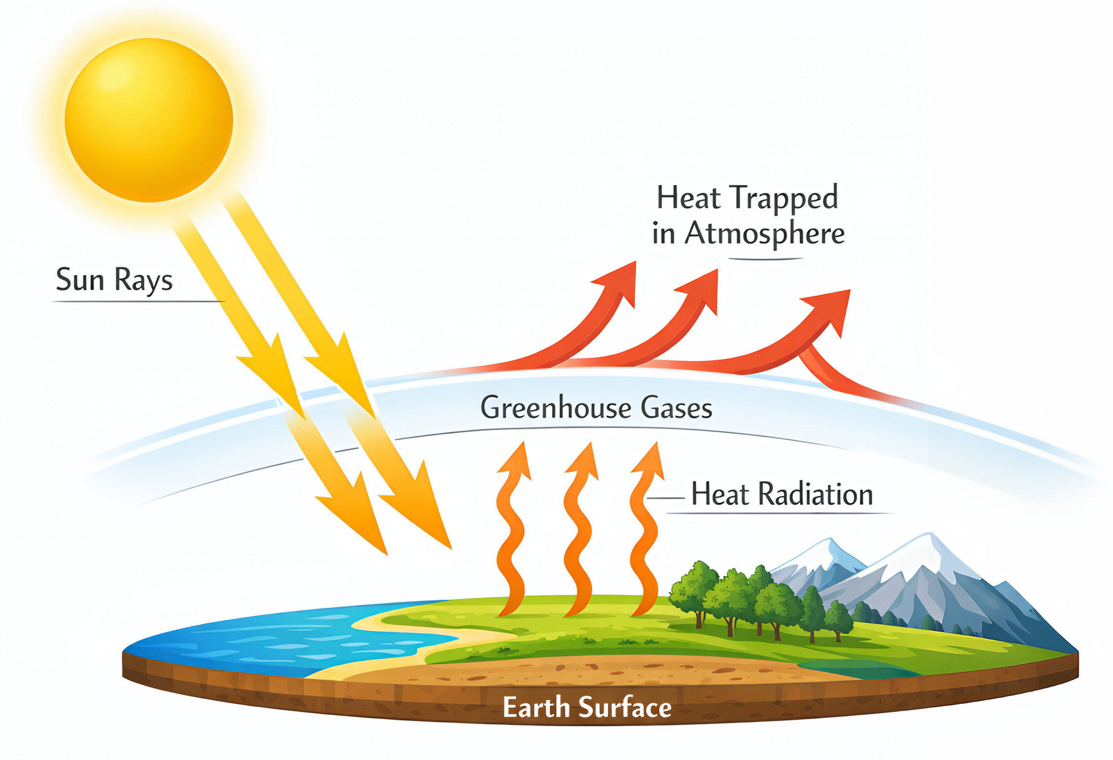
GREENHOUSE GASES
Notes:
This graphic shows the basic idea behind the greenhouse effect — the process that warms our planet. The sun sends energy down to Earth, and the surface absorbs it. Normally, some of that heat would escape back into space. But greenhouse gases in the atmosphere trap part of that heat and send it back down again.
This natural effect is essential for life, but the problem is that human activities — especially burning fossil fuels for things like heating — add extra greenhouse gases. That means more heat gets trapped, and the planet warms up.
So when we talk about improving heating systems in schools or reducing the amount of energy we use for heating, it’s not just about saving money. It’s also about reducing the greenhouse gases that contribute to this warming effect.

Slide 9
How much energy do you think a typical school or college wastes?
What do you think the impact of that is in terms of money wasted?
Notes:
Pause and think about that.
In many schools, between 10% and 30% percent of heating energy is wasted.
If a school spends around £200,000 a year on energy, that could mean £20,000 to £60,000 wasted.
That’s money that could go into:
equipment
facilities
or your learning environment.

Slide 10
Why do we waste energy?

Slide 11
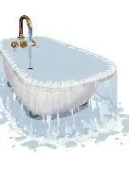

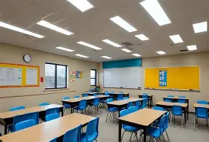
Why do we waste energy?
Visibility

Slide 12
Smart Metering, Monitoring and Controls (BEMS)
Smart Metering
Monitoring
Smart controls
Half hourly Data
Consumption profiling
Real-time energy use
What normal looks like
Benchmarking
Impact of changes
Optimisers
Weather compensating
Operating Logs

Slide 13
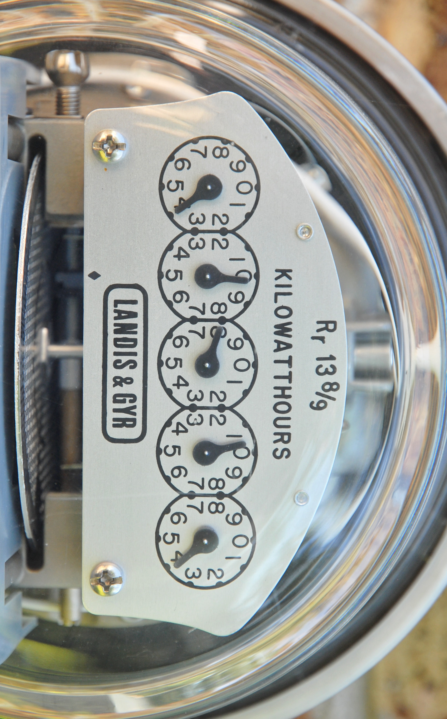
IF YOU CAN’T MEASURE IT, YOU CANNOT IMPROVE IT
Notes:
Two themes that run through the remainder of the is presentation. The first, to paraphrase the great physicist Lord Kelvin; if you don’t measure your energy use, you won’t be able to improve how you use it. We’ll look at some of the ways that you can measure you’re consumption shortly.

Slide 14

THE CHEAPEST UNIT OF ENERGY IS THE UNIT YOU DON’T USE
Notes:
The other is self-explanatory, the cheapest unit of energy, regardless of geopolitics, is the one you don’t use.

Slide 15
HOW MUCH ENERGY ARE YOU CURRENTLY USING?
REVIEW HISTORICAL USE
BENCHMARKING
Review and analyse energy invoices, meter readings and AMR data to build an understanding of how you have used energy over the last year
Compare your buildings against each other to identify those most in need of improvement
Notes:
Getting a thorough understanding of your current and historical consumption can help with effective procurement, help set targets, identify opportunities for energy saving and help engage building occupants to make behavioural changes. It may be beneficial to install loggers / AMR meters to provide you with more granular data. If you don’t have good quality data (e.g. actual meter reads for month start/end from your supplier invoices) then get into the habit of taking them.
Benchmarking can be undertaken in a number of different ways;
Look at your EPCs / DECs
kWh/m2/year
Consider other benchmarks.
tCO2e per pupil
£ per pupil
Which one you choose will depend on what your focus is. Is it to save money, reduce energy use or reduce carbon emissions? Just bear in mind that benchmarks for energy use in vary depending on several factors, including the size and age of the building, the number of students and staff, and the type of activities that take place in the school.

Slide 16
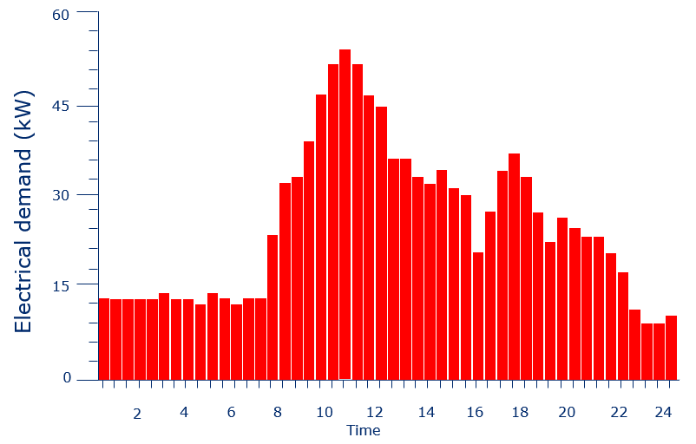
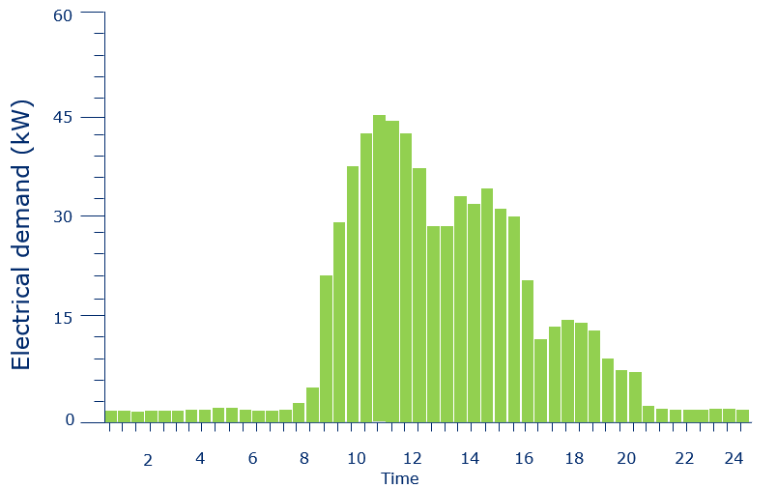
IMPACT OF OPERATIONAL IMPROVEMENTS
Notes:
Example of a school in which an out-of-hour survey had uncovered a number of electrical loads that were operating over night when not required, and the impact that resulted following a change.
Taking the early hours for example, an average load reduction of 11 kW was achieved for 8 hours – which equated to more than 32,000 kWh a year. Based on a unit cost of 30 p/kWh this alone would save nearly £10,000 a year and reduce carbon emission by 6.2 tCO2e – the equivalent of almost 2.25 domestic properties.

Slide 17
HOW A HEATING SYSTEM WORKS
Boiler or heat source
Pipes carry hot water
Radiators release heat
Thermostats and timers
Warm Room
Hot water is circulated through the school via an insulated pipe network.
Radiators transfer the heat from the water into each room.
Control systems regulate when the heating runs and how warm different areas get.
The aim is a comfortable, stable temperature — not overheating.
Generates the heat that supplies the entire building.
Notes:
This slide shows the key stages of how a school’s heating system actually works. It starts with the boiler or heat source — that’s where the energy is converted into heat for the building.
That heat is carried around the school as hot water moving through a network of pipes. When it reaches the radiators, they release the heat into each room, warming the space.
The whole system is managed by thermostats and timers. They control when the heating turns on, how warm different areas get, and how long the system runs.
All of this adds up to a room that feels comfortable to work in. But it’s worth remembering that every part of this process uses energy — and as we’ve already seen, heating is by far the biggest part of a school’s energy consumption. Understanding how the system works helps us see where improvements or smarter controls can make a real impact.

Slide 18
IMPROVING BEHAVIOUR / CONTROLS
EDUCATE
SWITCH-OFF
HEATING AND COOLING
REVIEW EXISTING CONTROLS
Building users need to understand how their actions impact energy use
Ensure lighting, ICT equipment and HVAC plant is only meeting genuine demand
Ensure areas are not being overheated or overcooled
Ensure existing controls (Boiler / BMS / time switches / TRVs etc) are appropriately set
Notes:
These are generally low cost measures that will have an immediate impact on your energy use.
The educate part can cover two areas; the obvious one whereby you raise awareness of how the users of buildings can positively or negatively impact the buildings energy use i.e. turning off lights when spaces are unoccupied, not leaving doors and windows open in spaces which are being heated or cooled. The less obvious part relates to the operation of the building services. Do you know how the heating system is controlled, or the external lighting, or the hot water system, or the air handlers? Are you able to make changes to the controls as the use of the building changes?
One the awareness raising is in place challenge staff and pupils to do their part and make them part of the process. Feedback the progress you make to maintain engagement. Switch off campaigns are great for this.
Review how and when you are heating or cooling spaces. Areas that are overheated can lead to the area being heated but windows / doors left open to cool the space. Typically, a 1C reduction in heating setpoint can reduce fossil fuel usage by around 8%. Increasing a cooling setpoint by 1C can reduce electricity use by around 3%. Whilst there are no temperatures specified within regulations such as The School Premises (England) Regulations 2012 or Education (Independent School Standards) Regulations 2014 (which applies to academies), DFE guidance recommends that normal teaching spaces are heated to 18C, with circulation areas or areas with high levels of physical activities are heated to 15C. Areas for pupils with special needs, low levels of activity or very young children should be heated to 21C.
Check that the existing controls are set appropriately. For example, that the school or home heating is not coming on too early, or running too late in the day. This is of particular importance in schools given the long periods of limited or non-occupation (holidays / weekends / overnight). It may be possible

Slide 19
TWO WAYS TO SAVE ENERGY
WHATE PEOPLE DO EACH DAY
CONTROLS AND TECHNOLOGY
switch off lights
close doors and windows
turn off screens
report problems
timers
thermostats
sensors
smart building controls
Notes:
There are really two sides to saving energy in a school. One side is the everyday behaviour — the things people do without needing any special equipment. Switching off lights, closing doors and windows, turning off screens, and reporting issues when something isn’t working properly. These actions seem small, but across a whole building they add up.
The other side is the technology that runs in the background. Timers, thermostats, sensors, and smart building controls help the heating and lighting operate efficiently without relying on people remembering every detail. When these systems are set up well, they prevent energy being used when it isn’t needed.
The important point is that neither approach works on its own. Real savings come from both: people reducing waste through good habits, and technology making sure the building only uses the energy it actually needs.

Slide 20
HOW PEOPLE CAN HELP SAVE ENERGY
TURN THINGS OFF
PREVENT HEAT LOSS
LEAVE CONTROLS ALONE
REPORT PROBLEMS
Lights, screens and projectors should not stay on in empty rooms.
Keep doors and windows shut during heating periods.
Thermostats should stay at the agreed setting.
Report overheating, cold spots, or anything that looks wasteful.
Notes:
There are a few simple behaviours that make a real difference to how much energy a school uses. The first is turning things off — lights, screens, projectors. If a room’s empty, there’s no reason for anything to be left running.
Keeping heat inside is another big one. When the heating’s on, open doors and windows let that heat escape, which means the system has to work harder to maintain the temperature.
It also helps if people leave the controls alone. Thermostats are set for a reason, and constantly adjusting them usually leads to wasted energy rather than a more comfortable room.
And finally, reporting problems matters. If a space is consistently too hot, too cold, or something seems to be wasting energy, letting someone know means it can be fixed instead of ignored.
These are small actions, but across a whole school they add up to meaningful savings.

Slide 21
HOW CONTROLS AND TECHNOLOGY HELP
THERMOSTATS
TIMERS AND SCHEDULES
ZONES AND VALVES
SENSORS AND SMART CONTROLS
Prevent rooms from overheating by keeping temperatures within the set range.
Ensure heating only runs when the building is in use, avoiding unnecessary energy use before or after the school day.
Allow different areas of the school to receive the right amount of heat, rather than heating the whole building the same way.
Automatically switch equipment off, monitor energy use, and help staff identify and reduce waste.
Notes:
Modern heating systems rely on more than just boilers and radiators — the real efficiency gains come from the controls behind them. Thermostats prevent rooms from drifting hotter than they need to be, which avoids wasting energy without affecting comfort.
Timers and schedules make sure the heating only runs when the building is actually in use. That stops the system from warming empty corridors before school starts or long after everyone has gone home.
Zoning and valves add another layer of control. They allow different parts of the school to be heated independently, so areas that aren’t being used don’t get the same level of heating as busy classrooms.
And then there are sensors and smart controls. These can switch equipment off automatically, track how energy is being used, and give staff the information they need to spot problems early.
All of these technologies work together to reduce waste and keep the heating system running efficiently — which matters when heating is the biggest part of a school’s energy use.

Slide 22
WHAT ENERGY WASTE LOOKS LIKE
Lights left on in empty rooms
Overheated classrooms
Windows and doors left open with heating on
Screens left running
Electricity is being used with no benefit.
If a room is uncomfortably warm, the heating is likely wasting energy.
Warm air escapes, forcing the system to work harder to maintain the temperature.
Computers and projectors continue to draw power even when they’re not needed.
Notes:
Energy waste is often easy to spot once you know what to look for. One of the most common examples is lights left on in empty rooms — that’s electricity being used for no purpose at all.
Another is overheated classrooms. If a room feels uncomfortably warm, it usually means the heating is running harder than it needs to, and that extra heat is pure waste.
Open doors or windows during heating periods are another big one. Warm air escapes, the system keeps trying to replace it, and the result is a lot of energy being burned for no benefit.
And finally, screens and projectors left running. Even when no one is using them, they continue to draw power.
These might seem like small things, but across a whole school they add up quickly. Spotting and reducing this kind of waste is one of the simplest ways to cut energy use.

Slide 23
WASTE MEANS HIGHER BILLS AND MORE CARBON
WASTEFUL BEHAVIOUR
ENERGY IS WASTED
MORE ENERGY IS USED
COSTS MONEY AND POLLUTES THE PLANET
Notes:
When energy is wasted, it doesn’t just disappear — it creates a chain reaction. It starts with wasteful behaviour, like leaving lights on or overheating rooms. That leads directly to energy being wasted, which means the system has to use even more energy to keep up.
The more energy we use unnecessarily, the higher the costs become — both for the school and for the planet. Every extra unit of energy burned adds to bills and increases carbon emissions.
So waste isn’t just about comfort or convenience; it’s about impact. Reducing waste means saving money and cutting carbon, which benefits everyone.

Slide 24
WHAT GOOD HEATING LOOKS LIKE
COMFORTABLE CLASSROOMS
HEATING ONLY WHEN NEEDED
NO OVERHEATING
HEAT KEPT INSIDE
Most teaching spaces are designed to feel comfortable at around 18–21°C.
The system should run during school hours, not when the building is empty.
If rooms are much warmer than necessary, energy is being used inefficiently.
Doors and windows should stay closed to prevent heat escaping.
Notes:
Good heating isn’t just about making rooms warm — it’s about using energy in a controlled, efficient way. Classrooms should feel comfortable, usually somewhere around 18 to 21 degrees. Warmer than that doesn’t improve learning; it just wastes energy.
Heating should also match how the building is used. There’s no benefit in running the system long before people arrive or after everyone has gone home.
Overheating is another clear sign of inefficiency. If a room feels far too warm, the system is using more energy than it needs to, and that extra heat is simply wasted.
And finally, keeping heat inside matters. Open doors and windows let warm air escape, forcing the system to work harder to maintain the temperature.
All of these points add up to the same idea: effective heating is about comfort without waste

Slide 25
RECOMMENDED INTERNAL TEMPERATURES
Maintain comfort and save energy by keeping rooms at the right temperature.
Room Type | Recommended Temp
📚 Classrooms / Teaching Areas | 18–21°C
💼 Offices / Staff Rooms | 19-21°C
👣 Hallways / Corridors | 17–19°C
🚻 Toilets / WC | 18–19°C
🏋️ Gym / Sports Halls | 16–18°C
🍽️ Dining Hall / Kitchens | 18–20°C
Every 1°C above recommended temperature increases energy use by ~10%.
Notes:
Different spaces in a school don’t all need to be the same temperature. Classrooms are usually comfortable between 18 and 21 degrees — warm enough to focus, but not so warm that energy is wasted. Offices and staff rooms tend to sit slightly higher because people are mostly sitting still.
Corridors can be cooler because no one spends long periods there, and gyms are deliberately kept on the cooler side because people are active and generate their own heat. Dining halls and kitchens sit somewhere in the middle, balancing comfort with the extra heat produced by cooking equipment.
The key point is that heating every space to the same high temperature isn’t efficient. And there’s a big impact: for every degree above the recommended range, energy use goes up by roughly ten percent. That’s why getting these temperatures right matters — it keeps people comfortable while avoiding unnecessary waste.

Slide 26
REAL IMPROVEMENTS THAT EXPERTS MAKE
ADJUSTING TIMES AND SETTINGS
FIXING FAULTS
USING DATA TO SPOT WASTE
Experts check whether heating starts too early, runs too late, or is set higher than necessary.
They repair issues such as broken valves, faulty sensors, or controls that aren’t working correctly.
They review energy‑use patterns over time to spot signs of inefficiency or problems.
Notes:
Improving a heating system isn’t just about turning things on and off — it’s about understanding how the whole system behaves. One of the first things experts do is look at the timings and temperature settings. If the heating starts too early, runs too long, or is set hotter than it needs to be, that’s wasted energy.
They also deal with faults. A single broken valve or a sensor that’s giving the wrong readings can cause whole areas of a building to heat up unnecessarily, so fixing those issues makes a big difference.
And then there’s the data. By analysing energy‑use patterns over days, weeks, or months, experts can spot unusual spikes or trends that suggest something isn’t working as it should.
These improvements might not be obvious day‑to‑day, but they’re some of the most effective ways to cut waste and make the heating system run efficiently.

Slide 27
GREEN CAREERS LINKED TO THIS WORK
ENGINEERS
TECHNICIANS
ENERGY MANAGERS
Design and improve heating, energy and building systems.
Identify faults and repair equipment so systems run efficiently.
Monitor how energy is used and find opportunities to reduce waste.
Notes:
There are far more careers linked to energy and buildings than most people realise. Beyond engineers, technicians and energy managers, there are specialists who design how whole building systems work, from heating and ventilation to lighting and controls. Data analysts play a growing role too, using information to understand patterns and help organisations make smarter decisions.
Sustainability consultants work with schools, councils and companies to reduce carbon emissions and meet environmental goals. Facilities managers look after buildings day‑to‑day, making sure everything runs safely and efficiently. And with the shift to low‑carbon heating, there’s a growing need for people who can install and maintain technologies like heat pumps.
All of these careers contribute to making buildings more efficient, cutting carbon and reducing waste — and they’re becoming more important every year.

Slide 28
Thank you
Notes:
Thanks for listening.

