Slide 1
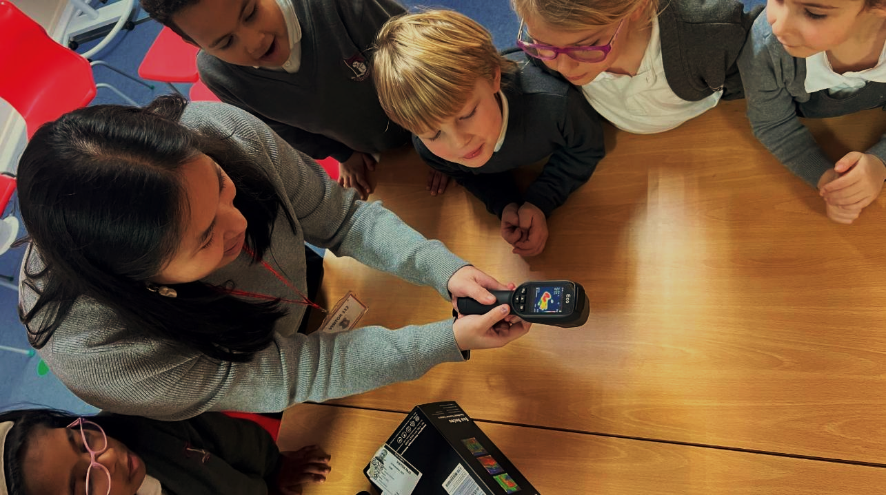










Great British Energy Solar Partnership
Green Skills and Careers

Slide 2

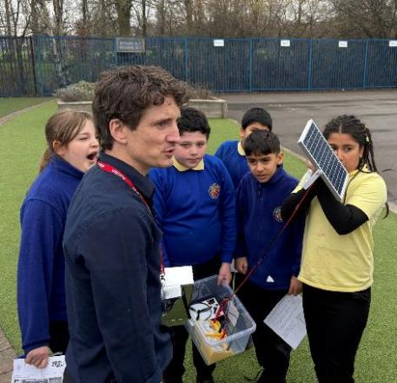
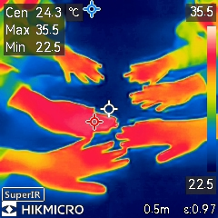
Helping your School reach Net Zero
A group of green industry expert organisations have been working with selected schools in the region to reduce their energy bills and help them reach net zero – paid by the GB Energy

Slide 3

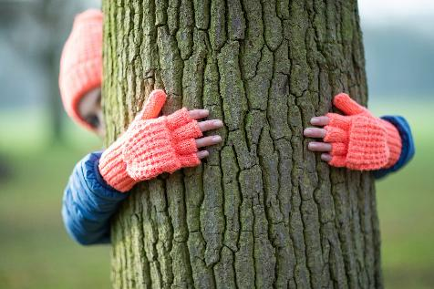
Abigail Gorman
I work at the North West Net Zero Hub
My role is a Net Zero Junior Project Officer
Background:
Studied Geography, Psychology and Philosophy at A-levels
I went to Liverpool Hope University to study
BSc Geography
Graduated in 2024 and started my graduate role at the hub in the October

Slide 4

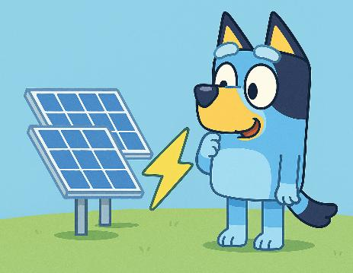
Simon Rule
I work for Place Group, which I started 24 years ago
I lead on helping schools reach Net Zero
Background:
Graphic Design Apprentice at 16
Many years in Design Industry
Started a Charity to run Schools in 2012
Now work with Schools to save them money

Slide 5
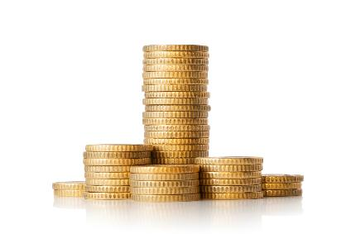

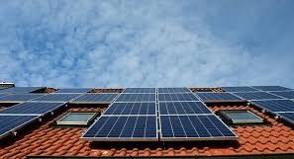
Helping your School reach Net Zero
Solar panels fitted to Belle Vue’s roofs – expected to save £37,000 a year and reduce tonnes of harmful green house gases

Slide 6
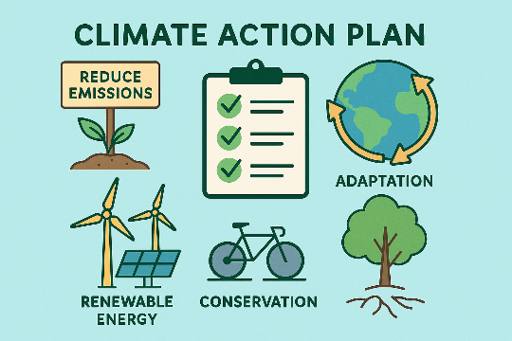

Helping your School reach Net Zero
You may have been involved in Belle Vue’s Climate Action Plan

Slide 7
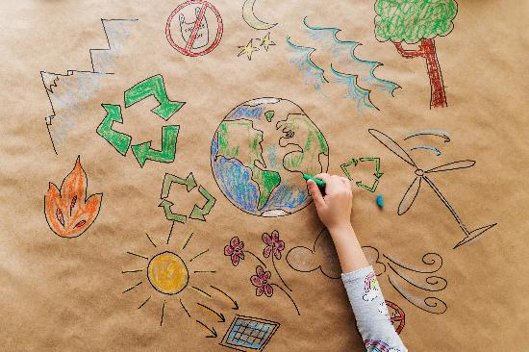
What is meant by Net Zero?
Net Zero is the balance between
the amount of greenhouse gas that's produced and the amount that's removed from the atmosphere
UK to be Net Zero by 2050 written in law

Slide 8
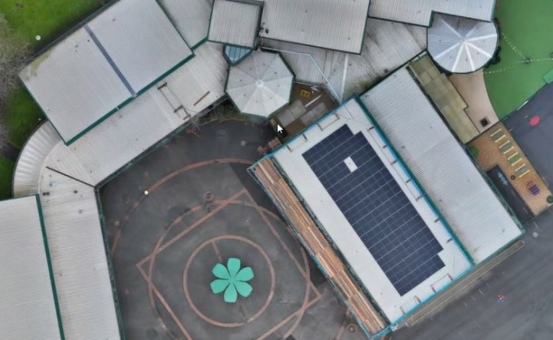
What is meant by Net Zero?
If all schools in England went solar, it would save £500m a year
54.2% of emissions reductions have been achieved since 1990

Slide 9

What is the Green Economy?
Green Economy = Jobs + Technology + the Planet
Generated £70 billion in 2022
690,900 green jobs in 2023
600,00 new green jobs by 2030
Green economy growing 3 times faster
Worth £1 trillion in the UK by 2030
Notes:
The green economy is booming, and we would like to share our experience of the types of jobs that young people can get in the future.

Slide 10
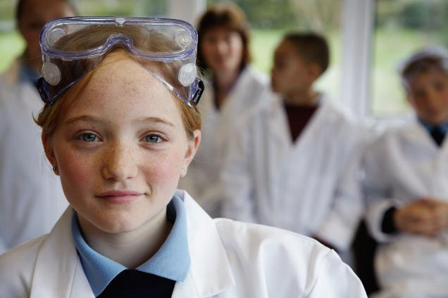
What are Green Skills and Careers?
The knowledge, abilities, and attitudes needed to support a sustainable, low-carbon economy, covering technical expertise

Slide 11



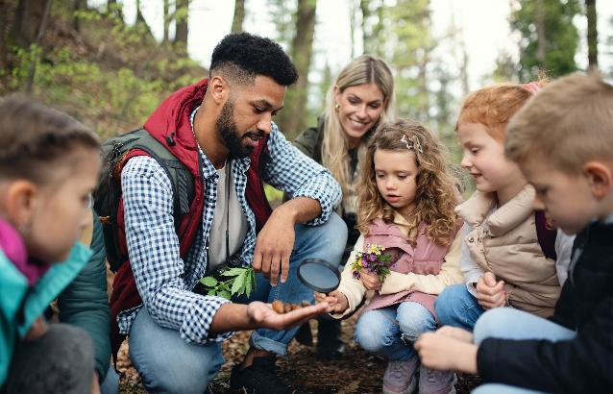
Green Jobs
Environmental Scientist
Study plants, animals and the world around us

Slide 12
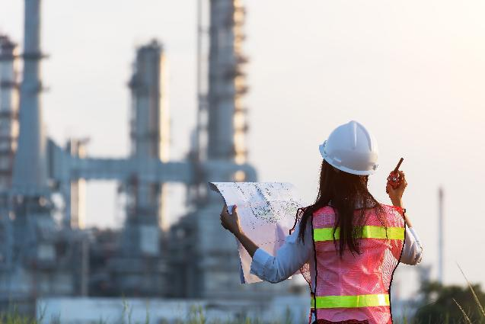
Green Jobs
Engineers
Designing, building, and operating technologies that minimize environmental impact

Slide 13
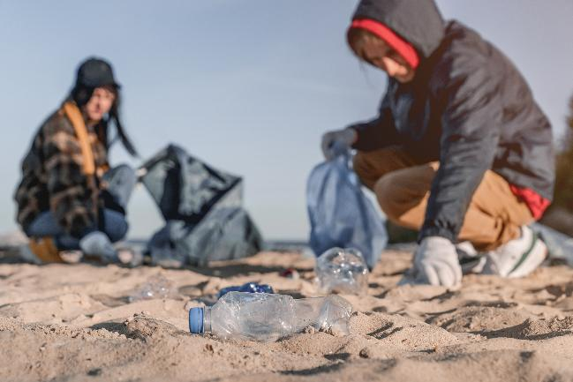
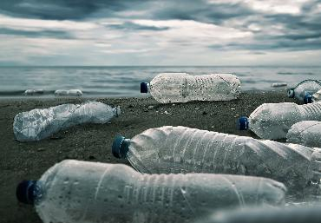
Green Jobs
Recycling Ranger
Help to make sure waste is recycled correctly so as much as possible gets reused

Slide 14
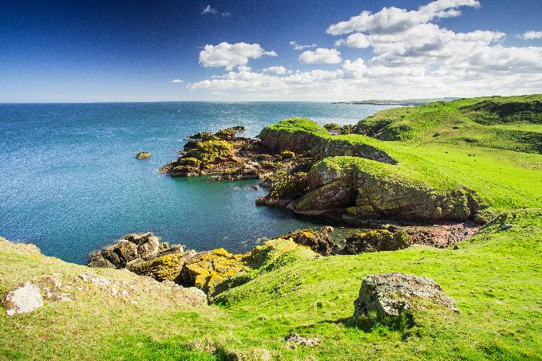
Green Jobs
Water Officer
Every Drop Counts! Water officers help to protect rivers, lakes, and oceans

Slide 15
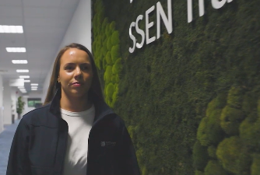
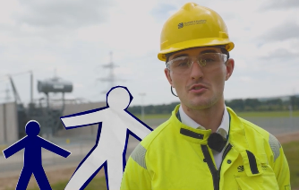
What type of green jobs are there?
Manufacturing
Engineering
Construction
Services
Energy
Technology
Science
Environment
Communications
Change Management
Apprenticeships
Degrees
AI to analyse data and accelerate decision making to maximise efficiency

Slide 16


What are Green Jobs?
What's a green jobs graduate scheme like?
Green Jobs

Slide 17
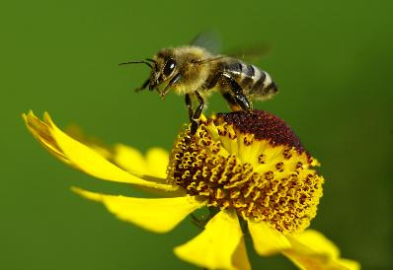
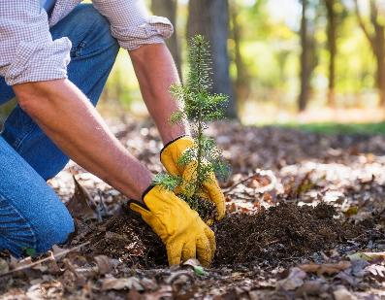
What do you want to do?
Please all stand up
Sit down if you know 100% what you want to do in your future career
Stay stood up if you care about the planet
Stay stood up if you want a job that benefits others

Slide 18
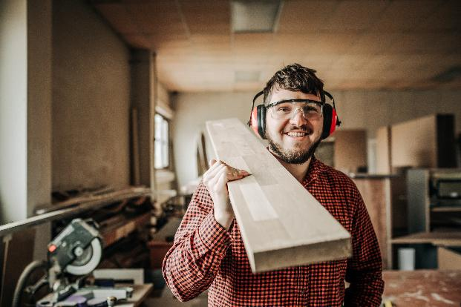
Would you like to know more?
Speak with your Sustainability Lead Teacher
Speak with your Careers Lead Teacher
Search the internet for green jobs

Slide 19

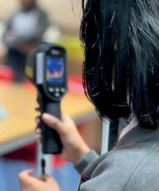
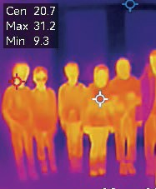
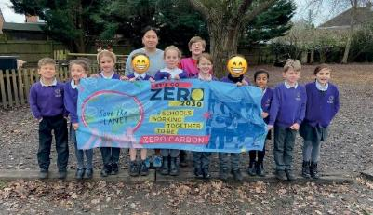
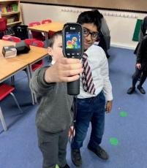
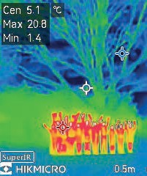

Questions?
Notes:
How to advise/communicate about multiple suppliers/stakeholders
ie
LGZ
Eco schools
UKSSN
STEM Learning
Lloyds Bank Green Buildings Toolkit
Sharing best practice – feedback from you!

Slide 20
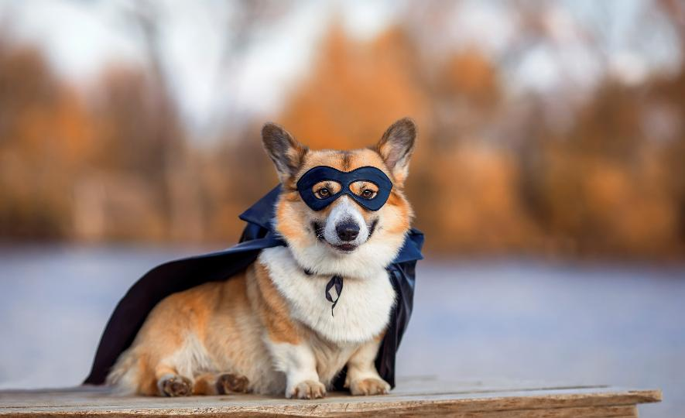





Thank you

Slide 21

Email
NWNZHub@liverpoolcityregion-ca.gov.uk
Website
  Local Energy North West |
LinkedIn
www.linkedin.com/company/north-west-net-zero-hub/

