Slide 1
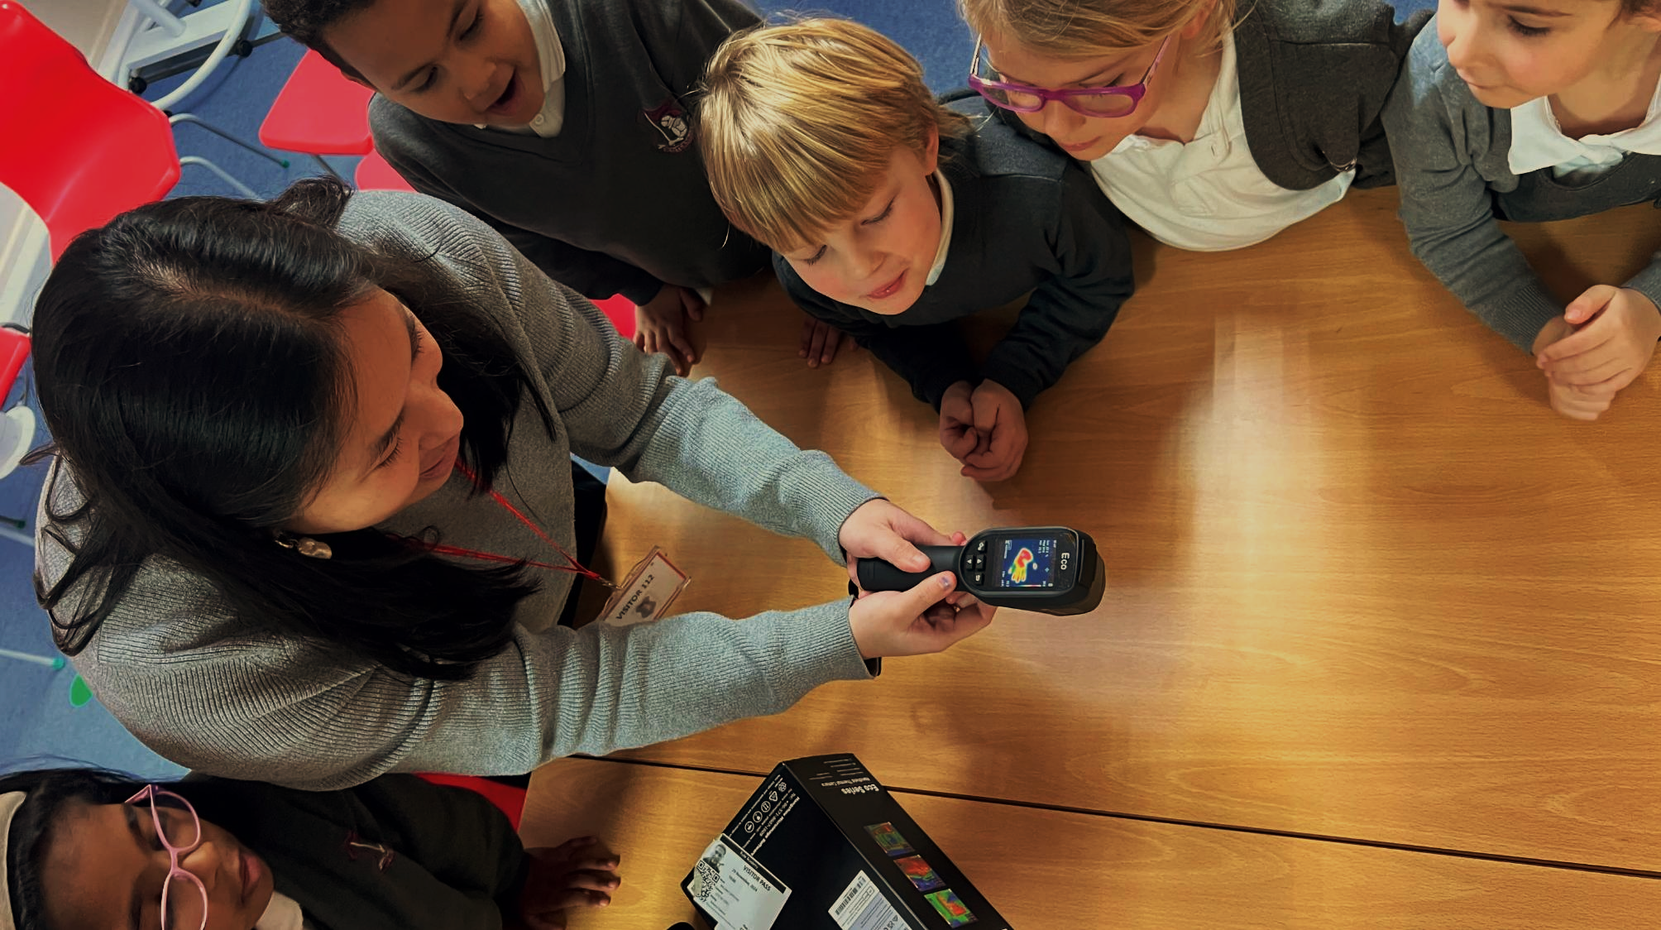









GBESP
Green Skills and Careers
Powering our Planet

Slide 2

What you will learn today?
Energy and how it works
What makes renewable energy great
Learn how solar panels (PV) works
How much of our power comes from solar PV
How you could work with energy

Slide 3

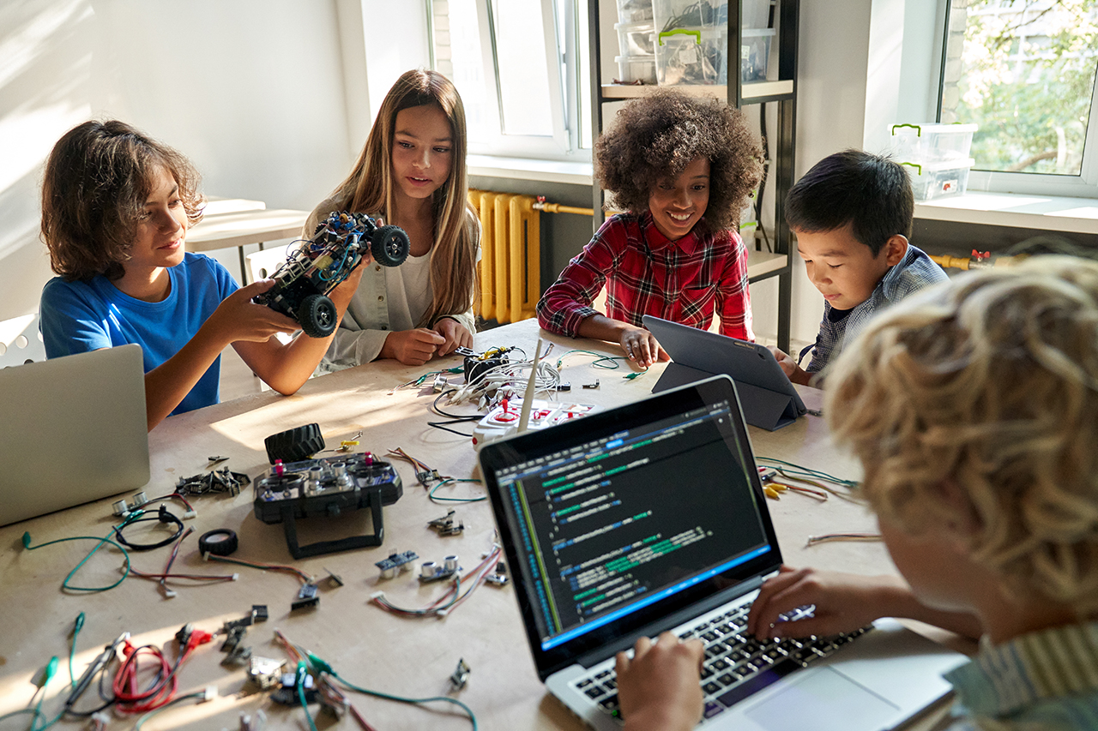
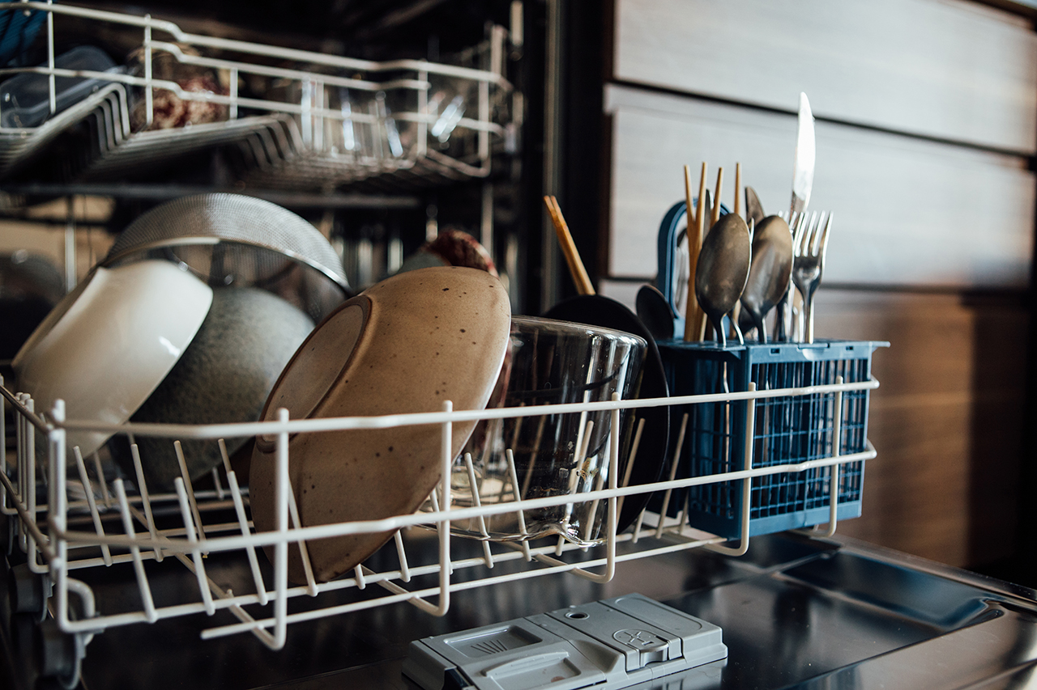
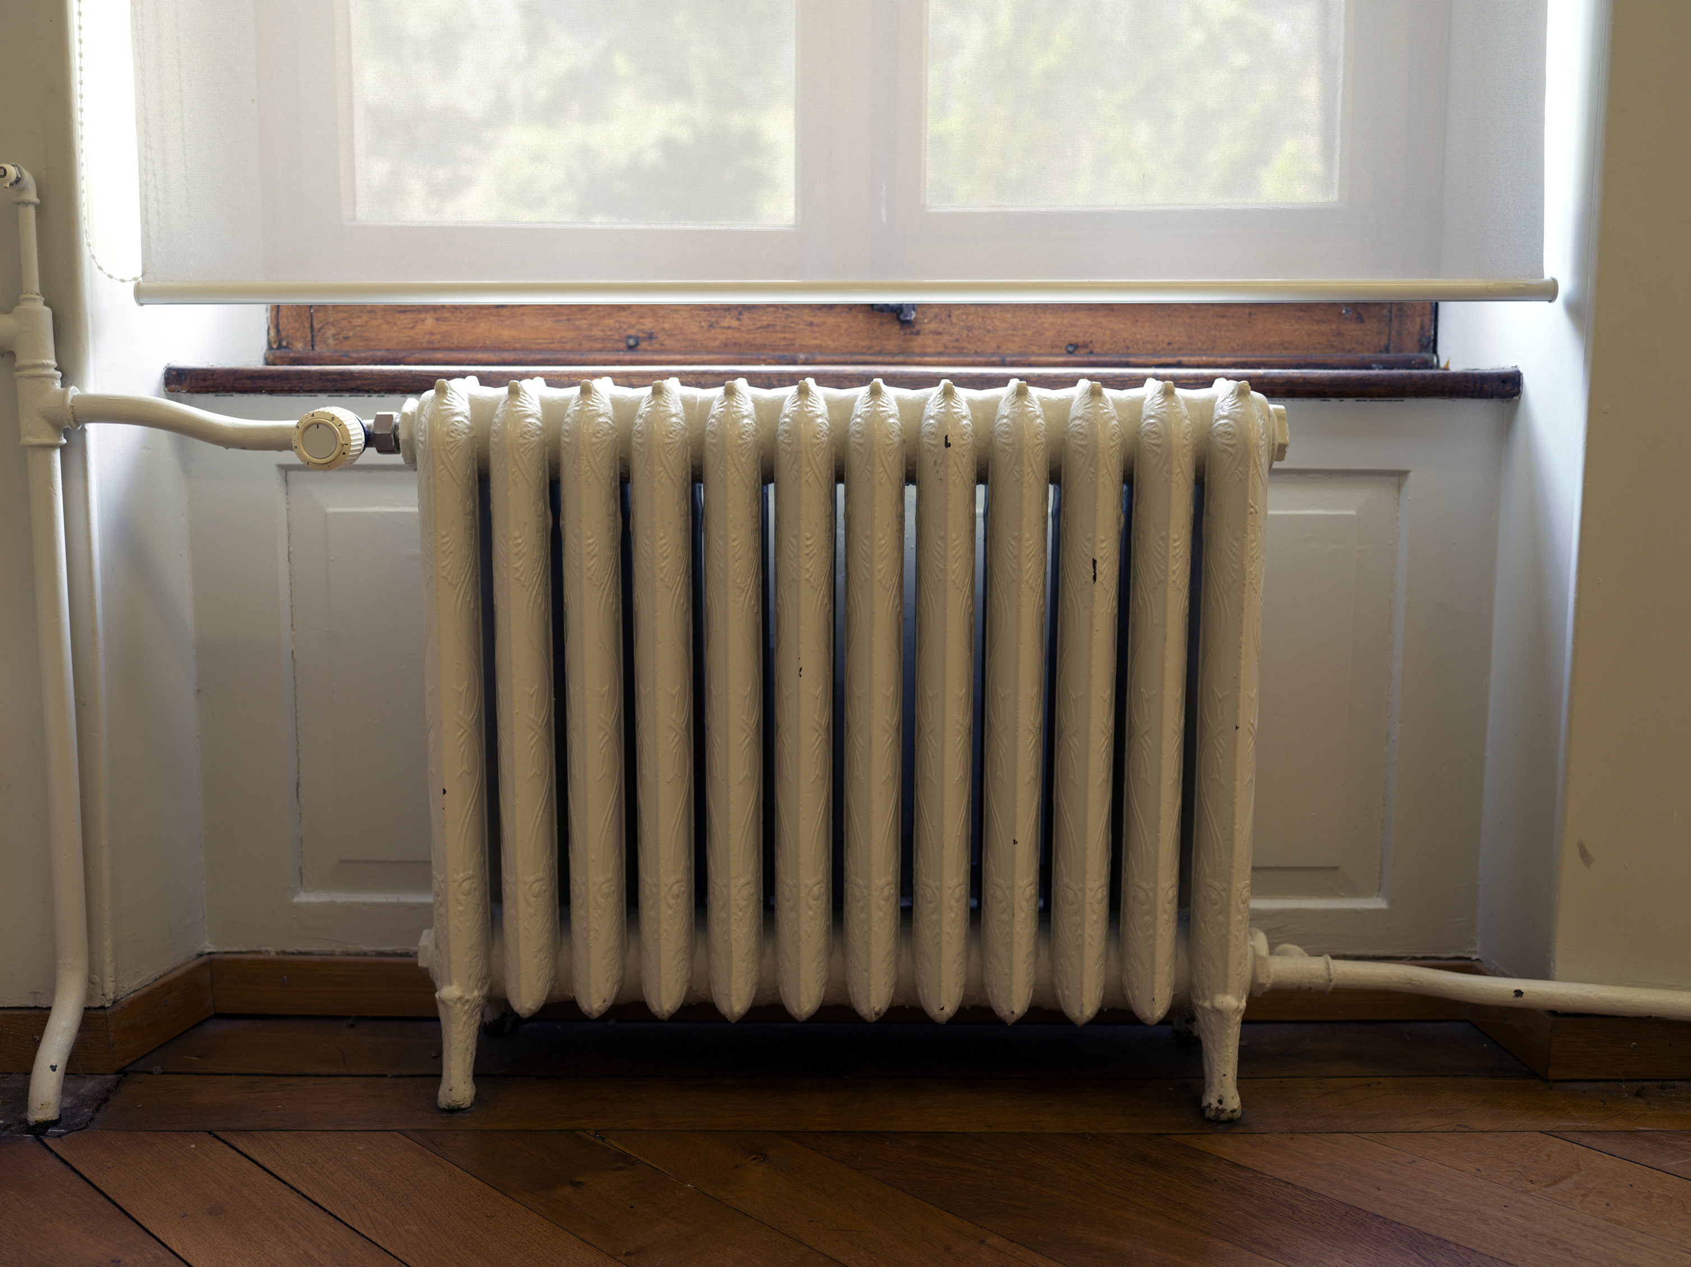
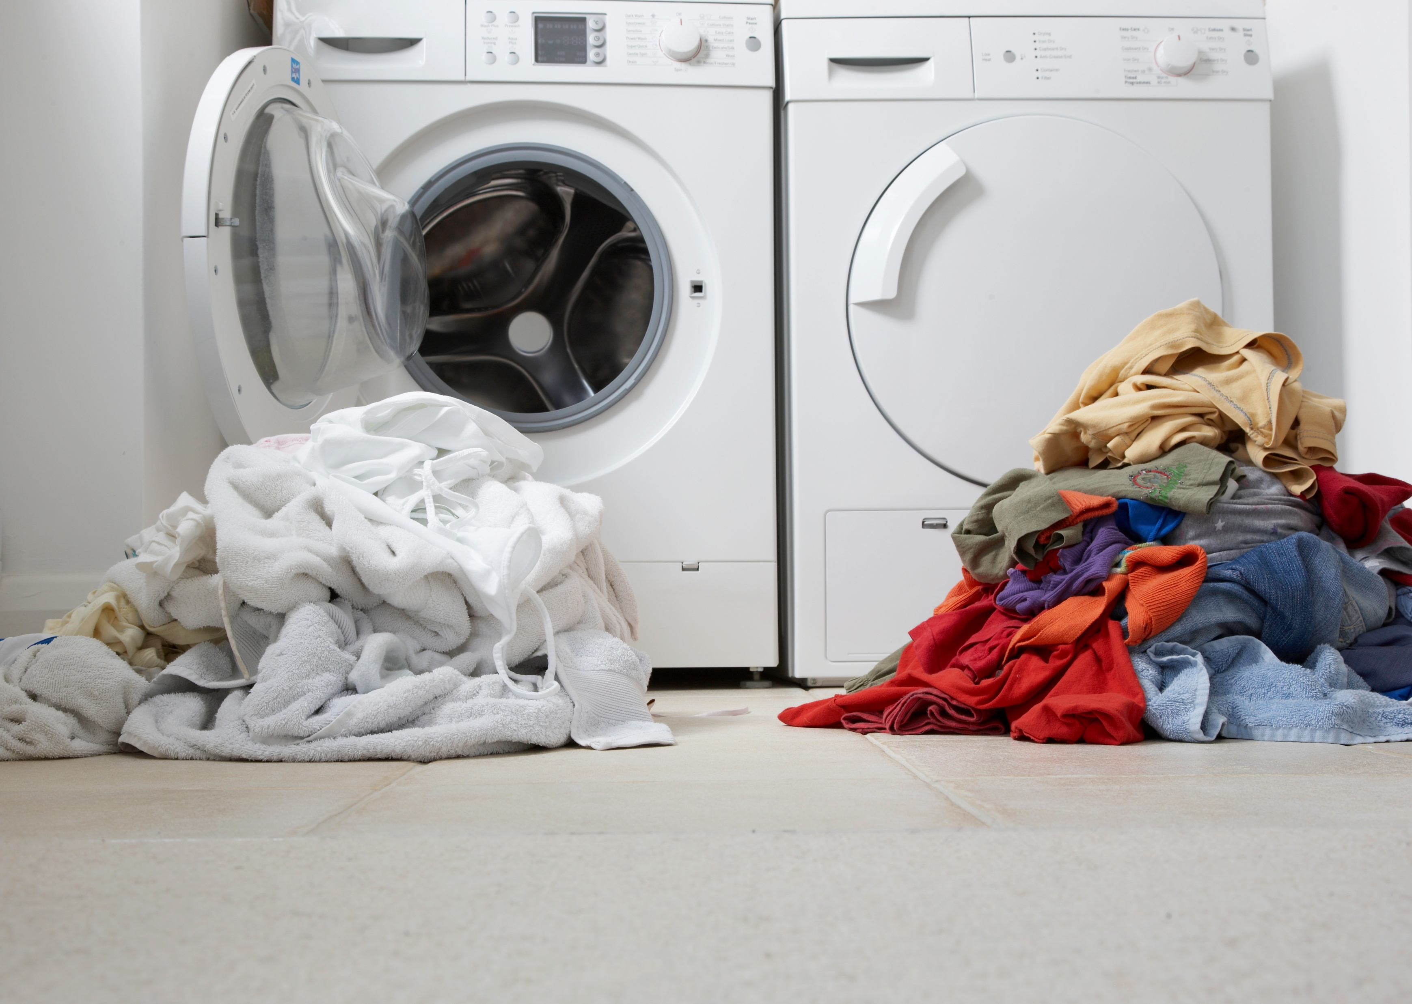
What is energy?
Energy is something we use every day, even if we don’t think about it. It’s really important in modern life, allowing us to live comfortably and safely.

Slide 4
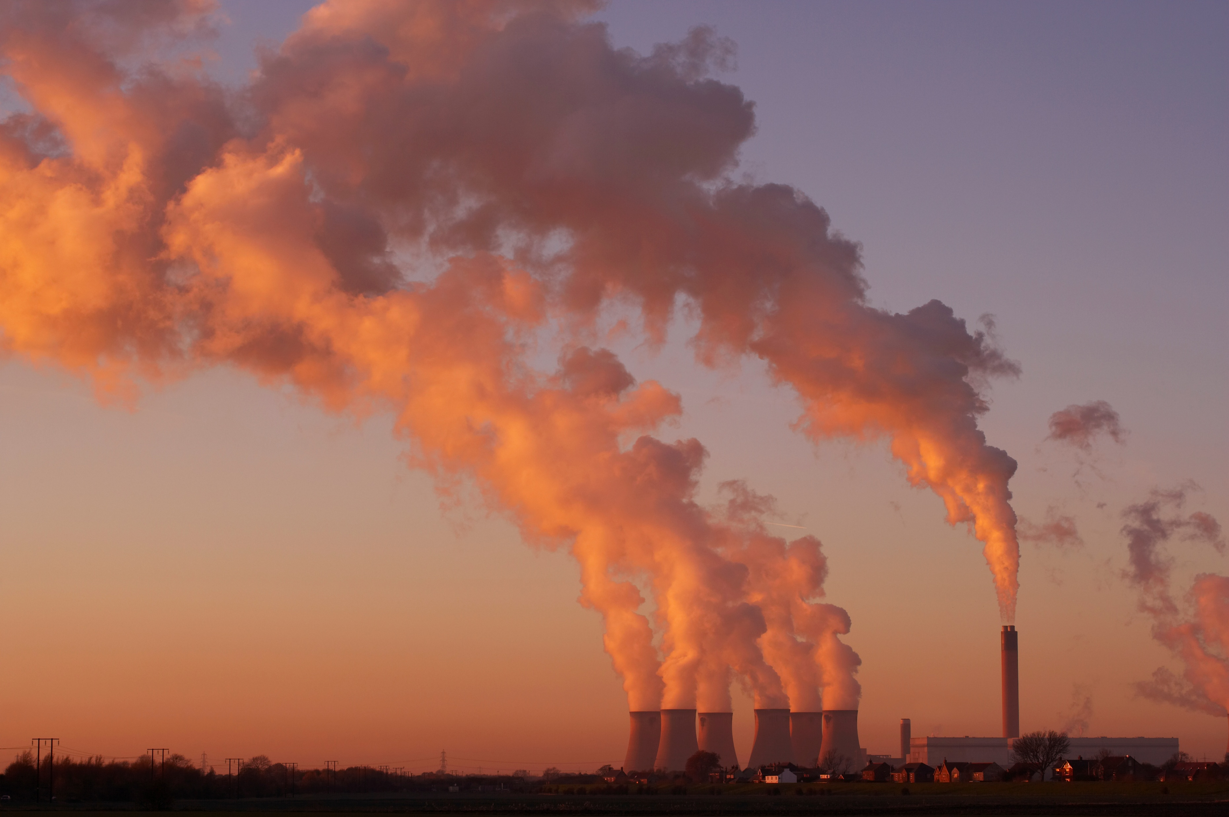
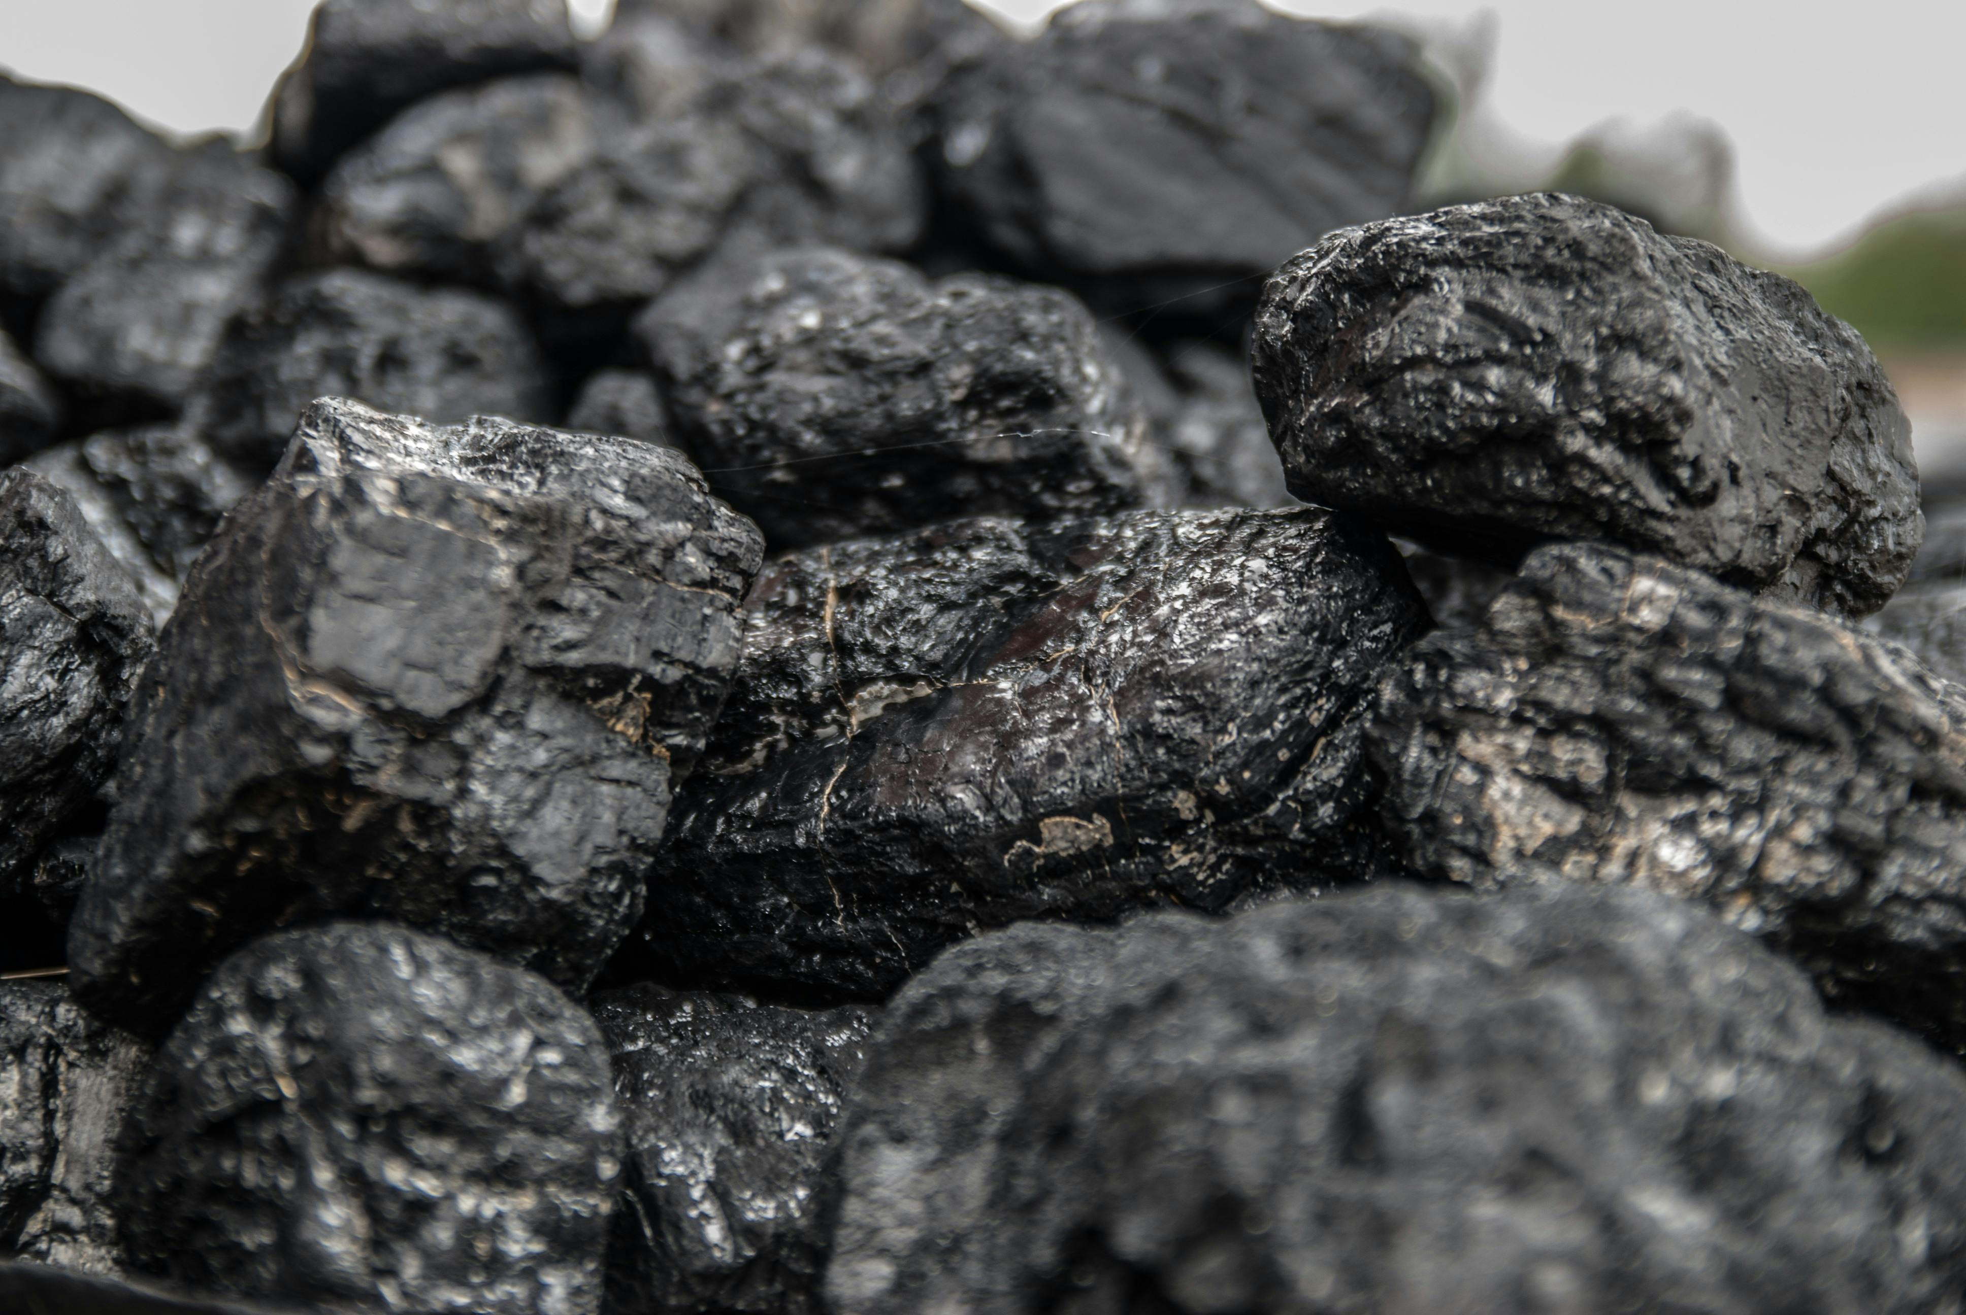
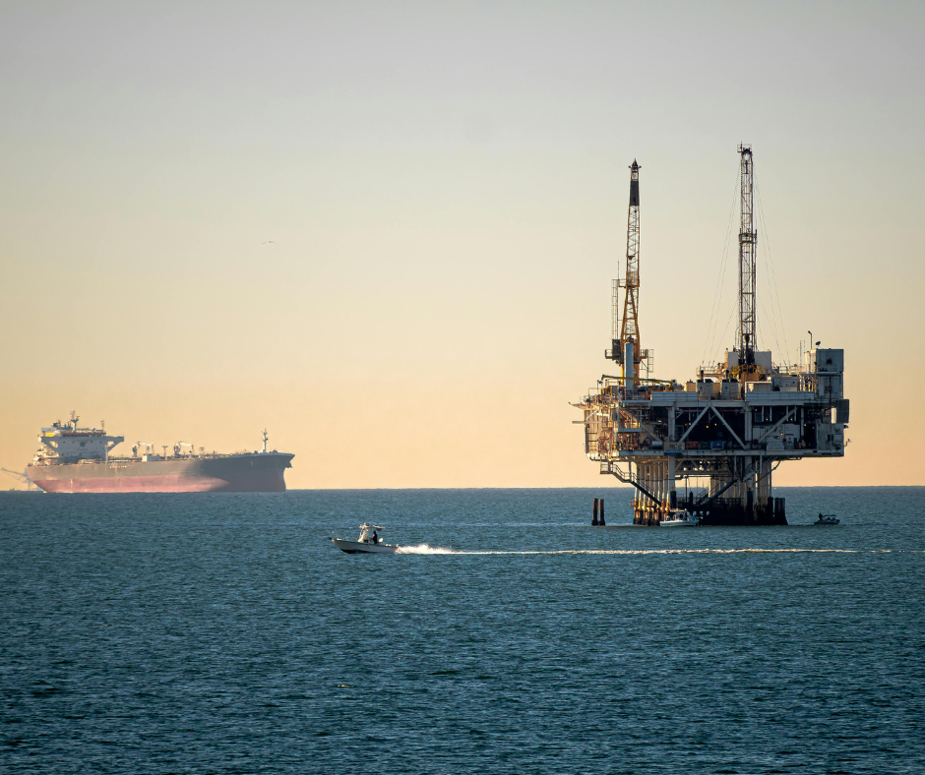
Where does energy come from?
One way to generate energy is by burning coal, oil, and gas.
These are called fossil fuels.
When fossil fuels are burnt, they make very high-temperature heat.
This heat is used to boil water, creating high pressure steam that spins turbines connected to electrical generators.

Slide 5

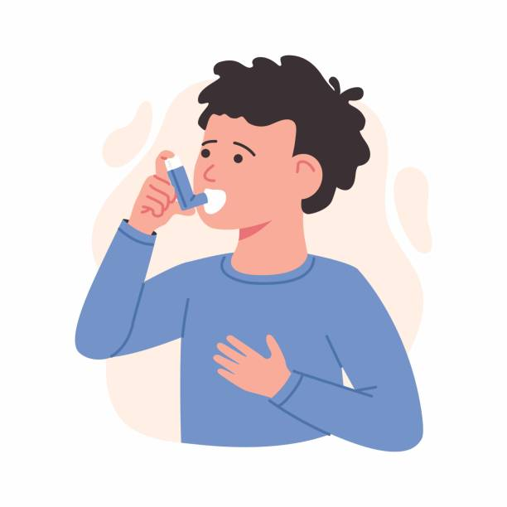

What’s bad about fossil fuels?
Harmful to the planet
Mining, extracting, and using fossil fuels releases harmful gasses into the air (pollution). This leads to climate change.
Harmful to life
Pollution is harmful to humans, animals, and plants. It can impact our health and make it harder to grow crops.
Unsustainable
Fossil fuels are a finite resource, meaning they will eventually run out, so we can’t rely on them forever.

Slide 6
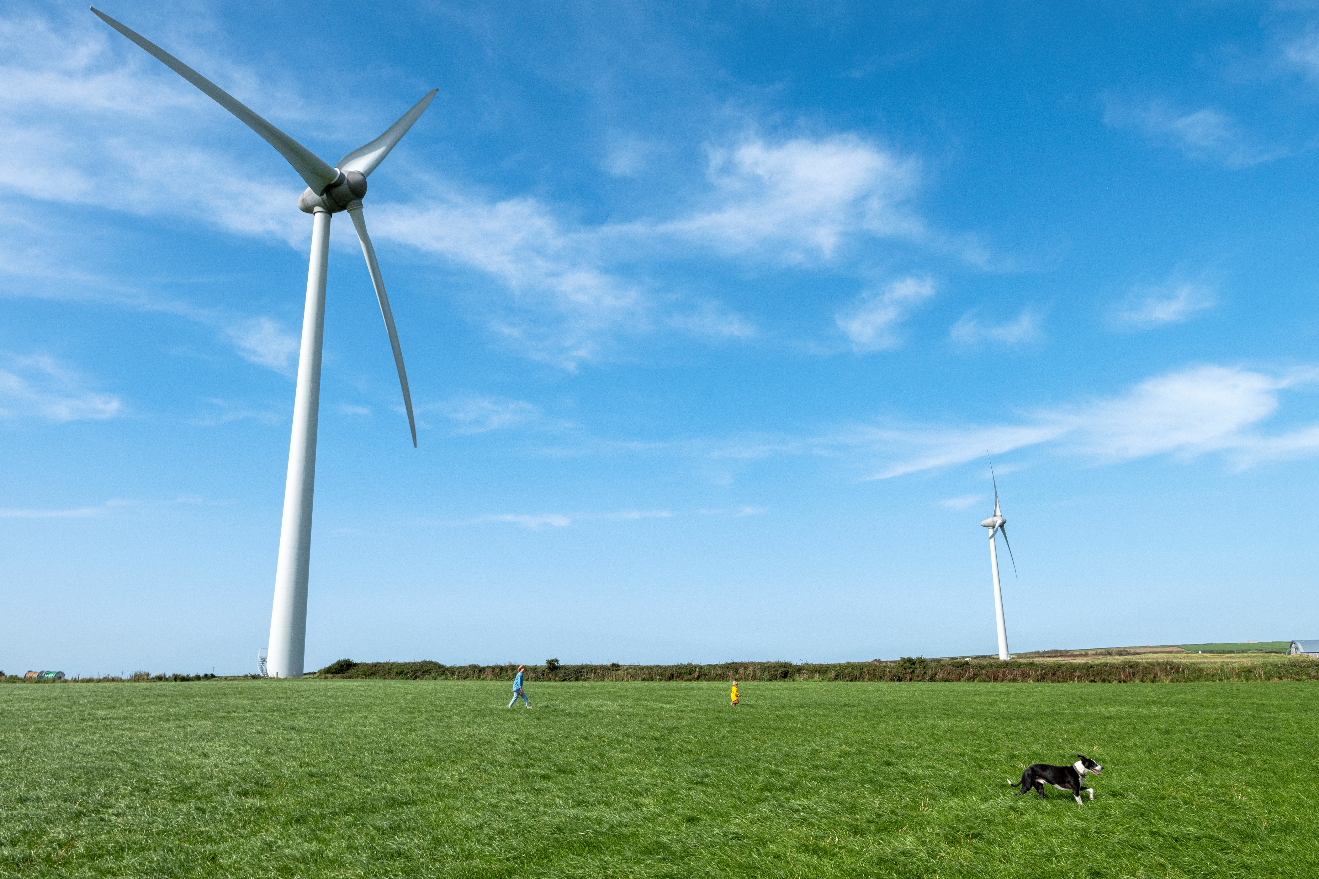
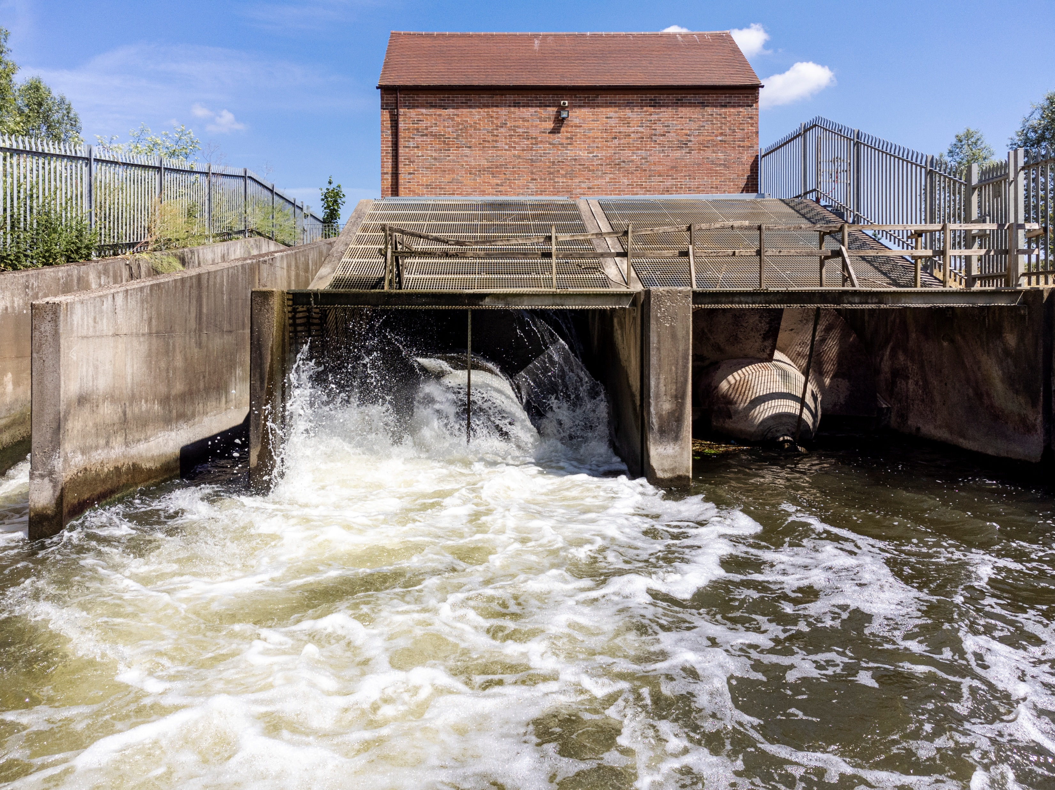
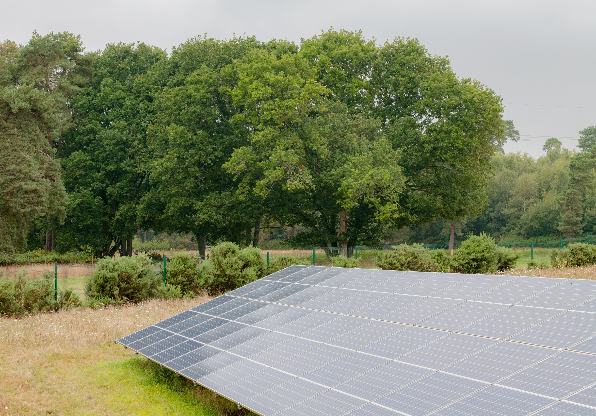
Is there a better way?
We don’t need to burn things to make our energy!
Wind power
Hydro power
Solar power

Slide 7
What’s good about renewable energy?
Sustainable
Renewable energy is made from infinite resources, meaning it will never run out!
Clean
Renewable power plants create far less pollution compared to fossil fuel power plants. This is better for health, plants, and the planet!
Resilient
Once renewable power systems are set up, the energy they generate is essentially free.

Slide 8
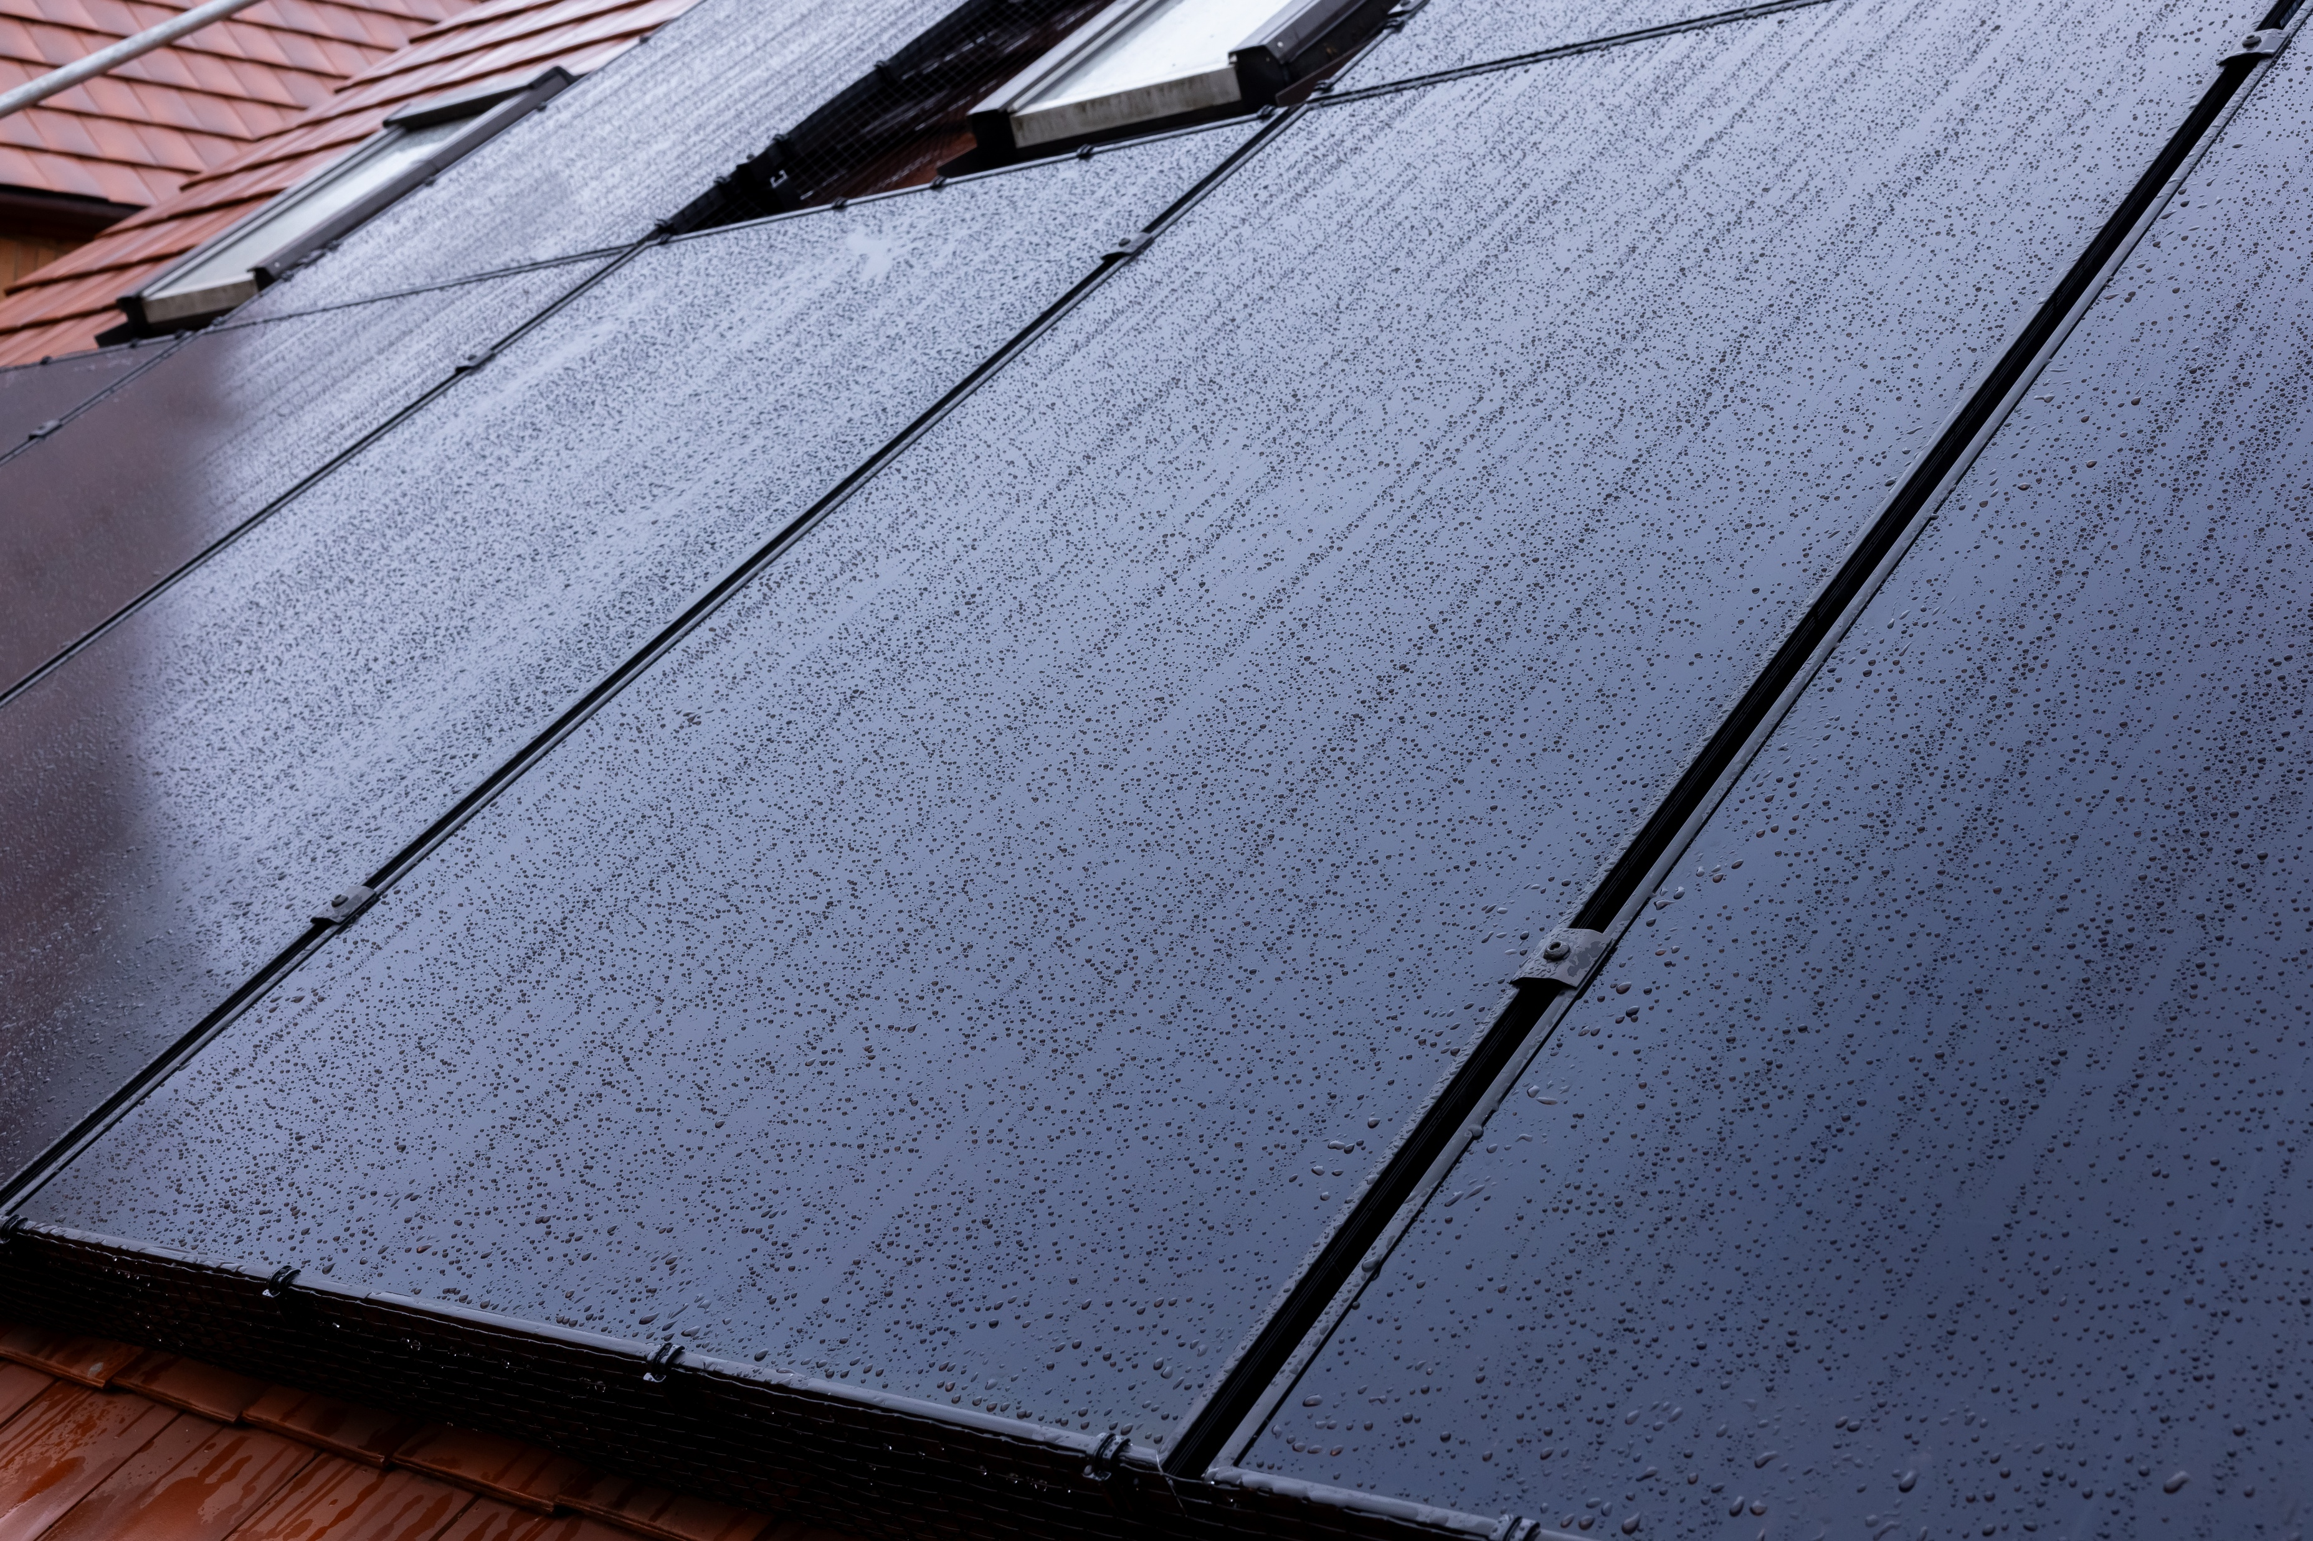
Solar Energy
Solar panels are really popular. Here’s why:
They can go on roofs of homes, schools, and businesses
Solar panels are quiet, reliable, and have very few moving parts, so they don’t need much looking after.
Over time, solar panels have got better and cheaper for people and businesses.

Slide 9
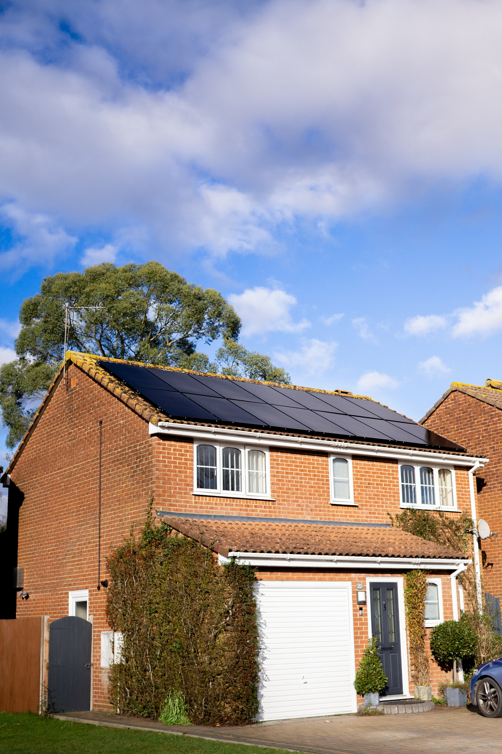
How do we get energy from the sun?
Solar panels turn sunlight directly into electricity using special materials called semiconductors.
When sunlight hits a semiconductor inside a solar cell, it frees tiny particles called electrons and allows them to move – this movement is what creates electricity.
1. Sunlight hits the solar panel and puts energy into the electrons.
2. The electrons start moving, creating electricity.
3. The electricity flows through wires to power our buildings and devices.

Slide 10
Let’s do an activity
Ask the students to stand up in the centre of the room.
The room is now a solar cell.
Each student represents one electron within the cell.
When the curtains are closed, everyone must stand still.
When the curtains open, everyone is free to move around.
When the electrons are flowing, electricity is generated!

Slide 11
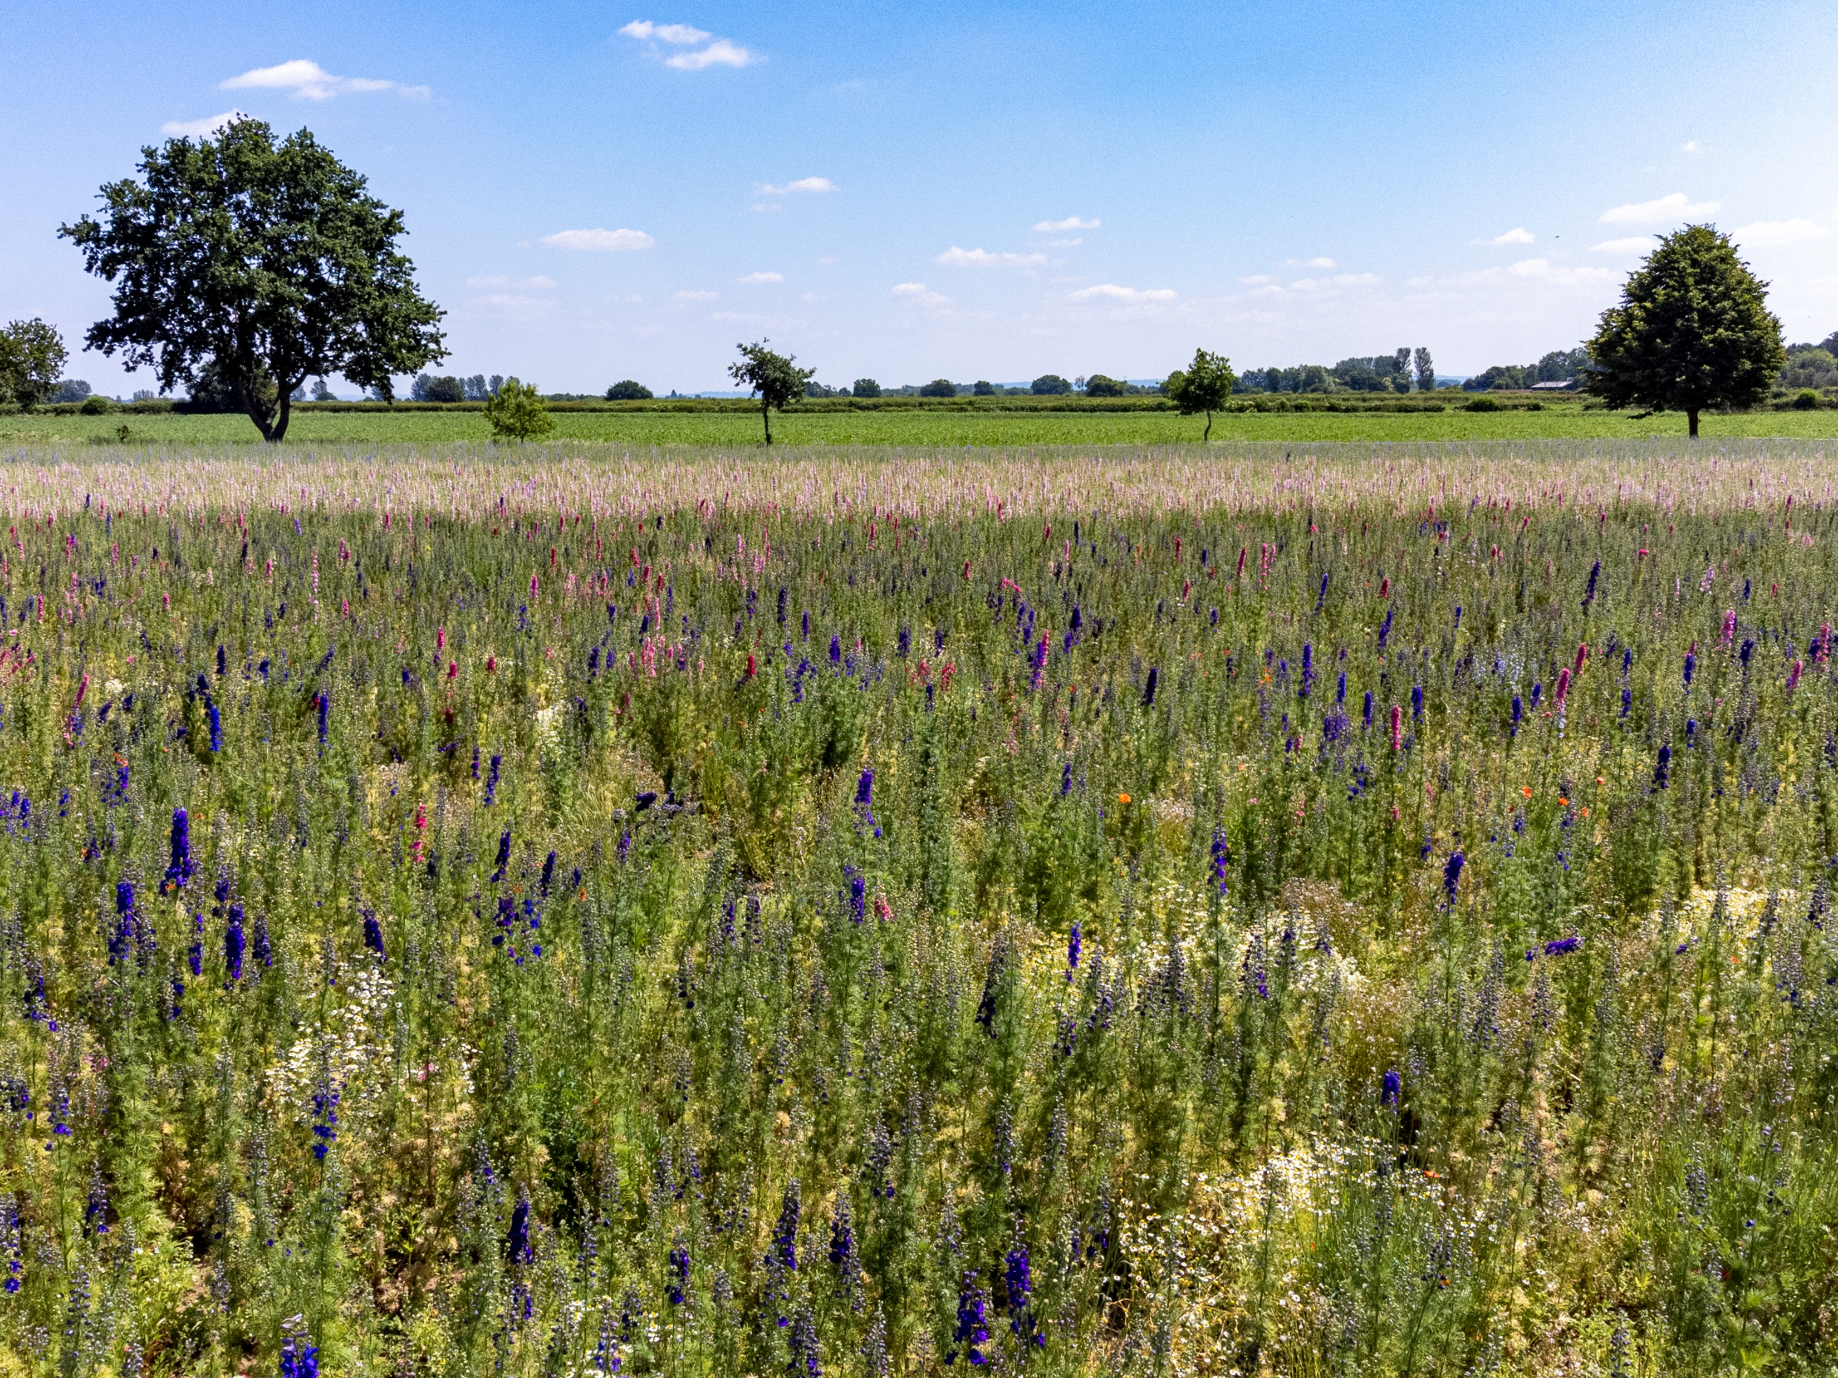
How much energy can solar provide?
Not so long ago, solar energy was a futuristic idea. But now we use it every day!:
Last year, over 6% of electricity used in Great Britain was generated using solar PV.
On long, sunny days, when lots of solar energy is being generated all at once, over 30% of electricity in Great Britain has been solar powered!
That’s one in three lights, one in three computers, one in three lava lamps – all powered by the sun!
See how much solar energy is powering the country right now:
National Grid: Live
Notes:
How many solar panel projects do you think there were last year?
1.7M!

Slide 12
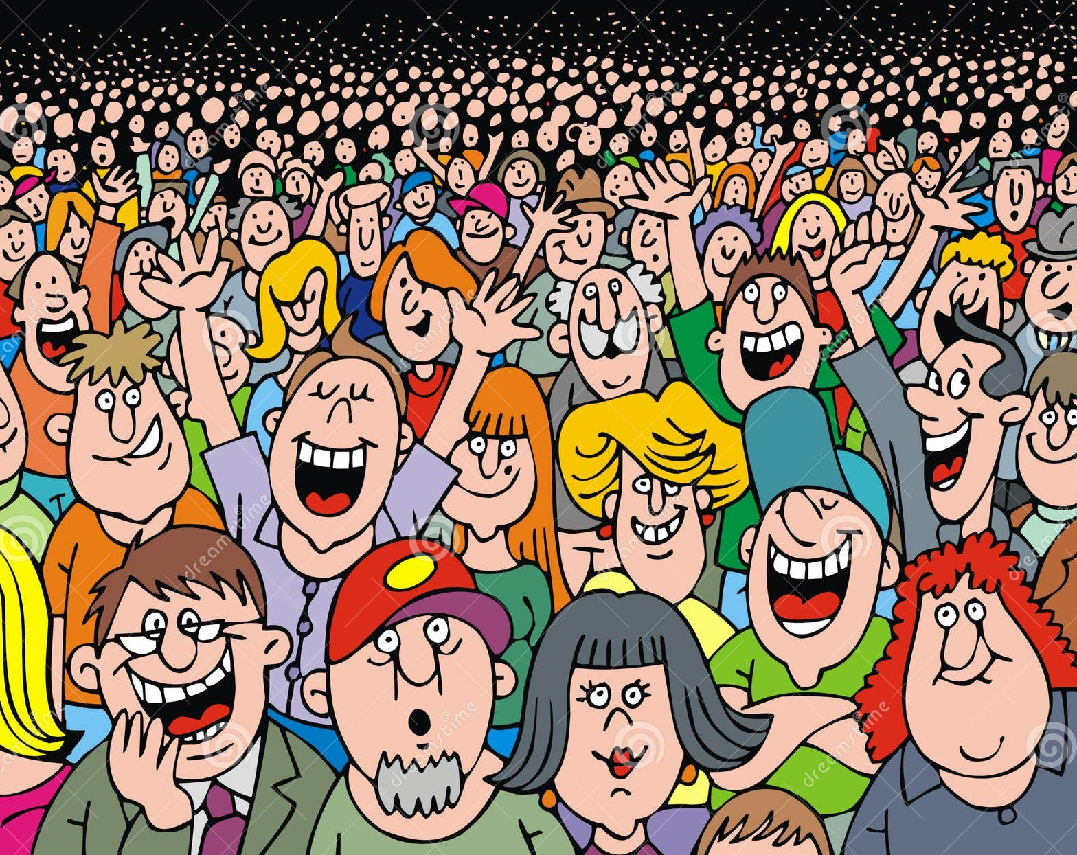
Who makes it all happen?
Renewable energy doesn’t happen on its own — people plan it, build it and look after it every day.
In the UK, green jobs are growing 4x faster than anything else!

Slide 13
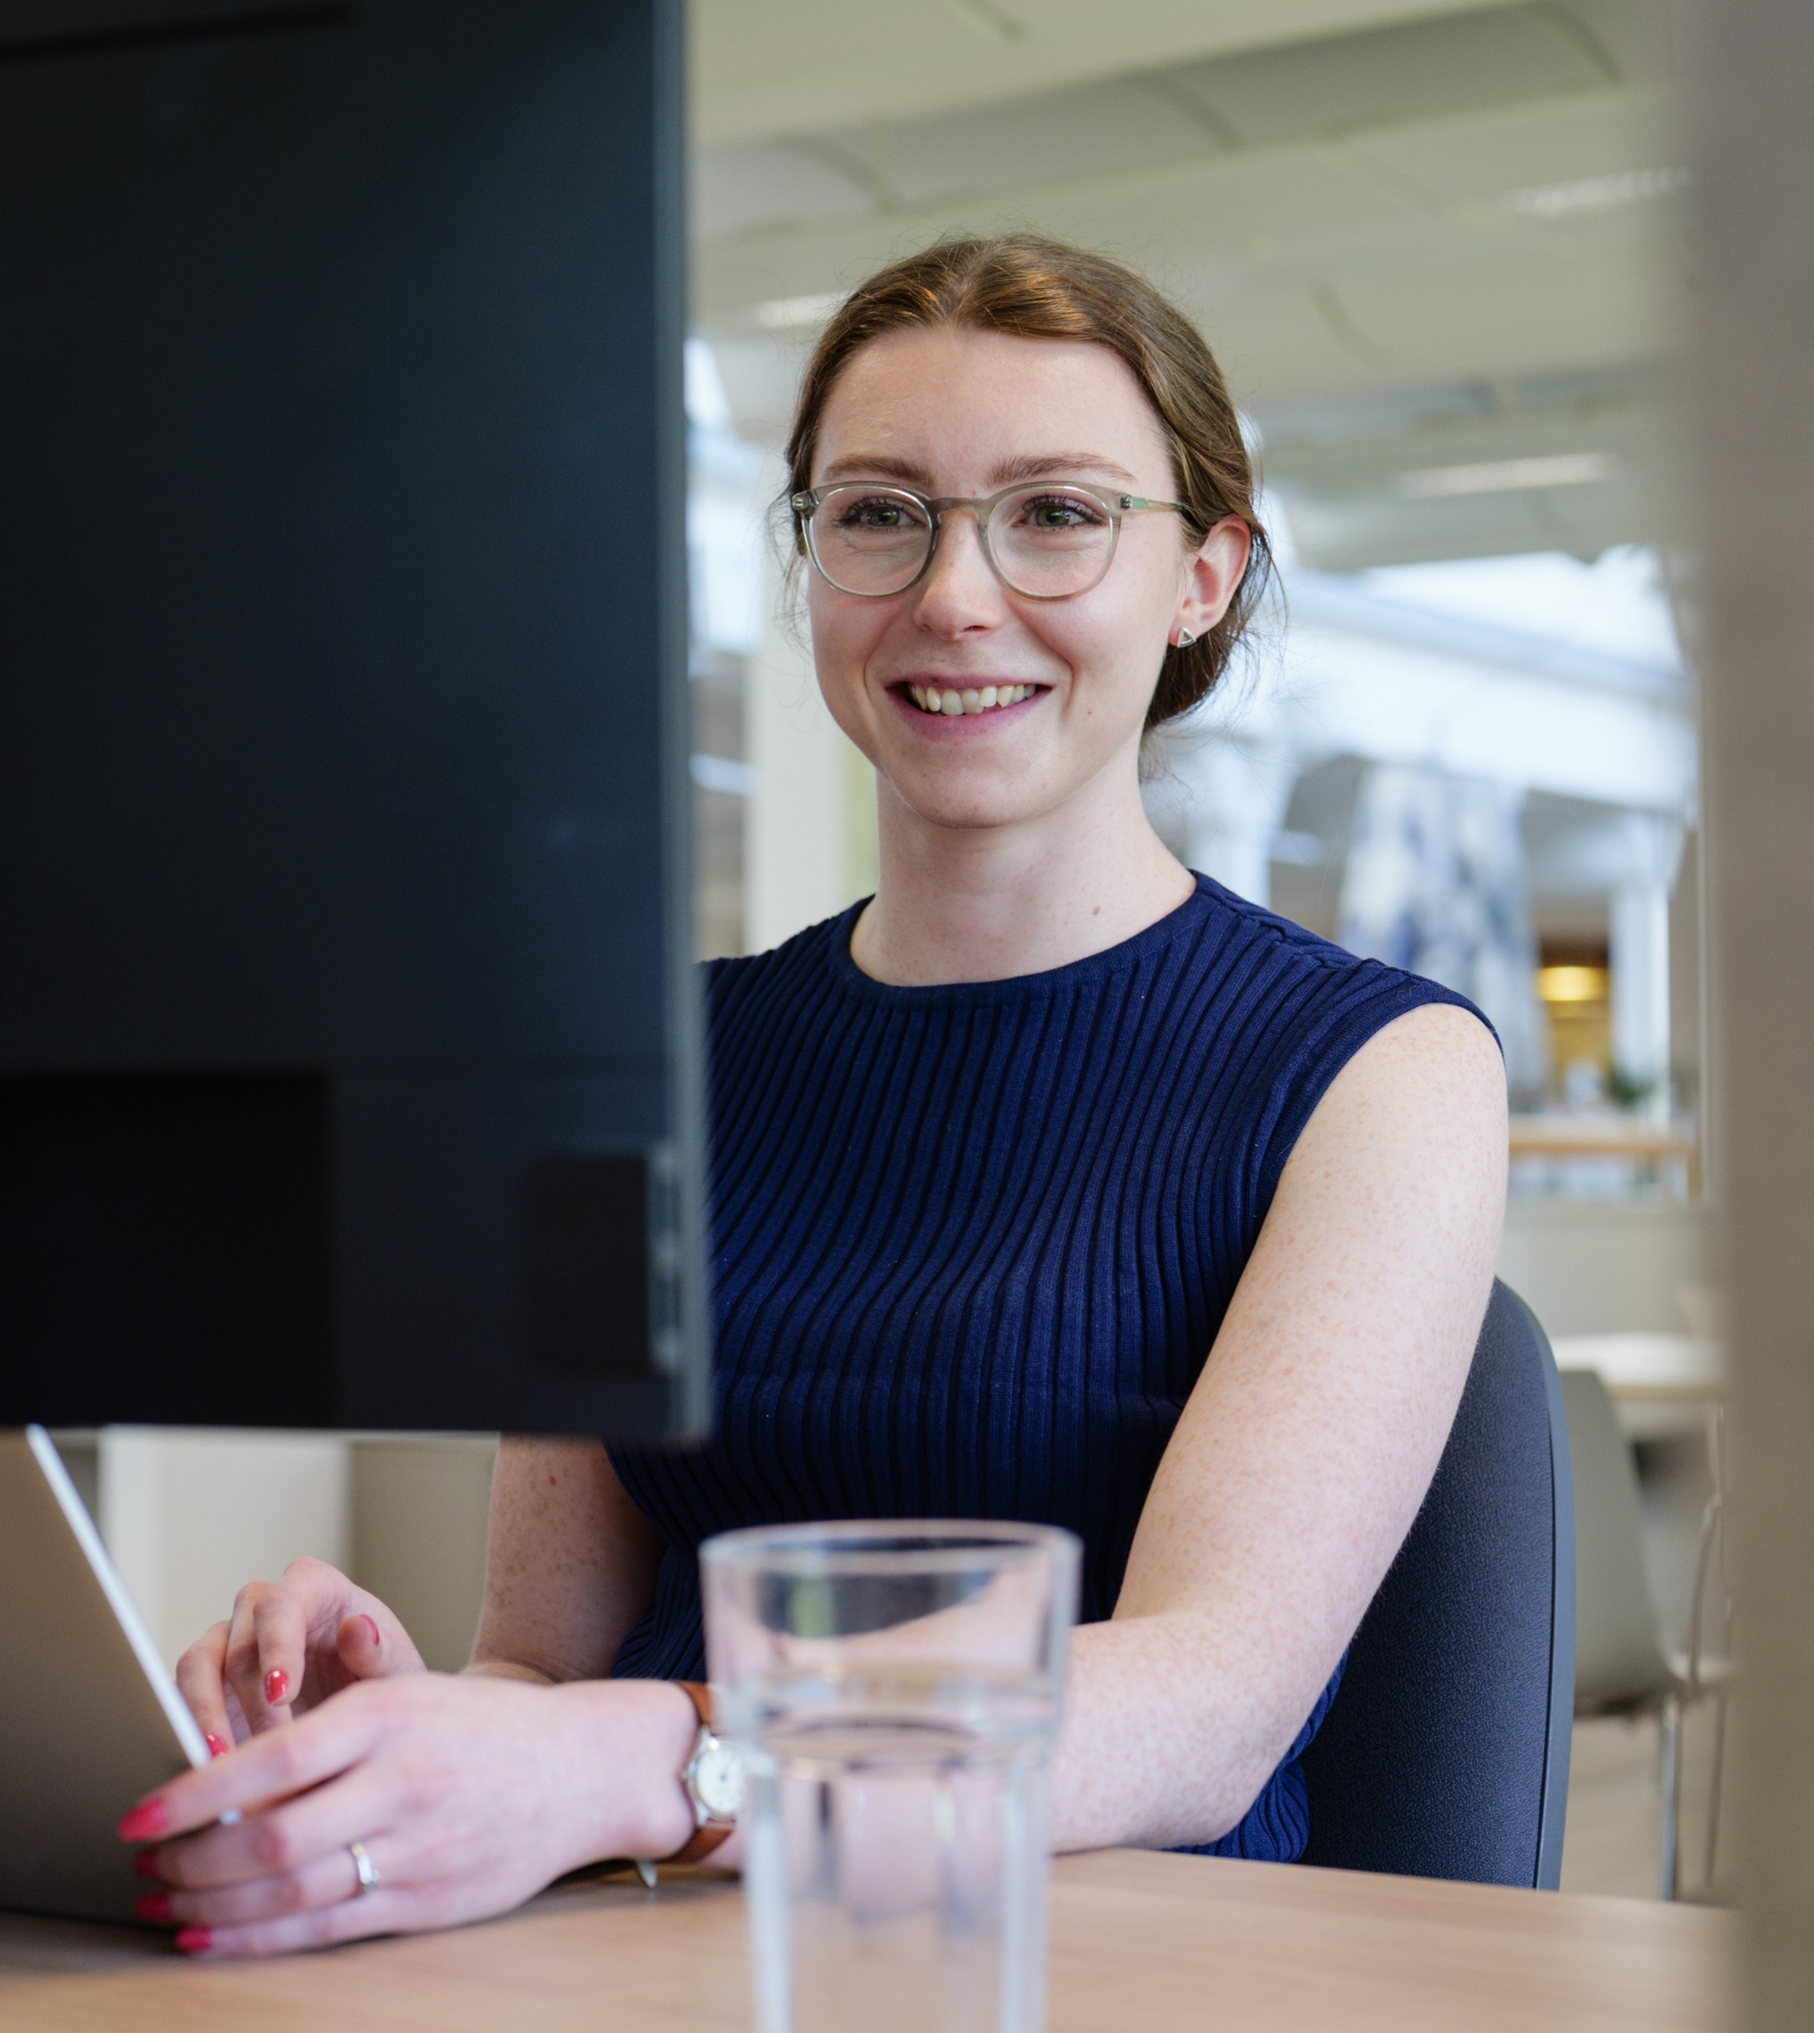
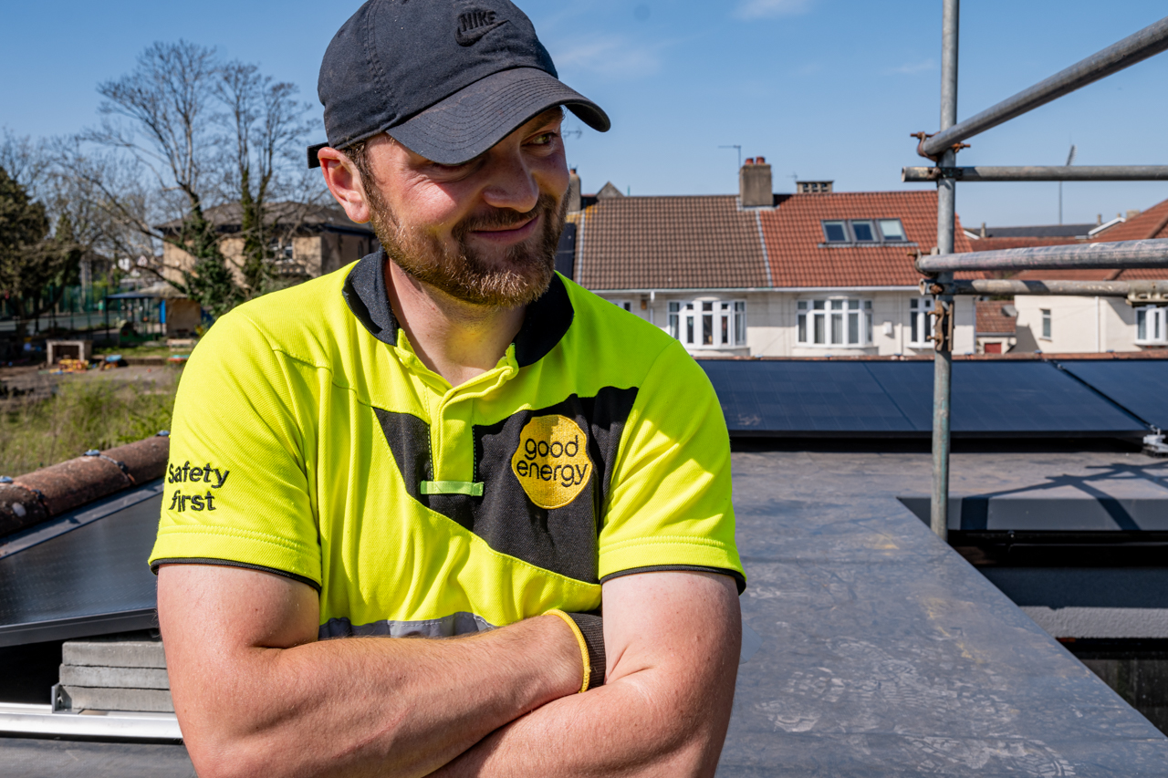
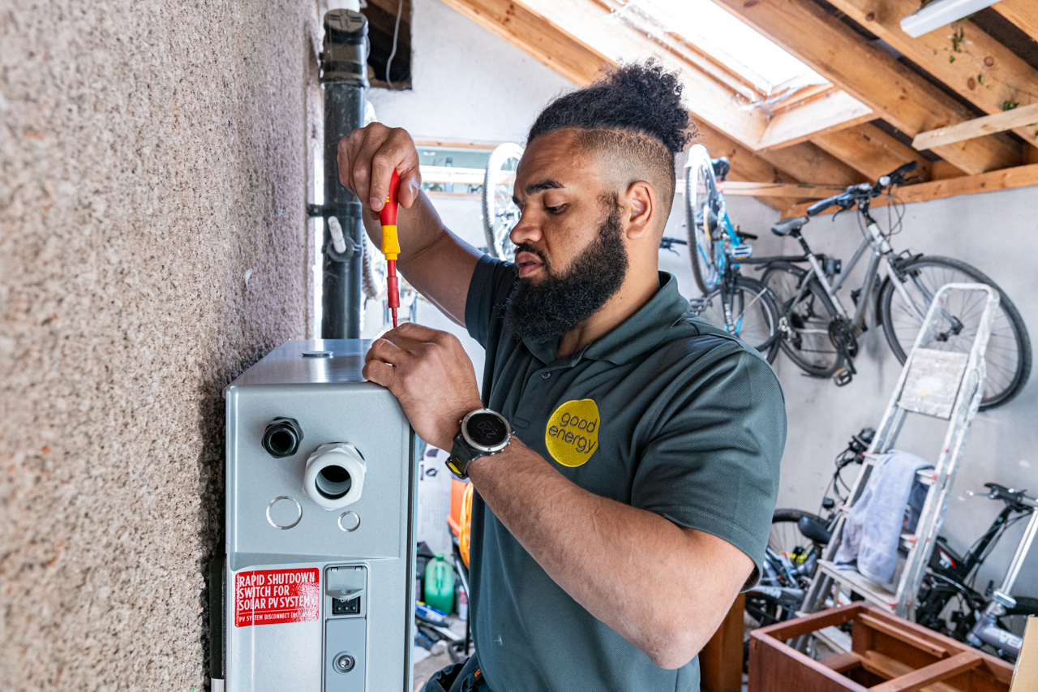
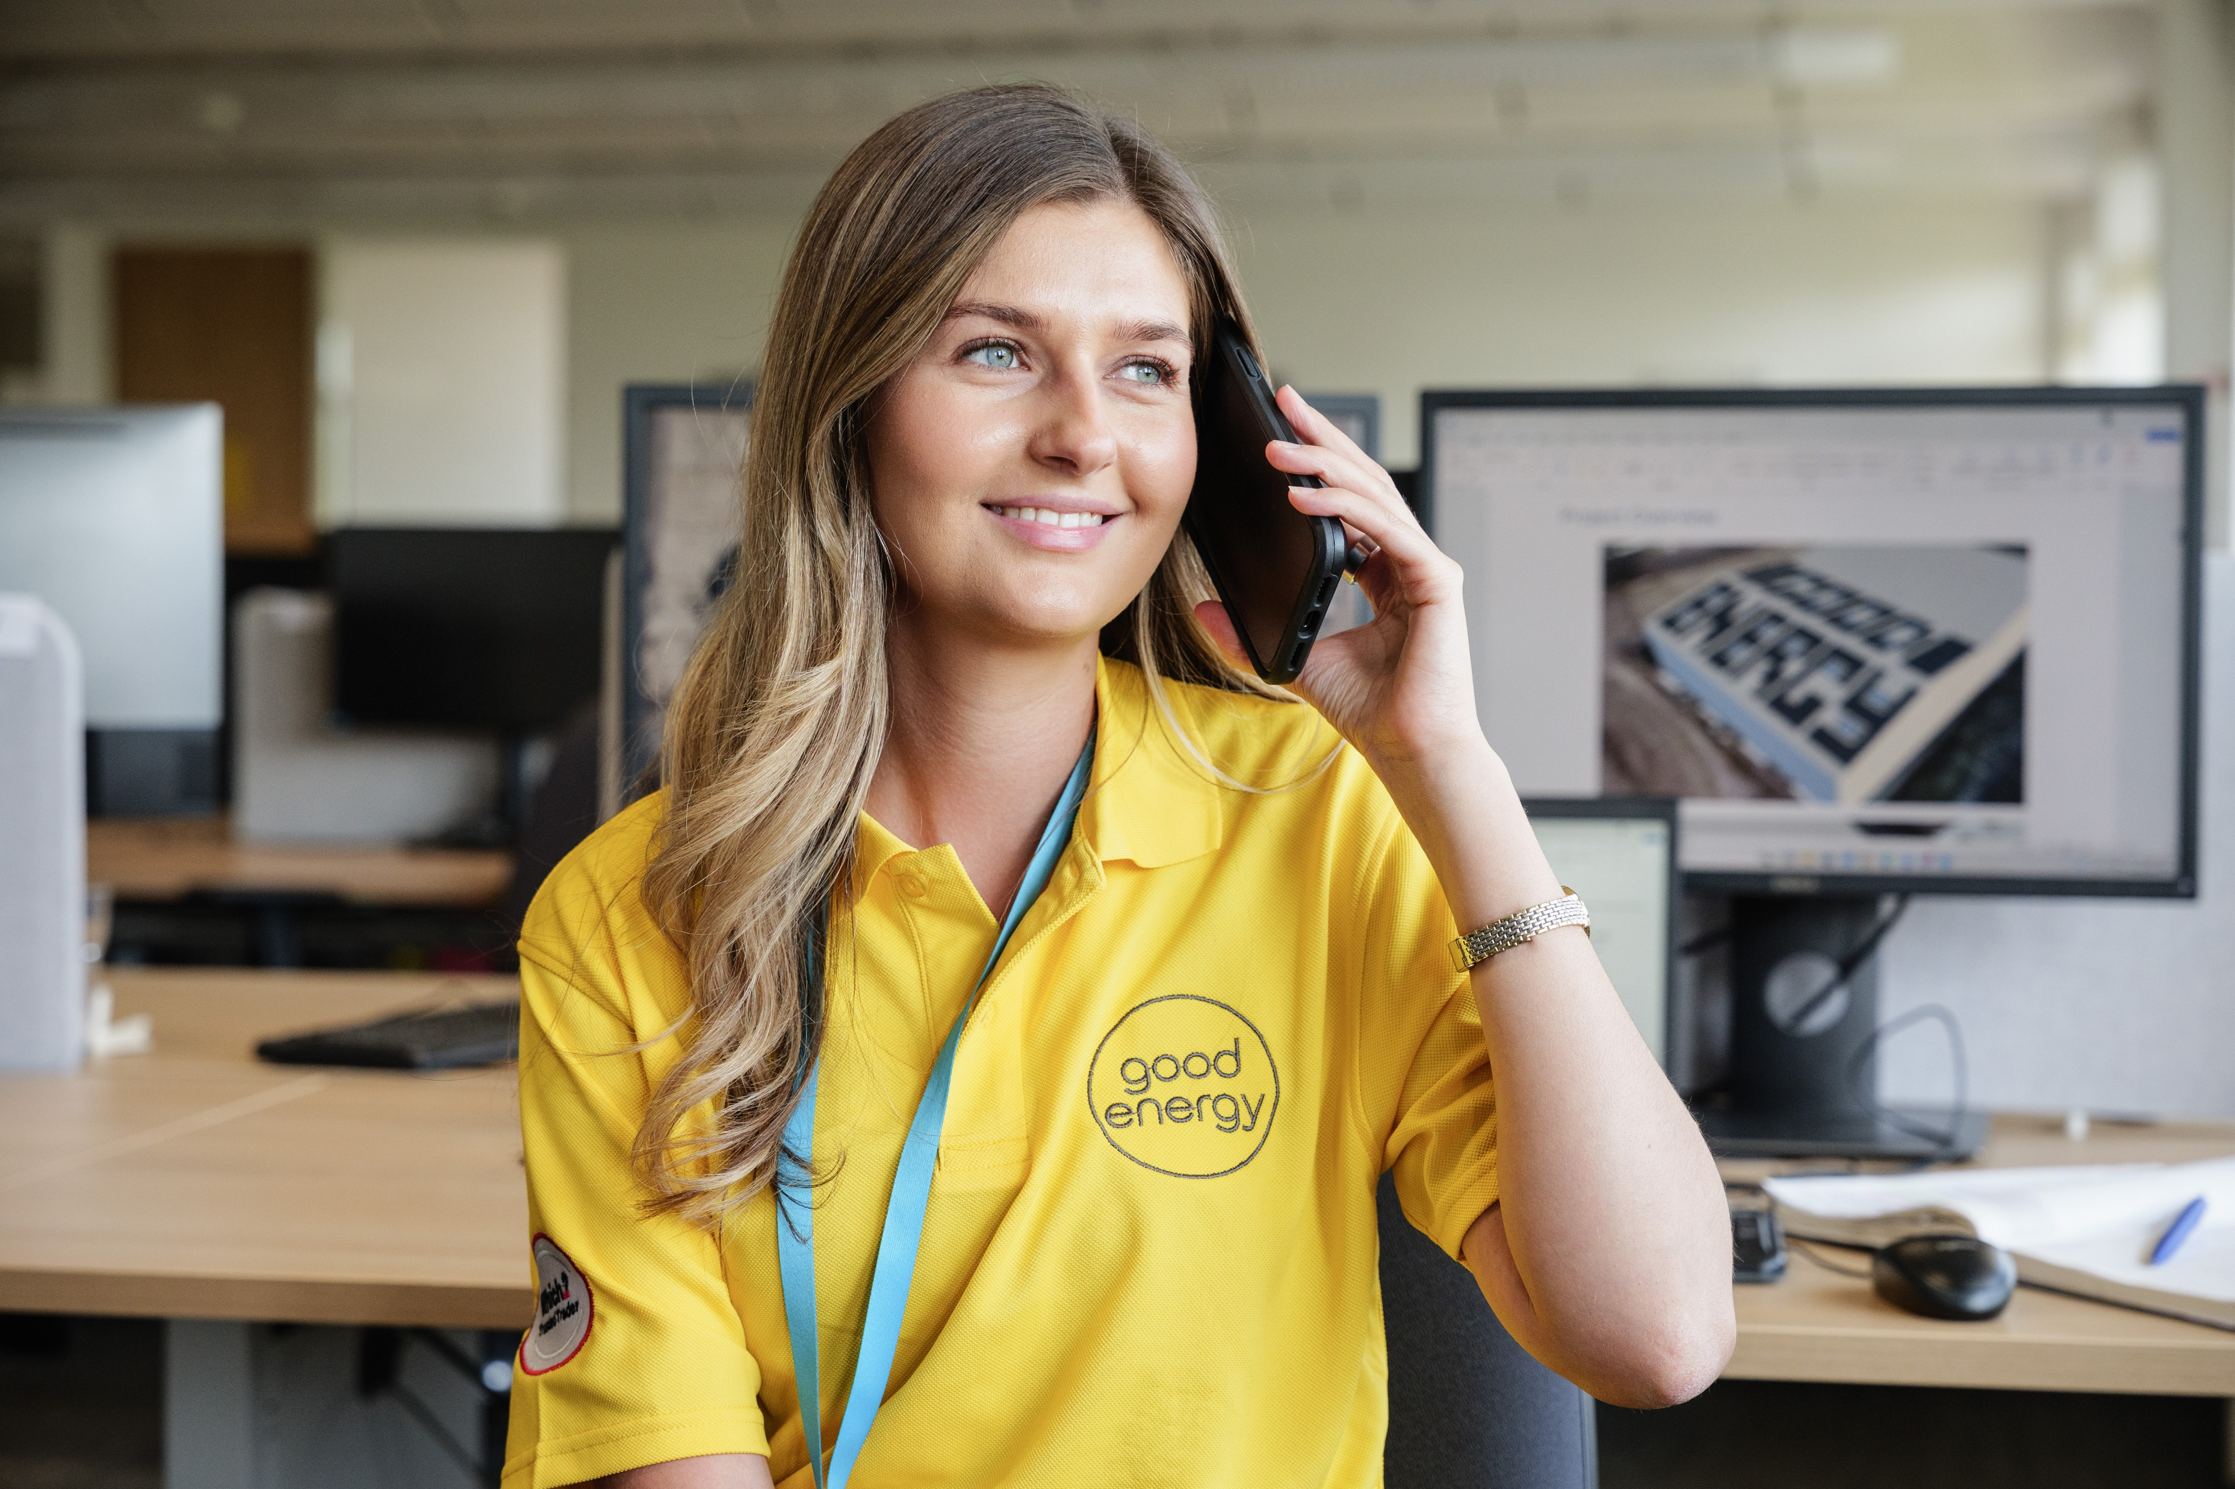
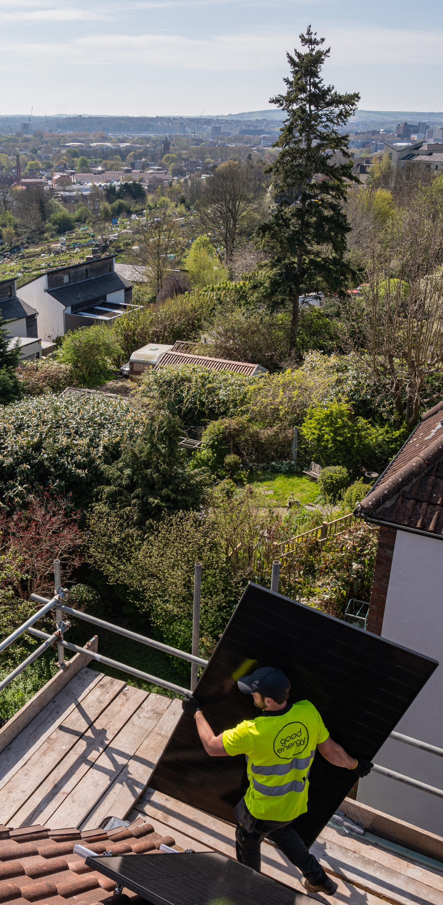
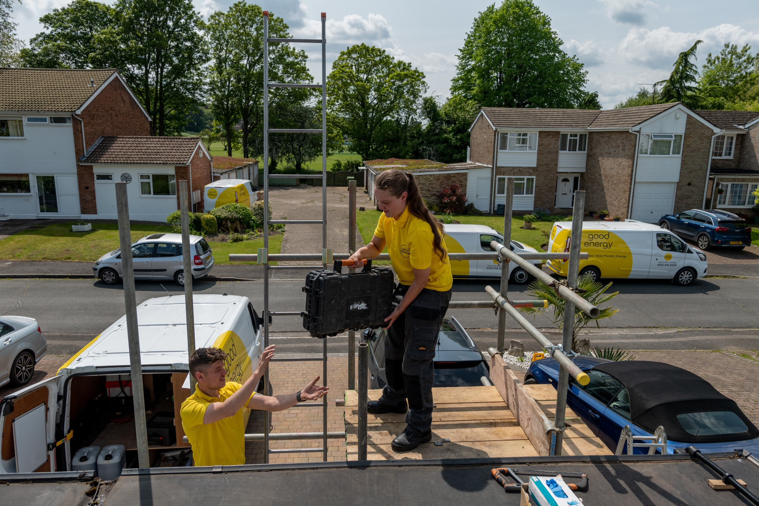
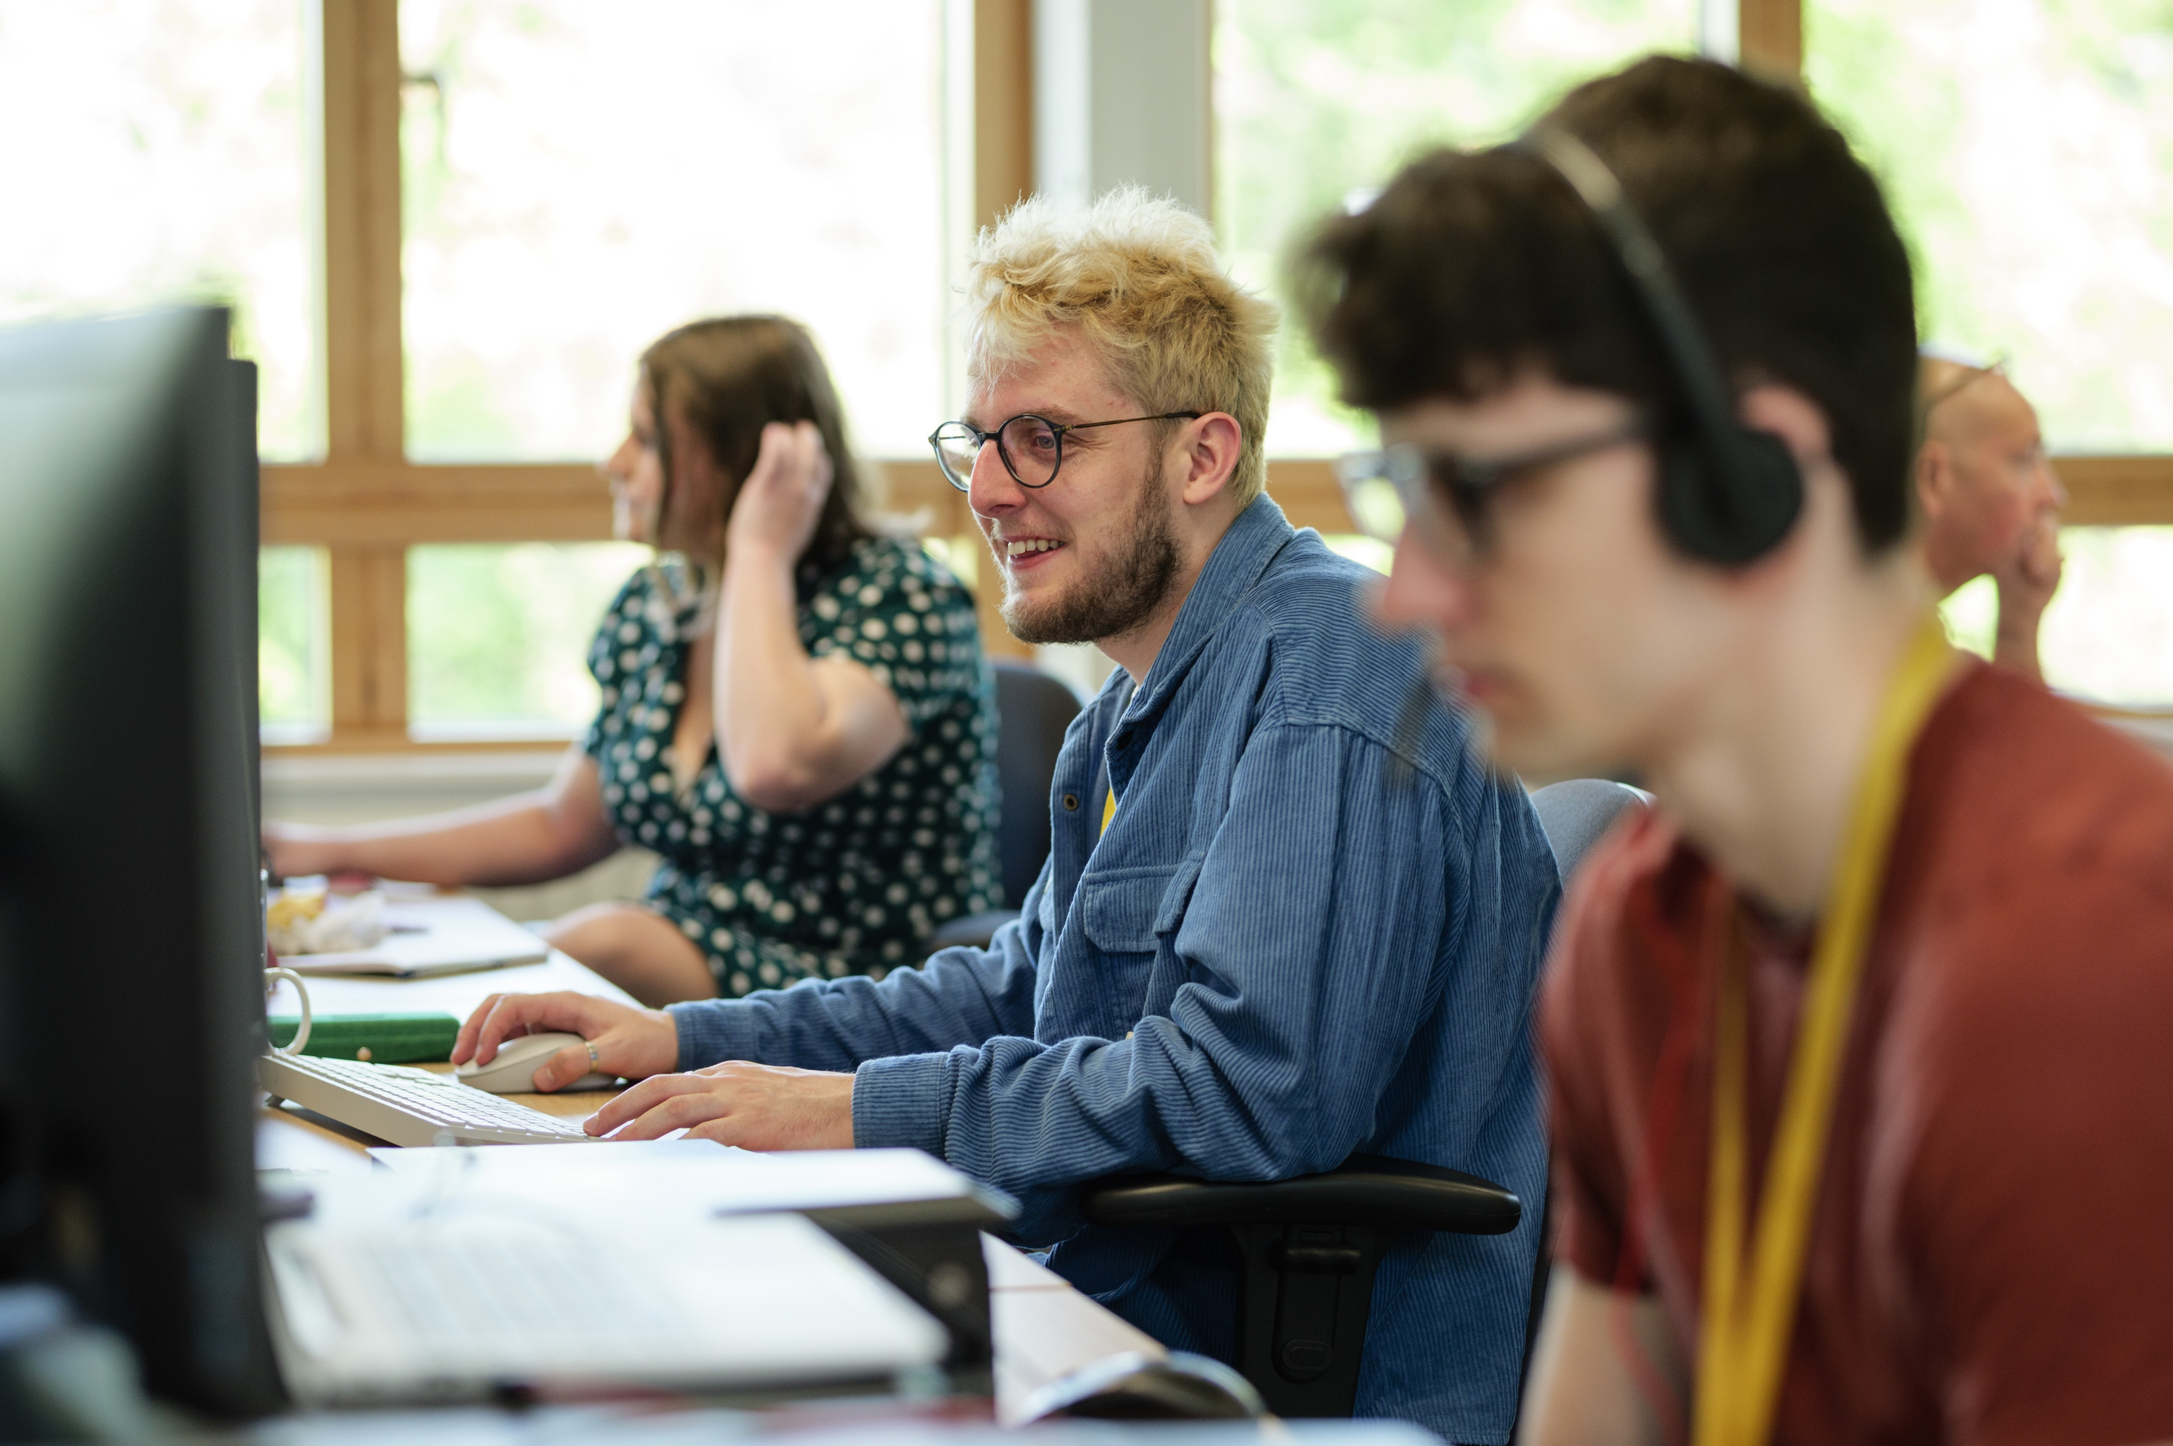
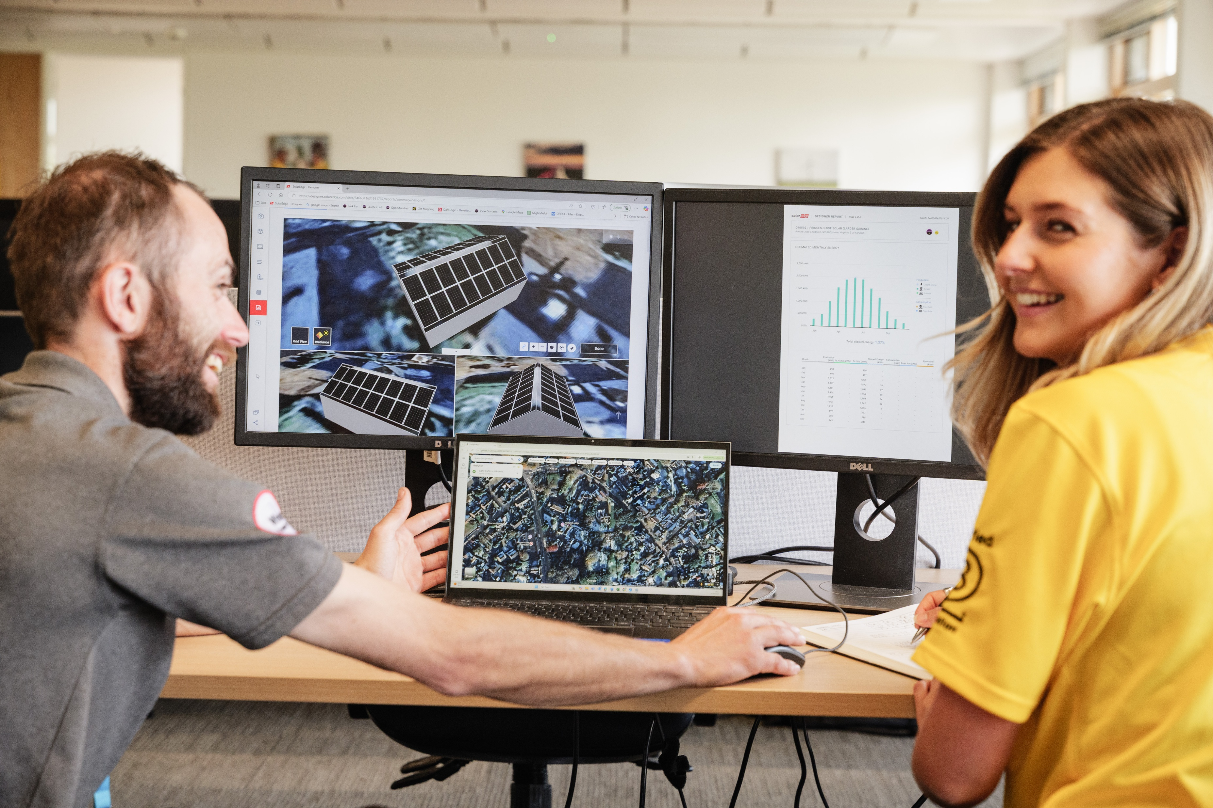
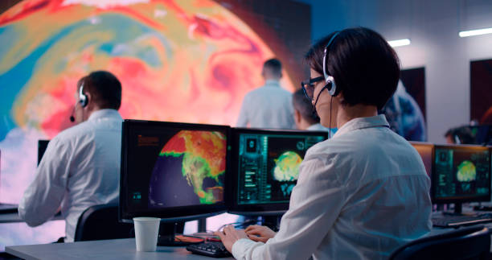
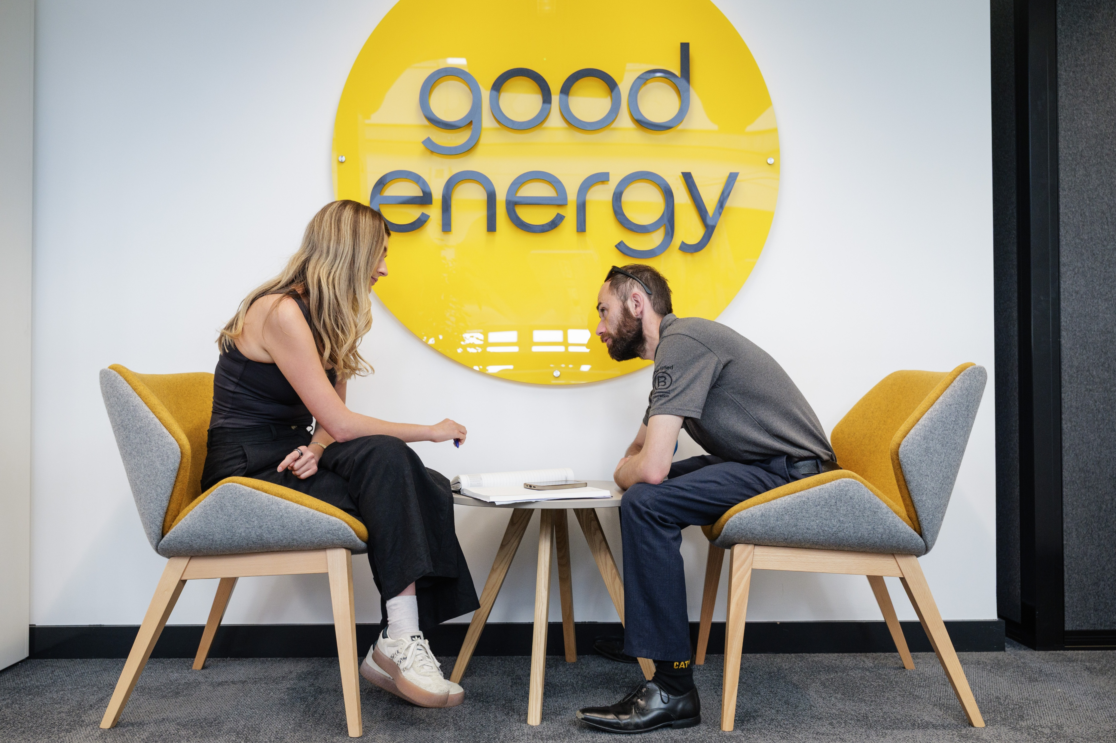
Could you work in the clean energy sector?
We need lots of bright people to work with us:
Solar panel installer
PV design engineer
Electrician specialising in renewables
Climate scientist
Energy analyst
Maintenance technician

Slide 14
Could you work in the renewable sector?
If you like building things and working with your hands…
you could make a great solar installer!
Fit solar panels onto roofs
Work outdoors with a team
Solve problems to do their job safely
Make sure panels can get as much sunlight as possible
Work hands-on, helping homes and businesses make more clean energy!

Slide 15
Could you work in the renewable sector?
If you’re a careful problem solver and like fixing things safely…
you could make a great electrician or technician!
Electricians:
Connect and wire up electrical systems so solar energy can be used inside buildings
Test, and check to make sure everything is working properly
Help turn solar energy into power we can use every day

Slide 16

Could you work in the renewable sector?
If you enjoy designing or improving how things work with maths and science…
you could make a great engineer!
Engineers:
Design and plan how to install solar energy.
Use maths, science and problem-solving to make systems work properly
Work out the best way to make, and use electricity
Test ideas and improve technology so it works better and lasts longer
Help shape the future of clean energy by designing smarter solutions

Slide 17
Could you work in the renewable sector?
If you enjoy experiments and discovering new ideas…
you could make a great climate scientist!
Climate scientists:
Study the climate and how it is changing over time
Use science to understand weather, oceans and temperatures
Explore how people affect the planet
Help explain climate change to governments, schools and communities
Help people make decisions to protect the planet

Slide 18
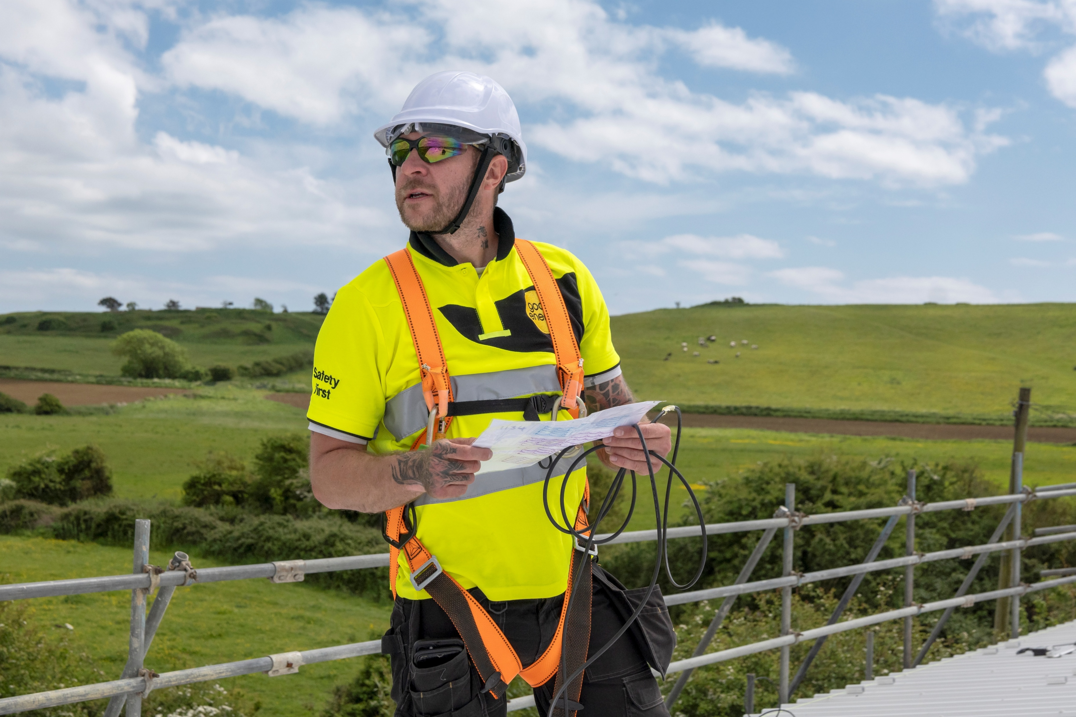
Could you work in the renewable sector?
If you like organising, planning and helping teams work together…
you could make a great project manager!
Project managers:
Plan and organise the projects
Look after different teams, like engineers, installers and electricians
Make sure projects are done on time
Solve problems and make decisions
Help turn clean energy ideas into real life projects

Slide 19
What you now know
You should know:
Understand what renewable energy is
Understand the benefits of renewable energy
Know how solar PV works
Know how much of the UKs power comes from solar PV
How you could work with solar

Slide 20
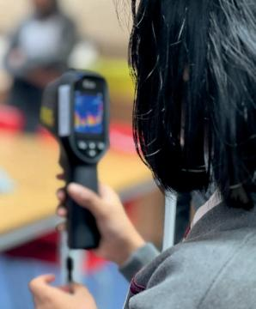
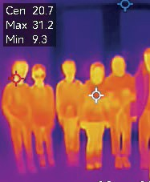
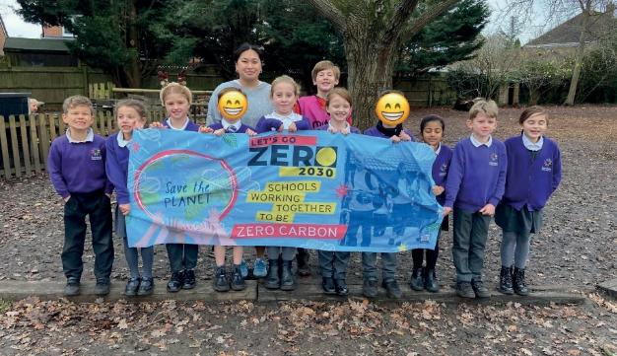
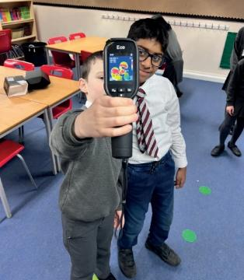
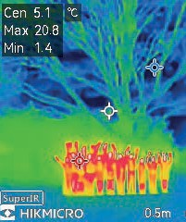

Questions
Notes:
How to advise/communicate about multiple suppliers/stakeholders
ie
LGZ
Eco schools
UKSSN
STEM Learning
Lloyds Bank Green Buildings Toolkit
Sharing best practice – feedback from you!

Slide 21
Thank you

