Slide 1










GBESP
Green Skills and Careers
Creating a zero carbon school

Slide 2

Green Skills and Careers
A group of green industry expert organisations have been working with selected schools in the region to reduce their energy bills and help them reach net zero.
The green economy is booming, and we would like to share our experience of the types of jobs that young people can get in the future.

Slide 3


Speakers
Aisyah Duggie
Tom Heaton
Let’s Go Zero Climate Action Advisor and Team Leader in Cheshire
Let’s Go Zero Climate Action Advisor in Lancashire​​

Slide 4
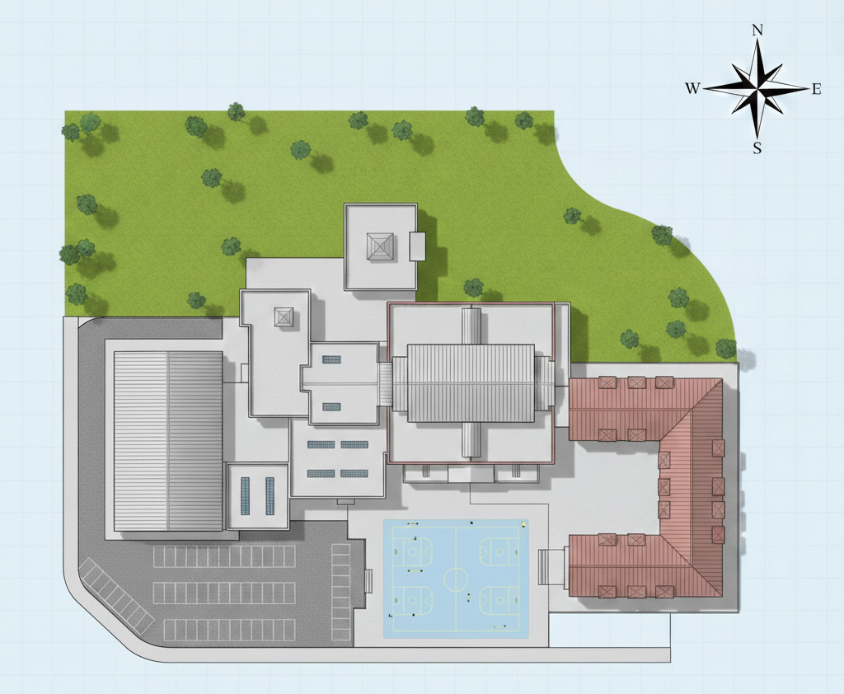
Task – design a future-proof school
MAIN BUILDING
SPORTS HALL
SCIENCE AND DT BLOCK
CAR PARK
Notes:
Explain the task:
The fictional school blueprint represents a typical secondary school. We’ve included grassy areas, paved areas, different types of buildings and a compass so that you can think about the orientation of the sun as it moves over the building.
Your job is going to be to use the materials on your tables to future-proof the school in terms of energy use and moving away from fossil fuels. (SECONDARY) We’re also going to talk about something called Adaptation and Resilience a little bit.
Before we start trying to solve the first problem, you’re going to need to grab a pen and label some key parts of the school which I’ll show you now.
The way it’s going to work when we start is that you’ll have little square cut outs of things like solar panels or insulation which you can put on buildings. There’s an explainer sheet for your group so if you see anything that you don’t understand you can read a quick explanation of it.

Slide 5
Scenario
Electricity use is high in school during the daytime.
Notes:
OK, so here’s problem number 1. The school uses a lot of electricity during the day time. As well as trying to reduce energy consumption, there are modifications you can make to buildings so that they can generate electricity on site.
Your job is to look at some of the cut outs you’re being given and put them on the blueprint of the school. They don’t need to be stuck down or anything – I want you to discuss in your groups and move things around if you want to. Think about the shape of the building but also think about that compass!
Off you go, I’ll give you a few minutes.
DISCUSSION/DEBRIEF
Solar panels on roof spaces e.g. sports hall, main building. Avoiding north facing sections e.g. upper half of main building. Any ideas from kids about flat versus sloped sections, or whether roof is strong enough to support? Did anyone put panels on the ground? EV charging in the car park?

Slide 6

Job profile
Solar Installer and qualified electrician
Training time 3-4 years
Salary (qualified) £38-45k (senior) £50-62k
Notes:
So there are a load of different job roles involved in building projects like this – but one of the most obvious ones has to be the installers of solar panels. I’ve put some information up here about the people who might do this work, how long it might take them to train and what they might expect to earn.
Probably worth pointing out that an electrician’s qualification will be needed here and that you also need to be confident working at height. You might also need to know a bit about roof structure and design!

Slide 7
Scenario
The main building and sports hall always feels cold in the winter even when it’s being heated. Gas costs are increasing.
Notes:
Here’s problem number 2 – there are parts of the building that always feel cold, even when the gas boiler’s firing. The cost of natural gas keeps shooting up, too. So we need a new heating system, but we also need to keep the heat in the building!
Same idea – move the cut outs around, discuss where you’re putting things and why. Don’t worry if you’re not sure, and if you’re not sure what to use to solve the problem, read the explainer sheet!
Few minutes, off you go!
DISCUSSION/DEBRIEF – insulation in walls/roof spaces, particularly of affected buildings. Positioning of heat pump (flat ground, paved section behind sports hall?)

Slide 8
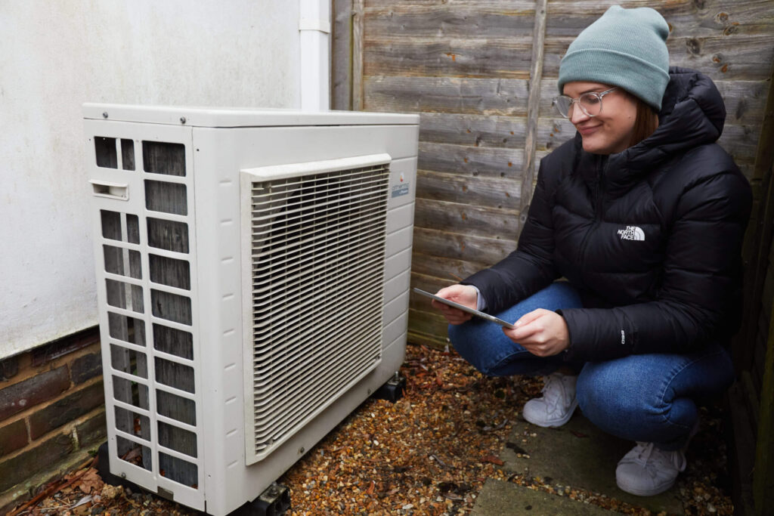
Job profile
Retrofit co-ordinator
Training time: 5 years
Salary:
(qualified) £35-45k
(senior) £50-65k
Notes:
Like before, there’s way more job roles involved in these jobs than we have time to discuss. I’ve picked a couple out for this section.
This role is more of a site survey and advice role. So they might be asked to come to a building and spend some time walking round, looking in roof spaces, considering the build design and maybe doing some calculations to figure out what to do with the building. So they might for example say “we recommend installing insulation here to improve the thermal comfort of the building and reduce energy consumption”

Slide 9
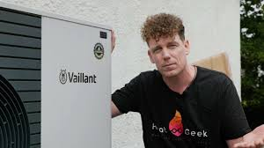
Job profile
Heat pump installer
Training time: 2-3 years
Salary:
(qualified) £35-45k
(senior) £46-55k
(self-employed) £50-80k
Notes:
Going a bit more specific now, heat pumps are fairly complex and new technology in terms of home heating, although the way they work is very similar to air conditioning, which has been around for ages. There’s a big gap in the workforce in terms of people being able to install these at the moment, or what they call a skills shortage.
On this slide I’ve also dug around for estimates about what you can earn if you’re interested in running your own business. A lot of successful tradespeople move towards this once they’ve learned their trade. If you’re working for yourself you can expect to earn more and develop more skills in terms of managing projects and people!

Slide 10
Scenario
The outdoor parts of the school flood in heavy rain.
Notes:
So here’s a new problem. We have quite frequent heavy rainfall and strong storms in the UK. This can damage buildings, cause damp and also cause what’s called localised flash flooding.
If we open the next envelope, we’ll find some features that can be used to reduce flooding and overheating.
You know the task by now, pop some stuff on your plan, chat it through!
DISCUSSION/DEBRIEF – quite a few things you can use here, sustainable drainage is probably the obvious one. But tree planting, rainwater harvesting, ponds and green roof will all help. What we call ‘paved’ surfaces usually make flooding worse because water has to find the nearest drain. Drains often can’t cope with the volume of rainwater.

Slide 11
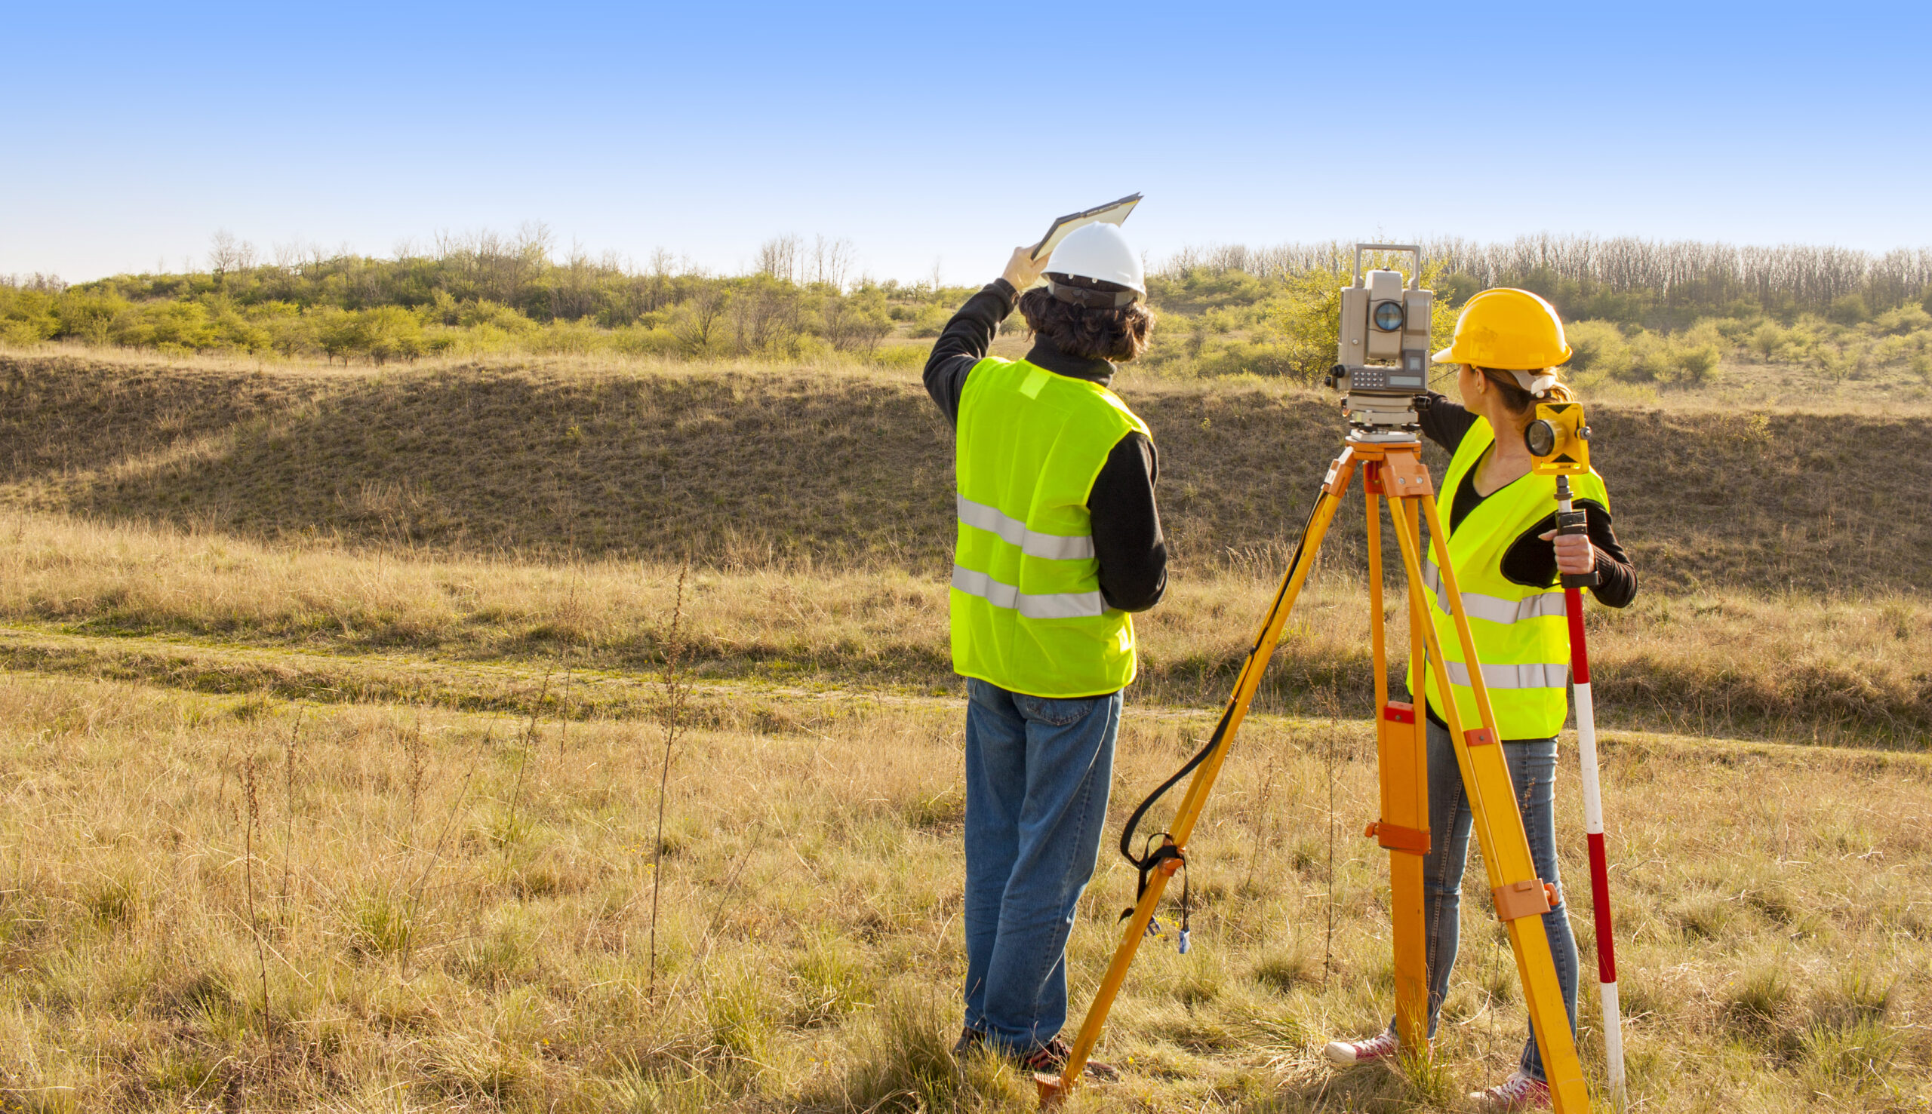
Job profile
SuDS engineer
Training time: 3-5 years
Salary:
(qualified) £38-52k
(senior) £55-72k
(consultant) £80-100k
Notes:
SuDS is ‘sustainable drainage’. This is basically a specific type of civil engineer, so there’s quite a lot of training involved. Again though, this area has a significant skills gap. They look at the ground and how it can be made to drain better using natural solutions, to reduce flooding.

Slide 12
Scenario
East, south and west-facing classrooms get too warm in the summer due to strong sunlight.
Notes:
Last one! This time the problem is that the weather’s too nice! We can’t cancel school and send everyone off to silverdale park for an ice cream or whatever. School has to continue! How can we cool the school.
You know the drill by now – what can you put on the building? It might be getting a bit crowded by now so feel free to remove some of your stuff from the previous tasks.
DISCUSSION/DEBRIEF – So shading is the main thing here. The main thing that overheats buildings is when sunlight pounds in through a window – the energy doesn’t leave so easily, even with ventilation. So the best thing to do is to shade the outside. This also reduces energy consumption because if you’ve got air conditioning, you don’t need to use as much. We’ve also got some natural solutions like green walls, green roof and tree planting which help with this sort of stuff.

Slide 13
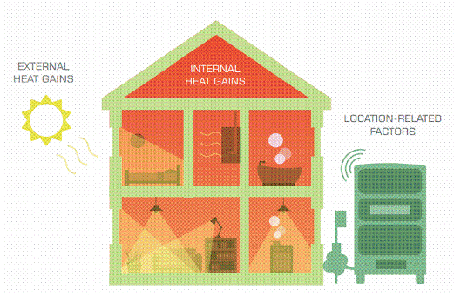
Job profile
Adaptation and resilience specialist (building overheating)
Training time: 4 years
Salary:
(qualified) £42-55k
(senior) £60-85k
(Freelance) £400-600/day
Notes:
So here’s our last job role in depth. This one is a job that practically doesn’t exist – I mean, it does, but very few people actually do this. Overheating buildings don’t get as much coverage when looking at climate risks in this country because the period of time it happens for tends to be quite short. It’s becoming more and more of an issue over time though as global temperatures increase.
GET SOME PICTURES OF THE PLANS THROUGHOUT OR BEFORE THE PACK UP
PLEASE PACK UP THE CUT OUTS BACK INTO ENVELOPES SO THEY CAN BE USED AGAIN.

Slide 14

Job profiles
Builder
Window fitter
HGV driver
Retail specialist
Logistics specialist
Caterer
Supply chain auditor
Stadium manager
Notes:
So we’re going to wrap up in a minute, but before we do, we should just recognise that we only looked at a small selection of quite stereotypical and quite technical ‘green jobs’. This list here shows some of the other areas affected for buildings – moving away from schools temporarily and thinking about the co-op stadium out by the Etihad, just east of town. They’ve been on a bit of a journey to improve the sustainability of their stadium – and this includes things like where they’re buying stuff from, what food they’re serving and how they manage the stadium itself in terms of energy and transport to and from.
So green skills and careers doesn’t just mean heating engineer or solar installer – there are loads of jobs, more than I’ve listed here – that will be affected by the need to reduce carbon footprint of businesses and organisations like schools.

Slide 15
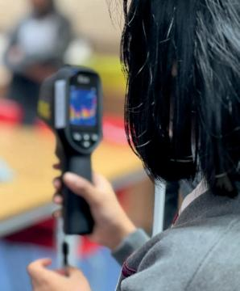
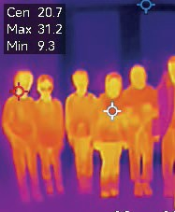
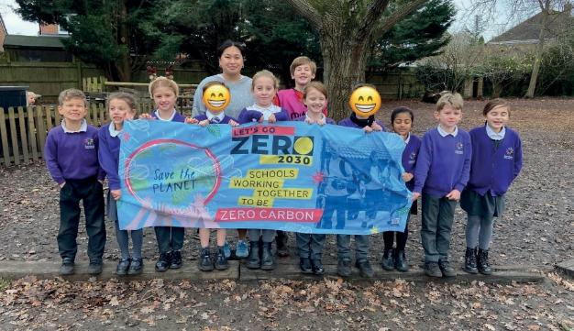
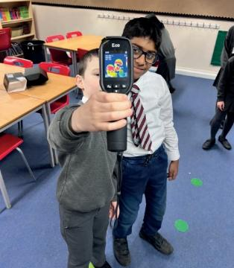
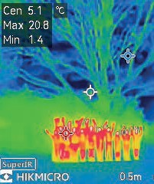

Questions

Slide 16
Thank you

