Slide 1
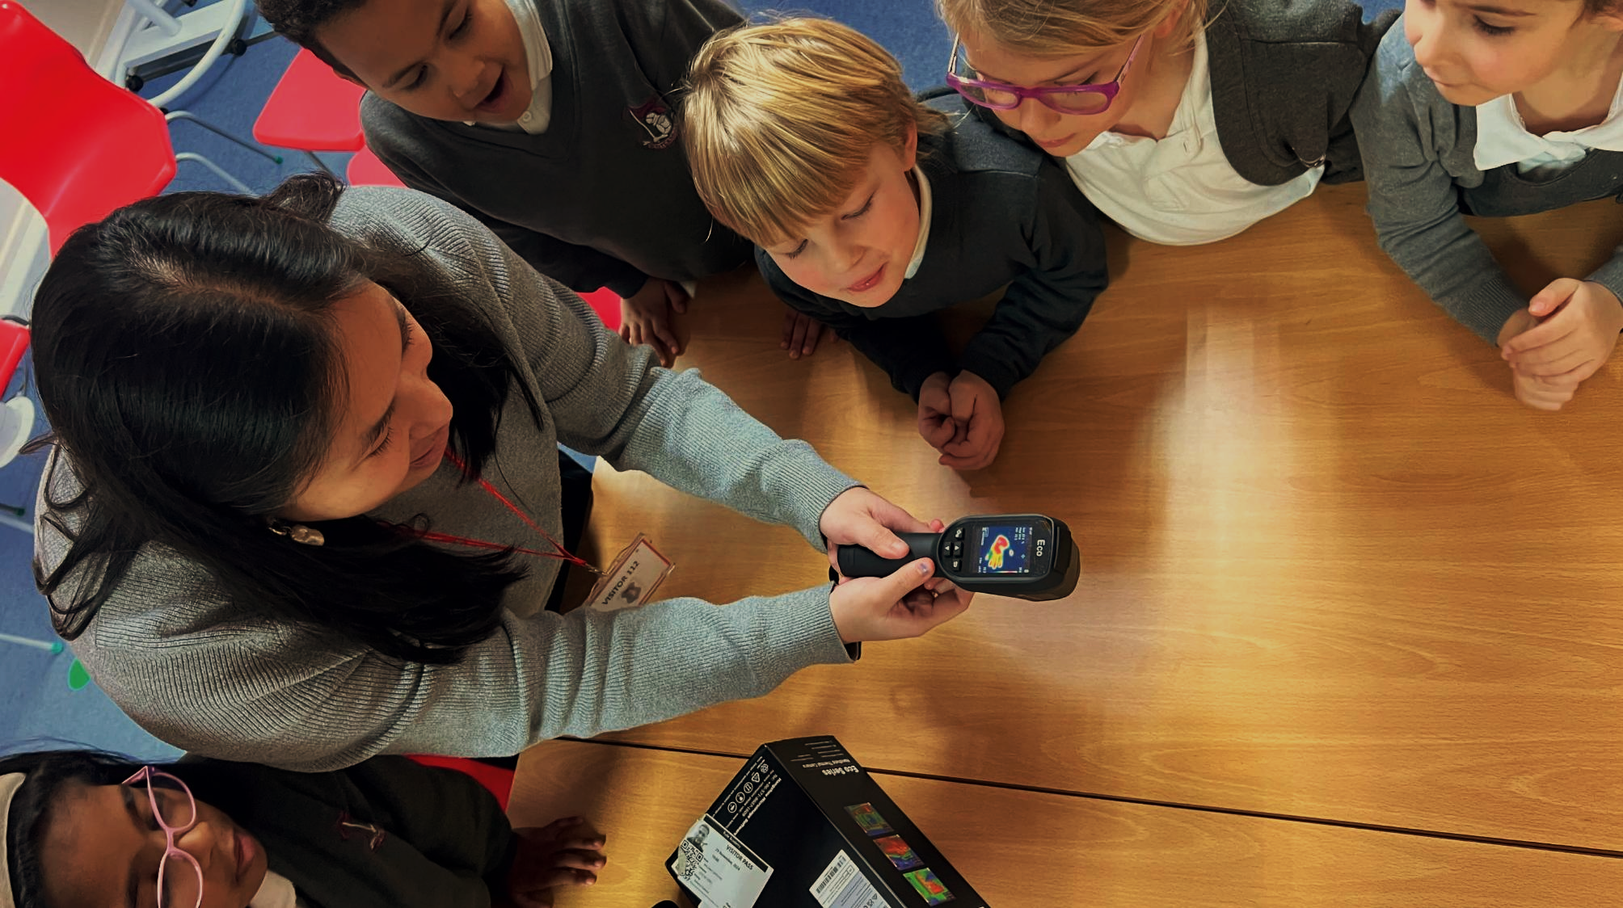










GBESP
Green Skills and Careers
Reducing waste at school level
Notes:
Green Careers: Building Skills for a Water-Wise Future
Join this session to explore how protecting water resources can open the door to exciting and meaningful green careers.
John and Jasmine from Blue Marble will share how they’ve supported schools to reduce water consumption through the Great British Energy Solar Partnership (GBESP), demonstrating the positive impact young people can have in their communities.
Trish Barrett from Telex Water will explain why lowering water use in schools is increasingly important in the face of water scarcity, and how Telex Water has helped schools take action. She will also highlight green career pathways in the water industry that support schools and communities to tackle climate change.
The session will conclude with a live Q&A for students to ask questions and learn more about careers in sustainability.

Slide 2



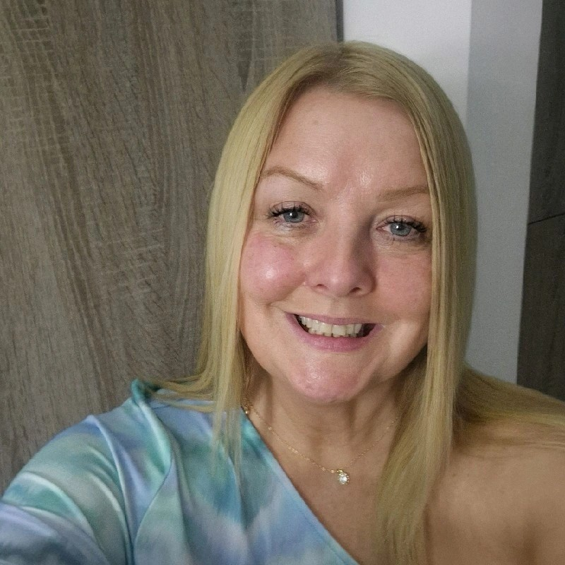
Introduction
John Edwards
Blue marble
Jasmine Newhouse
Blue Marble
Trish
Telex Water

Slide 4


Slide 5
Average bill increase by April 2029
47%
Severn Trent
35%
£104 billion total expenditure
Thames
26%
53%
Affinity
Anglian
21%
Southern
Water
41%
Northumbrian
South Staffs
Wessex
Yorkshire
32%
United Utilities
23%
South-West

Slide 6
Why?

Slide 7
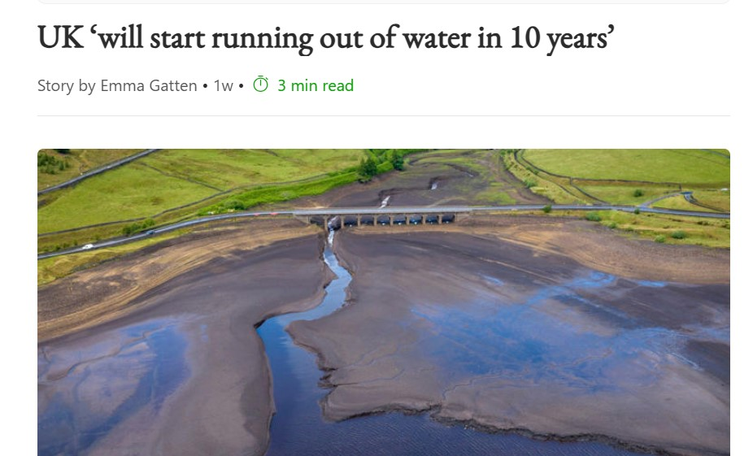
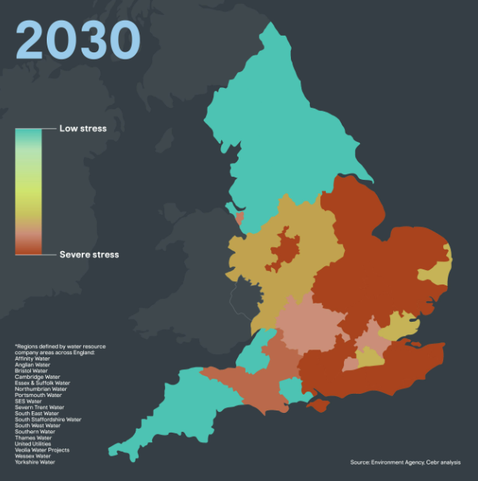
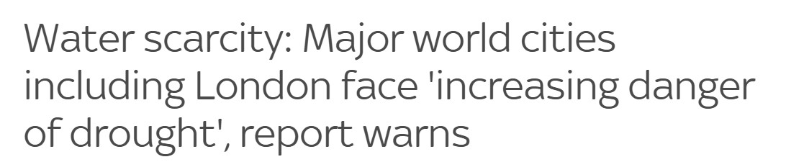
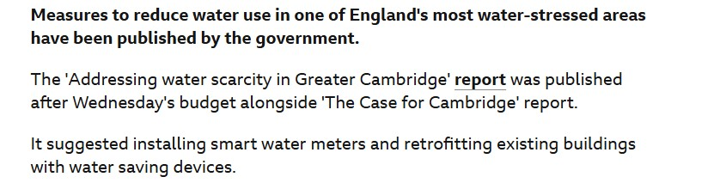
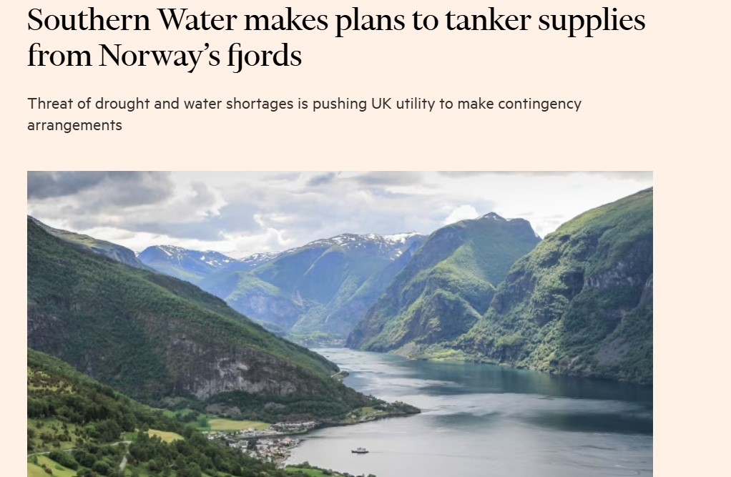
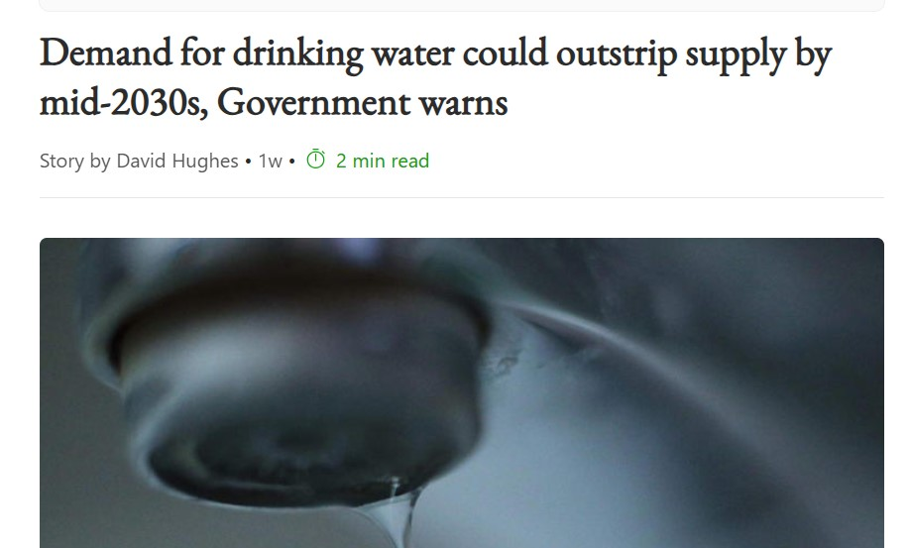
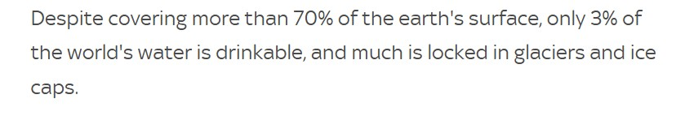
Rising Global Water Crisis: Shortages, Drought Risks, and Urgent Action Needed

Slide 8
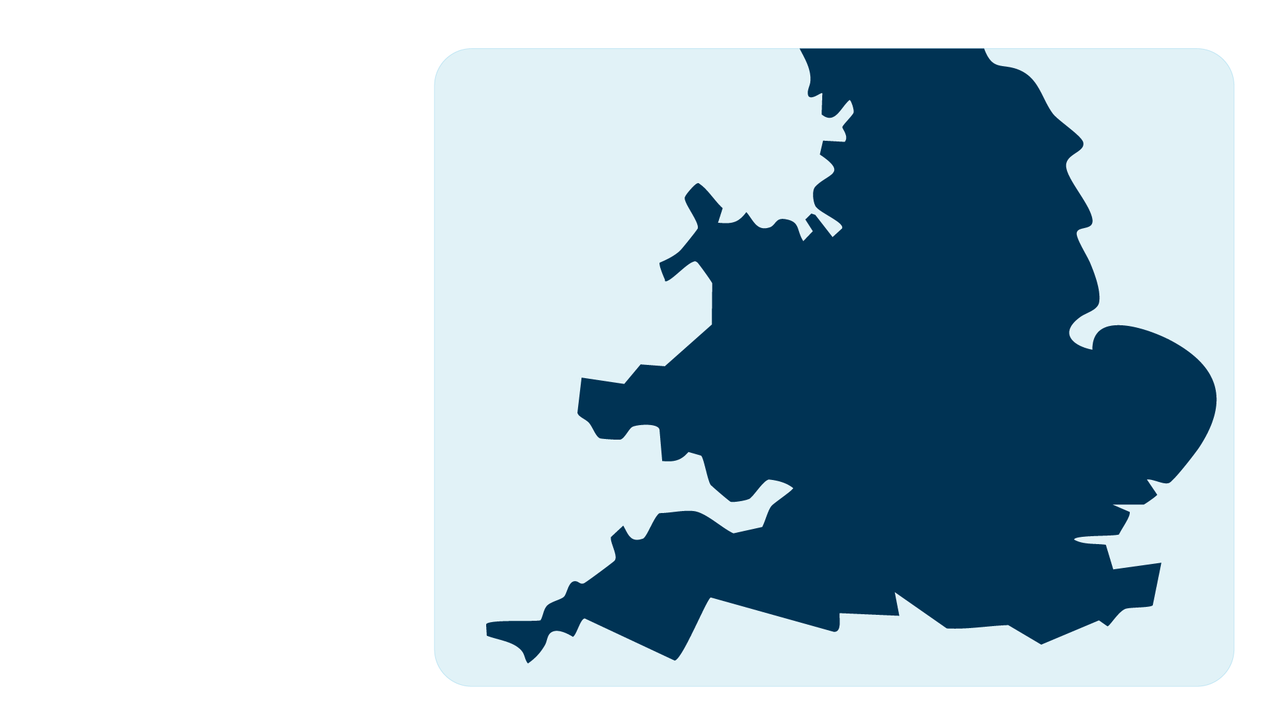
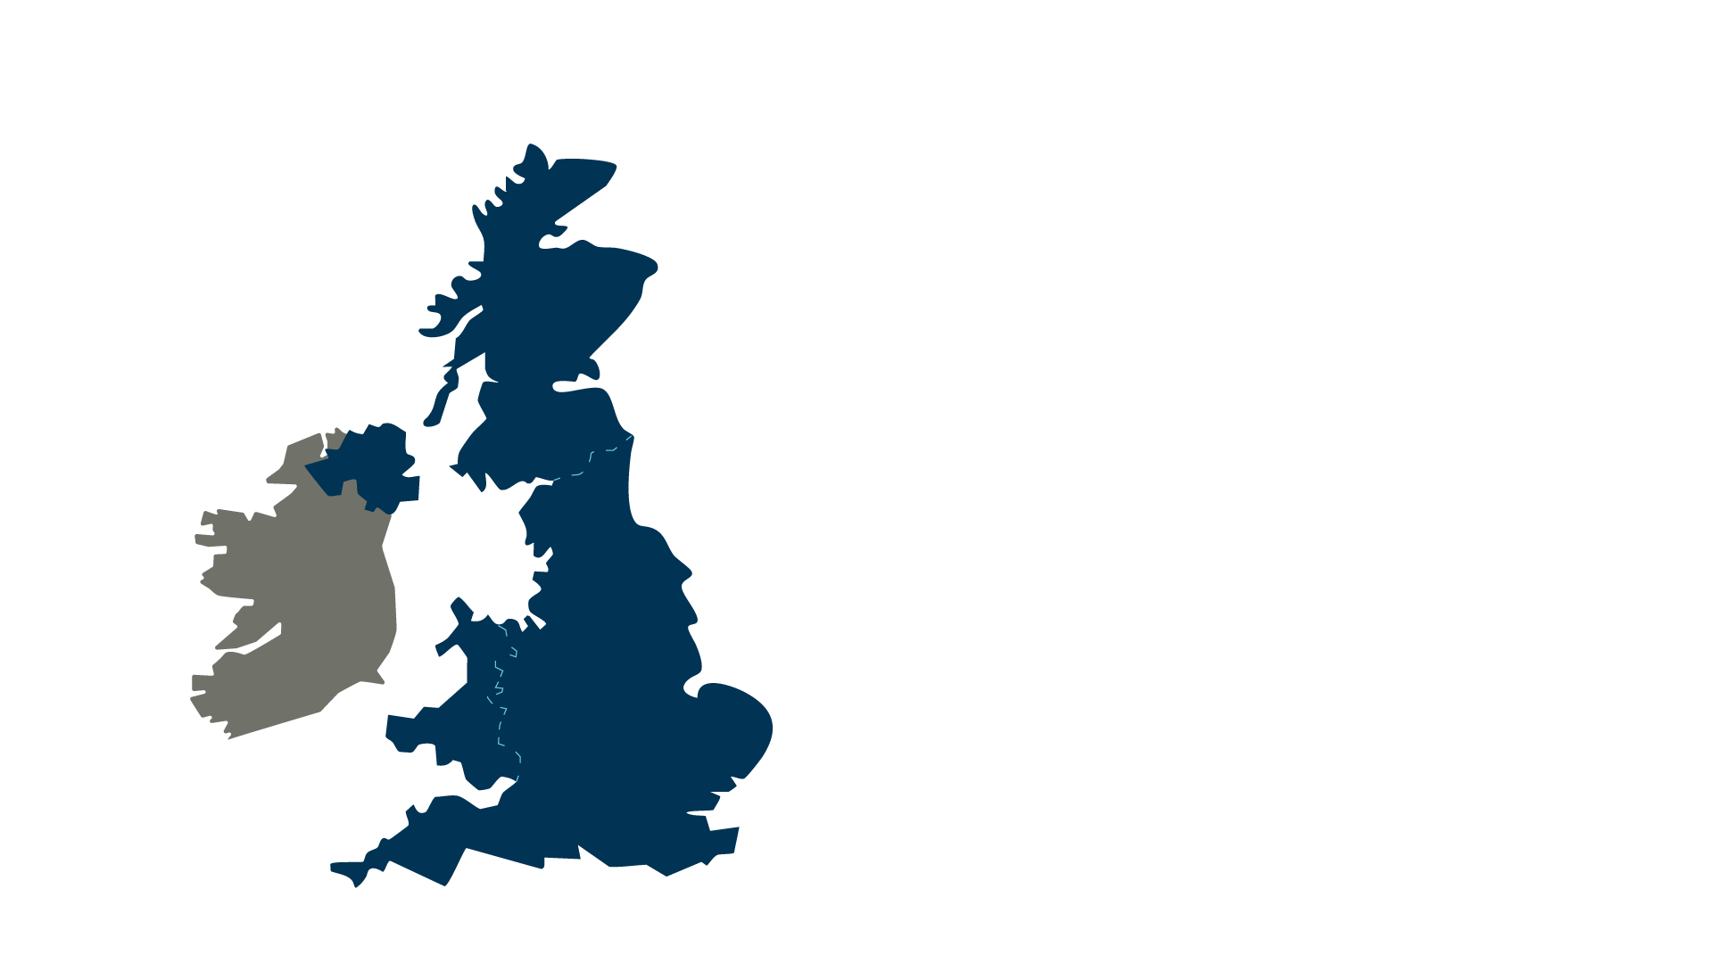
The new water reservoirs planned for England
South Lincolnshire
£1.8bn 2040
166.5
Abingdon
£2.2bn 2039
293
Fens
£4.1bn 2039
87
Cheddar 2
£2.8bn 2035
13
Broad oak
£300m 2033
22
Mendips quarry
£840m 2040s
46
KEY £2.8bn = cost 2035 = Operational start date
13 = Million litres a day supplied
Havant Thicket
£325m 2031
21

Slide 9
How can you reduce usage?
1
Want cold water? No need to run the tap
5
Make sure your urinals have sensors and do not have a continuous flow
Fill up the office dishwasher rather than washing up your dishes and mugs by hand
Reuse your rain water
to wash your fleet
2
6
3
Why not install a shower timer to avoid wasting water
7
Water Butts can be used to recycle rain water for your plants and grass
4
Take shorter showers

Slide 10
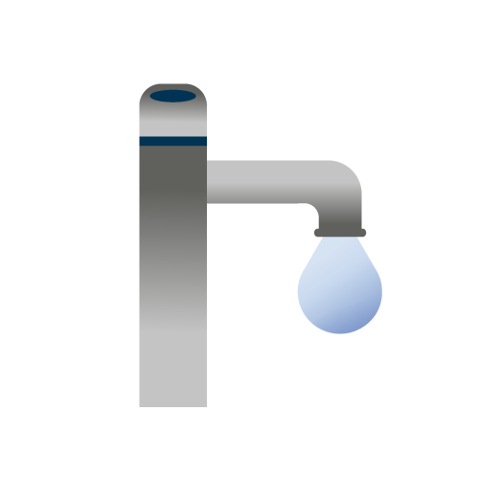
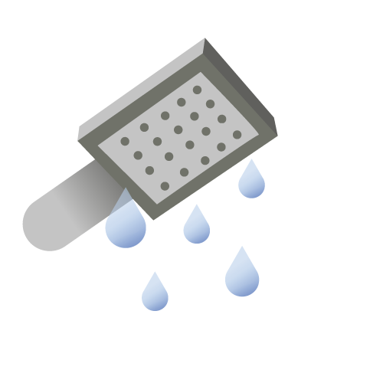

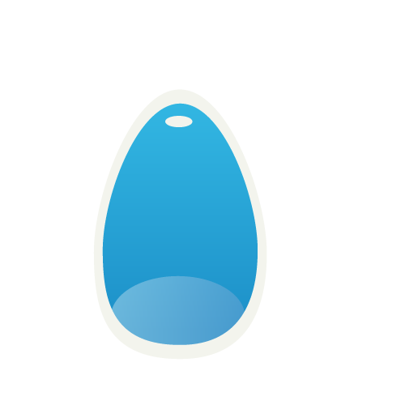

Step up to the mark in the bathroom
Employee bathrooms are one of the easiest areas to score some quick wins when it comes to saving water. Here are some suggestions:
`
`
Fit push taps
Super efficient showers
Minimise every flush
Save whilst spending a penny
Make a splash
Turning off the taps stops costly constant drips. Consider fitting push or sensor taps to reduce water running to waste.
Installing aerating showerheads, can reduce the flow by 50%, while timers encourage staff to take shorter showers.
Older toilets can use up to 13 litres every flush. Installing a flush saver device can save up to 1.2 litres per flush.
Uncontrolled urinals can waste 100’s of litres of water per hour. Fit control devices or fit PIR sensors (passive infrared) to control flushing frequency.
Check all the toilets for leaks as modern push button loos can leak due to sticking buttons or faulty valves and waste up to 250 litres an hour.
Turning of the taps stop costly constant drips. Consider fitting push or sensor taps to reduce water running to waste.
Turning of the taps stop costly constant drips. Consider fitting push or sensor taps to reduce water running to waste.

Slide 11
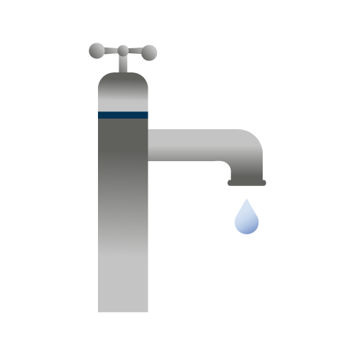

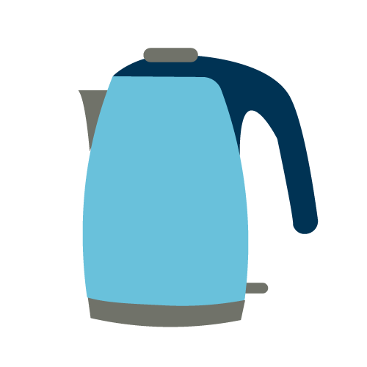
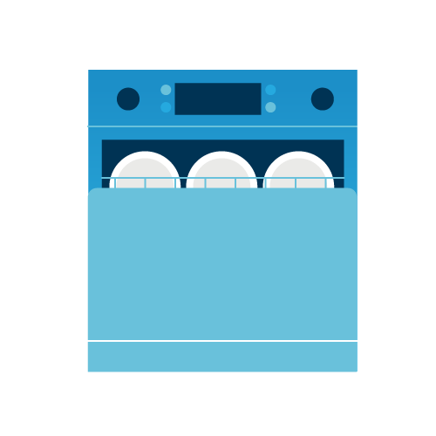
Start saving in the kitchen
Whatever your business, there’s plenty of opportunities to reduce water usage in the kitchen. Here are some suggestions:
Turn taps off
Spare the kettle
Feed the dishwasher
Cool it
Don’t leave taps running constantly for vegetable washing, rinsing or defrosting.
Store jugs of water in the fridge instead of running the tap or use a water cooler.
Don’t overfill the kettle and only boil what you need.
Use a dishwasher or dip into a bowl of hot water to wash up. Don’t leave taps running to wash individual mugs or plates.

Slide 12





Dial it up outdoors
Getting the team to think a little more about working wisely with water is half the battle, here’s some fast fixes your team can put into action.
Hang up the hosepipe & sprinklers
Wheely clean
Water less
Windows can wait
Butts are best!
Dusty transport still does the job, so only clean vehicles when they really need it. Why not use recycled water?
Choose shrubs that love dry conditions and try to water plants early morning and evening to reduce consumption.
Look for opportunities to reduce window cleaning activities during the summer or recycle collected rainwater.
Collect rainwater and keep thirsty plants topped up for free with water butts.
They can use more water in an hour than a family of four uses in day. Fit nozzle triggers or try to limit usage.

Slide 13
The process
Trisha Barrett

Slide 14

Water Account Management Delivers Results
This year Telex has reviewed the water consumption of more than 1,000 education establishments and we continue to monitor them
We have flagged 52 sites as having high consumption
Scheduled leakage investigations and arranged repair jobs
Working together with our customers we have saved almost 570,000 cubic meters of water from being wasted
Achieved a rebate of £200,000 for one Trust

Slide 15
Thank you

Slide 16
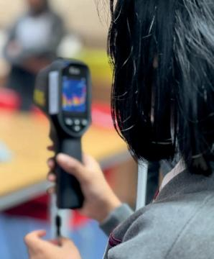
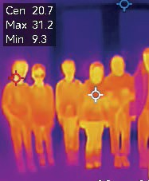
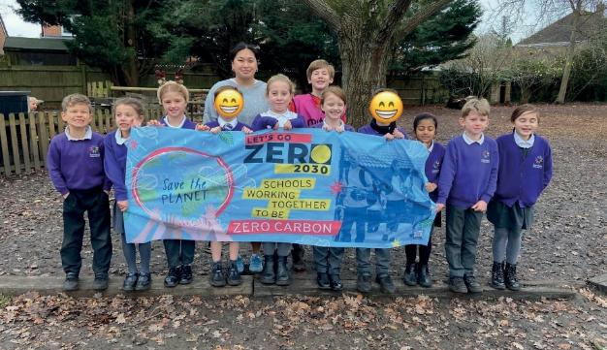
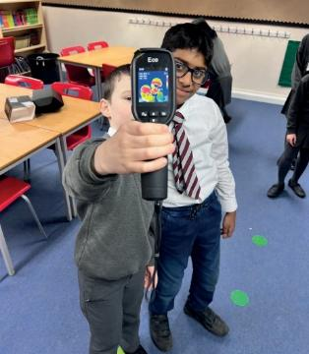
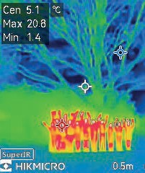

Questions

Slide 17
Thank you

