Slide 1
Topography 101
Design Engineer Construct
Laurus Ryecroft
May 2026

Slide 2
Agenda
1
2
Introduction
Topography 101
Marianna Carcano
3
4
Learning & Development Specialist
Practical Survey
Conclusion and Q&A
Ross Macauley
Head of Internal Operations & Production

Slide 3
60 Years of Innovation
First photogrammetry-based body scanning system – Mephisto EX. 3D Project Mapping used at BBC TV Centre & Microsoft Xbox launch. Early adopter of Augmented Reality
First terrestrial laser scanner in Europe – Cyrax 2500
First to combine CCTV footage with laser scan data for crime scene reconstruction
First to combine laser scanning & photogrammetry – National Injuries Database
First mainframe CAD workstation – GDS
1964
1985
1999
2008
2010
2012
Plowman Craven Associates established, working predominately with the DoE and Property Services Agency
1972
1989
2005
2009
2011
2014
First electronic tacheometer – Zeiss Reg Elta
First to develop underwater photogrammetric solutions for off-shore oil platforms
First cyber-scanning system in Europe – Cyberware WBX Head and Body scanners
Early adopter of kinematic scanning on railway. Plowman Craven Limited established
Early adopter of BIM & Scan-to-BIM. Industry leading BIM Survey Specification
Early adoption of fully immersive virtual reality for BIM – Occulus Rift Condition Survey Builder. Direct involvement with Leica in development of P40 and RTC360
2025
2024
2023
2020
2019
2018
2016
2015
Easl, Plowman Craven’s proprietary data management platform launched
Investment by Agathos enables GeoTech global growth
First “100% removal of boots on ballast” solution for UAS Rail Surveying – Vogel Freedom
First to achieve ultra-flat floor analysis for Amazon Robotics
First survey company to achieve ISO19650 BIM Level 2 Accreditation
First to adopt kinematic indoor SLAM-based scanning for area referencing
Creator of world’s most accurate UAS system – Vogel R3D. Delivery of Europe’s largest scan-to-BIM project – Palace of Westminster
First body scanning system for fitness market – 3dYu/4D Reality. Involved in developing software for BIM Construction Verification – Clear Edge Verity
3

Slide 4
60 Years of Innovation
First photogrammetry-based body scanning system – Mephisto EX. 3D Project Mapping used at BBC TV Centre & Microsoft Xbox launch. Early adopter of Augmented Reality
First terrestrial laser scanner in Europe – Cyrax 2500
First to combine CCTV footage with laser scan data for crime scene reconstruction
First to combine laser scanning & photogrammetry – National Injuries Database
First mainframe CAD workstation – GDS
1964
1985
1999
2008
2010
2012
Plowman Craven Associates established, working predominately with the DoE and Property Services Agency
1972
1989
2005
2009
2011
2014
First electronic tacheometer – Zeiss Reg Elta
First to develop underwater photogrammetric solutions for off-shore oil platforms
First cyber-scanning system in Europe – Cyberware WBX Head and Body scanners
Early adopter of kinematic scanning on railway. Plowman Craven Limited established
Early adopter of BIM & Scan-to-BIM. Industry leading BIM Survey Specification
Early adoption of fully immersive virtual reality for BIM – Occulus Rift Condition Survey Builder. Direct involvement with Leica in development of P40 and RTC360
2025
2024
2023
2020
2019
2018
2016
2015
Easl, Plowman Craven’s proprietary data management platform launched
Investment by Agathos enables GeoTech global growth
First “100% removal of boots on ballast” solution for UAS Rail Surveying – Vogel Freedom
First to achieve ultra-flat floor analysis for Amazon Robotics
First survey company to achieve ISO19650 BIM Level 2 Accreditation
First to adopt kinematic indoor SLAM-based scanning for area referencing
Creator of world’s most accurate UAS system – Vogel R3D. Delivery of Europe’s largest scan-to-BIM project – Palace of Westminster
First body scanning system for fitness market – 3dYu/4D Reality. Involved in developing software for BIM Construction Verification – Clear Edge Verity
4

Slide 5
60 Years of Innovation
First photogrammetry-based body scanning system – Mephisto EX. 3D Project Mapping used at BBC TV Centre & Microsoft Xbox launch. Early adopter of Augmented Reality
First terrestrial laser scanner in Europe – Cyrax 2500
First to combine CCTV footage with laser scan data for crime scene reconstruction
First to combine laser scanning & photogrammetry – National Injuries Database
First mainframe CAD workstation – GDS
1964
1985
1999
2008
2010
2012
Plowman Craven Associates established, working predominately with the DoE and Property Services Agency
1972
1989
2005
2009
2011
2014
First electronic tacheometer – Zeiss Reg Elta
First to develop underwater photogrammetric solutions for off-shore oil platforms
First cyber-scanning system in Europe – Cyberware WBX Head and Body scanners
Early adopter of kinematic scanning on railway. Plowman Craven Limited established
Early adopter of BIM & Scan-to-BIM. Industry leading BIM Survey Specification
Early adoption of fully immersive virtual reality for BIM – Occulus Rift Condition Survey Builder. Direct involvement with Leica in development of P40 and RTC360
2025
2024
2023
2020
2019
2018
2016
2015
Easl, Plowman Craven’s proprietary data management platform launched
Investment by Agathos enables GeoTech global growth
First “100% removal of boots on ballast” solution for UAS Rail Surveying – Vogel Freedom
First to achieve ultra-flat floor analysis for Amazon Robotics
First survey company to achieve ISO19650 BIM Level 2 Accreditation
First to adopt kinematic indoor SLAM-based scanning for area referencing
Creator of world’s most accurate UAS system – Vogel R3D. Delivery of Europe’s largest scan-to-BIM project – Palace of Westminster
First body scanning system for fitness market – 3dYu/4D Reality. Involved in developing software for BIM Construction Verification – Clear Edge Verity
5

Slide 6
60 Years of Innovation
First photogrammetry-based body scanning system – Mephisto EX. 3D Project Mapping used at BBC TV Centre & Microsoft Xbox launch. Early adopter of Augmented Reality
First terrestrial laser scanner in Europe – Cyrax 2500
First to combine CCTV footage with laser scan data for crime scene reconstruction
First to combine laser scanning & photogrammetry – National Injuries Database
First mainframe CAD workstation – GDS
1964
1985
1999
2008
2010
2012
Plowman Craven Associates established, working predominately with the DoE and Property Services Agency
1972
1989
2005
2009
2011
2014
First electronic tacheometer – Zeiss Reg Elta
First to develop underwater photogrammetric solutions for off-shore oil platforms
First cyber-scanning system in Europe – Cyberware WBX Head and Body scanners
Early adopter of kinematic scanning on railway. Plowman Craven Limited established
Early adopter of BIM & Scan-to-BIM. Industry leading BIM Survey Specification
Early adoption of fully immersive virtual reality for BIM – Occulus Rift Condition Survey Builder. Direct involvement with Leica in development of P40 and RTC360
2025
2024
2023
2020
2019
2018
2016
2015
Easl, Plowman Craven’s proprietary data management platform launched
Investment by Agathos enables GeoTech global growth
First “100% removal of boots on ballast” solution for UAS Rail Surveying – Vogel Freedom
First to achieve ultra-flat floor analysis for Amazon Robotics
First survey company to achieve ISO19650 BIM Level 2 Accreditation
First to adopt kinematic indoor SLAM-based scanning for area referencing
Creator of world’s most accurate UAS system – Vogel R3D. Delivery of Europe’s largest scan-to-BIM project – Palace of Westminster
First body scanning system for fitness market – 3dYu/4D Reality. Involved in developing software for BIM Construction Verification – Clear Edge Verity
6

Slide 7
60 Years of Innovation
First photogrammetry-based body scanning system – Mephisto EX. 3D Project Mapping used at BBC TV Centre & Microsoft Xbox launch. Early adopter of Augmented Reality
First terrestrial laser scanner in Europe – Cyrax 2500
First to combine CCTV footage with laser scan data for crime scene reconstruction
First to combine laser scanning & photogrammetry – National Injuries Database
First mainframe CAD workstation – GDS
1964
1985
1999
2008
2010
2012
Plowman Craven Associates established, working predominately with the DoE and Property Services Agency
1972
1989
2005
2009
2011
2014
First electronic tacheometer – Zeiss Reg Elta
First to develop underwater photogrammetric solutions for off-shore oil platforms
First cyber-scanning system in Europe – Cyberware WBX Head and Body scanners
Early adopter of kinematic scanning on railway. Plowman Craven Limited established
Early adopter of BIM & Scan-to-BIM. Industry leading BIM Survey Specification
Early adoption of fully immersive virtual reality for BIM – Occulus Rift Condition Survey Builder. Direct involvement with Leica in development of P40 and RTC360
2025
2024
2023
2020
2019
2018
2016
2015
Easl, Plowman Craven’s proprietary data management platform launched
Investment by Agathos enables GeoTech global growth
First “100% removal of boots on ballast” solution for UAS Rail Surveying – Vogel Freedom
First to achieve ultra-flat floor analysis for Amazon Robotics
First survey company to achieve ISO19650 BIM Level 2 Accreditation
First to adopt kinematic indoor SLAM-based scanning for area referencing
Creator of world’s most accurate UAS system – Vogel R3D. Delivery of Europe’s largest scan-to-BIM project – Palace of Westminster
First body scanning system for fitness market – 3dYu/4D Reality. Involved in developing software for BIM Construction Verification – Clear Edge Verity
7

Slide 8
60 Years of Innovation
First photogrammetry-based body scanning system – Mephisto EX. 3D Project Mapping used at BBC TV Centre & Microsoft Xbox launch. Early adopter of Augmented Reality
First terrestrial laser scanner in Europe – Cyrax 2500
First to combine CCTV footage with laser scan data for crime scene reconstruction
First to combine laser scanning & photogrammetry – National Injuries Database
First mainframe CAD workstation – GDS
1964
1985
1999
2008
2010
2012
Plowman Craven Associates established, working predominately with the DoE and Property Services Agency
1972
1989
2005
2009
2011
2014
First electronic tacheometer – Zeiss Reg Elta
First to develop underwater photogrammetric solutions for off-shore oil platforms
First cyber-scanning system in Europe – Cyberware WBX Head and Body scanners
Early adopter of kinematic scanning on railway. Plowman Craven Limited established
Early adopter of BIM & Scan-to-BIM. Industry leading BIM Survey Specification
Early adoption of fully immersive virtual reality for BIM – Occulus Rift Condition Survey Builder. Direct involvement with Leica in development of P40 and RTC360
2025
2024
2023
2020
2019
2018
2016
2015
Easl, Plowman Craven’s proprietary data management platform launched
Investment by Agathos enables GeoTech global growth
First “100% removal of boots on ballast” solution for UAS Rail Surveying – Vogel Freedom
First to achieve ultra-flat floor analysis for Amazon Robotics
First survey company to achieve ISO19650 BIM Level 2 Accreditation
First to adopt kinematic indoor SLAM-based scanning for area referencing
Creator of world’s most accurate UAS system – Vogel R3D. Delivery of Europe’s largest scan-to-BIM project – Palace of Westminster
First body scanning system for fitness market – 3dYu/4D Reality. Involved in developing software for BIM Construction Verification – Clear Edge Verity
8
Notes:
Many achievements and technological advancements. But let’s not forget this is a survey company, and therefore let’s talk about Topo

Slide 9
Topographic Survey
A topographic survey is an accurate representation of a site which is scaled and detailed to show all the natural and manmade features and their levels.

Slide 10
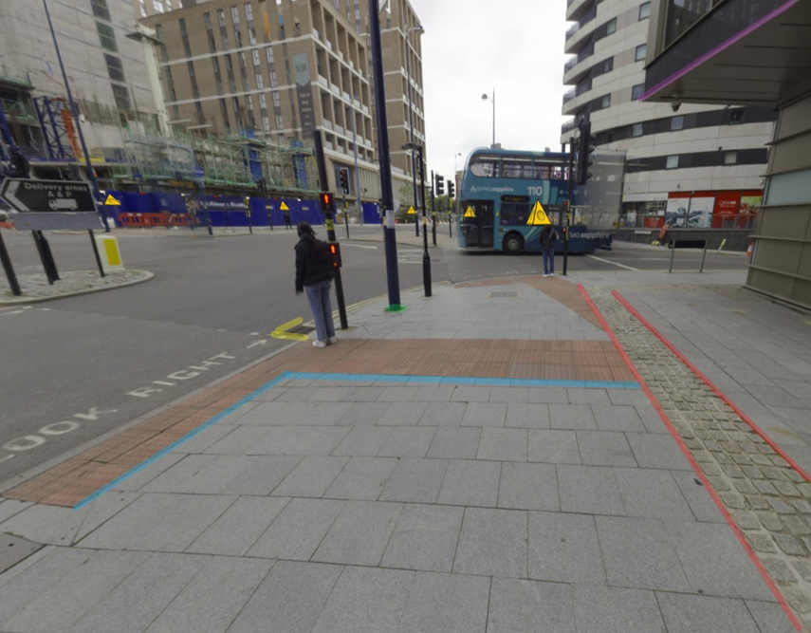
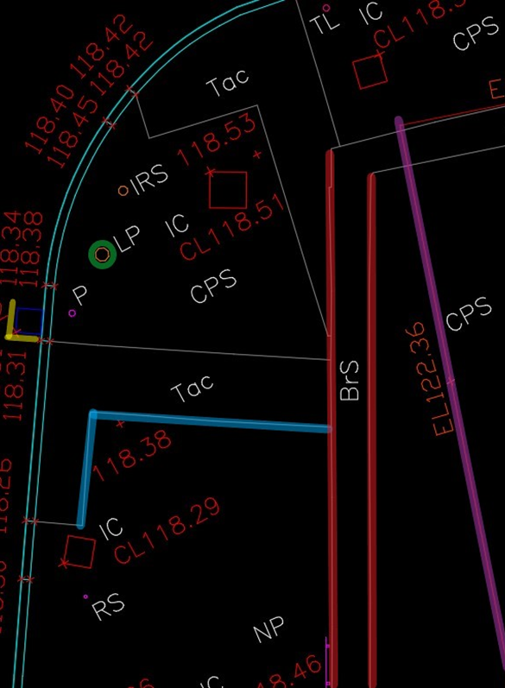
What do we present on a Topo ?
Any unmovable feature touching the ground and of other relevant features such as:
Building's canopies / Overhanging structures
Overhead Line Equipment
Eave and Ridge Levels of neighboring buildings roofs
Construction site extent
Notes:
So what does this mean ? What do we present on a Topo ?
Unmovable – if you can move it i.e. a plastic cone or a barrier then I wouldn’t show it
Temporary construction site related features are an exception and would generally be shown

Slide 11
What do we present on a Topo ?
What can we understand from this information ?
Levels
Dimensions
Coordinates
Of any feature observed
Notes:
What can we understand
…
Coordinates

Slide 12
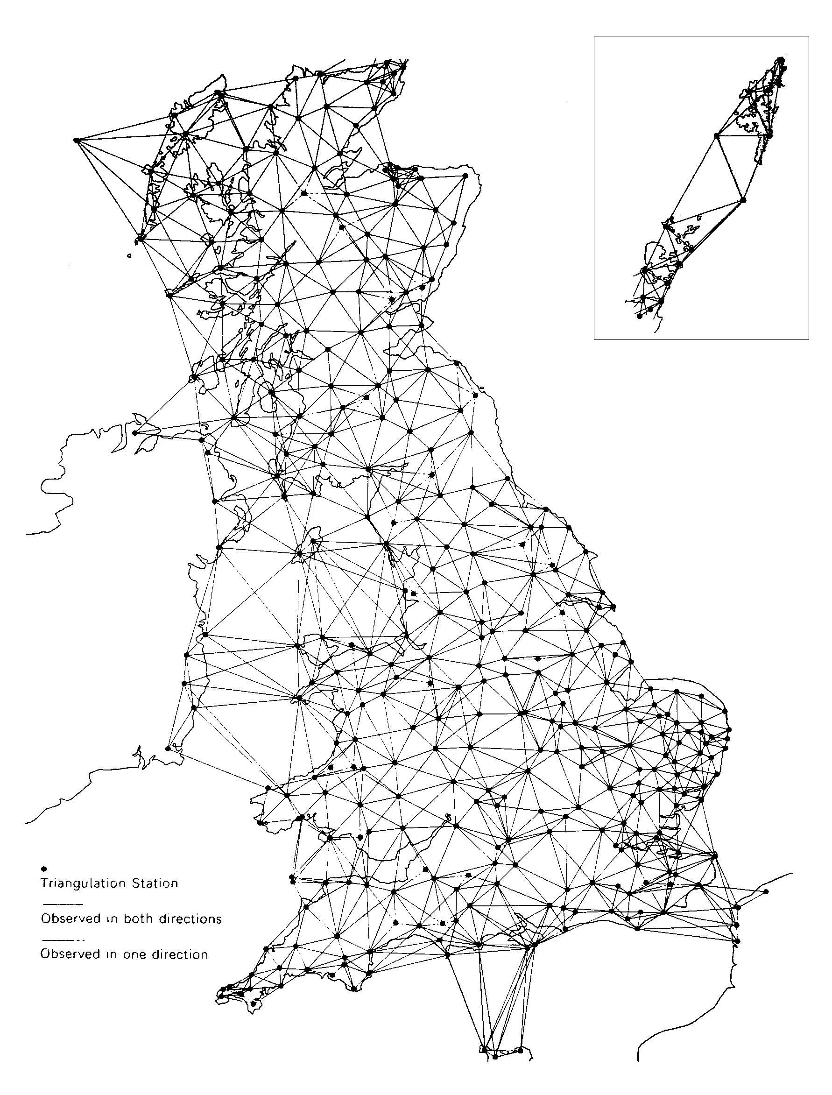

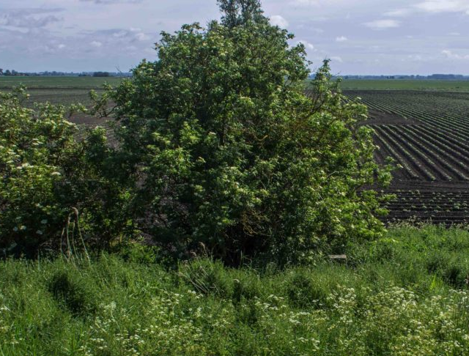
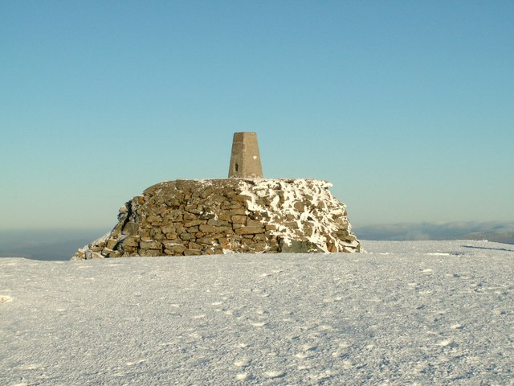
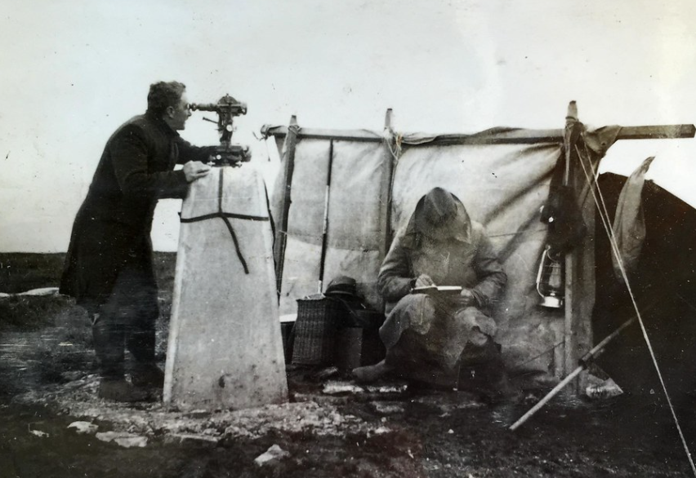
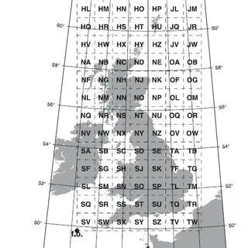
Coordinate Grid
Ordnance Survey National Grid (OSGB)
A Military established grid for the UK
A system of geographic grid references, distinct from latitude and longitude.
It utilizes real distances to reduce the error given by the curvature of the Earth on a national scale.
30 years
6500+ Trig Pillars
Ben Nevis has the highest trig pillar;
Little Ouse has the lowest, sitting at -0.533m below sea level
The most isolated trig point lies on the remote island of St Kilda
Notes:
So what are the coordinates referring to ?
.
.
.
OSGB > Reduce error given by the curvature of the earth
TRIG FUN FACT

Slide 13
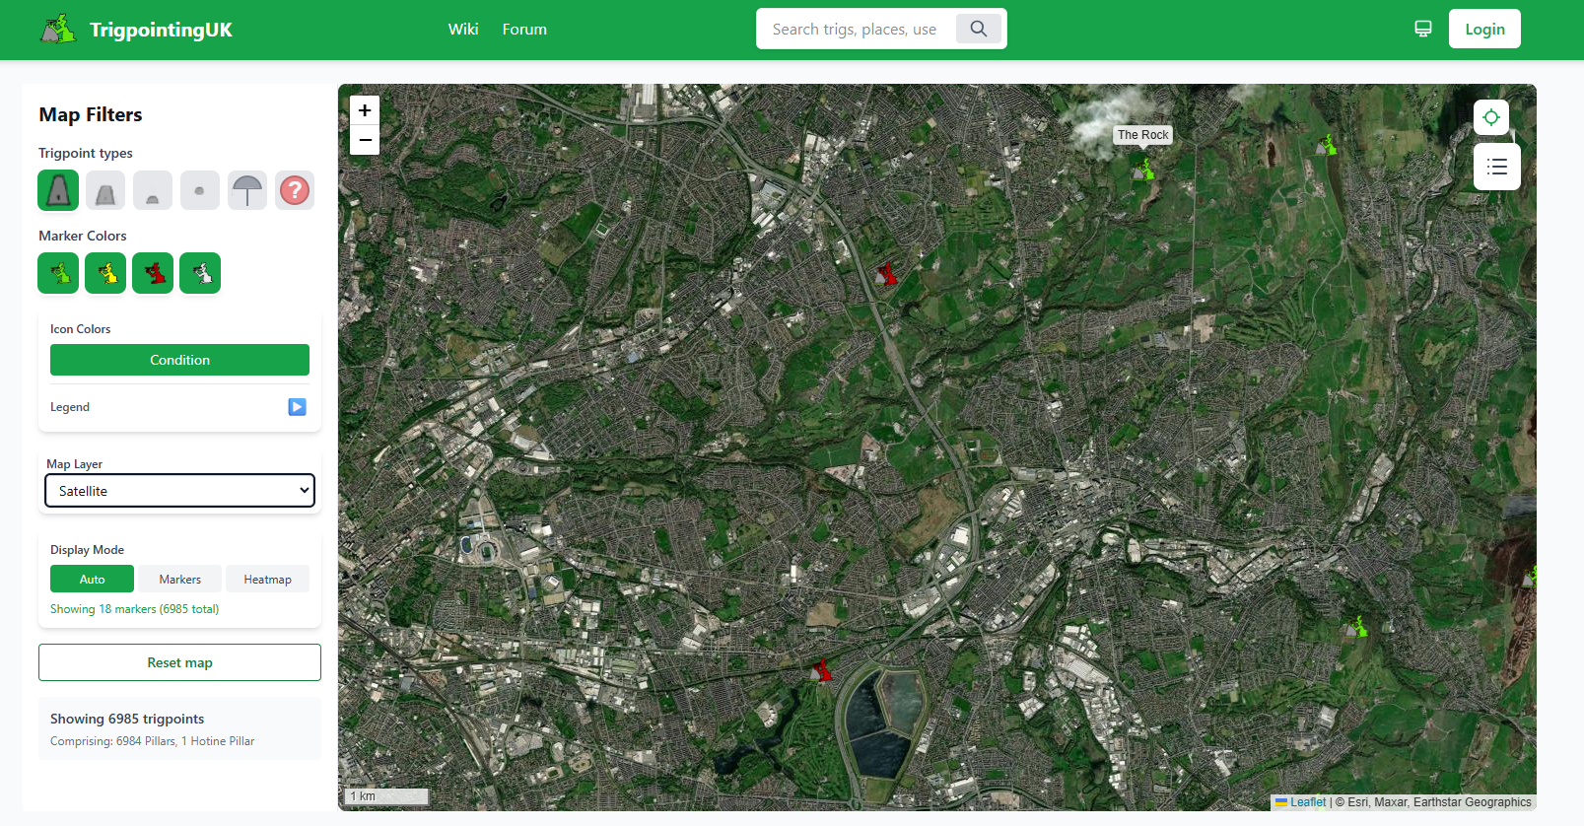
Notes:
Closest Trig > the Rock

Slide 14
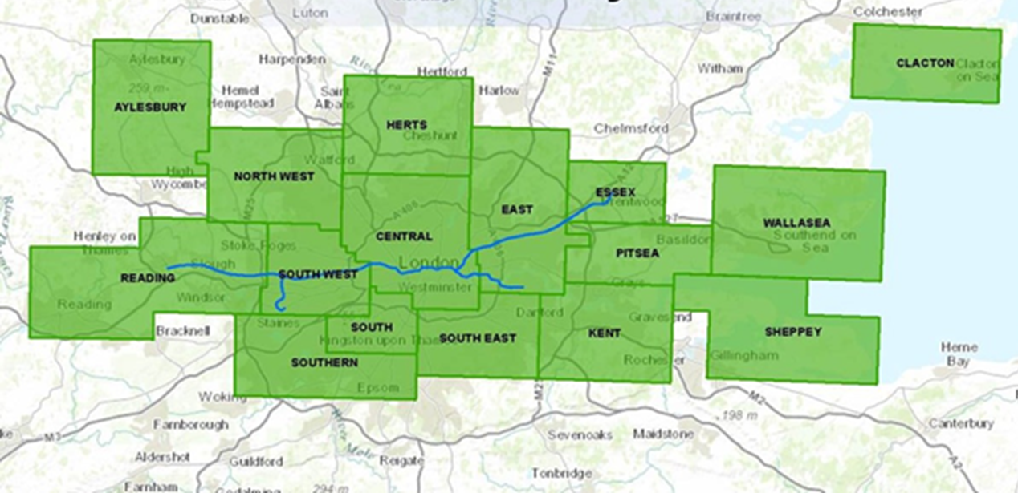
Coordinate Grid
London Survey Grid (LSG or LU)
Civil engineering grid for the Underground
Is designed to minimize grid distortion caused by the Earth’s curvature over the London Underground area.
It “lifts” all the tunnels to a positive Z value
Notes:
Local grid – minimize distortion even further
.
.
.
We use Coordinate grids because are far more precise than Latitude and Longitude

Slide 15
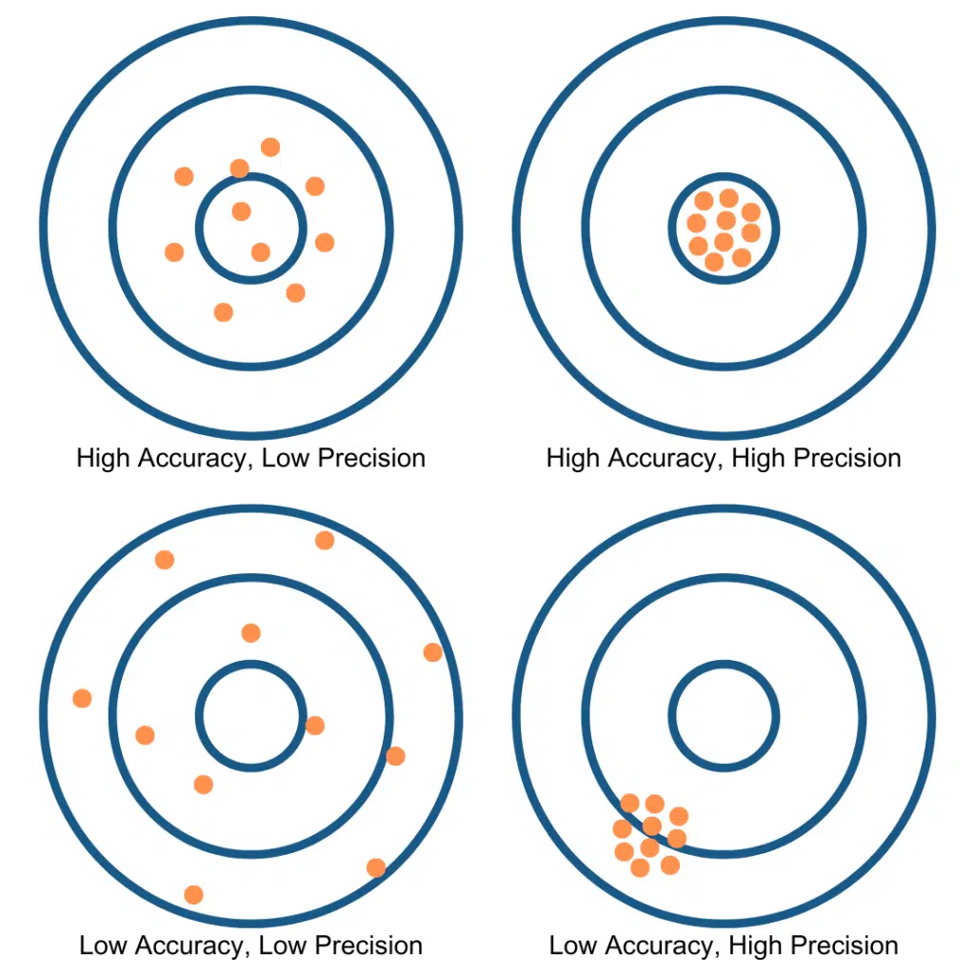
Accuracy & Precision
Survey Talk
Accuracy
Precision
How close a measurement is to the correct value
The measurement will be close to standard measurement
How close is a series of measurements to each other
The measurement will be similar every time we measure
Notes:
….but what does Precision mean in surveying.
Precision and Accuracy are used as synonyms but do not have the same meaning
.
.
.
To ensure precision we check the equipment quarterly, to ensure accuracy we work up to RICS standards

Slide 16
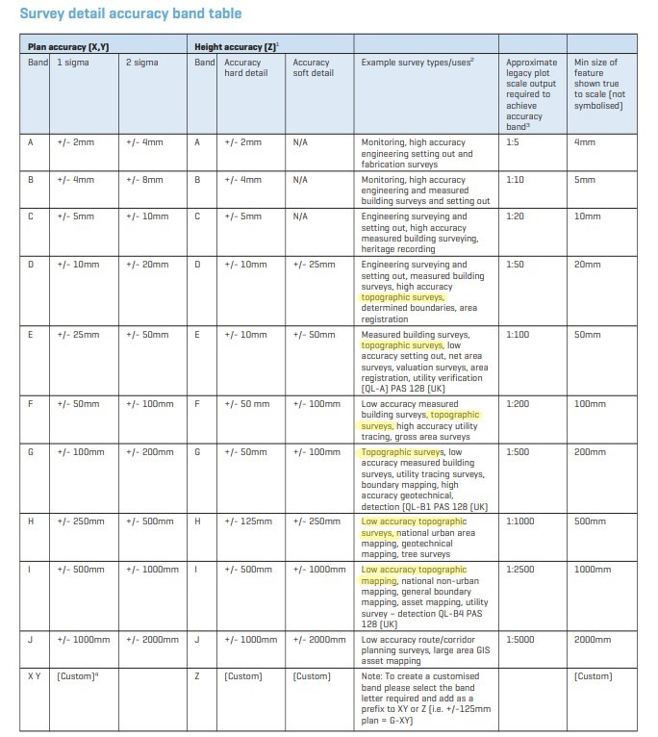
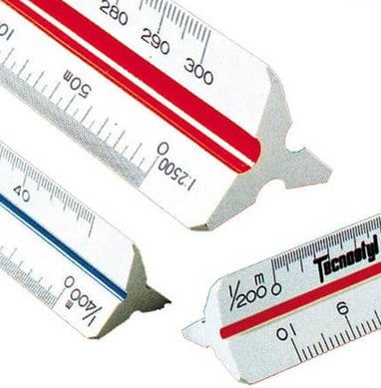
Survey Tolerance
How accurate our survey must be to the true measurements ?
Notes:
Who decides how accurate our survey has to be ?
Survey tolerance is how much can we be off from the true measurements.
Royal Inst of Chartered Surveyors established this table to set the standard of practice for surveys in relation to the survey scale
The scale number shown how many times we need to enlarge our piece of paper to achieve the real-life size of a certain object.
When I was in school, we used this triangular ruler (shockingly called scale ruler) to convert the measurements, each face had a different scale size
In yellow I highlighted the Topographic surveys – which can be carried out from scale 1:50 up to 1:2500.
Why do we use scales and how they differ from one another ?
A 1:50 Topo will be very “zoomed in” while a 1:2500 Topo will be a very “zoomed out” version of our site

Slide 17
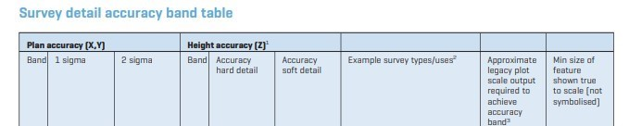

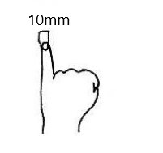
Survey Tolerance – High
Your pinkie is about 10mm wide
Notes:
1:50 topo for example is used in high accuracy surveys, for example the Topo of this school could be done 1:50.
In this case our accuracy on site is also high:
X, Y, Z
Consider your pinkie is about 1 cm wide

Slide 18
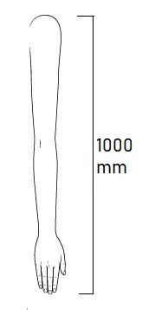

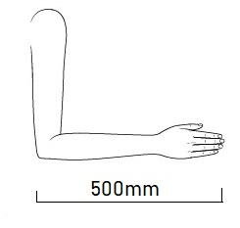
Survey Tolerance - Low
Your arm is about 1000mm long
Your elbow length is about 500mm
Notes:
A 1:2500 Topo will be for example a boundary survey
In this case our survey accuracy will be up to 10cm
..
Usually we would advise our clients what would suit them best in terms of scale

Slide 19
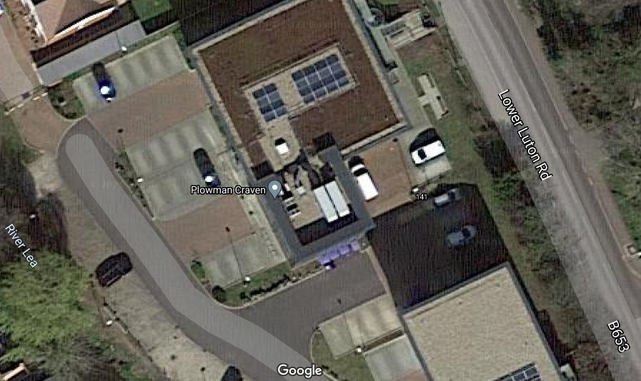
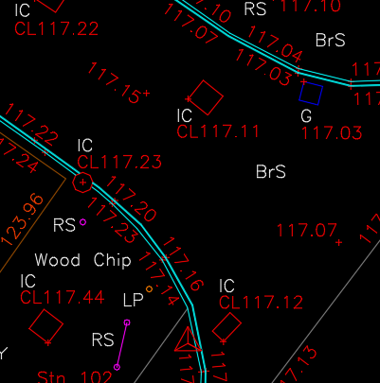
Survey Scale & Feature Resolution 1:50
Large Scale
High Accuracy
Detailed
Notes:
Counter intuitive scale definition
1:50 is considered a Large scale because it basically shows everything “large”
In this scenario we have a very “zoomed in” version of our site
the more you zoom in (to a higher accuracy) the more you can see, therefore more items will be presented

Slide 20
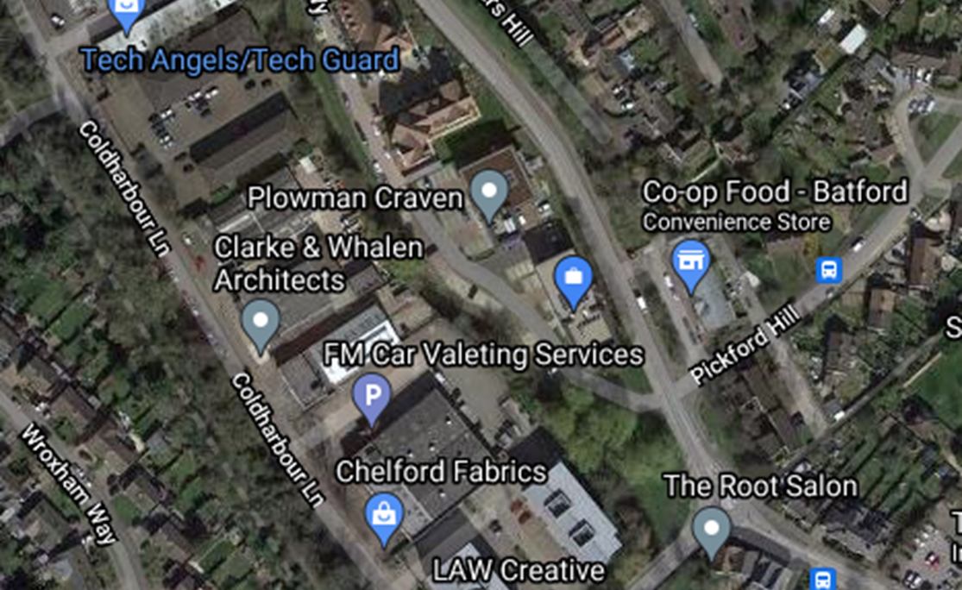
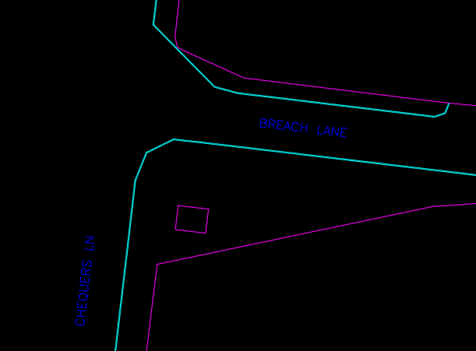
Survey Scale & Feature Resolution 1:2500
Small Scale
Low Accuracy
Not detailed
Notes:
Counter intuitive scale definition
1:25000 is considered a small scale because it shows everything small and not detailed
.
In this scenario we have a very “zoomed out” version of our site.
…and The more you zoom out (to a lower accuracy) the less items will be presented

Slide 21
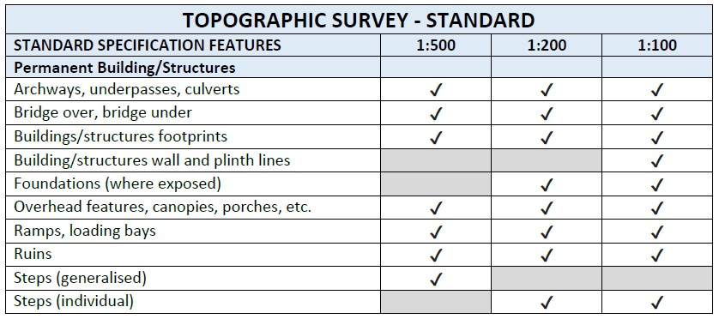
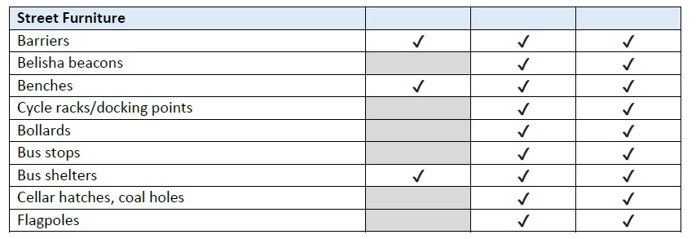
Presentation
Notes:
So we learnt that based on the scale of the drawing we present features differently.
This is a small example of presentation differences for our Topo – at 1:100 most items are ticked, the greater the scale the less items we show

Slide 22
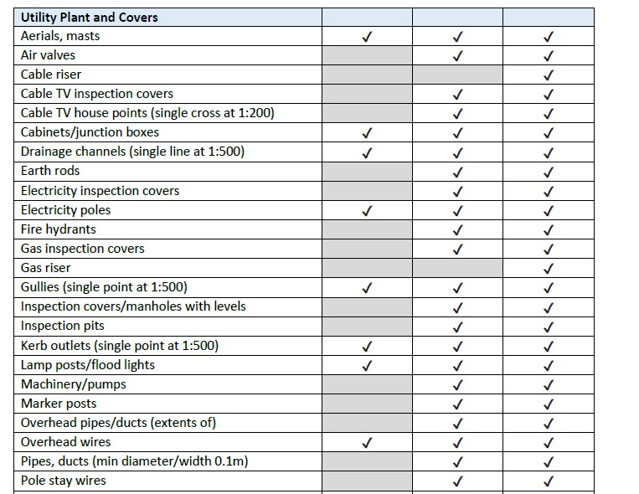
Presentation

Slide 23
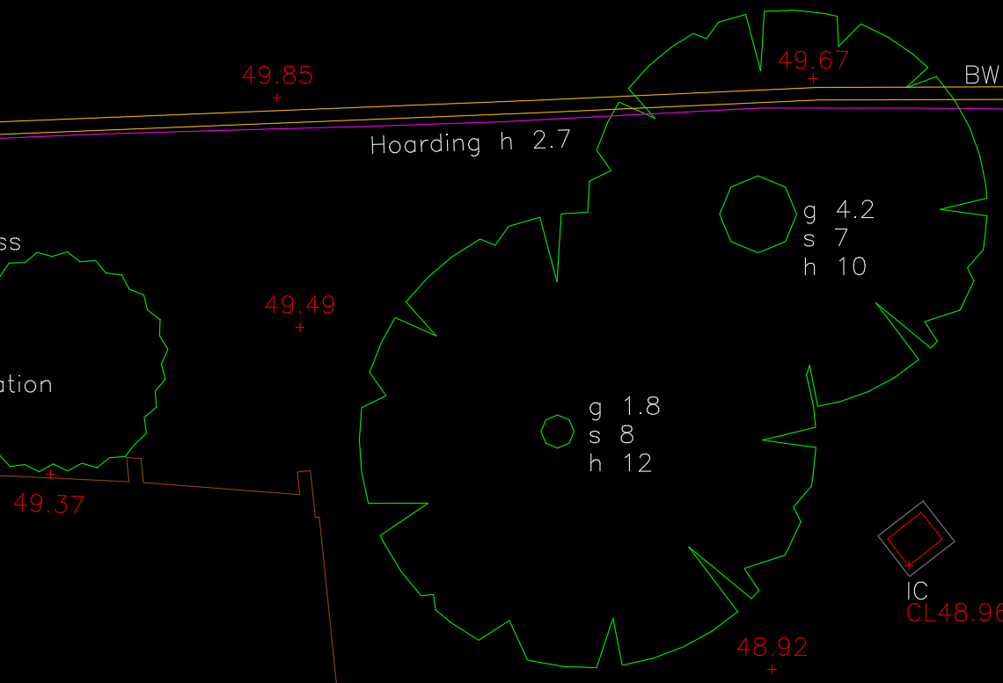
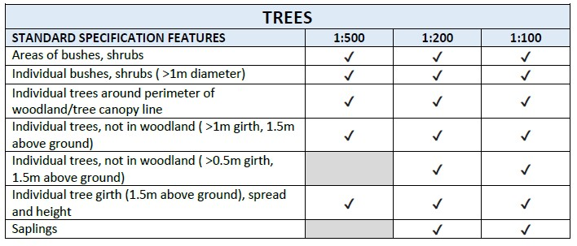
Presentation
Trees & vegetation
We include basic tree & vegetation information in all our surveys.
For more information such as tree species, we then involve our Environmental department to carry out an Arboricultural Survey
Notes:
Trees and vegetation are also shown differently depending on the scale or the information required

Slide 24
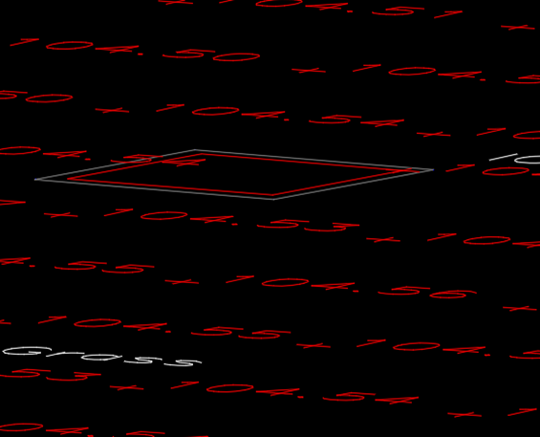
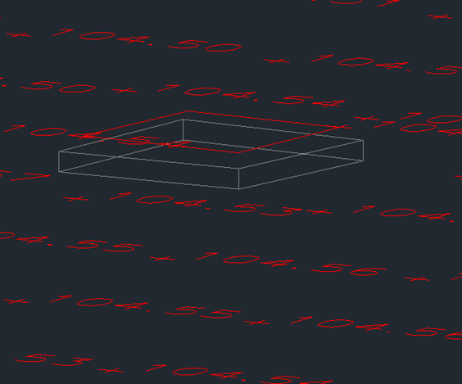
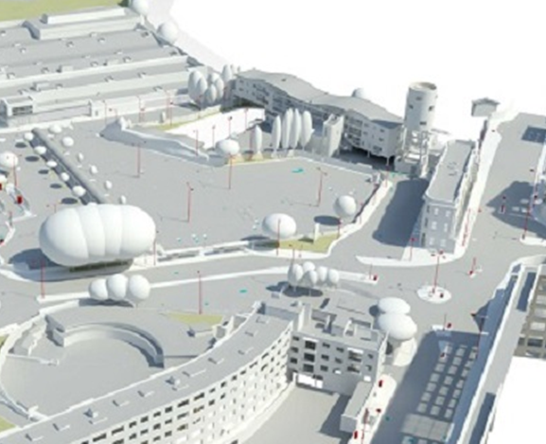
Data Output
The survey information can be used to produce different kind of deliverables
2D – Drawing
The features are shown as lines.
The linework is shown in X, Y.
The levels on the drawing are giving the Z information
3D – Drawing
The features are shown as lines.
The linework is shown in X, Y and Z.
3D – Model
The features are shown as surfaces and are a true representation of the site.
Depending on the Scale (called Level of Detail) the features will be less or more symbolized.
.
Notes:
Once we know the scale, and therefore the level of accuracy required, we then need to know in which format we will deliver our Topo.

Slide 25
Topographic Survey
A topographic survey is an accurate representation of a site which is scaled and detailed to show all the natural and manmade features and their levels.
A topographic survey is an accurate representation of a site which is scaled and detailed to show all the natural and manmade features and their levels.
A topographic survey is an accurate representation of a site which is scaled and detailed to show all the natural and manmade features and their levels.
A topographic survey is an accurate representation of a site which is scaled and detailed to show all the natural and manmade features and their levels.
A topographic survey is an accurate representation of a site which is scaled and detailed to show all the natural and manmade features and their levels.
Notes:
Accurate: we know how accurate we need to be
Representation: we know what we need to present
Scaled: we know the scale of the drawing
Detail: how detailed our topo will be

Slide 26
Topographic Survey
How do we capture Topographic Information ?

Slide 27
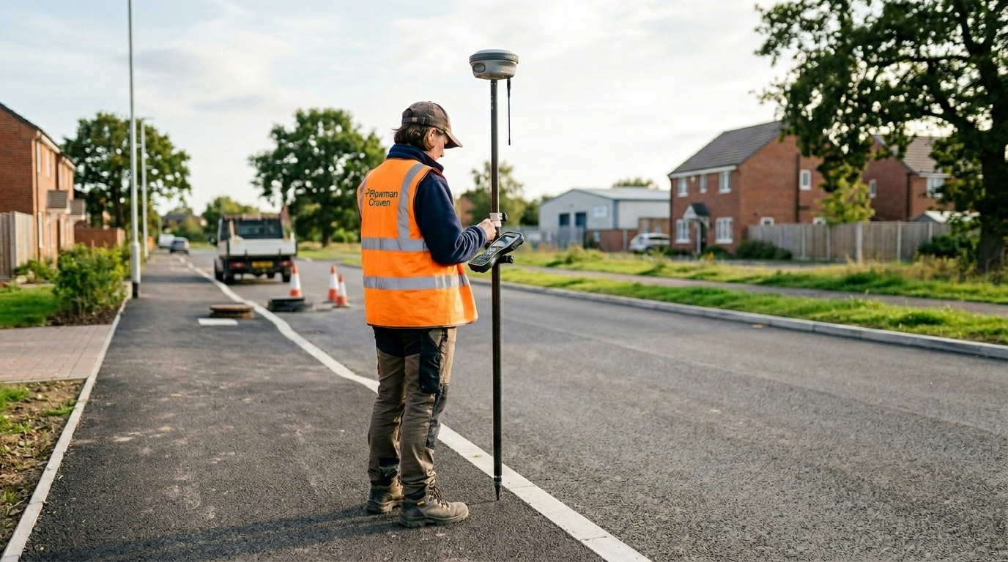
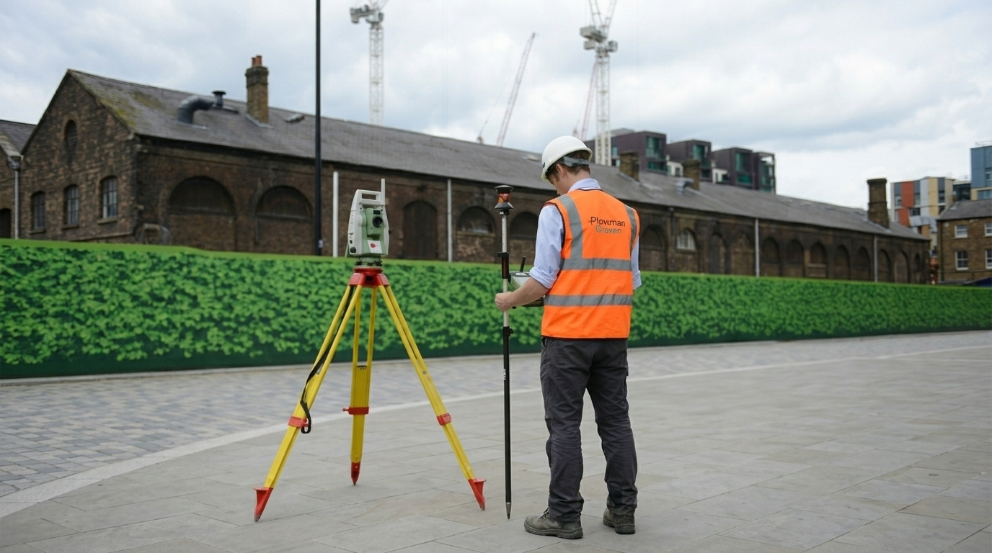
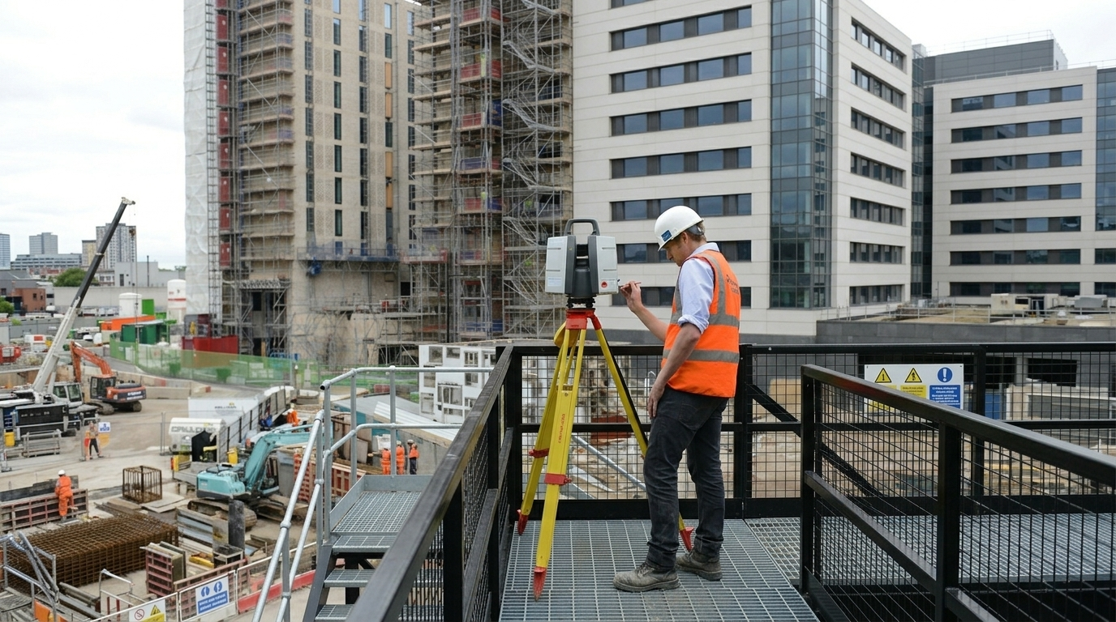
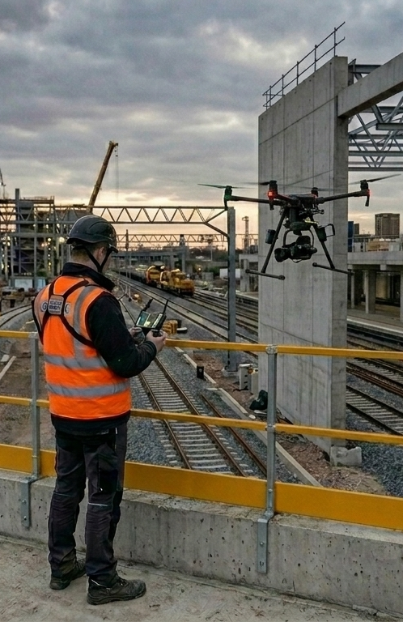
Data Collection
GNSS
Total Station
Laser Scanner
UAS
Notes:
We can use a variety of instruments, as technology advances we will always try to adopt new methods and strategies
These are some macro categories, each of those can be either used in different ways or can be found in different models.
how we would use these for a specific topo purpose

Slide 28
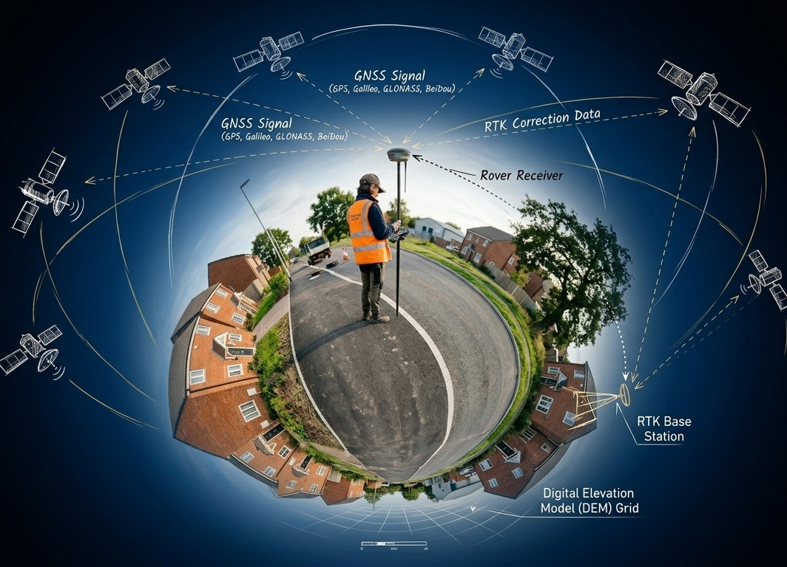
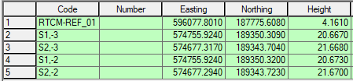
GNSS Systems & RTK Technology
How Does It Work?
GNSS receivers pick up signals from multiple satellite constellations (GPS, GLONASS, Galileo, BeiDou)
How Does It Measure?
The system measures the travel time of radio signals from at least four satellites to calculate a 3D position (X, Y, Z) and records the coordinates of each point, relative to the satellites.
Typical RTK accuracy: is suitable for most topographic surveys where line-of-sight to the sky is available
Global Navigation Satellite Systems (GNSS) are the backbone of modern positioning in surveying
✅ Pros
Centimeter-level accuracy (typically 10–20 mm horizontal, 20–30 mm vertical)
Fast data collection over large open areas
One-person operation possible
⚠️ Cons
Requires clear sky view - fails under dense tree canopy or in urban canyons
Needs reliable correction data link (radio range or mobile signal)
Multipath errors near reflective surfaces

Slide 29
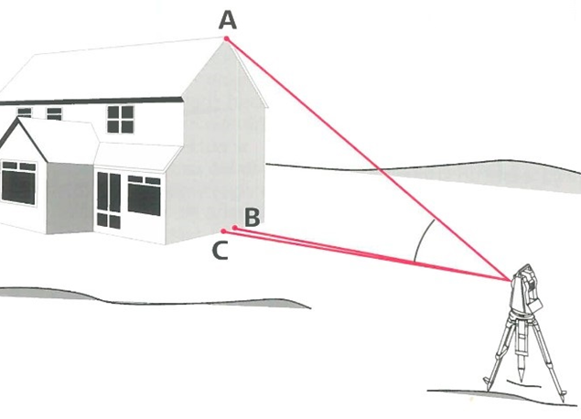
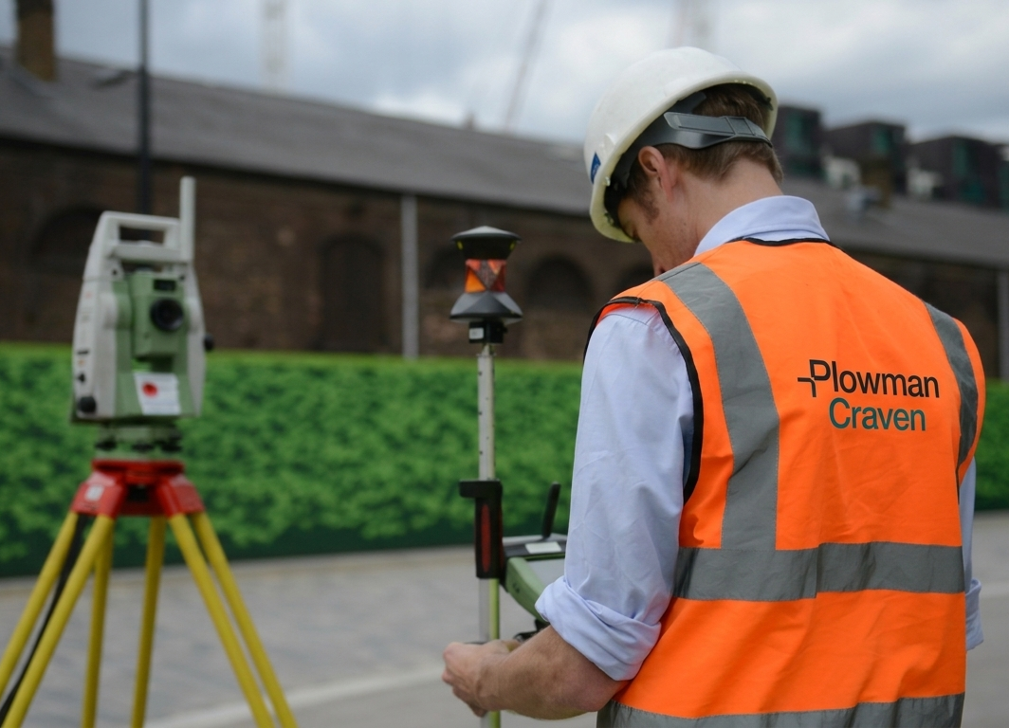
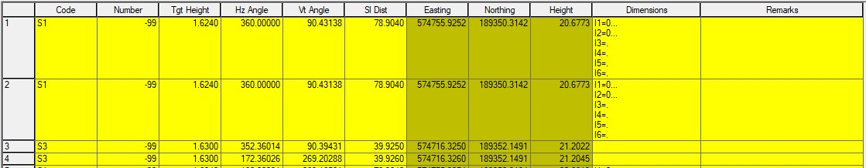
Total Station Technology
How Does It Work?
A total station simultaneously measures horizontal angles, vertical angles, and slope distances to a target prism (or reflectorless to a surface). An onboard computer calculates coordinates in real time.
How Does It Measure?
Distance is measured using infrared or laser EDM - a beam is sent to a prism or surface, and the return time/phase is used to calculate distance. Angles are measured electronically via glass circles and encoders. The combination of distance + angles yields precise 3D coordinates relative to a known point.
There are different level of precision instruments, but the total station we use can measure at least:
Up to 1500mt with +/- 1.5mm accuracy (using prism)
Up to few hundred Mt (using laser)
The total station it offers precise angle and distance measurements.
✅ Pros
Works in any weather and in obstructed environments
No satellite signal required
⚠️ Cons
Line-of-sight to the target is always required
Slower data collection over large areas

Slide 30
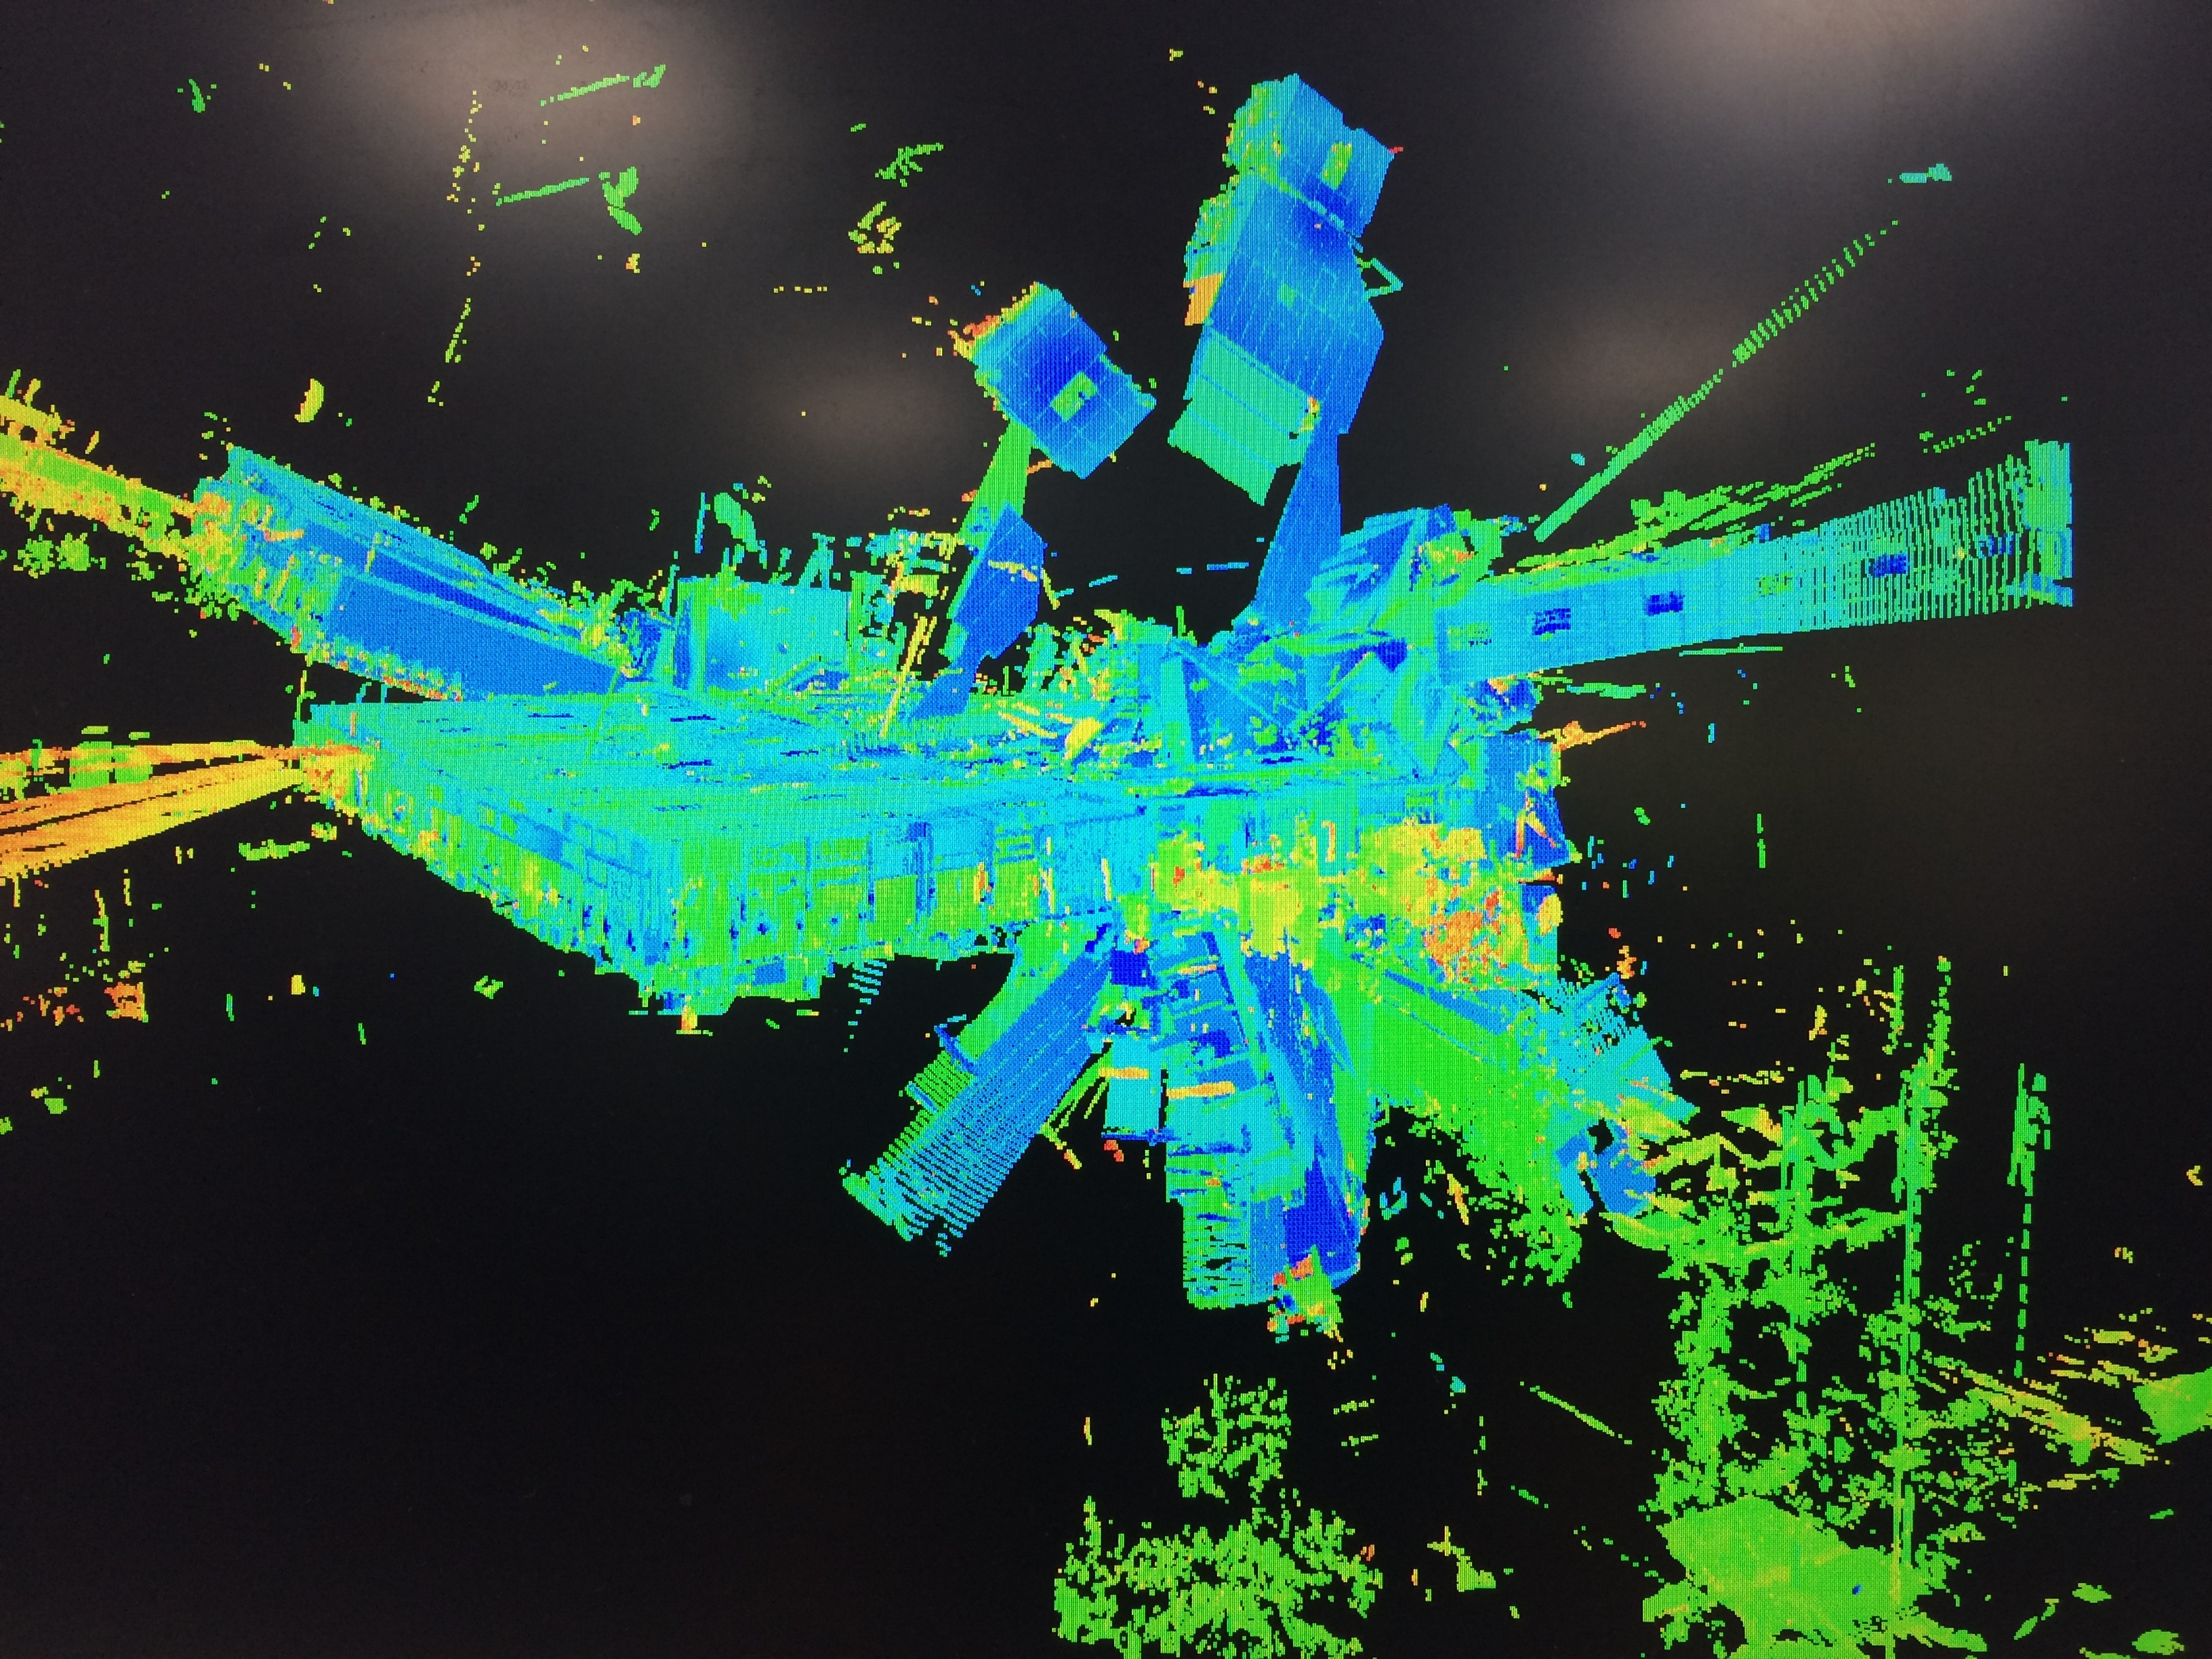
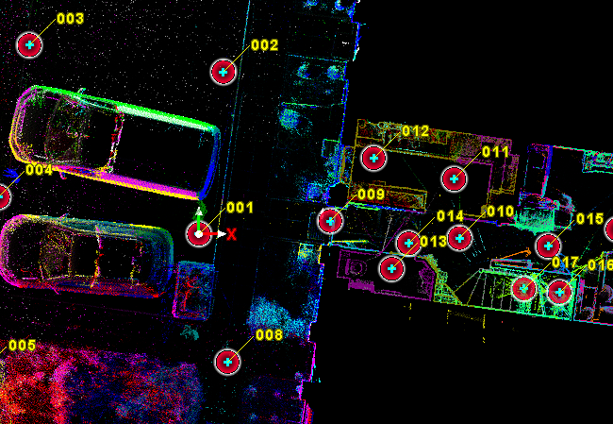
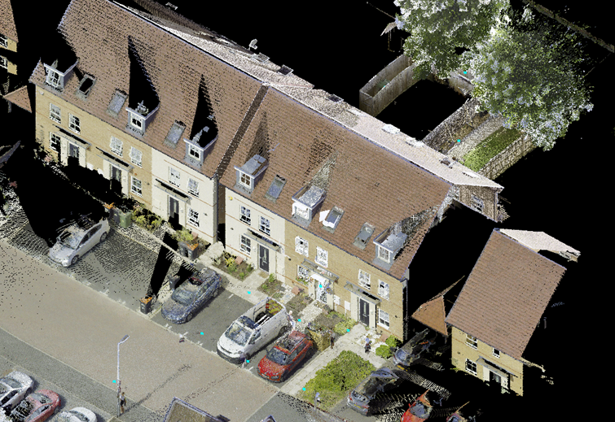
LiDAR & SLAM Technology
How Does It Work?
LiDAR emits rapid pulses of laser light and measures the return time to calculate distances to surfaces, building up a dense point cloud. SLAM algorithms process this data in real time - the scanner tracks its own position by continuously matching newly captured geometry against what it has already recorded
How Does It Measure?
Each laser pulse measures a precise range (time-of-flight or phase-shift). Scanners fire millions of pulses per second across a wide field of view. Each scan is a piece of the puzzle.
Static terrestrial LiDAR scanners can achieve +/-1–3 mm at close range. Mobile SLAM systems typically achieve +/-10–30 mm
Laser Scanners enable rapid, detailed 3D capture of environments that would be challenging or dangerous to survey conventionally.
✅ Pros
Extremely dense 3D data capture - millions of points per second
Works indoors and in GNSS-denied environments
Captures complex geometry rapidly
Reduces time on site significantly
⚠️ Cons
Expensive equipment and specialist processing software
Large data volumes require powerful computing
SLAM drift can accumulate over long distances
Point clouds require post-processing before usable deliverables
Notes:
Imagine a 360panorama – nowadays we can do them with the phone
How? We spin around and then point up and down
The scanner is doing the same, but instead of the full photo is shooting many close “pixels”
---
Imagine this like a puzzle.
Each scan must fit with the next using common features
---
GPS is required to drag the cloud to the right location – we need to move the whole puzzle to the right place
The TS is required because our scanner doesn’t enough survey accuracy – imagine hanging a puzzle on the wall, without the frame. The puzzle might hold but it will definitely start bend in places, the scanner is the same: our puzzle needs a sturdy frame to keep it in place and the TS is this frame

Slide 31
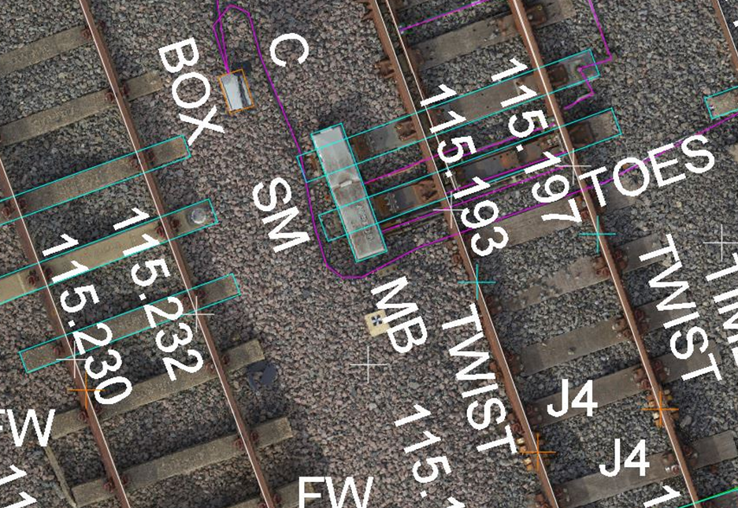
UAS
How Does It Work?
A drone flies a pre-planned grid pattern, capturing overlapping images of the ground below. Ground Control Points (GCPs) tie the model to a real-world coordinate system.
How Does It Measure?
Each photo has a predefined overlap with the neighboring images. The images are stitched together through common points, and the software is creating a master model
With good GCPs and flight planning, UAS photogrammetry achieves+/-20–50 mm horizontally and +/- 30–60 mm vertically. RTK-enabled drones can push accuracy to +/- 20–30 mm.
Unmanned Aerial Systems (UAS or drones) equipped with high-resolution cameras (or LiDAR sensors) have transformed topographic surveying.
✅ Pros
Covers large areas rapidly - hectares in minutes
Produces rich visual outputs: orthomosaics, 3D models, contours
Safe for hazardous or inaccessible terrain
Cost-effective for large topographic surveys
⚠️ Cons
Requires CAA/regulatory approval and trained operators
Weather-dependent - wind and rain ground the drone
Vegetated areas reduce ground model quality
GCP placement still requires ground survey work
Notes:
There are different kind of drone surveys, some utilise scanners and some cameras.
At Plowman Craven we utilise a camera fitted drone
Overlap
Stich = master model meaning a blanket flapping in the wind
The model will be linked to survey grid, effectively we will “pin” this blanket on the sofa to eliminate creases

Slide 32
How to choose the right tool ?
GNSS
Total Station
Laser Scanner
UAS

Slide 33
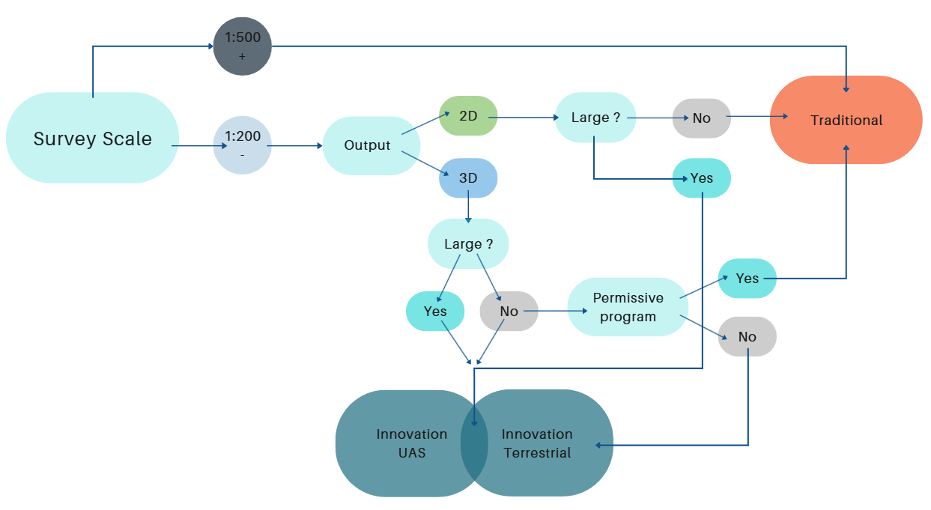
Survey Tool Decision Chart
Notes:
I tried to simplify the decision making process, bear in mind this is only a guideline and as for everything exceptions happen at least twice a day
An important that will impact our decision is also the cost of the survey.
GPS to UAV is also how expensive it is to us to deploy such tools

Slide 34
….some other factors to consider
Which equipment is available ?

Slide 35
Can the staff competently carry out traditional work ?
….some other factors to consider
Which equipment is available ?

Slide 36
Can the staff competently carry out traditional work ?
….some other factors to consider
Which equipment is available ?
Is the project local ?

Slide 37
Can the staff competently carry out traditional work ?
….some other factors to consider
Which equipment is available ?
Is the project local ?
Is there chance the client could want more ?

Slide 38
Can the staff competently carry out traditional work ?
….some other factors to consider
Which equipment is available ?
How’s the weather?
Is the project local ?
Can innovation be deployed ?
Is there chance the client could want more ?

Slide 39
Project Planning
Scope and Methodology

Slide 40
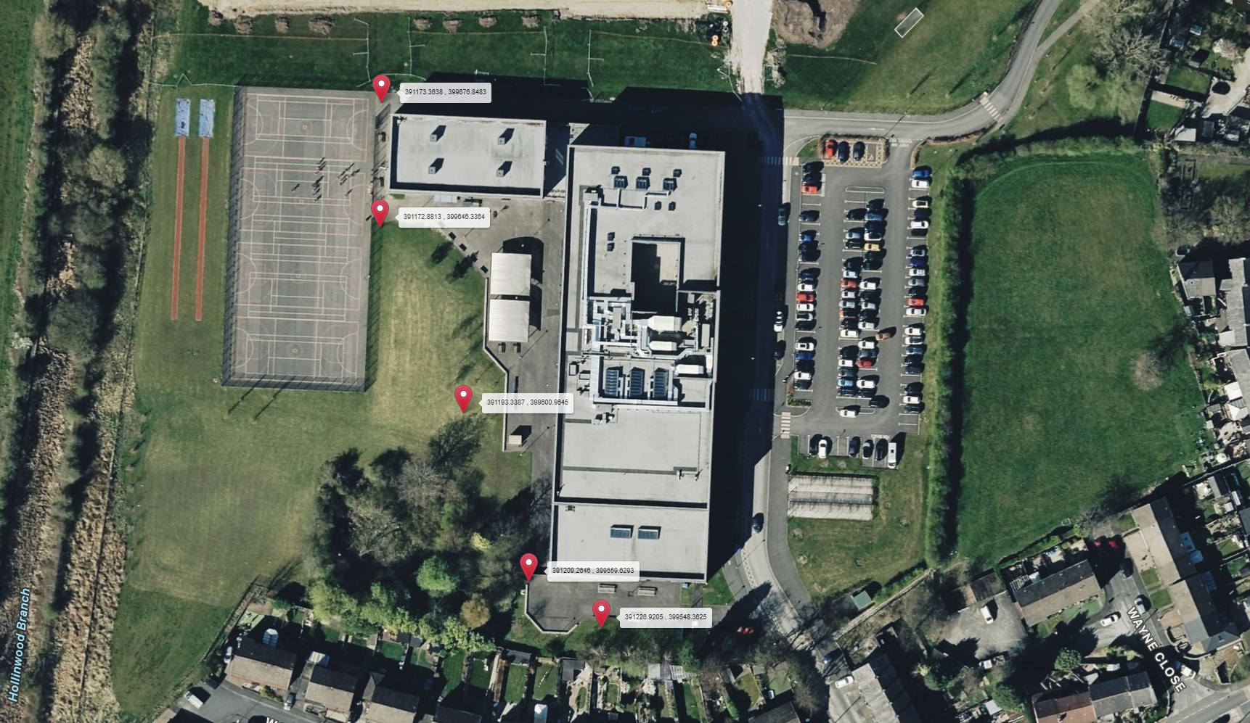
S8
S7
S6
S5
S4

Slide 41
S8
Step 1
Find the nails S6, S5, S7
S7
S6
S5
S4

Slide 42
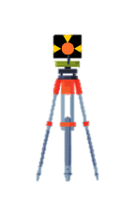
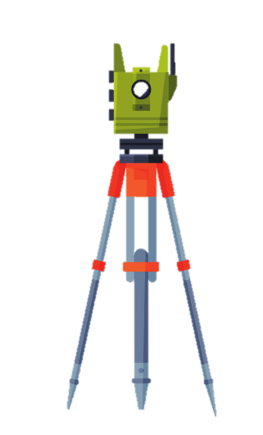
S8
Step 2
Set up the TS and the reference point
S7
The total station is set-up over a point and is using a back sight prism set over another point to confirm its orientation.
Both points coordinates x, y, z are known.
In a nutshell
S6
Have coordinates on your usb and import them prior starting the job.
Ensure to set up over the correct points.
Best Practice
S5
S4

Slide 43
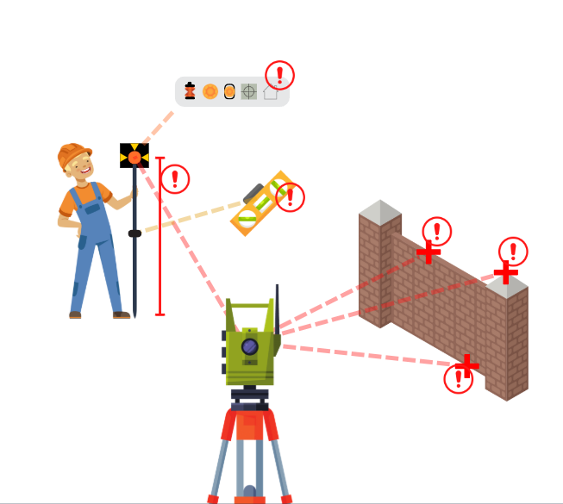
S8
Step 3
Start Measuring !
S7
Critical:
target height
target level
prism constant
With Prism
S6
Critical:
point of observation
Reflectoreless
S5
S4

Slide 44


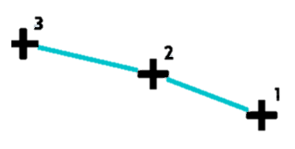
How to measure ?
Points
Strings
Shapes
Singular points recorded for:
Levels
Construction points
QA checks
sequence of points that join in a line recorded for:
any break feature in the terrain(Kerbs, Walls, banks)
any feature that can be represented by lines (Fence, wall, building service routes)
Sequence of points that create a geometrical shape recorded for:
Inspections and manhole covers
Street furniture
Trees

Slide 45
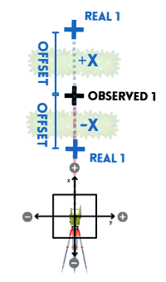
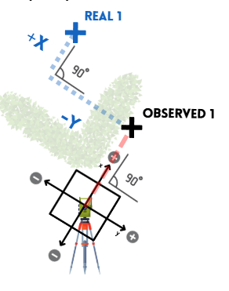
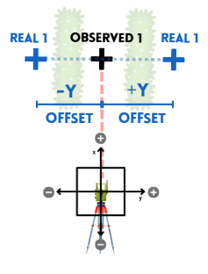
How to measure ?
Without a direct line of sight ?
Offset Left and Right
Offset In and Out
Offset In, Out, Left and Right

Slide 46



How to measure ?
The centre of a tree?
Measure Distance
Measure Angle
Perspective is key !

Slide 47
How to measure ?
Different Strings ?
The colour will often be linked to the correspondent AutoCAD layer
Fence
Wall
The attributes will enable the string to produce some extra information which will be either directly used, or used to complete the drafting
Kerb Solid
P= Distance for automatic parallel offset
Colour
Attributes
P
The linetype will often be linked to the correspondent AutoCAD layer
Building
Building Overhead
Linetype
Remarks are used to annotate extra information such as height or notes that will be needed for processing or editing data
Fence
Remarks
1.5h SF

Slide 48



How to measure ?
Different Strings ?
When observing string features, the string must be broken by increasing the string number to avoid messy drawings.
When observing curved features comma codes must be added to the string number.
Breaking the Strings
Curving the Strings

Slide 49


How to measure ?
Different Shapes ?
When observing circular elements different codes can be used depending on the occasion.
When observing squared or rectangular elements different codes can be used depending on the occasion.
Circles
Rectangles

Slide 50


How to measure ?
Tips and tricks
If you measure it, we can make it work.
Don’t know the code ? Just measure it !
Don’t trust your memory! Notes and remarks will be very precious to help you remember
Tip n. 1
Tip n. 2

Slide 51



How to measure ?
Tips and tricks
Photos, Photos, PHOTOS !!!
Regular checkpoints to save your life
Tip n. 3
Tip n. 4

Slide 52


Slide 53

Your Career in Surveying Starts Here
Whether you've got GCSEs, A-Levels, or a degree - there is a pathway into surveying made for you.
The built environment is going digital, and we're looking for the next generation of talent to help lead that change.

Slide 54
🔍 Internships and Placements
🏫 University Students
🎓 A-Level / T-Level
📚 School Leavers

Slide 55

Internships & Placements: Explore Before You Commit
🔍 Discover
Explore whether BIM, geospatial science, or infrastructure surveying is the right fit for your career.
Work Experience Week
Summer Placements
Internships

Slide 56

University Students
🎓 Junior Roles
University | Course Title | Key Focus Area
Newcastle University | BSc/BEng Geospatial Engineering | Satellite positioning, laser scanning, and geodesy.
University of East London (UEL) | BSc Surveying and Mapping Sciences | Mapping, land surveying, and computing.
UCL (London) | BSc Geomatics (within Civil Eng) | Digital mapping and spatial data management.
University of Glasgow | BSc/MSc Geospatial & Mapping Sciences | Land, engineering, and hydrographic surveying.
University of Plymouth | BSc Geography with GIS & Data Science | Cartography, remote sensing, and digital planets.

Slide 57

Apprenticeships
💷 Earn while you learn
Level 6: Geospatial Mapping & Science Specialist
The Deal: You work 4 days a week for a surveying firm and study 1 day a week for a BSc.
Duration: 5 years.
Outcome: BSc (Hons) in Surveying & Mapping + Pathway to MRICS (Chartered Status).
Recent Providers/Employers: Universities: UEL, CU Apprenticeships (Coventry).

Slide 58

Survey Assistant
🏗️ Your First Step in the Field
Support expert survey teams across both field and office environments, gaining broad early exposure.
Pipeline into Junior Surveyor roles.
✅ Who We're Looking For
Hands-on individuals with a genuine interest in technology and the built environment

Slide 59
Thank you !
.
.
.
Any question ?

